Slide 1
总复习
郭杏莉
xlguo@mail.xidian.edu.cn
课程信箱：
18092406024@163.com
pwd：guoxingli6024

Slide 2
课程主要内容
Chap 1：Introduction to Data Mining
Chap 2: Data
Chap 3: Exploring Data
Chap 4: Classification
Chap 6: Association Analysis
Chap 8: Cluster Analysis

Slide 3
第一章 引言
什么是数据挖掘？

Slide 4
第二章 数据
什么是数据？什么是数据的特征？特征的值？
特征的类型：标称、序数、区间、比值？离散 连续？
数据集的类型：记录、图、有序的
结构数据的特征：维度、稀少、分辨率
记录数据、数据矩阵、文档数据、交易数据、图数据、有序数据
数据质量：噪声和奇异值；缺失值；重复值…
数据预处理：集成、抽样、维规约、特征子集选择、特征创建、离散化（二元化）、变量变换
相似性计算：欧式距离、明可夫斯基距离、马氏距离
简单匹配 Jaccard系数 余弦相似性、相关系数

Slide 5
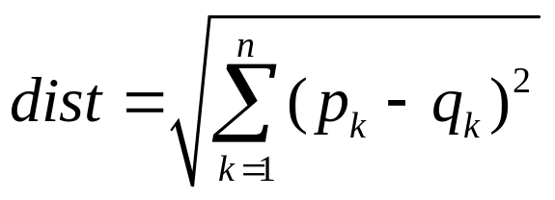
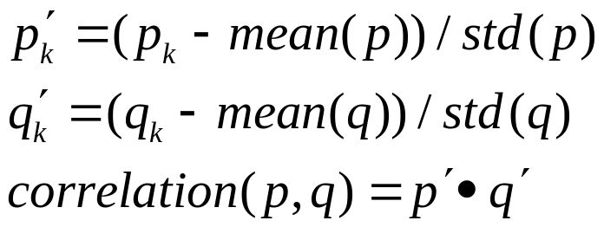
相似性（距离）度量
欧式距离
Simple Matching and Jaccard Coefficients （二元向量）
SMC = number of matches / number of attributes
= (M₁₁ + M₀₀) / (M₀₁ + M₁₀ + M₁₁ + M₀₀)
J = number of 11 matches / number of not-both-zero attributes values
= (M₁₁) / (M₀₁ + M₁₀ + M₁₁)
皮尔森相关系数
余弦相似性
cos( d₁, d₂ ) = (d₁ • d₂) / ||d₁|| ||d₂||

Slide 6
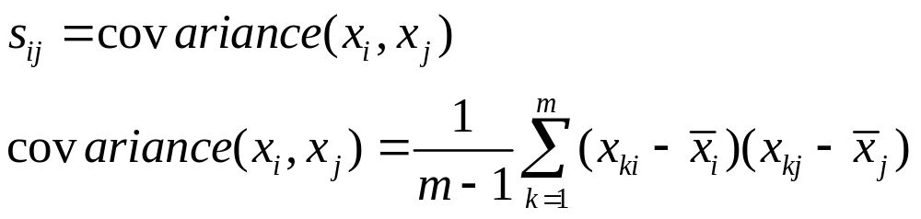
第三章 探索数据
汇总统计：频率 位置 分布
频率 众数 百分位数 均值 中位数 极差 方差
协方差矩阵
可视化：表示 安排 选择
直方图 盒图箱图 散点图 等高线图 数据矩阵 平行坐标 Chernoff脸

Slide 7
第四章 分类
什么是分类？分类的应用？
决策树分类算法 Hunt’s algorithm
决策树的构造
属性划分指标和方法
不纯性度量指标：
基尼系数
信息熵
错误分类率

Slide 8







不纯性度量指标
Gini指标
信息熵
信息增益
错误分类率

Slide 9

不同度量指标的比较
For a 2-class problem:

Slide 10

Continuous Attributes: Computing Gini Index...
For efficient computation: for each attribute,
  Sort the attribute on values
  Linearly scan these values, each time updating the count matrix and computing gini index
  Choose the split position that has the least gini index
Sorted Values
Split Positions

Slide 11

拟合不足和过分拟合
Overfitting
Underfitting: when model is too simple, both training and test errors are large

Slide 12
分类中的其他问题
分类模型
模型的评价
交叉验证
混淆矩阵
分类的准确率
TPR
FPR
模型比较：奥卡姆剃刀
通过分类错误率计算泛 化错误：悲观方式，乐观方式
模型分类性能差异的统计显著性

Slide 13
第六章 关联规则
基本概念：事务 项 项集 支持度计数 频繁项集
Apriori
频繁项集生成
关联规则生成
FP树
树的生成
在后缀树上发现频繁项集
兴趣度度量指标：支持度 置信度 ……
闭频繁项集 极大频繁项集

Slide 14


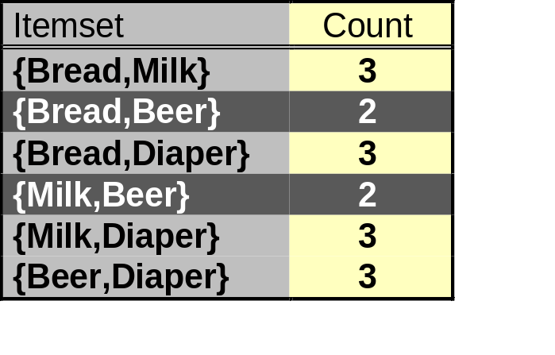
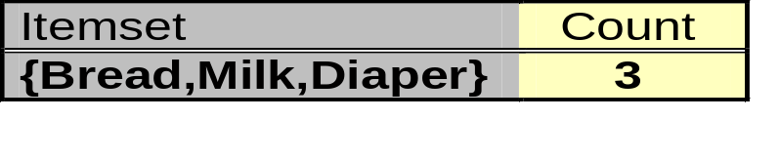

Illustrating Apriori Principle
Items (1-itemsets)
Pairs (2-itemsets)
(No need to generate
candidates involving Coke
or Eggs)
Minimum Support = 3
Triplets (3-itemsets)
If every subset is considered,
With support-based pruning,
6 + 6 + 1 = 13

Slide 15
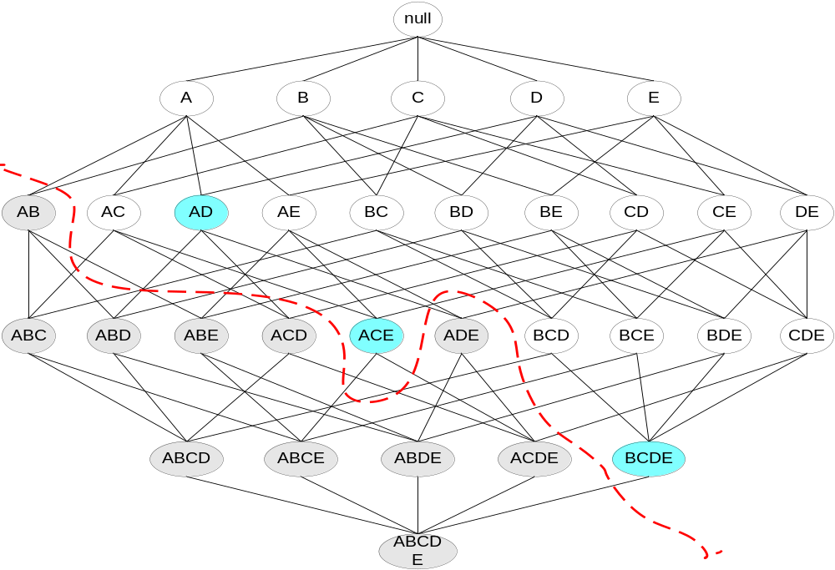
Maximal Frequent Itemset（极大频繁项集）
An itemset is maximal frequent if none of its immediate supersets is frequent（它的直接超集都不频繁）
Maximal Itemsets
Infrequent Itemsets
Border

Slide 16
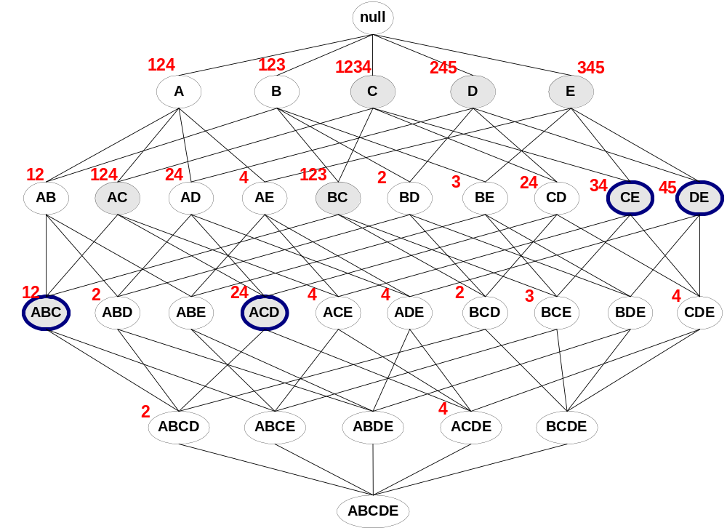
极大频繁项集和闭频繁项集
Minimum support = 2
Closed but not maximal
Closed and maximal
# Closed = 9
# Maximal = 4

Slide 17
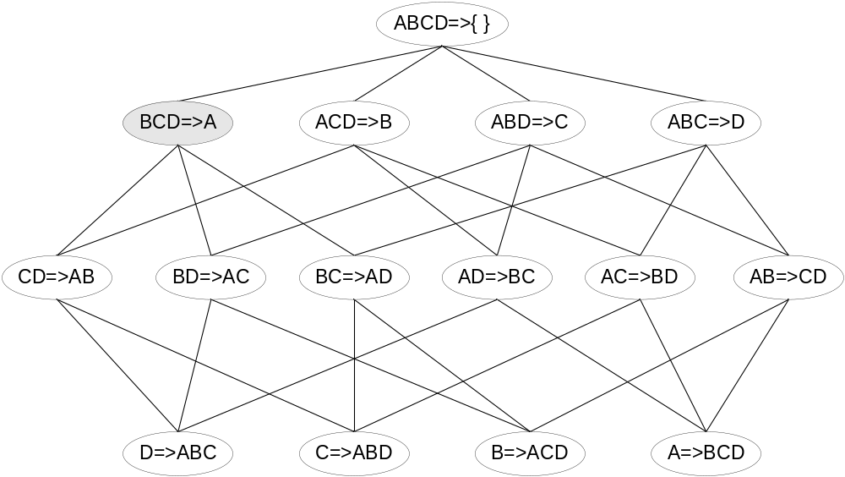

Apriori 算法中关联规则的产生
Lattice of rules
Low Confidence Rule
Pruned Rules

Slide 18
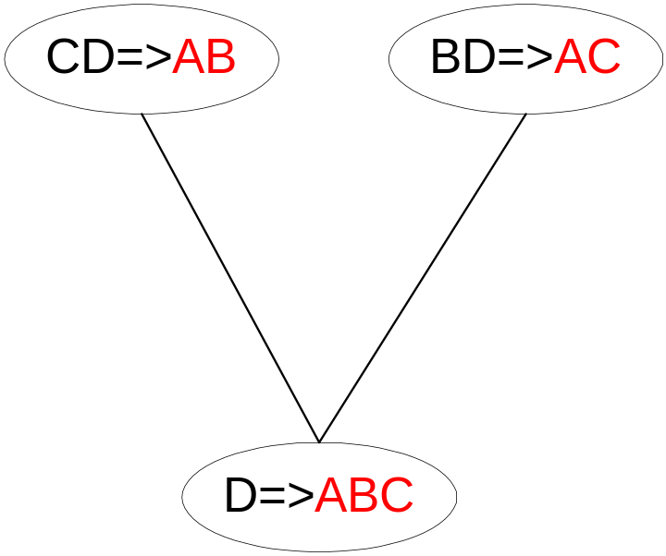
Apriori 算法中关联规则产生
Candidate rule is generated by merging two rules that share the same prefix
in the rule consequent
join(CD=>AB,BD=>AC)
would produce the candidate
rule D => ABC
Prune rule D=>ABC if its
subset AD=>BC does not have
high confidence

Slide 19
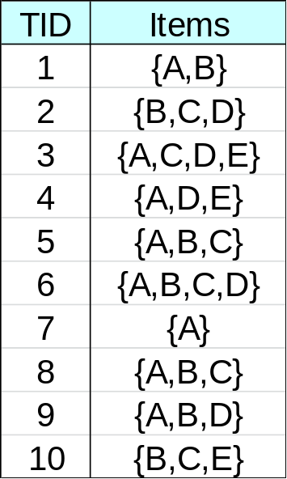
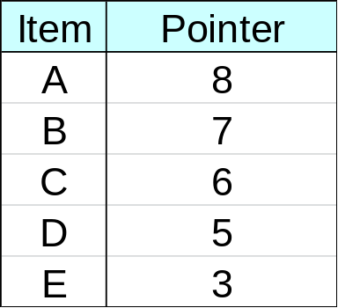
FP增长算法树的构造
null
A:8
B:2
B:5
C:1
D:1
C:2
C:3
D:1
D:1
E:1
D:1
E:1
E:1
D:1

Slide 20
关联规则度量指标
支持度
置信度
其它的
主观兴趣度
客观兴趣度

Slide 21
第八章 聚类
什么是聚类？
K-means
SSE
层次聚类
单链
全链
组平均
Ward方法
基于密度的聚类DB-Scan

Slide 22

K-means Clustering
Partitional clustering approach
Each cluster is associated with a centroid质心 (center point)
Each point is assigned to the cluster with the closest centroid
Number of clusters, K, must be specified
The basic algorithm is very simple

Slide 23
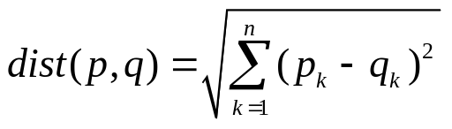
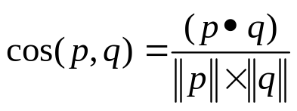

Closeness measure
  Euclidean distance
  cosine similarity
  Correlation

Slide 24

Bisecting K-means
Bisecting K-means algorithm
  Variant of K-means that can produce a partitional or a hierarchical clustering

Slide 25
Limitations of K-means
K-means has problems when clusters are of differing
  Sizes
  Densities
  Non-globular 球状的球类的shapes
K-means has problems when the data contains outliers.

Slide 26
Agglomerative Clustering Algorithm
凝聚的层次聚类算法
More popular hierarchical clustering technique
Basic algorithm is straightforward
  Compute the proximity matrix
  Let each data point be a cluster
  Repeat
  Merge the two closest clusters
  Update the proximity matrix
  Until only a single cluster remains
Key operation is the computation of the proximity of two clusters
  Different approaches to defining the distance between clusters distinguish the different algorithms

Slide 27
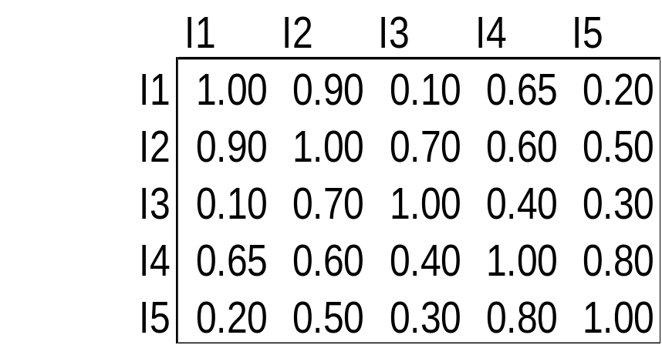
Cluster Similarity: MIN or Single Link
Similarity of two clusters is based on the two most similar (closest) points in the different clusters
  Determined by one pair of points, i.e., by one link in the proximity graph.
1
2
3
4
5

Slide 28
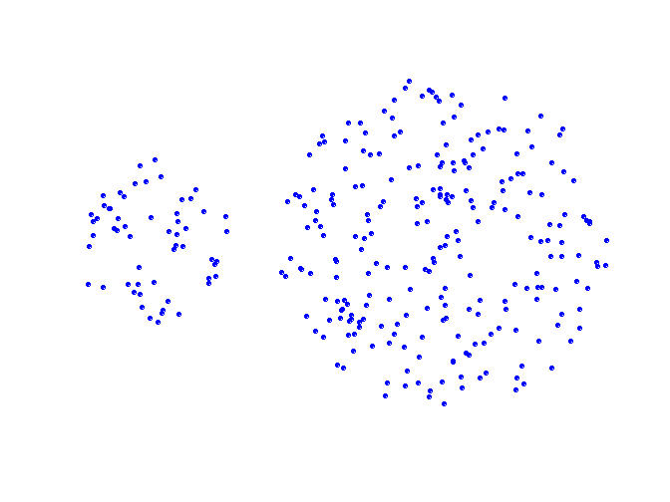
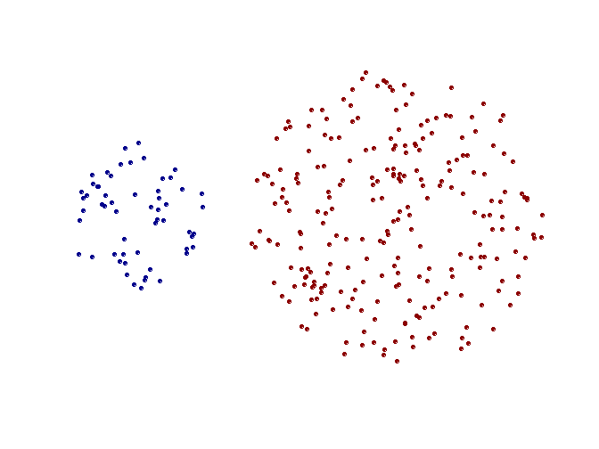
Strength of MIN
Original Points
Two Clusters
Can handle non-elliptical（非椭圆的） shapes

Slide 29
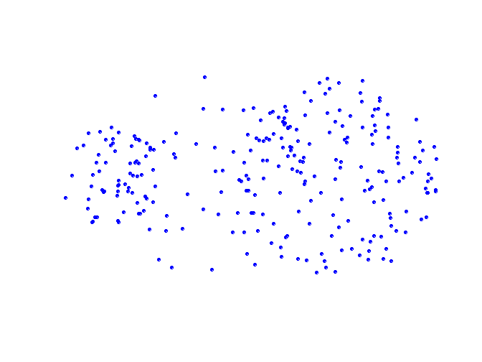
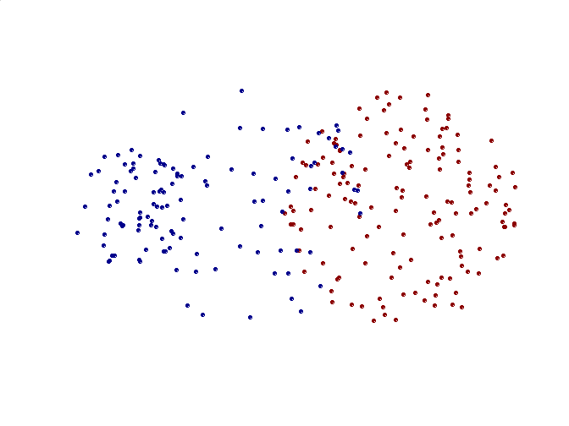
Limitations of MIN
Original Points
Two Clusters
Sensitive to noise and outliers

Slide 30

Cluster Similarity: MAX or Complete Linkage
Similarity of two clusters is based on the two least similar (most distant) points in the different clusters
  Determined by all pairs of points in the two clusters
1
2
3
4
5

Slide 31
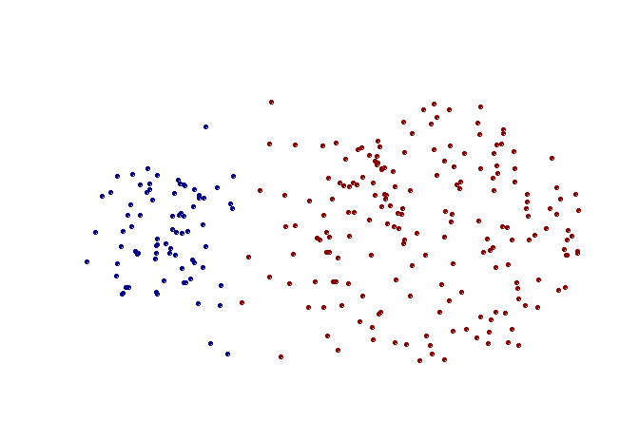
Strength of MAX
Original Points
Two Clusters
Less susceptible to noise and outliers

Slide 32
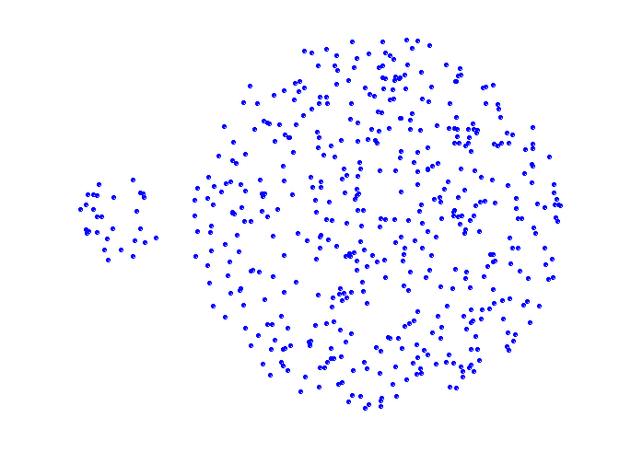
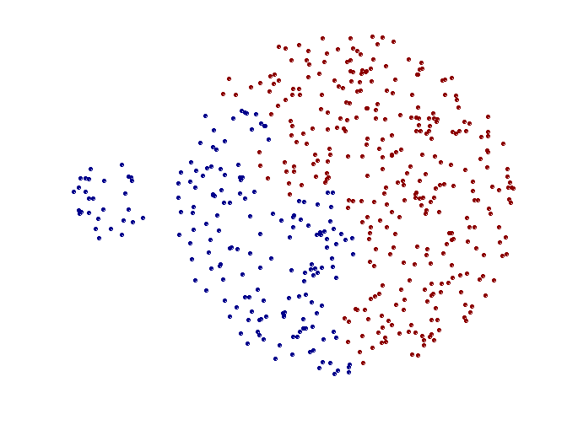
Limitations of MAX
Original Points
Two Clusters
Tends to break large clusters
Biased towards globular clusters

Slide 33
DBSCAN Algorithm
Eliminate noise points
Perform clustering on the remaining points
1：将所有点标记为核心点、边界点和噪声点
2：删除噪声点
3：为距离在Eps之内的所有核心点之间赋予一条边
4：每组连通的核心点形成一个簇
5：将每个边界点指派到一个与之关联的核心点的簇中

Slide 34


When DBSCAN Works Well
Original Points
Clusters
Resistant to Noise
Can handle clusters of different shapes and sizes

Slide 35



When DBSCAN Does NOT Work Well
(MinPts=4, Eps=9.75).
Original Points
Varying densities
High-dimensional data
(MinPts=4, Eps=6.92)

Slide 36
预祝大家考试顺利！取得优异成绩！

