Slide 1
Student Grade Calculator
Interactive JavaScript & ReactJS Application Development
Problem Statement: "Enter marks, calculate total and average, assign grades, and display results."
Course: Full Stack Web Development | Class: III CSE — C Section
Submission for Task 2 Self-Learning Evaluation

Slide 2
1. Project Overview & Core Features
Simple, automated marks entry and grade calculation for students
Project Objective
To develop a clean, responsive single-page web application using ReactJS that eliminates manual calculation errors and provides instant academic grade evaluation.
Key Requirements Fulfilled
• Interactive React components with JSX
• State management using useState & useEffect
• Form handling with client-side validation (0 - 100 range)
• 3 functional pages/views without complex page reloads
• Interactive CRUD: Add, Search, Filter, Edit, and Delete
Core Features
• Student Details Input: Captures Student Full Name and Roll Number with validation.
• 5 Subject Marks Entry: Inputs marks for Web Dev, DBMS, DSA, OS, and Networks.
• Real-Time Calculations: Instantly updates Total (out of 500), Average (%), Grade, and Pass/Fail status as marks are typed.
• Student Records Directory: Saves records in a table with search by name/roll no, filter by grade/status, and edit/delete actions.
• Browser Persistence: Uses localStorage so student records stay saved on page refresh.

Slide 3
2. Technical Architecture & React Concepts
Clean modular structure designed for easy comprehension and explanation
Modular Components
• Navbar.jsx: Top menu bar to switch between the 3 functional pages.
• GradeCalculator.jsx: Form to enter student marks and live results display box.
• StudentRecords.jsx: Table of saved records with search, filter, edit & delete.
• GradingScale.jsx: Reference table showing grading rules and cutoffs.
React Hooks Used
• useState (Navigation): Tracks activePage ('calculator', 'records', 'scale').
• useState (Form Data): Stores student name, roll number, and 5 subject marks.
• useState (Records): Maintains the list of all saved student records.
• useState (Results): Stores computed live total, average, grade, and status.
• useEffect (Auto-Compute): Re-calculates totals and grades immediately whenever marks change.
• useEffect (Storage): Saves records to browser localStorage automatically.
Helper Logic (gradeHelper.js)
• calculateTotal(): Sums all 5 subject marks (maximum 500).
• calculateAverage(): Divides total marks by 5 to find percentage.
• calculateGrade(): Maps average % to letter grades (A+ to F).
• checkPassStatus(): Verifies that every subject has ≥ 50 marks. If any subject < 50, marks status as Fail.

Slide 4
3. Application Workflow & Grading Scheme
Step-by-step user interaction and academic evaluation criteria
Step-by-Step Application Workflow
Step 1: Input Details: Enter student name, roll number, and 5 subject marks.
Step 2: Instant Feedback: The live results card calculates Total, Average %, Grade, and Pass/Fail status in real time.
Step 3: Validation Check: Ensures marks are valid numbers between 0 and 100 and fields are not empty.
Step 4: Save to Directory: Clicking 'Calculate & Save Record' adds the student to records and opens the directory view.
Step 5: Search, Filter & Edit: Users can search by name/roll no, filter by grade/status, edit existing records, or delete records.
Standard Grading Scheme
• 90% – 100% ➔ Grade A+ (Outstanding / Distinction)
• 80% – 89% ➔ Grade A (Excellent)
• 70% – 79% ➔ Grade B (Very Good)
• 60% – 69% ➔ Grade C (Good / First Class)
• 50% – 59% ➔ Grade D (Satisfactory / Second Class)
• Below 50% ➔ Grade F (Fail / Re-appear)
* Passing Condition: A student must score ≥ 50 marks in each individual subject to pass. Scoring < 50 in even one subject marks the student as 'Fail'.

Slide 5
4. Demonstration, Conclusion & Links
Live project demonstration highlights and submission deliverables
Key Demonstration Highlights
• Responsive Layout: Works cleanly across desktop screens and smaller mobile devices.
• No External Clutter: Pure ReactJS and CSS without heavy animations or transitions for simple explanation.
• Full CRUD Capabilities: Create new scorecards, Read/Search directory, Update/Edit marks, and Delete.
• Local Persistence: Data is safely stored in browser localStorage.
• Instant Calculation: useEffect eliminates any delay in computing average, total, and letter grades.
Submission Deliverables
✔ ReactJS Source Code:
Organized into components, utils, and styles.
✔ Public GitHub Repository:
https://github.com/Gladeeyy/student-grade-calculator
✔ Live Development Server:
Running locally at http://localhost:5173
✔ Screenshots Included:
Embedded in README.md and repository
✔ PowerPoint Presentation:
5 structured slides prepared for evaluation viva

Slide 6
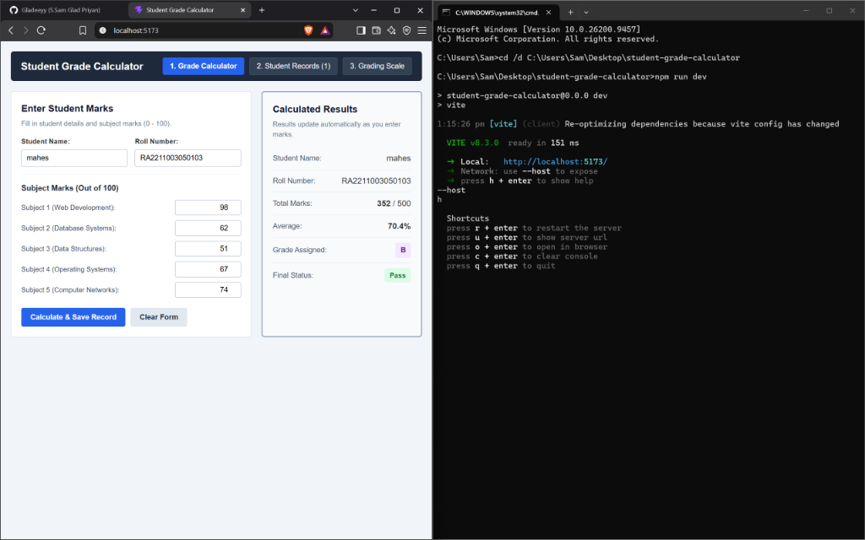
5. Screenshot: Grade Calculator View
Real-time calculation of total, average, letter grade, and pass/fail status

Slide 7
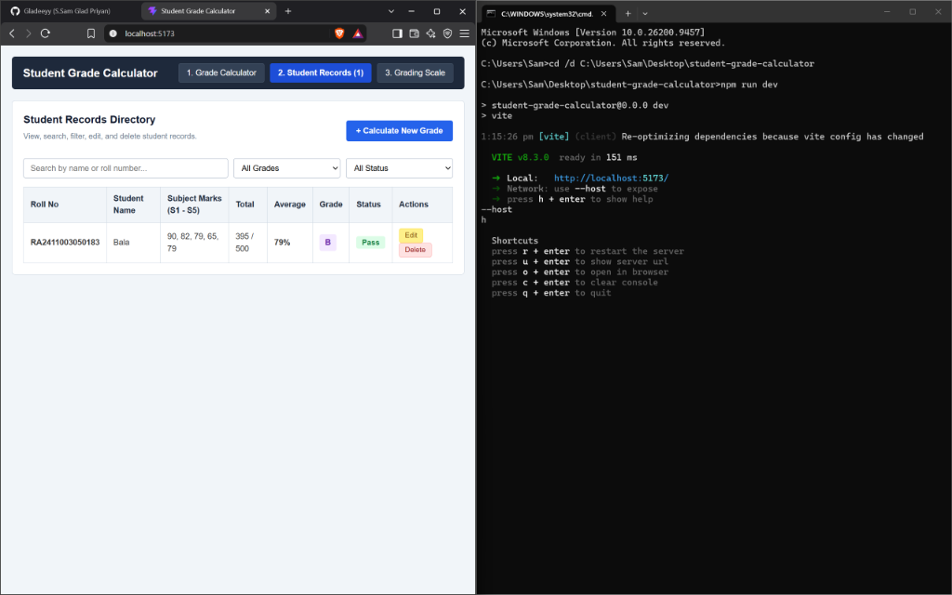
6. Screenshot: Student Records Directory
Interactive table with search by name/roll no, filtering, edit and delete

Slide 8
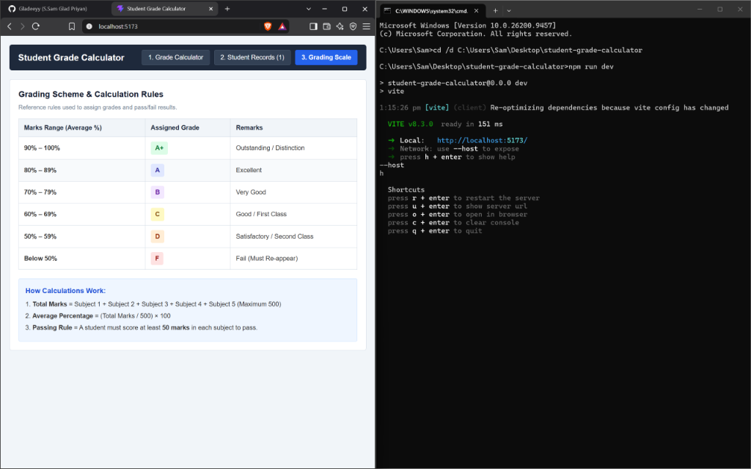
7. Screenshot: Grading Scheme & Rules
Reference table showing marks percentage cutoffs, assigned grades, and formulas

