Slide 1


Customer Feedback Analysis: Insights from Top Clients Over Five Years
Gladice Lee – Business Operations & Strategy Analyst, Sales Department
Conducted Using TARFlow Platform with Dr. Hwang San-Yih

Slide 2
Overview of the Study
01
02
03
Analysis based on five years of data from the top 10 clients with the highest yearly purchases
Feedback on three key aspects: 1. Sales representatives 2. Products offered 3. Overall company and service quality
Conducted on the Text Analytics and Retrieval Flow (TARFlow)platform with text-mining tools. Guided by business advisor Dr. Hwang San-Yih, leveraging his expertise.
Dataset
Survey Scope:
Tools & Expertise:

Slide 3
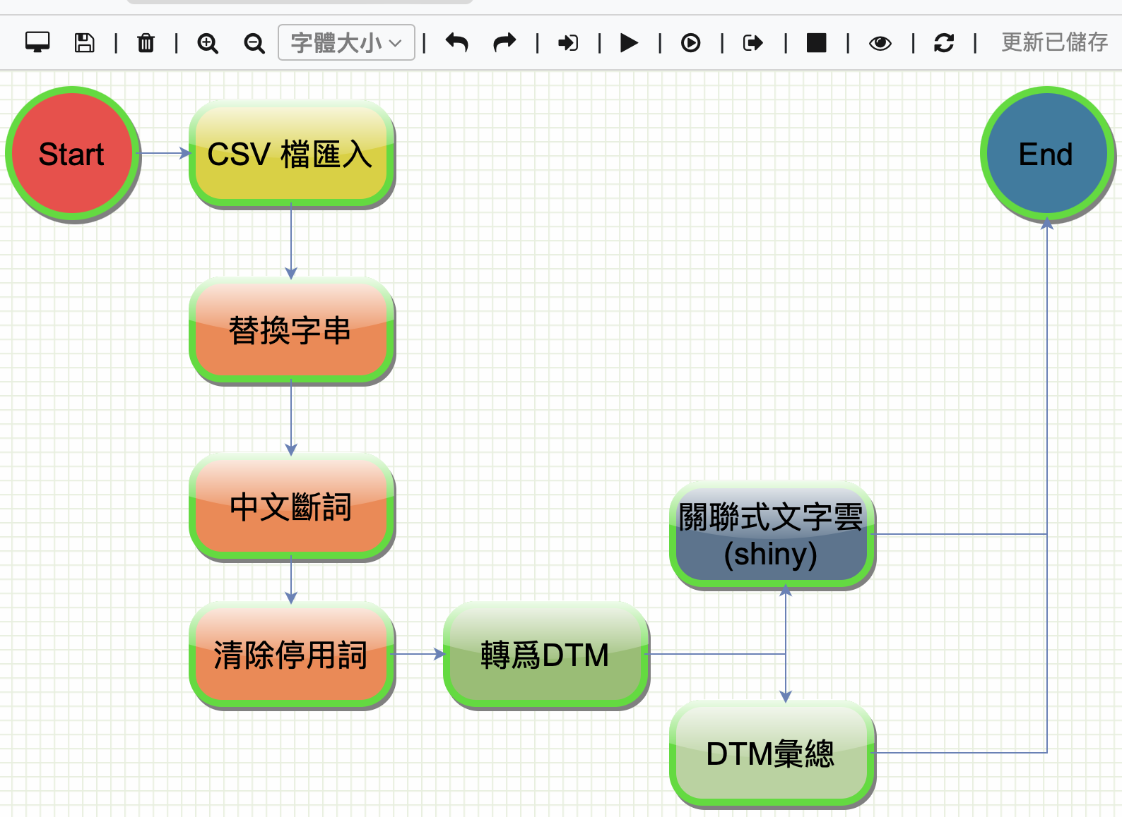
Analysis Process
1. Preprocessing Steps:
Vocabulary Replacement (替換字彙) | Ensures consistent terminology by standardizing synonymous terms in the dataset
Chinese Word Segmentation (中文斷詞) | Utilized NLP tokenization techniques to break down Chinese text into meaningful units for analysis
Stop Word Removal (清除停用字) | Eliminated non-informative words, such as conjunctions and prepositions, to enhance the focus on key insights
Document-Term Matrix (DTM) Creation | Transformed raw text data into a structured matrix format, mapping word frequencies across documents for further analysis
2. Visualization & Summarization:
Association Word Clouds (關聯式文字雲) | Generated visually engaging word clouds using Shiny, highlighting frequently co-occurring terms to reveal patterns and relationships
DTM Summarization (DTM 匯總) | Aggregated and summarized DTM data to identify dominant themes, trends, and sentiment across feedback categories

Slide 4

01
Feedback on Sales Representatives

Slide 5
Key Findings: Sales Representatives
DTM Dictionary Highlights
Category Analysis
Category | Data Count | Proportion
Positive Feedback | 39 | 57%
Negative Feedback | 4 | 6%
Delivery Time | 6 | 9%
After-Sales Service | 19 | 28%
Total | 68 | 100%
The analysis categorized terms related to feedback on sales representatives, emphasizing positive attributes like professionalism, responsiveness, and after-sales service

Slide 6
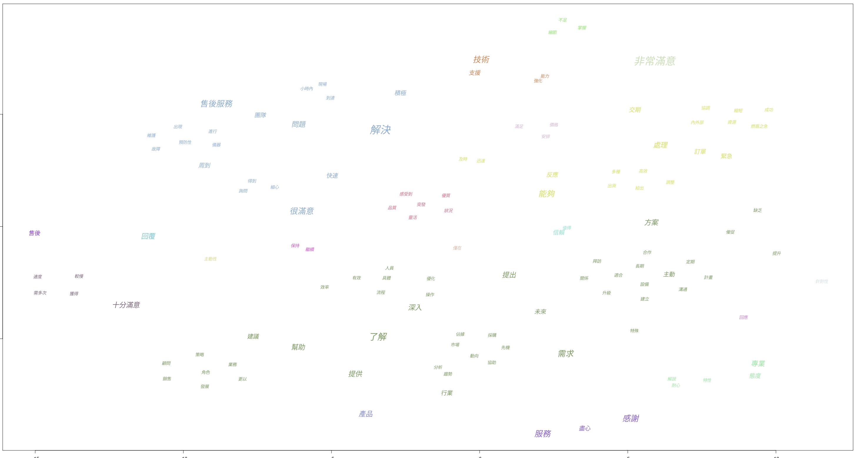
Key Findings: Sales Representatives
Pie chart illustrating feedback proportions
Word cloud showing key terms related to sales representatives

Slide 7
Key Findings: Sales Representatives
Analysis Results:
Positive Trends: Customers appreciated professionalism, quick responses, and high-quality after-sales support.
Improvement Areas: Issues with delayed responses and delivery scheduling need to be addressed.

Slide 8

02
Feedback on Products Offered

Slide 9
Key Findings: Products Offered
DTM Dictionary Highlights
Category Analysis
Category | Data Count | Proportion
Positive Feedback | 16 | 24%
Negative Feedback | 4 | 6%
After-Sales Maintenance | 14 | 21%
Product Performance | 26 | 38%
Product Pricing | 3 | 4%
Product Patents | 2 | 3%
Technical Training | 3 | 4%
Total | 68 | 100%
Category | Data Count | Proportion
Positive Feedback | 39 | 57%
Negative Feedback | 4 | 6%
Delivery Time | 6 | 9%
After-Sales Servce | 19 | 28%
Total | 68 | 100%
- The analysis categorized terms focusing on product performance, pricing, and after-sales maintenance.

Slide 10
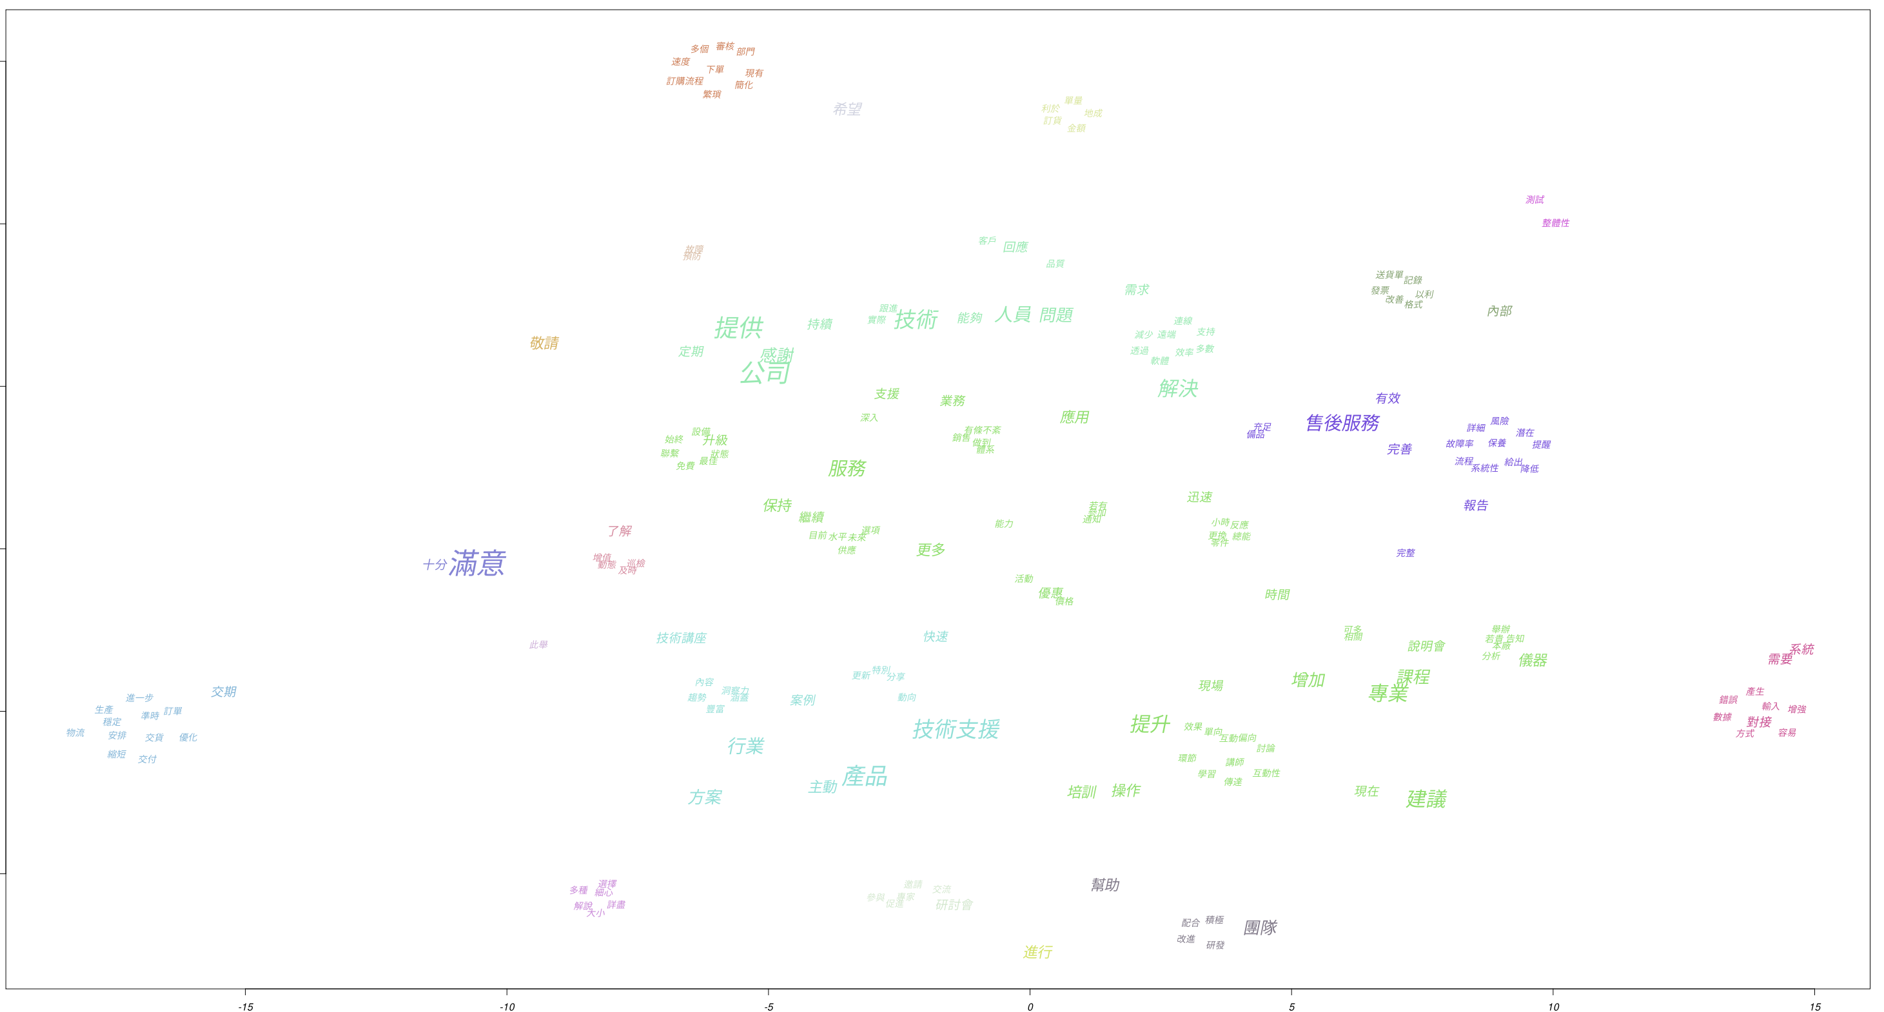
Key Findings: Products Offered
Pie chart illustrating feedback proportions
Word cloud showing key terms related to sales representatives

Slide 11
Key Findings: Products Offered
Analysis Results:
Positive Trends: Customers appreciated professionalism, quick responses, and high-quality after-sales support.
Improvement Areas: Issues with delayed responses and delivery scheduling need to be addressed.

Slide 12

03
Feedback on Overall Company and Service

Slide 13
Initiative prioritization matrix
DTM Dictionary Highlights
Category Analysis
Category | Data Count | Proportion
Positive Feedback | 31 | 37%
Negative Feedback | 3 | 4%
Technical Seminars | 13 | 15%
After-Sales Service | 2 | 2%
Technical Support | 25 | 30%
Product Pricing | 3 | 4%
Order Process | 7 | 8%
Total | 84 | 100%
- Terms categorized feedback on service efficiency, order processes, and technical support quality.

Slide 14
Key Findings: Products Offered
Pie chart illustrating feedback proportions
Word cloud showing key terms related to sales representatives

Slide 15
Key Findings: Products Offered
Analysis Results:
- Positive Trends: Customers appreciated professional technical support and smooth order processes.
- Improvement Areas: Address pricing transparency and improve the order management system.

Slide 16

Insights and Recommendations

Slide 17
Actionable Insights
Sales Representatives
Recommendations
Insight
Implement Advanced CRM Tools: Integrate Customer Relationship Management (CRM) systems with AI-powered reminders to ensure timely responses
Customers value professionalism, quick responses, and high-quality after-sales support
- Provide Targeted Training: Develop training modules focusing on improving communication, empathy, and proactive customer interaction
Negative feedback highlights delays in response and inconsistent follow-ups
- Establish Feedback Loops: Regularly collect and review client feedback to identify improvement opportunities and reward high-performing representatives

Slide 18
Actionable Insights
Products Offered
Recommendations
Insight
Enhance Product Training Programs: Introduce detailed training sessions and user-friendly manuals to guide customers on product usage
Customers appreciate product performance, reliability, and detailed after-sales support
Optimize Compatibility Testing: Collaborate with clients to identify compatibility issues early and provide tailored solutions
Concerns about compatibility, insufficient product training, and inconsistent maintenance
Strengthen After-Sales Maintenance: Expand maintenance teams and develop faster ticket resolution processes for repairs

Slide 19
Actionable Insights
Overall Company
and Service
Recommendations
Insight
Increase Pricing Transparency: Publish detailed cost breakdowns or implement dynamic pricing calculators to enhance client trust
Customers highly value technical support, seminars, and efficient order processes
Streamline Order Processing: Automate order workflows with end-to-end tracking systems to reduce errors and delays
Negative feedback suggests pricing transparency and order management are areas for improvement
Expand Technical Seminars: Host more frequent seminars or webinars to educate clients on advanced technical topics and innovations

Slide 20
Acknowledgment
Disclaimer: This presentation provides a brief overview of the comprehensive customer feedback analysis study. Due to business confidentiality and credential restrictions, certain sensitive data and insights cannot be disclosed publicly.
Special Thanks:
To Dr. Hwang San-Yih for his invaluable guidance and expertise.
To the TARFlow platform team for providing essential tools and support.

Slide 21

Questions and Discussion
Thank you for your attention!
Please feel free to ask questions or provide feedback.

