Slide 1

US Regional Sales Analysis
Kuan Jung (Gladice) Lee

Slide 2
Table of contents
01
02
03
04
Introduction to the Report and Data
Identifying Potential Items for Stocking
Evaluating Sales Channel Performance
Assessing Sales Team Performance

Slide 3
Introduction
Introduction
Welcome to my data-driven insights presentation. Today, we will embark on an analytical exploration of the US regional sales data. This project provides a comprehensive analysis using Python, leveraging powerful libraries such as Pandas for data manipulation and Matplotlib for data visualization.
This presentation is more than just a review of figures; it's a strategic analysis aimed at uncovering the underlying patterns and insights that have driven the sales activities, offering actionable recommendations for future growth.

Slide 4
Data Source: The dataset utilized for this analysis is sourced from Kaggle, curated by Dorothy Joel. The data can be accessed via here.
Data Overview:
Total Entries: 7,992
Columns: 16
Additional Columns Created:
‘date_difference’: Measures the difference between order and delivery dates.
‘Unit Profit’: Calculates the profit per unit sold.
‘Total Profit’: Aggregates the profit for each transaction.

Slide 5
Potential Operational Improvements
1. Product Stocking Efficiency: By identifying products with the highest lead times and order frequencies, we can determine which items should be kept in stock to avoid shortages, thereby improving operational efficiency.
2. Sales Channel Optimization: Analyzing high-performing sales channels provides a deeper understanding of customer behavior, enabling more targeted marketing strategies and effective advertising campaigns.
3. Sales Team Incentives: Recognizing top-performing sales teams allows us to implement reward systems to incentivize success. Additionally, offering discount codes for the products they excel in selling can boost orders and profitability.

Slide 6
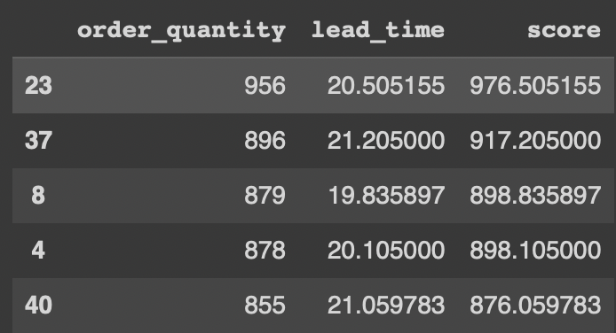
Product Stocking Analysis
Product Stocking Analysis
Data Cleaning:
Lead Time and Order Frequency Scoring:
A combined score for lead time and order frequency was calculated
The top five products with the highest scores are listed below:
Standardized the format of both delivery and order dates to %d/%m/%Y
Calculated the average lead time per product by determining the difference between Delivery Date and Order Date
Computed the order frequency for each product ID

Slide 7
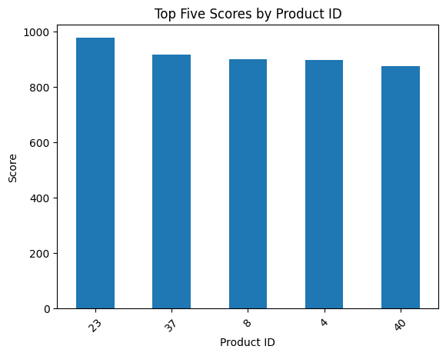
As observed, the top five product IDs with the highest scores are 23, 37, 8, 4, and 40
These products should be prioritized for inventory stocking to reduce lead times and improve operational efficiency

Slide 8
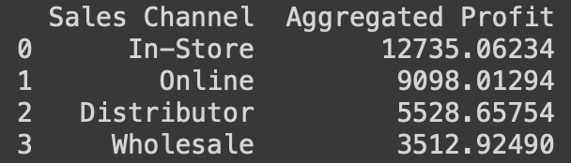
Sales Channel Evaluation
Sales Channel Evaluation
Profit Calculation:
Order Volume by Channel:
Calculated total profit for each order using the formula: (Unit Price - Unit Cost) * Order Quantity
Aggregated profits by channel (standardized in thousands for better visualization on the chart):
Analyzed the number of orders made through each of the four sales channels:
In-Store: 3,298 orders
Online: 2,425 orders
Distributor: 1,375 orders
Wholesale: 893 orders

Slide 9
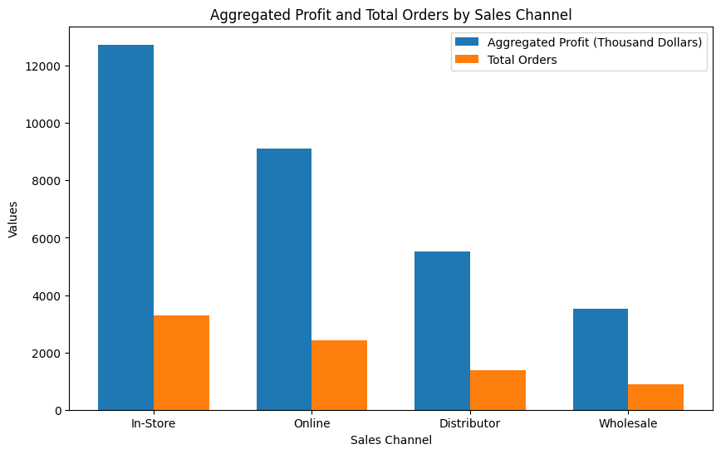
The bar chart illustrates that In-Store and Online channels are the primary methods through which customers place orders. These channels should be prioritized for increased focus and targeted advertising efforts.

Slide 10
Sales Team Evaluation
Sales Team Evaluation
Order Volume
by Sales Team:
Analyzed the number of orders made by 28 different sales teams. The order distribution is :
{key = Sales Team ID, value = order volume}
{6: 265, 14: 261, 21: 296, 28: 247, 22: 266, 12: 314, 10: 260, 4: 292, 23: 277, 8: 315, 9: 285,
5: 283, 25: 259, 2: 246, 7: 303, 24: 284, 18: 316, 20: 288, 13: 340, 19: 293, 17: 275, 26: 296,
11: 289, 15: 271, 16: 298, 27: 274, 3: 296, 1: 302}

Slide 11
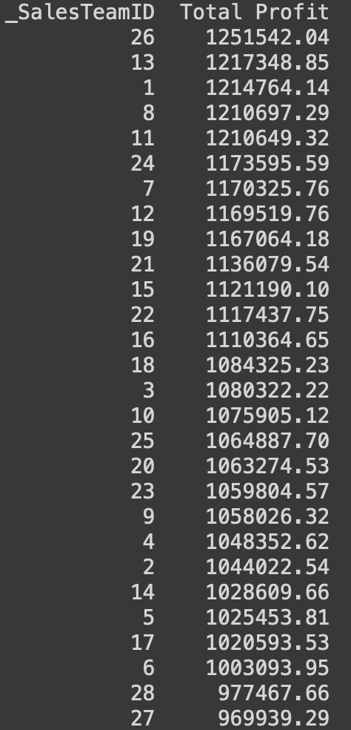

Sales Team Evaluation
Sales Team Evaluation
Profit Calculation:
The total profits are standardized in thousands for better visualization

Slide 12
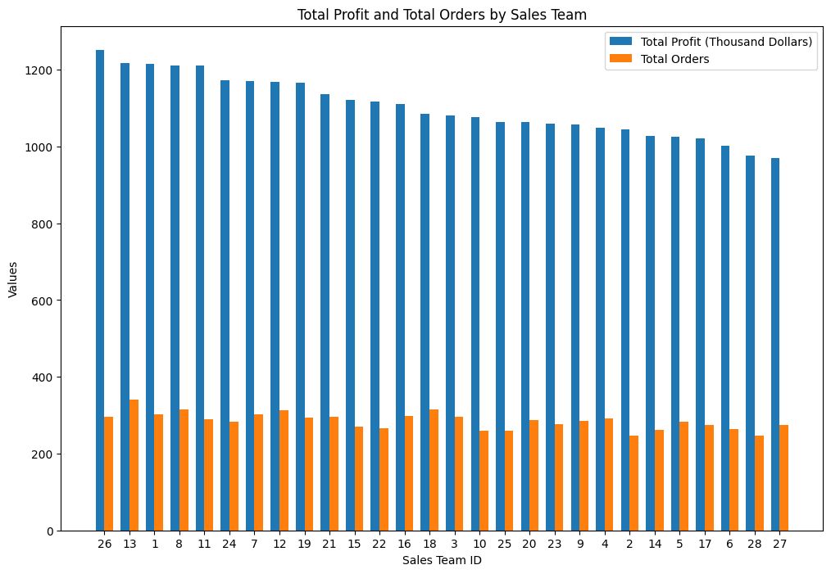
The bar chart reveals that the top five sales teams with the highest performance are 26, 13, 1, 8, and 11.Awards and incentives can be presented to these teams to further motivate and encourage their continued success.

Slide 13
Recommendations
Recommendations
Enhance Inventory Management: To minimize lead times and prevent stockouts, focus on optimizing inventory levels for high-demand products with extended lead times, specifically targeting items such as Product IDs 23, 37, 8, 4, and 40.
Refine Marketing Strategies: Allocate resources more effectively by concentrating marketing efforts on the In-Store and Online channels, which have demonstrated the highest customer engagement. This could include more targeted advertising campaigns tailored to these channels.
Implement Performance-Based Rewards: Recognize and incentivize top-performing sales teams, particularly Teams 26, 13, 1, 8, and 11. Consider implementing a structured rewards program or offering exclusive incentives to maintain high performance and drive further sales growth.

Slide 14
Thanks for your time!

