Slide 1
Interactive Financial Dashboard Using R Shiny
Interactive Financial Dashboard Using R Shiny
Real-time Financial Analysis with Adjustable Parameters
Presented by: Gladice Lee
Date: July, 8, 2024

Slide 2
Table of contents
01
Dashboard
Features
Project
Overview
Data and
Metrics
02
03
Core Functionality
- Real-Time Adjustments
Visualization of
Results
- Revenue, Cost, Profit
04
05
06
07
Monthly Growth Rate Analysis
Scenario Analysis

Slide 3
Project Overview: Objective and Tools
Objective:
Main Goal: The goal of this project was to create an interactive financial dashboard using R's Shiny package, allowing for real-time monitoring of key financial metrics like revenue, cost, profit, and growth.
Why Shiny?: Shiny allows us to build web-based, interactive applications in R without needing HTML, CSS, or JavaScript, which makes it a perfect choice for financial analysis.
Key Tools Used:
- Shiny: For building the interactive web application.
- ggplot2: For visualizing the financial data.
- dplyr: For efficient data manipulation and wrangling.
- DT: To create interactive tables.
readxl: To read Excel files with financial data.
Description:
The project showcases the power of Shiny by integrating reactive inputs and dynamic outputs that allow users to analyze financial data in real-time. By adjusting parameters like exchange rates, tax rates, and cost percentages, the dashboard can simulate various financial scenarios.

Slide 4
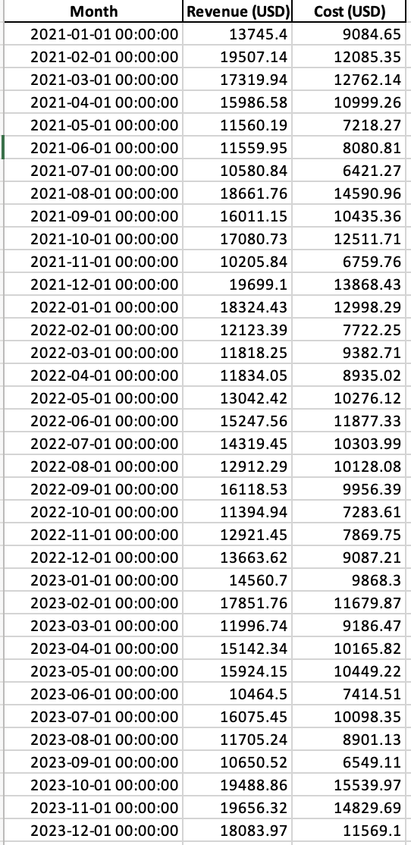
Financial Data and Key Metrics
Data:
- Source: A manually created Excel file with 36 months of financial data for revenue and cost.
- Columns in the Dataset:
Month: Each row corresponds to a month over 3 years.
Revenue (USD): The revenue generated in USD for each month.
Cost (USD): The cost associated with generating the revenue for each month.
Key Metrics Computed:
- Revenue (After Tax): Adjusts the revenue by applying user-defined tax rates.
- Cost (NTD): Converts cost from USD to NTD based on the adjustable exchange rate.
- Profit: Calculated as Revenue (After Tax) - Cost.
- Gross Margin: Measures profitability as (Profit / Revenue) * 100.
- Cumulative Profit: Running total of profit across months to track financial growth over time.
- Monthly Growth Rates: Calculates the percentage growth of revenue and profit month-over-month.
Explanation:
These metrics are essential for understanding the financial health of a business, and by integrating them into the dashboard, users can interactively explore how changes in key parameters affect performance.

Slide 5
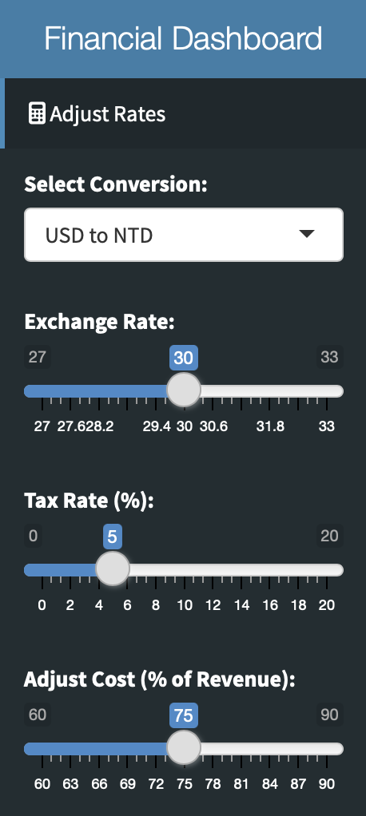
Dashboard Features: Interactive Controls
Core Functionalities:
- Adjustable Exchange Rates: Users can switch between USD to NTD and NTD to USD using a dropdown menu, and adjust the exchange rate using a slider (range: 27–33).
- Tax Rate Adjustments: A slider allows users to set the tax rate (range: 0–20%) and see how it impacts net revenue and profit in real-time.
- Cost Percentage Scenario Analysis: A cost adjustment slider (60%–90%) enables users to simulate different cost structures and their impact on profitability.
How It Works:
The reactive nature of Shiny means that whenever a user adjusts one of these controls, the app recalculates all financial metrics and updates the plots and tables instantly. This allows for real-time scenario analysis and decision-making.

Slide 6
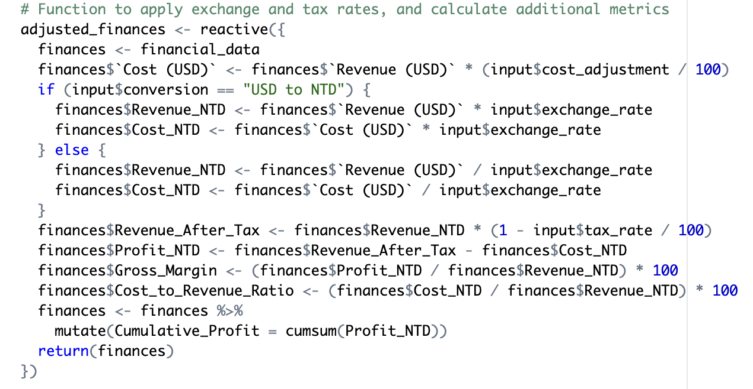
Real-Time Adjustments: Reactive Inputs
Explanation:
Reactive Programming: Shiny apps work by listening for changes to inputs (like exchange rate or tax rate), and whenever an input is modified, the server side recalculates all relevant data. This is called reactive programming.
Real-Time Financial Adjustments: By changing the exchange rate, tax rate, or cost percentage, users can see the immediate impact on key financial metrics like profit, gross margin, and cumulative profit. This functionality helps businesses make quick decisions based on hypothetical scenarios.
Key Code Snippet:

Slide 7
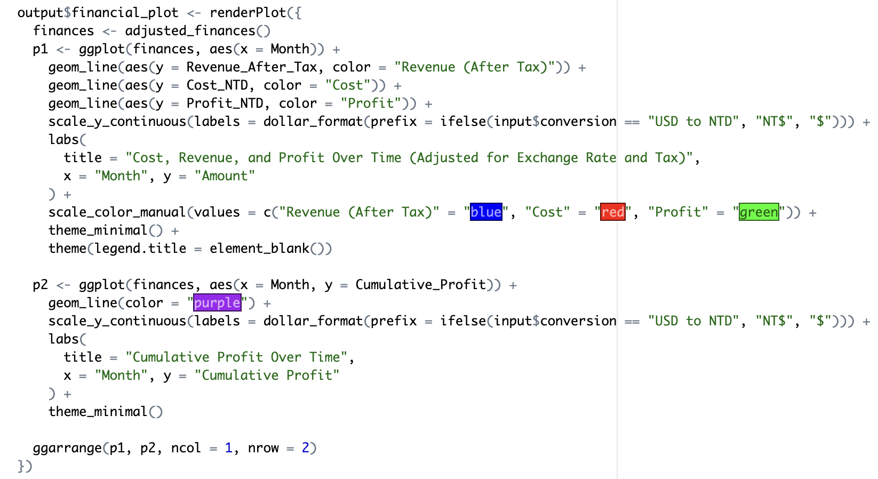
Visualizing Revenue, Cost, and Profit Over Time
Content:
- Plot 1: Displays Revenue (After Tax), Cost, and Profit over 36 months. Each of these financial metrics is plotted on a line graph, with different colors representing different metrics.
- Plot 2: Cumulative Profit shows the running total profit over time. This plot is useful for understanding long-term financial performance and the overall trend of profitability.
Why These Plots Are Important:
- Revenue vs. Cost: Helps to easily spot when costs are disproportionately high compared to revenue.
- Profit Visualization: Provides insight into how well the business is performing and how different inputs affect profitability.
- Cumulative Profit: Tracks financial health over time and can highlight long-term growth or decline.
Key Code Snippet for Plotting:

Slide 8
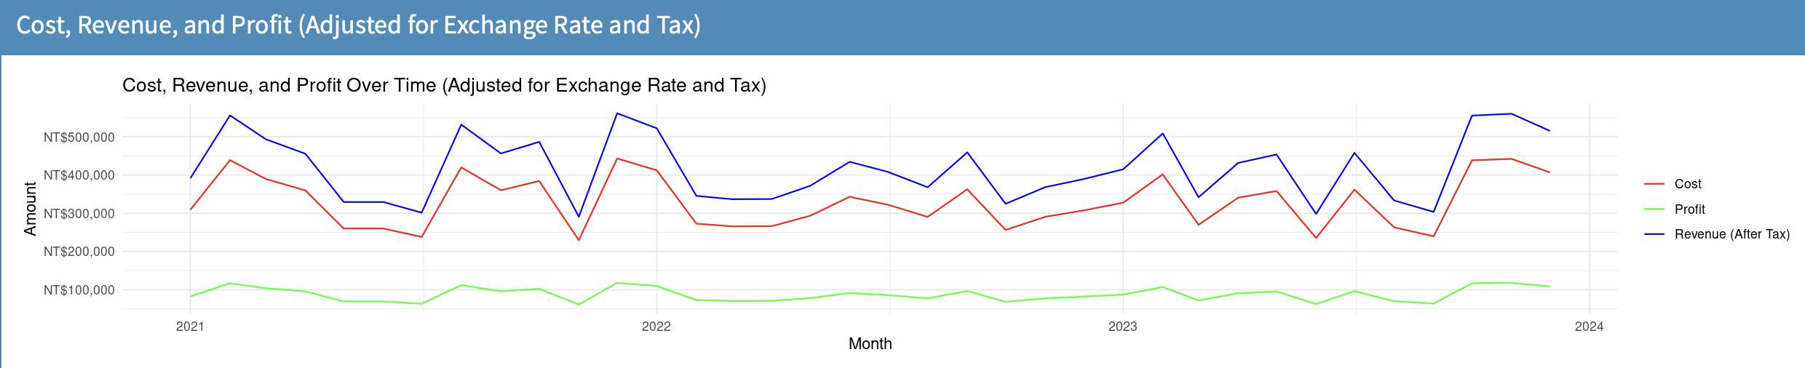
Scenario Analysis: Cost Adjustments
Content:
- What Is Scenario Analysis?: Scenario analysis allows businesses to evaluate the impact of different financial inputs (like cost percentages) on their financial performance. This feature simulates how changes in cost structures affect profit margins and overall profitability.
- Adjustable Input: The cost percentage slider allows users to adjust the cost as a percentage of revenue (e.g., set costs to be 75% of revenue).
- Immediate Feedback: As the user adjusts the slider, the profit and gross margin graphs update to reflect the impact of the new cost structure.
How It Works:
When the user changes the cost percentage, the app recalculates all related financial metrics and updates the graph to show the effect on profitability.

Slide 9
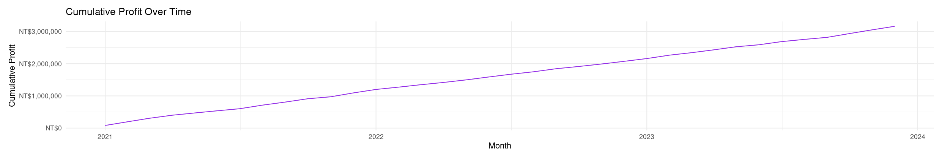
Monthly Growth Rate Analysis
Content:
Purpose: The Monthly Growth Rate Analysis helps users track how their revenue and profit have grown or shrunk on a month-by-month basis. This is crucial for understanding trends and forecasting future performance.
Metrics Calculated:
Revenue Growth (%):The percentage change in revenue compared to the previous month.
Profit Growth (%): The percentage change in profit compared to the previous month.

Slide 10
Thanks for your time
The dashboard is accessible at the following link:
https://gladice-lee.shinyapps.io/financialdashboard/

