Slide 1

Modular Multi-Agent
Document AI Platform
Redefining intelligence in enterprise workflows
Adaptive Policy Routing & Explainable Document Intelligence
PROJECT ID: 25-26J-129

Slide 2

Problem Statement
Document Overload
Companies process thousands of daily invoices, claims, and contracts with no intelligent routing or adaptation per document type.
No Memory
Lessons learned from one document are never applied to the next. The system remains permanently stuck at day-one performance.
No Trust
AI extracts fields with no explanation or evidence, lacking a structured way for humans to verify or correct results.
STAKEHOLDERS
Document processing teams
Compliance officers
Healthcare RCM analysts
Finance directors
PROJECT ID: 25-26J-129

Slide 3
What We Built
A pipeline of 14 intelligent agents that learns from every document, explains every decision, and validates every output.
IDPO: Intelligent Document Processing Orchestrator
Central pipeline coordinator with 14+ specialist agents. Adaptive OCR, entity extraction, field-level recovery, and escalation.
AHMN: Adaptive Hierarchical Memory Network
Three-tier memory (Redis → PostgreSQL → pgvector). Thompson Sampling selects policy. RABI solves cold-start. DAAF handles drift.
XAI-HITL: Human-Guided Explainable AI
BARTQA + LIME explanations + attention scores. Every extraction comes with traceable evidence. Human corrections feed back to loop.
Guardrails: Hallucination Detection & Validation
Six-layer ensemble: schema adherence, internal consistency, relevance, domain rules, PII detection, and semantic faithfulness.
PROJECT ID: 25-26J-129

Slide 4
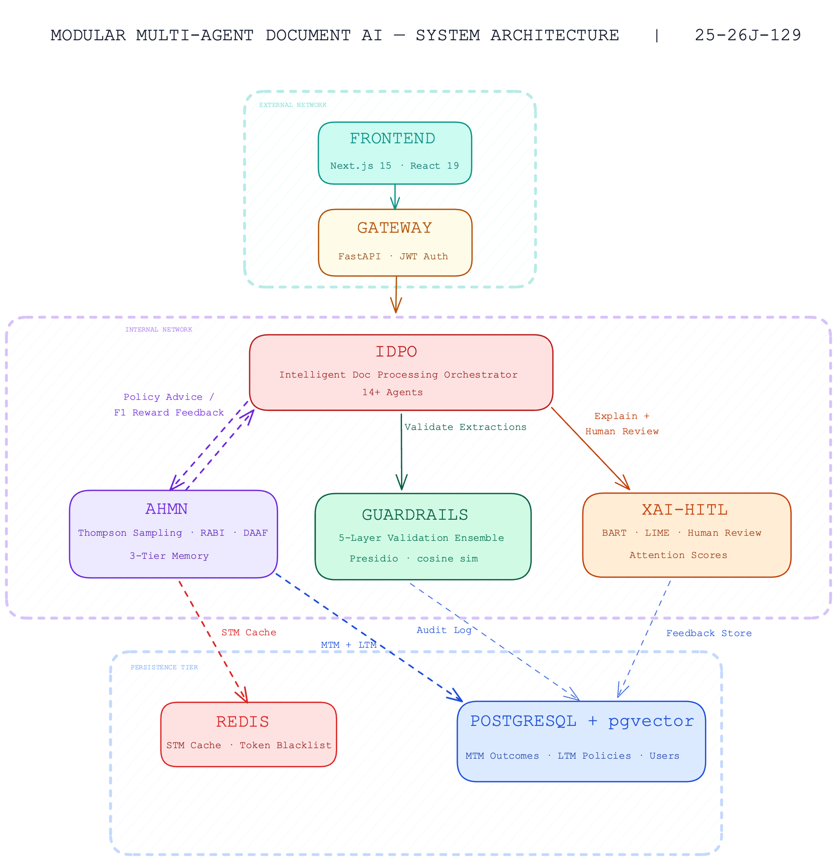

Slide 5

Adaptive Hierarchical Memory Network
Dasanayake D.R.L. | IT22350800
PROJECT ID: 25-26J-129
Adaptive Memory Network
Thompson Sampling
Learns optimal processing strategies per document type automatically.
RABI
Transfers knowledge to new document types (100 → 30 docs).
DAAF
Detects pattern shifts over time to maintain long-term accuracy.
40%
Routing Acc.
1.06s
Avg. Latency
Experimental Performance Metrics
Policy accuracy: Seen 45.5%, Near-Neighbor 50.0%, Cold-Start 0%, Overall 40%
RABI activation: 100% | Determinism: 100%
30 test cases across 3 regimes | Avg routing latency: 1.06s

Slide 6


Intelligent Document Processing Orchestrator
Nayanapriya S.A.T.| IT22892058
PROJECT ID: 25-26J-129
Hybrid Retrieval
BM25 keyword index combined with 256-d HashingEmbedder for precision recall.
Intelligent Document Processing Orchestrator (IDPO)
Extraction Modes
Bulk, Per-field, and Chain-of-Thought (Qwen3) selected via policy recommendation.
17 documents processed across 12 pipeline runs
Pipeline success rate: 70.6% (12/17)
Processing time: 332ms (fastest) to 42.0s (slowest)
Single-doc success: 87.5% (7/8 runs)
Batch processing: failures in 3+ doc runs
70.6%
Success Rate
332ms
Fastest Run

Slide 7

Hallucination & Guardrail Detection
Wijetunga W.L.A.T. | IT22910936
PROJECT ID: 25-26J-129
Schema Adherence — Rigid Pydantic model checks.
Hallucination Detection & Output Validator
Relevance — Cosine similarity field-to-source.
Internal Consistency — Financial formula validation.
PII Leakage — Context-aware masking (Presidio).
Faithfulness — Weighted semantic grounding.
Verified
Error isolation prevents pipeline blocks.
Validation Results & System Integrity
Schema: 100%, Relevance: 87%, Consistency: 94%, Domain Rules: 91%, PII: 96%, Faithfulness: 89%
8 document type schemas supported | Validation verified on live runs
Error isolation confirmed: layer failures don't block others

Slide 8

Explainable AI & Human In The Loop
Pathirana M.M. | IT22335050
PROJECT ID: 25-26J-129
PROJECT ID: 25-26J-129
BART Generative Q&A
Cross-attention character offset mapping for frontend highlighting.
Explainable AI Feedback Loop
LIME Mechanism
Perturbation-based word importance scoring.
Detailed Evaluation Metrics
Overall: 70% Q&A Accuracy (21/30)
Category Breakdown: Numerical 46.2%, Yes/No 85.7%, Factual 100%, Synthesis 80%
Reliability: 85.7% Polarity Correctness | Unanswerable Detector triggered 6/30 (4 app.)
HITL feedback verified: correct → alpha+1 in AHMN posterior
70%
Q&A Accuracy
100%
Factual Accuracy
Verified HITL Loop

Slide 9


System Evaluation & Metrics
Metric Domain | Component Performance | Outcome Verified
Policy Routing | 40% Routing Accuracy | Thompson Sampling Learnt State
Cold-Start | 100% RABI Activation | Posteriors Transferred correctly
Orchestration | 70.6% Pipeline Success | 12/17 docs processed successfully
Validation | 92.8% Layer Coverage | Guardrail Ensemble Integrity
Explainability | 85.7% Polarity Accuracy & 70% Q & A Accuracy | XAI highlight consistency verified
System Health | 100% Determinism | Total 77 Test Cases Passed
Feedback Loop Integration: Correct reviewer feedback successfully propagates to AHMN posterior (α+1).

Slide 10
Limitations
Seed Data
Small LTM seed (21 entries) limits initial reach.
PII Sensitivity
Presidio underperforms on local Sri Lankan names.
Synthesis Latency
High processing time for full XAI (89.5s).
Batch Reliability
Failure rates in high-concurrency 3+ doc runs.

Slide 11
Detailed Future Roadmap
BART Fine-tuning
Fine-tune on Sri Lankan financial, legal, and clinical documents.
LTM Seed Expansion
Expand from 21 to 100+ entries to significantly reduce policy bias.
DAAF Optimization
Implement per-document-type DAAF forgetting rates.
NER Pipeline Integration
Replace entity placeholders with a live, production-grade NER pipeline.
Multi-modal Integration
Integrate vision-language models directly into the IDPO framework.
Advanced RABI Search
Filtered pgvector nearest-neighbor search with domain exclusion.
Batch processing reliability improvements in IDPO

