Slide 1

Modular Multi Agent Document AI
25-26J-129

Slide 2
Introduction to the Problem
Document Overload: Companies can't efficiently process thousands of documents
No Memory: Systems forget previous work and repeat everything
Trust Issues: Users don't know if AI answers are correct

Slide 3
What's Wrong Now: Systems waste time reprocessing same documents Can't combine different types of data properly Poor at detecting wrong answers No way for humans to improve the system
Our Solution: Smart memory that remembers important information Multiple AI agents working together Better error detection and safety checks Human feedback makes system smarter over time

Slide 4
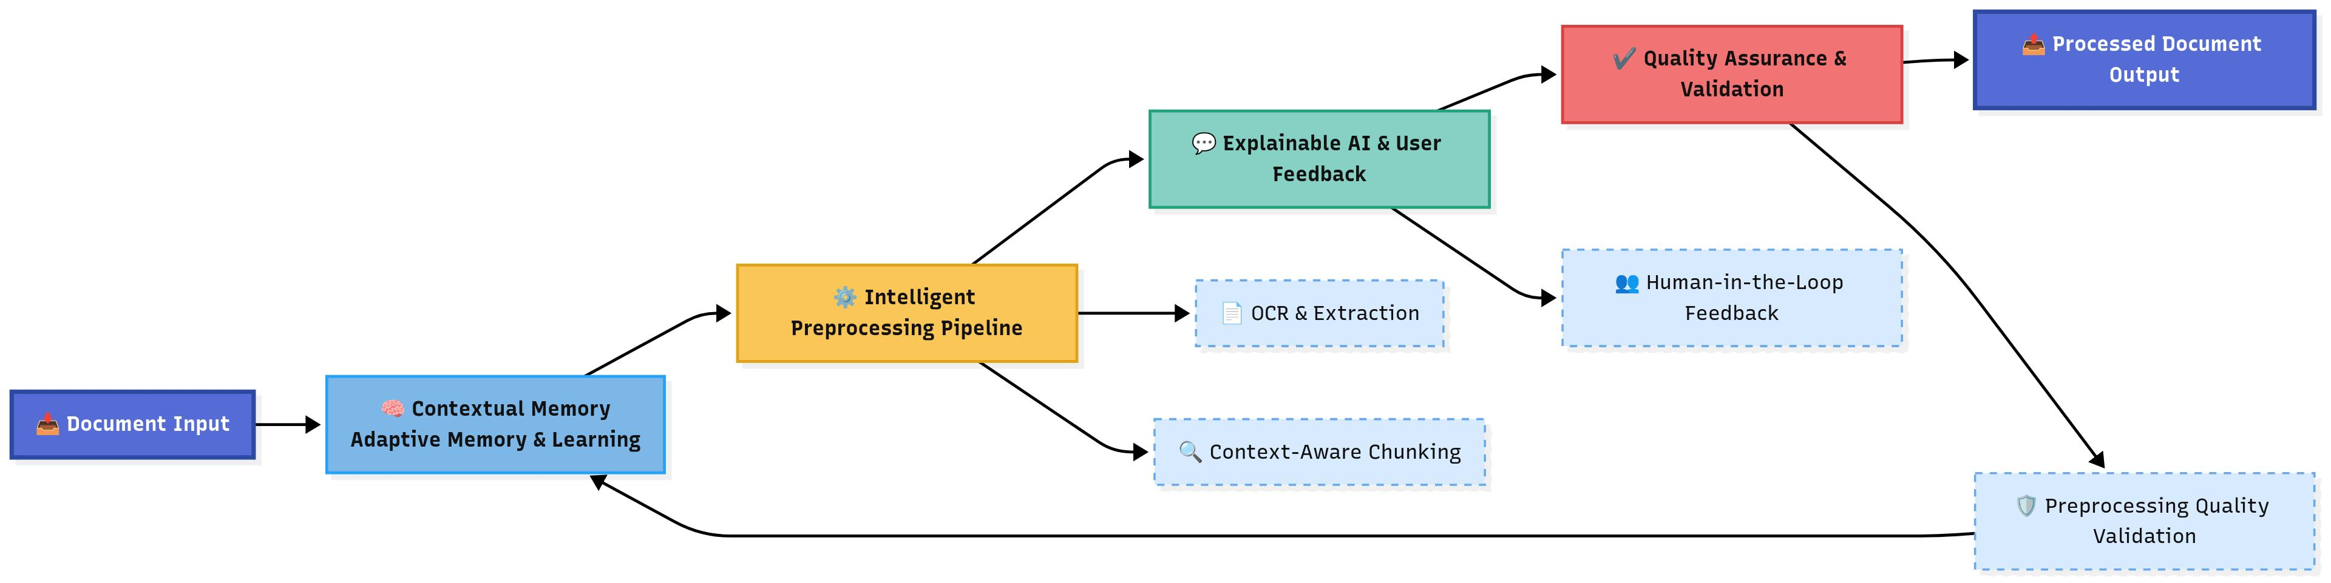
System Diagram

Slide 5

IT22892058| S A Thimuth Nayanapriya
Intelligent Document Processing Orchestration
BSc (Hons) in Information Technology Specializing in Data Science
IT22892058 | Nayanapriya S A T | 25-26J-129

Slide 6
Intelligent Document Processing Orchestration
The Sub-Problem:
The Solution:
Existing document pipelines are static and one-size-fits-all
Heavy OCR and LLMs are applied blindly, inflating costand latency
Failures trigger full document reprocessing, nottargeted recovery
No mechanism to balance accuracy, cost, and latencydynamically
Preprocessing decisions are hand-tuned, not learned
Routes documents based on quality & structural complexity
Selects agent-specialized preprocessing pipelines
Applies local models first, escalating only failing fields
Optimizes decisions using online policy learning
Consumes and sends policy guidance from and to AHMN
IDPO — an intelligent, policy-driven orchestration layer thatowns the entire preprocessing lifecycle, from document intake tocompliant structured output.
Functional Requirements Status:
FR‑01 Intake Gateway (batching/idempotency/de‑dup): 60%
FR‑02 DAE (type/vendor/complexity bins): 70%
FR‑03 Preprocessing Router (policy + AHMN): 60%
FR‑04 Preprocessing Workers (OCR/denoise/deskew/table): 65%
FR‑05 Local Extraction (layout‑aware + confidence): 55%
FR‑06 Recovery & Escalation (field‑level + flagship fallback): 45%
FR‑07 Provenance Writer (immutable audit trail): 70%
FR‑08 Policy Bandit (online optimization under SLOs): 10%
IT22892058 | Nayanapriya S A T | 25-26J-129

Slide 7
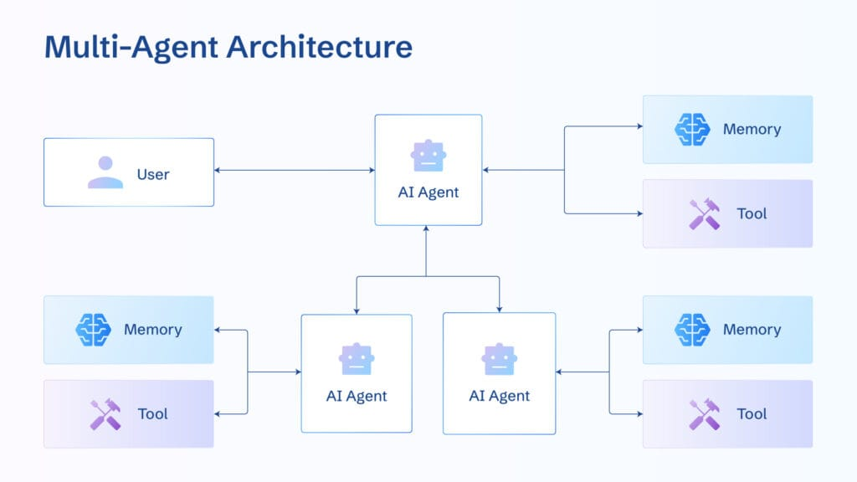
Intelligent Document Processing Orchestration
Design Excellence:
Complexity-Aware Routing
Different pipelines for pristine vs degraded documents
Agent-Specialized Preprocessing
Table-heavy, form-centric, image-dominant flows
Local-First, Escalate-Later Strategy
Lightweight models by default; flagship models only when required
Field-Level Recovery
Retry only failing fields, not entire documents
Vendor/layout-aware isolation prevents tail latency
Contribution:
Intake Gateway – batching, dedup, idempotency
Document Analysis Engine (DAE) – complexity & layout clustering
Preprocessing Router – selects optimal route using AHMN
Preprocessing Workers – quality-aware OCR, parsing, chunking
Local Extractor – layout-aware models / small LLM + tools
Recovery Agent – RAG-guided field-level retries
Tier-2 Escalator – budget-aware escalation to flagship models
Validator / Normalizer – rule packs, dictionaries, cross-field checks
Writer – structured output + full provenance
Policy Bandit Optimizer – continuous tuning of routing thresholds
Queues & Autoscaler – backpressure, fault isolation
IT22892058 | Nayanapriya S A T | 25-26J-129

Slide 8

IT22350800 | Dasanayake D. R. L.
Adaptive Hierarchical Memory Network
BSc (Hons) in Information Technology Specializing in Data Science
IT22350800 | Dasanayake D. R. L. | 25-26J-129

Slide 9
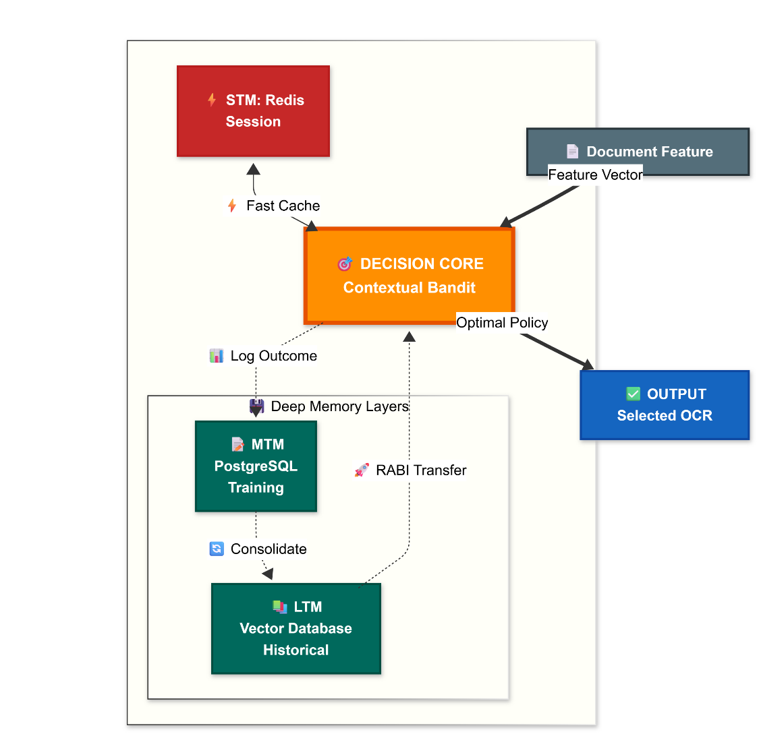
Adaptive Hierarchical Memory Network
The Sub-Problem:
Existing OCR pipelines reset for every document – “Amnesia” (Cold start)
The Solution:
Uses Retrieval-Augmented control to transfer historical knowledge, enabling adaptation for new vendors.
Cannot adapt to data drift (e.g., new vendor layouts).
Uses Reinforcement Learning to detect patterns and create a self-healing system that adapts to layout changes automatically.
IT22350800 | Dasanayake D. R. L. | 25-26J-129

Slide 10
Adaptive Hierarchical Memory Network
Design Excellence: 3-Tier Cognitive Memory
Innovation: A bio-inspired hierarchy (STM/MTM/LTM).
Benefit: Decouples fast reflexes from deep semantic wisdom, ensuring real-time intelligence.
Research Contributions
RABI (Cold Start): Uses transfer learning to project knowledge from past documents, achieving zero-shot optimization.
DAAF (Data Drift): A self-healing mechanism that mathematically detects layout changes and auto-tunes memory to adapt.
Functional Requirements Status:
FR-01 Memory Storage: Hierarchical Database deployed (Redis + Postgres).
FR-02 Pattern Recognition: Semantic Vector Embeddings (all-MiniLM) active.
FR-03 Adaptive Learning: Bandit Algorithms (Thompson/UCB1) implemented.
FR-04 API Integration: REST endpoints (/advice, /log) ready.
IT22350800 | Dasanayake D. R. L. | 25-26J-129

Slide 11

IT22335050 | Pathirana m.m
Human Guided Explainable AI
BSc (Hons) in Information Technology Specializing in Data Science
IT22335050 | Pathirana M.M | 25-26J-129

Slide 12
Human Guided Explainable AI
Functional Requirements Status:
FR-01 Question Answering Engine: Core Q&A pipeline implemented to process user queries (60% completed)
FR-02 Explainable AI Module: Explainability framework developed to provide transparent justifications for each generated answer (50% completed)
FR-03 Human In The Loop: HITL workflow integrated, enabling human reviewers
FR-04 User Interaction Interface: Web-based interface created for submitting questions, viewing answers, inspecting explanations, and providing human feedback in real time.
The Sub-Problem:
Opacity: Current Q & A Systems Generate Answers without reasoning
The Solution:
Explainability Layer: Integrate XAI techniques that exposes reasoning & evidence
HITL Engine: Enables real time human feedback
HITL Gap: Most platforms lack efficient feedback mechanism
IT22335050 | Pathirana M.M | 25-26J-129

Slide 13
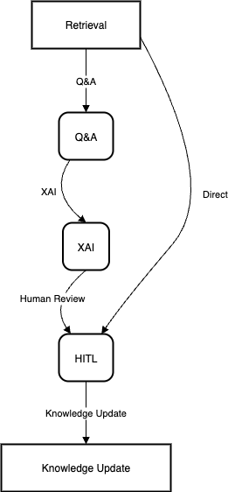
Human Guided Explainable AI
Design Excellence:
Multi-Layered Visual Interpretation: UI that color codes "Internal Attention" (SHAP) versus "External Logic" (LIME)
Active Feedback Loop: Structured annotation pipelines for human correction and reinforcement
Contribution:
Source-Grounded Justifications (links each answer to retrieved documents and passages).
Human-Validated Corrections (expert feedback injected directly into the decision loop).
HITL-Driven Refinement Loop (Q&A → XAI → Human Review → Knowledge Update).
IT22335050 | Pathirana M.M | 25-26J-129

Slide 14

IT22910936 | Wijetunga w.l.a.t.
Hallucination Detection and Guardrails
BSc (Hons) in Information Technology Specializing in Data Science
IT22910936 | Wijetunga W.L.A.T. | 25-26J-129

Slide 15
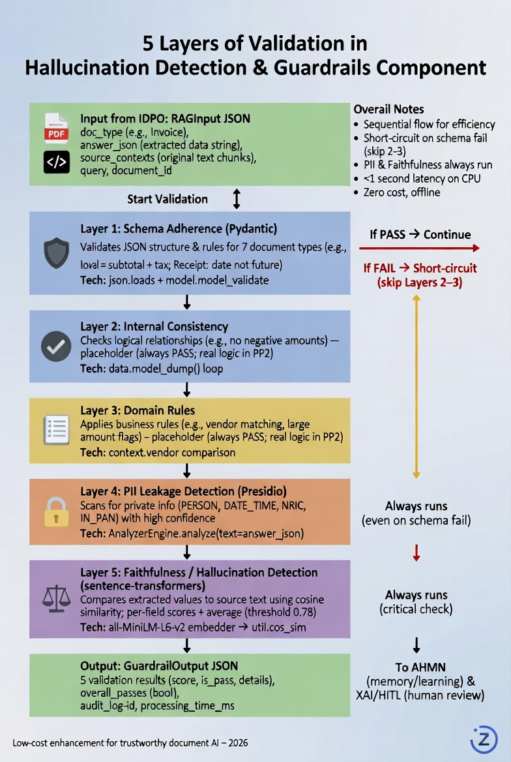
Hallucination Detection and Guardrails
Problem :
Hallucinations (LayoutLM, LlamaParse, Amazon Textract), PII leaks (names, NRIC, dates), logical errors in extracted document data (invoices, clinical summaries, receipts).
Root Causes:
No memory for learning from failures, lack of safety layers in RAG pipelines, trust issues in unstructured docs like invoices/clinical summaries.
Target Group:
Healthcare providers (medication to avoid harm), banks/insurers (claims to prevent fraud), legal firms (PurchaseOrders for compliance).
Solution:
FastAPI microservice with 5-layer validation on IDPO JSON output.
IT22910936 | Wijetunga W.L.A.T. | 25-26J-129

Slide 16
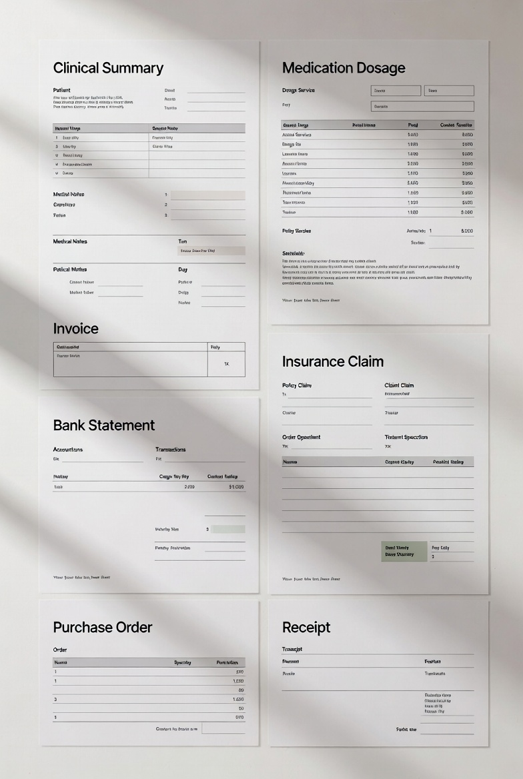
Hallucination Detection and Guardrails
Design Excellence:
Modular FastAPI microservice (editable pip package).
Sequential ensemble for efficiency (schema first → short-circuit).
Structured input (RAGInput) / output (GuardrailOutput) for agent integration.
Offline, zero runtime cost, <1s latency on CPU.
Contribution:
Per-field hallucination scoring (pinpoints exact fake values).
Document-specific schemas (7 types with real validators).
Lightweight enhancement over NeMo Guardrails (no LLM/GPU needed).
Ready for multi-agent loop (IDPO → Guardrails → AHMN/HITL).
IT22910936 | Wijetunga W.L.A.T. | 25-26J-129

Slide 17
Commercialization
Target Industries
Healthcare, Legal, Finance, Education
Revenue Model
Subscription-based with tiered plans
Enterprise: custom deployments, premium support, domain-specific modules
Investment Cost
Cloud Deployment | 100000
Conference Participation | 40000
Software Licenses | 20000

