Slide 1

Modular Multi Agent Document AI
25-26J-129

Slide 2
Introduction to the Problem
Document Overload: Companies can't efficiently process thousands of documents
No Memory: Systems forget previous work and repeat everything
Trust Issues: Users don't know if AI answers are correct

Slide 3
What's Wrong Now: Systems waste time reprocessing same documents Can't combine different types of data properly Poor at detecting wrong answers No way for humans to improve the system
Our Solution: Smart memory that remembers important information Multiple AI agents working together Better error detection and safety checks Human feedback makes system smarter over time

Slide 4
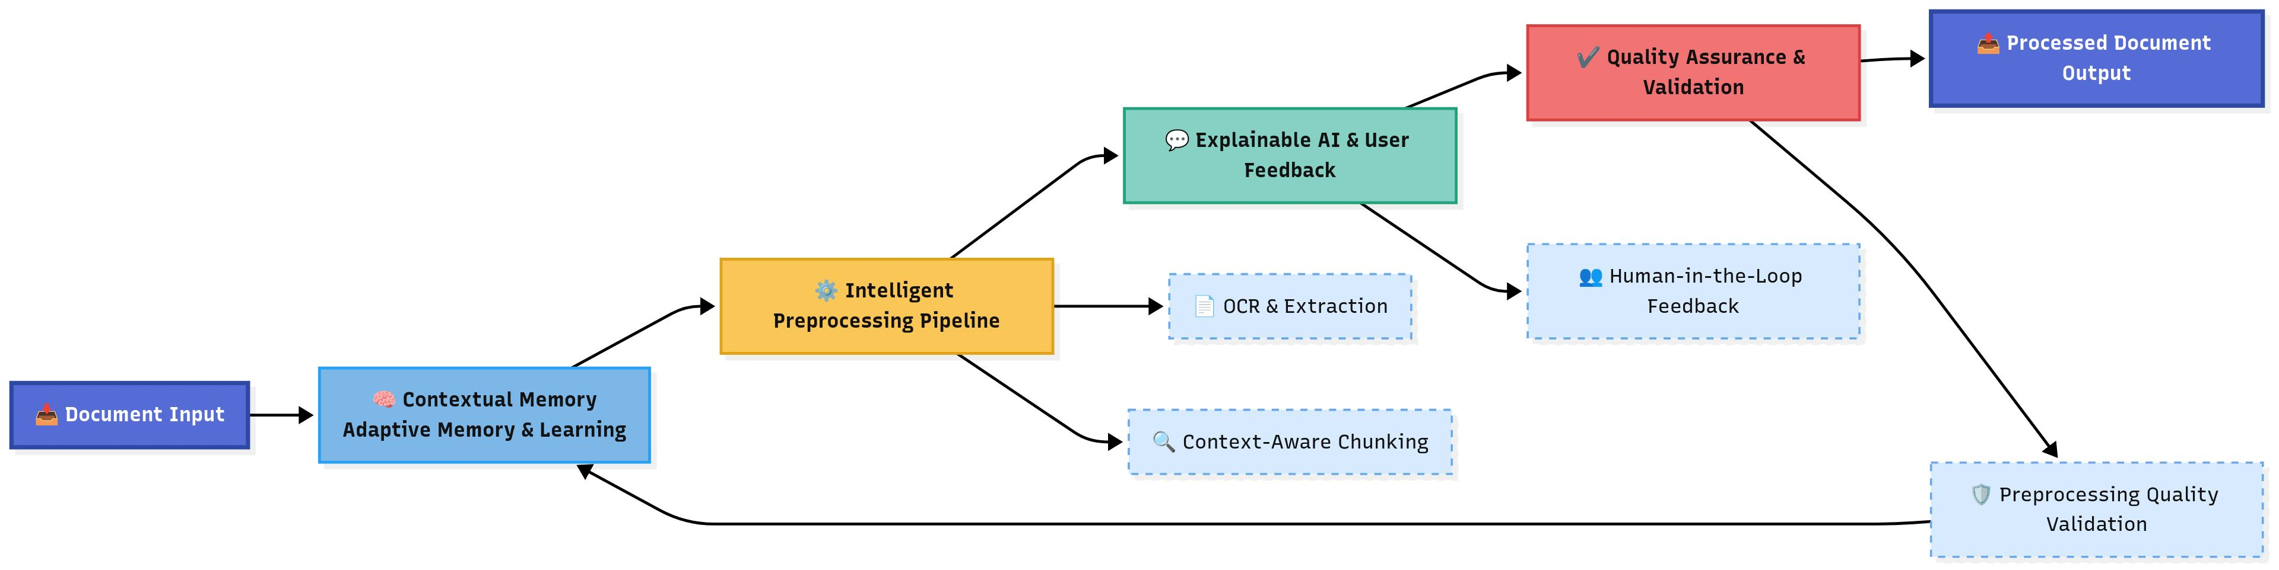
System Diagram

Slide 5

IT22892058 | S A T Nayanapriya
BSc (Hons) in Information Technology Specializing in Data Science
IT22982058 | S A T NAYANAPRIYA | 25-26J-129

Slide 6
Intelligent Document Processing Orchestration
Research Gap?
Current document AI pipelines use static preprocessing flows that do not adapt to document quality, layout, or complexity.
Existing fallback mechanisms are document-level, wasting compute and hiding which fields actually fail.
Lack of counterfactual evaluation means new preprocessing strategies can only be tested live, slowing research and risking instability.
Solution?
IDPO reframes preprocessing and routing as learnable policies, selecting optimal pipelines based on document context.
Field-level recovery and escalation ensures only uncertain fields are retried or escalated, not entire documents.
Offline evaluation with IPS/DR estimators enables safe comparison of new preprocessing policies before deployment.
IT22982058 | S A T NAYANAPRIYA | 25-26J-129

Slide 7
Intelligent Document Processing Orchestration
Main Objective
Build an intelligent orchestration and preprocessing framework for scalable document intelligence
Sub-Objectives
Design workflows that adapt to document complexity
Create specialized preprocessing paths for different document types
Enable cost–accuracy–speed trade-offs through smart orchestration
Introduce feedback-driven mechanisms for resilience and improvement
IT22982058 | S A T NAYANAPRIYA | 25-26J-129

Slide 8
Intelligent Document Processing Orchestration - Methodology
Ingest & Analyze – DAE classifies docs by type, vendor/layout cluster, and quality bin.
Policy Selection – Requests advice from AHMN; picks preprocessing policy ranked by Recency × Lift × Similarity.
Local Extraction – Runs calibrated local extractor; applies thresholds for acceptance.
Field-Level Recovery & Escalation – Low-confidence fields retried with AHMN hints; unresolved ones escalated to stronger models.
Validation – Rules, codebooks, consistency checks ensure quality.
Learning & Optimization – Logs outcomes; contextual bandits optimize policy; offline IPS/DR estimators safely evaluate new strategies; policies updated with drift signals.
IT22982058 | S A T Nayanapriya | 25-26J-129

Slide 9
IDPO: Success Evaluation/Validation:
Main Goal: Reliable extraction of structured entities from unstructured documents
Extraction Accuracy: Significant improvement in per-field F1 and Doc Accept@Thresholds
Field-Level Escalation Efficiency: Higher accuracy with reduced overhead vs. document-level fallback
Policy Optimization Success: Contextual bandits improve preprocessing policy selection over static baselines
Offline Evaluation Validity: IPS/DR estimates match outcomes from online A/B testing
Robustness: Stable performance under noise, skew, and vendor/layout drift
Data Availability & Ethical Clearance:
Dataset: Healthcare RCM (Revenue Cycle Management) dataset with vendor-stratified and quality-binned splits
Ethical Protocols: Anonymized logging, no PII stored in policy/memory modules
Compliance: GDPR-compliant data handling, versioned policies, and auditable provenance
IT22982058 | S A T NAYANAPRIYA | 25-26J-129

Slide 10
Intelligent Document Processing Orchestration
[1] H. Xu, Y. Li, and K. Zhang, “Adaptive Preprocessing Pipelines for Document AI Systems,” arXiv, 2025. [Online]. Available: https://arxiv.org/abs/2501.07894
[2] P. Patel and A. Kumar, “Field-Level Error Recovery in Document Information Extraction,” IEEE Access, 2024. [Online]. Available: https://ieeexplore.ieee.org/document/10487215
[3] J. Torres et al., “Counterfactual Evaluation of Preprocessing Strategies in NLP,” Proceedings of ACL, 2023, pp. 2145–2157. doi: https://doi.org/10.18653/v1/2023.acl-main.165
[4] K. Raman and D. Wang, “Contextual Bandits for Adaptive Pipeline Optimization,” Journal of Machine Learning Research (JMLR), vol. 24, no. 188, pp. 1–28, 2023.
[5] L. Chen, R. Kapoor, and F. Muller, “Document Layout Analysis and Vendor Clustering for Scalable Extraction,” The VLDB Journal, 2024. [Online]. Available: https://link.springer.com/article/10.1007/s00778-024-00884-5
[6] S. Fatemi and Y. Hu, “Evaluating Robustness of Document AI under Noise and Drift,” arXiv, 2025. Available: https://arxiv.org/abs/2502.06312
[7] J. Wang, M. Kim, and R. Thomas, “Selective Prediction and Abstention in Document Extraction,” NeurIPS, 2024.
[8] D. Yang and P. Ren, “Learning to Route Tasks Across Multi-Agent Extraction Systems,” ICLR Workshops, 2025.
[9] Z. Chen and L. Zhao, “Bandit-Based Policy Optimization in Adaptive Document Workflows,” KDD Applied Data Science Track, 2024.
[10] (PDF) “A Survey on Multi-Agent Orchestration for Large-Scale Document Processing,” ResearchGate. Available: https://www.researchgate.net/publication/33694512
IT22982058 | S A T Nayanapriya | 25-26J-129

Slide 11

Adaptive Hierarchial Memory Network
BSc (Hons) in Information Technology Specializing in Data Science
IT22350800 | Dasanayake D. R. L. | 25-26J-129

Slide 12
Adaptive Hierarchial Memory Network
The Problem?
No Memory: Current document AI systems start from zero with every new document
No Sharing: Systems can't apply lessons learned from one domain (healthcare) to another (finance)
Wasted Effort: Same preprocessing mistakes happen repeatedly across different document types
Our Solution: AHMN
Smart Memory: Remembers successful processing patterns and reuses them automatically
Cross-Domain Intelligence: Transfers knowledge between different document types
Continuous Learning: Gets smarter and faster with every document processed
IT22350800 | Dasanayake D. R. L. | 25-26J-129

Slide 13
Adaptive Hierarchial Memory Network
Data Science Specialization Applied
Deep Learning Models - Neural networks and embeddings for cross-domain pattern recognition
Statistical Learning - Machine learning algorithms for knowledge transfer and adaptation
Big Data Analytics - Large-scale data processing and pattern mining across document types
Predictive Modeling - Algorithms that learn and predict optimal preprocessing strategies
Experimental Design - A/B testing and validation frameworks for continuous improvement
How These Domains Fabricate the Solution?
Memory Storage & Retrieval
Cross-Domain Learning
Intelligent Decision Making
Scalable Architecture
IT22350800 | Dasanayake D. R. L. | 25-26J-129

Slide 14
Adaptive Hierarchial Memory Network
Success Evaluation/Validation:
Preprocessing Accuracy: Significant across different document domains
Memory Retrieval Speed: Low response time for pattern matching
Cross-Domain Transfer Success: High accuracy in applying learned patterns to new domains
Learning Efficiency: Reduction in preprocessing optimization time
Data Availability & Ethical Clearance:
Dataset: Healthcare RCM (Revenue Cycle Management) company dataset as the primary validation source
Ethical Protocols: Privacy-compliant memory storage with data anonymization
Compliance: GDPR-compliant data processing with explicit consent mechanisms
IT22350800 | Dasanayake D. R. L. | 25-26J-129

Slide 15
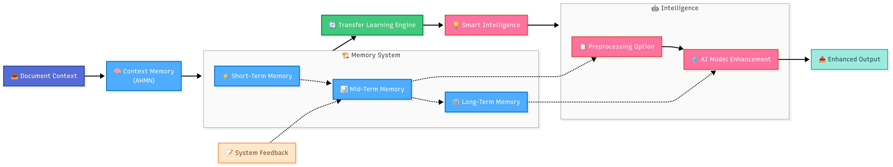
Hierarchial Memory Framework
Real-World Application Scenario:
Healthcare Implementation: System learns optimal OCR settings for medical forms across different hospital systems
Usage Process: Analyze document → Retrieve similar patterns from memory → Apply learned preprocessing → Update memory with results
IT22350800 | Dasanayake D. R. L. | 25-26J-129

Slide 16
Hierarchial Memory Framework
[1] X. Kang et al., "MemoryOS: Hierarchical Memory Structures for Contextual LLM Agents," arXiv preprint arXiv:2401.00368, 2025.
[2] T. Yuen, R. Kumar, and S. Li, "Intrinsic Memory Agents for Multi-Agent Systems," arXiv preprint arXiv:2502.12110, 2025.
[3] J. Gao et al., "Retrieval-Augmented Generation: Enhancing Factual Accuracy in LLMs," Information Processing & Management, 2023. [Online]. Available: https://www.sciencedirect.com/science/article/pii/S1389041724000093
[4] L. Wang et al., "Memory Techniques for Large Language Model Agents," The VLDB Journal, 2024. [Online]. Available: https://link.springer.com/article/10.1007/s00778-024-00864-x
[5] "LangChain Documentation," LangChain, 2025. [Online]. Available: https://python.langchain.com/docs/introduction/ (accessed Aug. 24, 2025).
[6] A. Frome et al., "DeViSE: A Deep Visual-Semantic Embedding Model," arXiv preprint arXiv:1411.2539, 2014.
[7] J. M. Jackson and M. D. Pinto, "Human Near the Loop: Implications for Artificial Intelligence in Healthcare," Clinical Nursing Research, vol. 33, no. 2–3, pp. 135–137, Jan. 2024.
[8] R. Karpas et al., "Agentic AI: Multi-Agent Planning and Reasoning for Large Language Models," IEEE Access, 2025. [Online]. Available: https://ieeexplore.ieee.org/document/10849561
[9] D. Reynolds and S. McDonell, "Retrieval-Augmented Generation for Knowledge Intensive Tasks," arXiv preprint arXiv:2305.10450, 2023.
[10] M. Kang, H. Lee, and J. Park, "Hierarchical Memory and Role-Based Knowledge in LLM Agents," arXiv preprint arXiv:2407.05678, 2024.
IT22350800 | Dasanayake D. R. L. | 25-26J-129

Slide 17

Human-Guided Explainable AI
BSc (Hons) in Information Technology Specializing in Data Science
IT22335050 | Pathirana M M | 25-26J-129

Slide 18
Human-Guided Explainable AI
Knowledge Gap/Problem Definition
AI Opacity Crisis: Current document AI systems provide outputs without explaining reasoning, leaving users unable to trust, validate, or audit decisions. This reduces adoption in high-stakes environments.
Human Feedback Bottleneck: Existing platforms rarely integrate human-in-the-loop corrections efficiently, causing delayed error correction and persistent model bias.
Current System Failures:
Outputs are opaque, lacking traceable evidence or interpretable rationale
Human corrections are ad hoc, unstructured, and not systematically used for learning
Structured data and embeddings exist in silos
Our Solution Addresses:
Explainable AI (XAI) Layer: Transparent, evidence-backed explanations for every output
Human-in-the-Loop (HITL) Integration: Structured points for human review and feedback, dynamically influencing model decisions and improving trust
IT22335050 | Pathirana M M | 25-26J-129

Slide 19
Human-Guided Explainable AI
Machine Learning & NLP
Explainable Transformers: Attention-based and attribution-aware models for interpretable document reasoning
Counterfactual & Feature Attribution Models: SHAP, LIME, and Integrated Gradients for transparent predictions
Human-In-The-Loop
Active Feedback Loops: Structured annotation pipelines for human correction and reinforcement
Uncertainty-aware Sampling: Prioritize instances with low confidence for human validation
Error Correction Models: Incorporate human interventions into model fine-tuning dynamically
Technologies in Data Science
Explainable ML Libraries: SHAP, LIME, Captum for real-time interpretability
Interactive Annotation Tools: Label-studio, Prodigy for efficient HITL workflows
Streaming Analytics & Feedback Integration: Kafka or Pulsar pipelines for live monitoring and adaptive system updates
IT22335050 | Pathirana M M | 25-26J-129

Slide 20
Human-Guided Explainable AI
How to Evaluate/Prove Success ?
Explainability Metrics: Quantify transparency and interpretability using fidelity, comprehensibility, and user trust scores
Human Feedback Effectiveness: Measure improvement in model accuracy and error reduction from HITL interventions
Data Availability & Ethical Clearance
Ethical Oversight: Ensure human feedback processes and AI explanations comply with privacy, bias, and transparency guidelines
IT22335050 | Pathirana M M | 25-26J-129

Slide 21
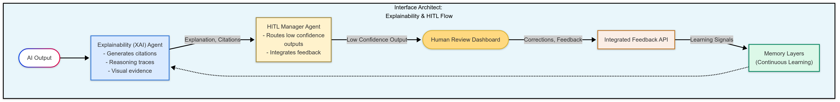
Human-Guided Explainable AI
IT22335050 | Pathirana M M | 25-26J-129

Slide 22
Human-Guided Explainable AI
[1] T. Yuen, R. Kumar, and S. Li, “Intrinsic Memory Agents for Multi-Agent Systems,” arXiv, 2025. [Online]. Available: https://arxiv.org/abs/2502.12110.
[2] “LangChain Documentation,” LangChain, 2025. [Online]. Available: https://python.langchain.com/docs/introduction/ (accessed Aug. 24, 2025).
[3] J. M. Jackson and M. D. Pinto, “Human Near the Loop: Implications for Artificial Intelligence in Healthcare,” Clinical Nursing Research, vol. 33, no. 2–3, pp. 135–137, Jan. 2024, doi: https://doi.org/10.1177/10547738241227699
[4] L. Wang et al., "Memory Techniques for Large Language Model Agents," The VLDB Journal, 2024. [Online]. Available: https://link.springer.com/article/10.1007/s00778-024-00864-x
[5] R. Karpas et al., “Agentic AI: Multi-Agent Planning and Reasoning for Large Language Models,” IEEE Access, 2025. [Online]. Available: https://ieeexplore.ieee.org/document/10849561.
[6] S. Fatemi and Y. Hu, “Enhancing Financial Question Answering with a Multi-Agent Reflection Framework,” arXiv (Cornell University), pp. 530–537, Nov. 2024, doi: https://doi.org/10.1145/3677052.3698686.
[7] N. Tan, Z. Seng, L. Zhang, Y.-C. Shih, D. Yang, and A. Salunkhe, “Improved LLM Agents for Financial Document Question Answering,” arXiv.org, 2025. https://arxiv.org/abs/2506.08726v1
[8] B. Faisal and D. Tunkel, “Explainable AI in Multi-Agent Systems: Advancing Transparency with Layered Prompting,” Feb. 01, 2025. https://www.researchgate.net/publication/388835453_Explainable_AI_in_Multi- Agent_Systems_Advancing_Transparency_with_Layered_Prompting
[9] “Autonomous Agents and Multi-Agent Systems,” SpringerLink, 2023. https://link.springer.com/journal/10458/updates/25215240
[10] “(PDF) Explainable AI: A Brief Survey on History, Research Areas, Approaches and Challenges,” ResearchGate. https://www.researchgate.net/publication/336131051_Explainable_AI_A_Brief_Survey_ on_History_Research_Areas_Approaches_and_Challenges
IT22350800 | Dasanayake D. R. L. | 25-26J-129

Slide 23
Interaction Between AHMN & IDPO
How IDPO Uses AHMN’s Memory
Policy Advice (Preprocessing)
Q: “For this doc type, vendor/layout, quality bin → which policy works best?” A: AHMN returns ranked policy IDs (scored by Recency × Lift × Similarity).
Context Bundle for Extraction (RAG)
Templates (fields, aliases, rules) Validators (regex, codebooks) Fix snippets (vendor-specific tips) → Guides IDPO’s extractor + retries
Field-Level Recovery
For low-confidence fields → IDPO requests hints/examples
AHMN provides fix snippets to sharpen recovery
How IDPO Feeds Back Into AHMN
Outcome Logging
Chosen preprocessing policy, PolicyOutcome: OCR WER, layout F1, field F1, cost, latency, Extraction results: accepted / escalated / failed fields
Consolidation & Updates
AHMN promotes policies/templates with positive lift, Demotes those with drift/regressions, Updates PreprocPolicyMemory with new vendor/layout mappings
Cross-Domain Transfer
If Policy A works for Vendor X → suggest for Vendor Y with similar layout cluster, Transfer suggestions provided to IDPO during future advice

Slide 24

Hallucination Detection and Guardrails
BSc (Hons) in Information Technology Specializing in Data Science

Slide 25
Hallucination Detection and Guardrails
Research Gap
Lack of consistently reliable metrics or frameworks to quantify and validate high volume AI-generated content accuracy before user interaction. [Rule based detection - Wildflare Guardrail Pipeline]
Provided Solution
Multi-layered detection + guardrails (semantic, prompt, consistency, token checks); automatic flag/block/escalate.
IT22910936 | Wijetunga W.L.A.T. | 25-26J-129

Slide 26
Hallucination Detection and Guardrails
Application of Specialization-based Knowledge
Domains: NLP, AI Trust & Safety, Model Evaluation.
Technologies: BERT, RAG, semantic embeddings, validator LLMs tools like FacTool/SelfCheckGPT.
Evaluation: Compare to gold standards; cross-checked outputs; aim up to 80% accuracy. (Approx. metrics)
Data/Ethics: Uses open datasets, ethical review, privacy upheld.
IT22910936 | Wijetunga W.L.A.T. | 25-26J-129

Slide 27
Hallucination Detection and Guardrails
Evaluation/Validation:
Benchmark vs. expert (“gold standard”) answers
Ensemble scoring (accuracy, grounding, consistency)
Entropy – Captures answer uncertainty
Semantic Similarity – Measures the closeness between generated answer and its supporting context
Schema Checks – Detects structural or domain violations
Success metric: up to 80% detection accuracy (Approx. estimation)
Data & Ethics:
Uses open-access, permission-cleared datasets
Follows privacy standards, ethical review for validation and human-in-the-loop feedback
IT22910936 | Wijetunga W.L.A.T. | 25-26J-129

Slide 28
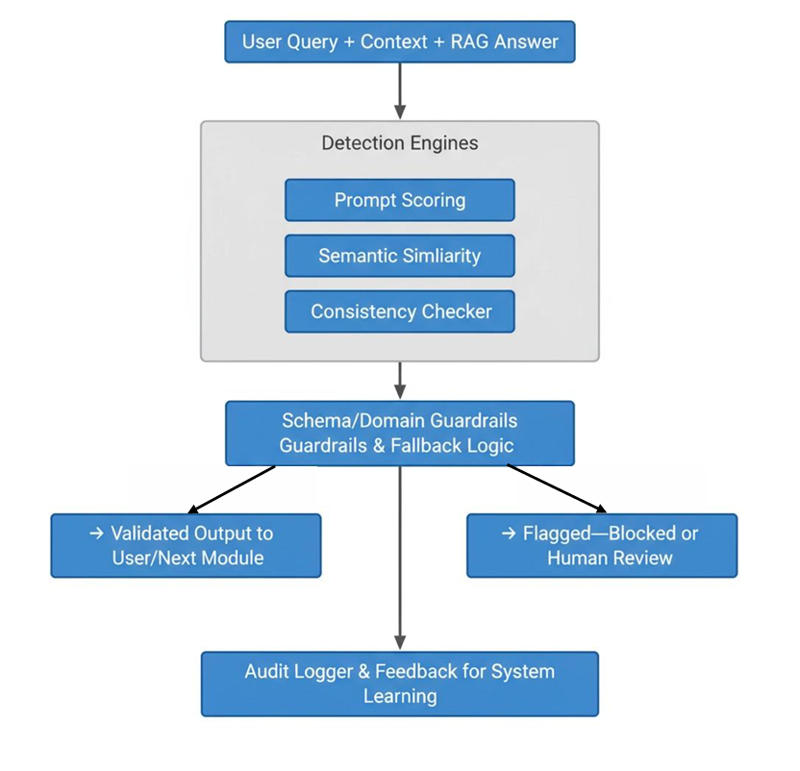
Hallucination Detection and Guardrails Famework
IT22910936 | Wijetunga W.L.A.T. | 25-26J-129

Slide 29
Hallucination Detection and Guardrails
[1] J. M. Jackson and M. D. Pinto, “Human Near the Loop: Implications for Artificial Intelligence in Healthcare,” Clinical nursing research, vol. 33, no. 2–3, pp. 135–137, Jan. 2024, doi: https://doi.org/10.1177/10547738241227699
[2] X. Wu, T. Ma, X. Li, Q. Chen, and L. He, “Human-in-the-loop document layout analysis,” arXiv, 2021. [Online]. Available: http://arno.uvt.nl/show.cgi?fid=160955
[3] D. Gosmar and D. A. Dahl, “Hallucination Mitigation using Agentic AI Natural Language-Based Frameworks,” arXiv.org, 2025. https://arxiv.org/abs/2501.13946
[4] A. Kovacs, “LettuceDetect: A Hallucination Detection Framework for RAG Applications | Towards Data Science,” Towards Data Science, Mar. 10, 2025. https://towardsdatascience.com/lettucedetect-a-hallucination-detection-framework-for rag-applications/(accessed Aug. 24, 2025).
[5] J. Song et al., “RAG-HAT: A Hallucination-Aware Tuning Pipeline for LLM in Retrieval-Augmented Generation,” 2024. Available: https://aclanthology.org/2024.emnlp-industry.113.pdf
[6] “Benchmarking Hallucination Detection Methods in RAG,” Cleanlab, 2024. https://cleanlab.ai/blog/rag-tlm-hallucination-benchmarking/ (accessed Aug. 24, 2025).
[7] M. Humbert-Droz, “Detecting Hallucinations in Healthcare AI,” Medium, May 28, 2025. https://pub.towardsai.net/detecting-hallucinations-in-healthcare-ai-99aa67e55bb7 (accessed Aug. 24, 2025).
[8] “Detect hallucinations for RAG-based systems | Amazon Web Services,” Amazon Web Services, May 16, 2025. https://aws.amazon.com/blogs/machine-learning/detect hallucinations-for-rag-based-systems/ (accessed Aug. 24, 2025). 21
[9] K. Pavan, “Building Agentic RAG Pipelines for Medical Data with CrewAI and Qdrant,” Medium, Jan. 12, 2025. https://ai.gopubby.com/building-agentic-rag-pipelines for-medical-data-with-crewai-and-qdrant-3a00a48fb0d1 (accessed Aug. 24, 2025).
IT22910936 | Wijetunga W.L.A.T. | 25-26J-129

Slide 30
Commercialization
Target Industries
Healthcare, Legal, Finance, Education
Revenue Model
Subscription-based with tiered plans
Enterprise: custom deployments, premium support, domain-specific modules
Investment Cost
Cloud Deployment | 100000
Conference Participation | 40000
Software Licenses | 20000

