Slide 1
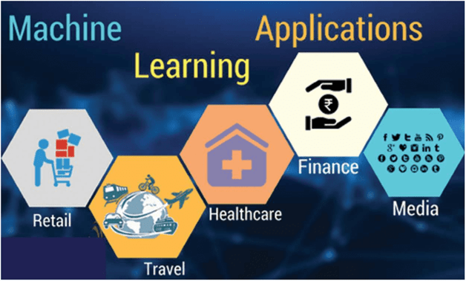
Machine Learning Applications Overview
Gladys A. Delos Santos
BSCS-3B

Slide 2
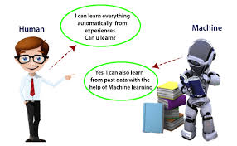
What is Machine Learning?
Machine learning (ML) is defined as a discipline of artificial intelligence (AI) that provides machines the ability to automatically learn from data and past experiences to identify patterns and make predictions with minimal human intervention. This article explains the fundamentals of machine learning, its types, and the top five applications. It also shares the top 10 machine learning trends.
Reference: https://www.spiceworks.com/tech/artificial-intelligence/articles/what-is-ml/

Slide 3
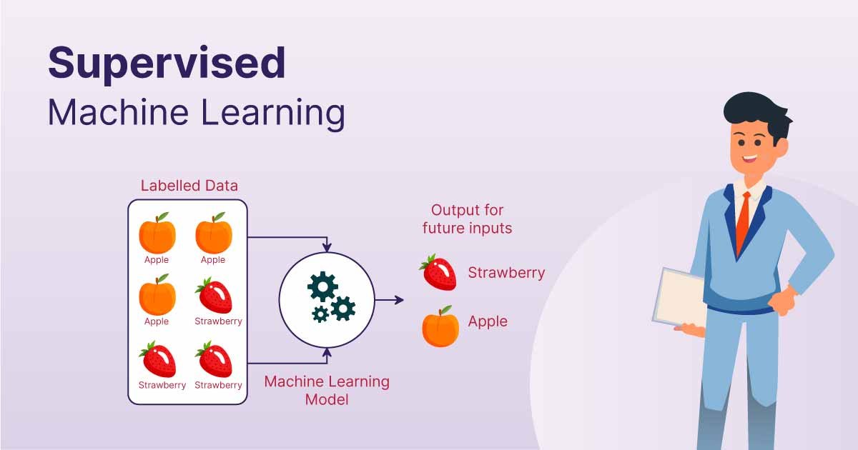
Types of Machine Learning You Should Know
1. Supervised machine learning
This type of ML involves supervision, where machines are trained on labeled datasets and enabled to predict outputs based on the provided training. The labeled dataset specifies that some input and output parameters are already mapped. Hence, the machine is trained with the input and corresponding output. A device is made to predict the outcome using the test dataset in subsequent phases.
Reference: https://www.spiceworks.com/tech/artificial-intelligence/articles/what-is-ml/

Slide 4
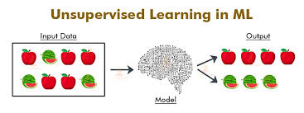
Types of Machine Learning You Should Know
2. Unsupervised machine learning
Unsupervised learning refers to a learning technique that’s devoid of supervision. Here, the machine is trained using an unlabeled dataset and is enabled to predict the output without any supervision. An unsupervised learning algorithm aims to group the unsorted dataset based on the input’s similarities, differences, and patterns.
Reference: https://www.spiceworks.com/tech/artificial-intelligence/articles/what-is-ml/

Slide 5
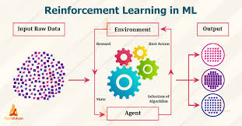
Types of Machine Learning You Should Know
3. Reinforcement learning
Reinforcement learning is a feedback-based process. Here, the AI component automatically takes stock of its surroundings by the hit & trial method, takes action, learns from experiences, and improves performance. The component is rewarded for each good action and penalized for every wrong move. Thus, the reinforcement learning component aims to maximize the rewards by performing good actions.
Reference: https://www.spiceworks.com/tech/artificial-intelligence/articles/what-is-ml/

Slide 6
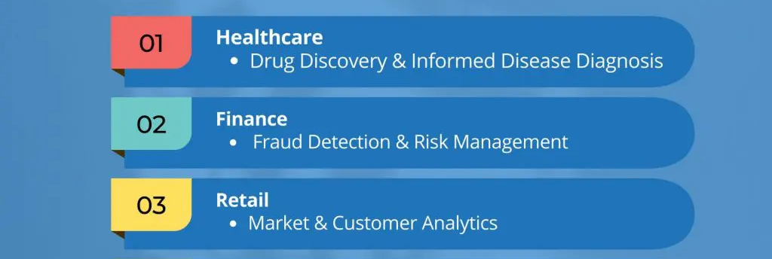
Examples of Machine Learning

Slide 7

Healthcare: Predictive Diagnostics
In healthcare, Early Preventive Detection through Predictive Diagnostics uses advanced tools and data analysis to identify potential health issues early, leading to timely interventions, improved outcomes, and cost savings by preventing serious conditions before they develop.
In healthcare, supervised learning enhances Early Preventive Detection through Predictive Diagnostics by training models on historical patient data to predict future health issues. This approach enables early identification of potential problems, allowing for timely interventions and improved patient outcomes.
Solution Impact: Improved Patient Outcomes - By using predictive diagnostics and supervised learning, healthcare can detect potential health issues early, leading to timely interventions and better management of conditions, ultimately enhancing patient outcomes.

Slide 8
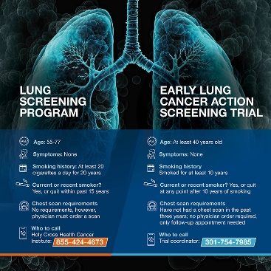

Lung Cancer Diagnostic Data Set
UCI Machine Learning Repository - Lung Cancer Data Set:
https://archive.ics.uci.edu/dataset/62/lung+cancer
Kaggle - Lung Cancer Data:
https://www.kaggle.com/datasets/yusufdede/lung-cancer-dataset

Slide 9
Finance: Fraud Detection
Solution Impact: Advanced fraud detection in finance using machine learning improves real-time identification and prevention of fraud, resulting in reduced financial losses, enhanced security, and increased operational efficiency.
Real-time fraud detection in finance uses advanced technologies and data analysis to swiftly identify and prevent fraud. It involves analyzing transaction data, employing machine learning and rule-based systems, and integrating with other security measures. This dynamic approach requires ongoing updates to adapt to new fraud techniques and ensure compliance, helping institutions minimize losses and protect assets.
Machine learning types used in fraud detection include supervised learning, which trains models on labeled historical data to classify transactions as fraudulent or legitimate using techniques like logistic regression and decision trees; unsupervised learning, which identifies anomalies without predefined labels using methods such as clustering algorithms and anomaly detection; and reinforcement learning, which adapts strategies based on feedback and evolving patterns to optimize decision-making over time.

Slide 10


Credit Card Fraud Detection
Data Set Example Link:
https://www.kaggle.com/datasets/emmamichael101/credit-card-fraud-detection-dataset
Project Example Link:
https://www.kaggle.com/competitions/credit-card-fraud-prediction

Slide 11
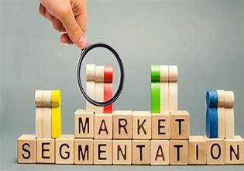
Marketing: Customer Segment
Customer segmentation in marketing involves dividing a broad customer or market base into sub-groups of consumers based on shared characteristics. This process helps businesses tailor their marketing strategies more effectively to meet the needs of different segments.
Unsupervised learning is a type of machine learning where the model is not provided with labeled data. Instead, the model tries to identify patterns and groupings in the data on its own. In the context of customer segmentation, unsupervised learning can help identify distinct customer segments based on various features like purchasing behavior, demographics, or engagement levels.
Solution Impact: Customer segmentation divides a market into sub-groups based on shared traits to refine marketing strategies. Unsupervised learning techniques like K-Means, Hierarchical Clustering, and DBSCAN identify these segments by detecting patterns in data. Dimensionality reduction (PCA, t-SNE) aids visualization, while association rules (e.g., Apriori) uncover behavior relationships. This approach enhances targeting, retention, resource allocation, revenue, and product development, leading to more personalized marketing.

Slide 12


Market Customer Segmentation Data
Data Set Example Link: https://www.kaggle.com/datasets/yasserh/customer-segmentation-dataset
Project Example Link: https://www.kaggle.com/code/jazidesigns/customer-segmentation-in-python

Slide 13
Summary of Machine Learning Applications
Machine learning (ML) significantly impacts real-world challenges by analyzing large datasets to enhance decision-making, automate repetitive tasks, and optimize processes across various industries. It enables personalized experiences on digital platforms and provides predictive analytics for risk management, demand forecasting, and disease detection. Additionally, ML tackles complex problems such as image and speech recognition, natural language processing, and autonomous driving, driving advancements in technology and improving everyday life.
The future of machine learning will see major advancements with tighter integration with AI and IoT, more advanced algorithms, and improvements in model explainability and fairness. Edge computing will enable real-time processing, and privacy-preserving techniques like federated learning will ensure data protection while enabling effective applications.
Conclusion: Machine learning has become a transformative force in solving real-world problems, driving innovation, and enhancing various aspects of modern life. As technology continues to evolve, ML will likely become even more integral to diverse applications, offering new opportunities and addressing emerging challenges. The ongoing advancements promise to make ML systems more capable, transparent, and ethical, further expanding their potential to positively impact society.

Slide 14
Thank you
By: Gladys A. Delos Santos
BSCS-3B
Notes:
In Slide Show mode, click the arrow to enter the PowerPoint Getting Started Center.

