Slide 1
Exploratory Data Analytics (cse3040)
A COMPREHENSIVE ANALYSIS ON FOOD WASTAGE
Team members
GLADWIN DANIEL P 23MIA1058
RESHMA G 23MIA1017
KARTHIKEYAN A 23MIA1123
Team Name – Team F
Registration- WINTER SEMESTER 2024-2025

Slide 2


Abstract
This project explores the progress and challenges in achieving Sustainable Development Goal 12 Responsible Consumption and Production by analyzing food wastage data. Utilizing a dataset containing global metrics on food wastage across households, retail, and food service sectors, this study examines key trends and factors contributing to inefficiencies in the food supply chain. The analysis aims to investigate disparities in food waste among different regions and identify actionable strategies to reduce waste generation. By focusing on patterns of food loss, this research provides insights for policymakers, researchers, and stakeholders to design effective interventions that support sustainable consumption and production systems globally

Slide 3

Objective
Analyze global food wastage patterns across different sectors (household, retail, food service) Investigate regional disparities in food waste generation Develop predictive models for future food wastage trends 2025-2030 Identify actionable strategies to reduce food waste and support SDG 12 Provide data-driven insights for policy development and sustainable consumption practices

Slide 4

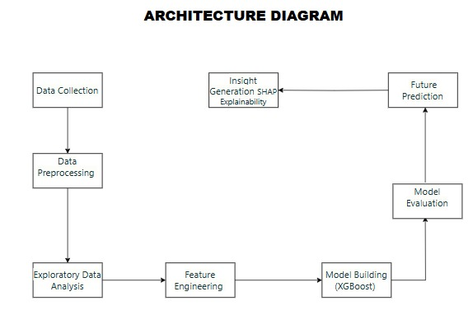
Proposed Methodology

Slide 5
Module Description
Data Collection:
Gathering food wastage dataset with global metrics
Data Preprocessing:
Cleaning, handling missing values, standardization
Exploratory Data Analysis:
Statistical analysis and visualization of patterns
Feature Engineering:
Creating temporal features for prediction

Slide 6

Model Building:
01
Implementing XGBoost regressor for multi-output prediction
02
Using metrics like R², MSE, and RMSE
03
Projecting food wastage trends for 20252030
04
Deriving actionable strategies and recommendations
05

Slide 7

Dataset
Dataset Overview:
Food Wastage Dataset containing metrics from 214 countries
Key Metrics:
Combined figures, household estimates, retail estimates, and food service estimates (all in kg/capita/year)
Shape:
214, 12 with no missing values
Goal:
Analyze patterns, build predictive models, and develop waste reduction strategies to support SDG 12

Slide 8
DATASET
Features:
Country, Region, Combined figures, Sector-specific estimates Household, Retail, Food Service), Confidence levels
Regional Coverage:
Includes data from Southern Asia, Sub-Saharan Africa, Northern Africa, and other global regions
Summary Statistics:
Global average household waste 84.29 kg/capita/year), retail waste 15.12 kg/capita/year), and food service waste 27.38 kg/capita/year)

Slide 9
DATASET
Data Distribution:
Shows significant variation in waste generation across regions
Combined waste figures range from 61 to 260 kg/capita/year
Strong relationship between household waste and overall waste generation

Slide 10

DATASET
Regional Analysis:
Visualization of waste patterns by region using bar plots, box plots, and violin plots
Sector Comparison:
Household waste represents largest proportion of total waste
Confidence Levels:
Dataset includes confidence metrics for reliability assessment

Slide 11
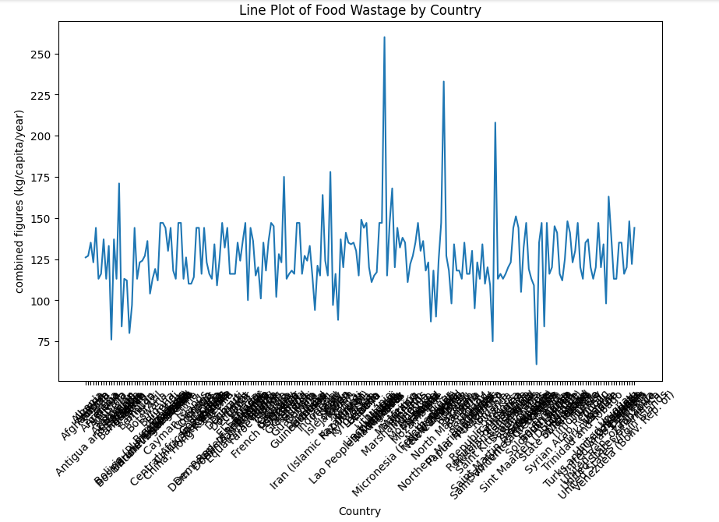
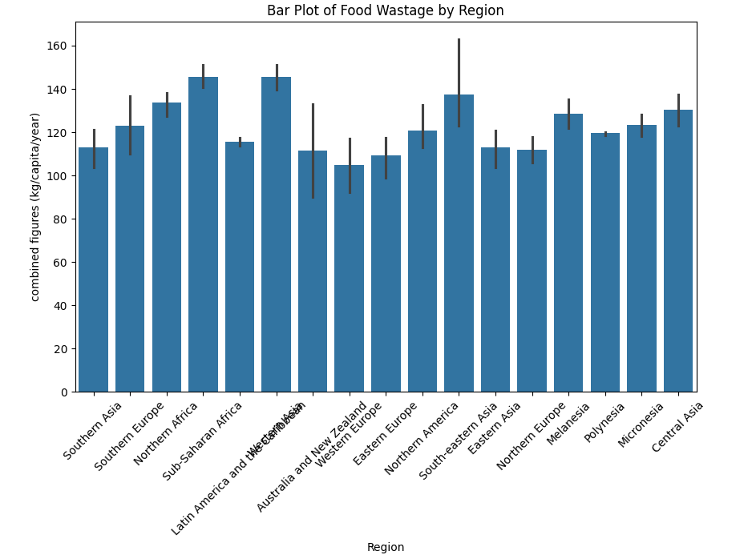
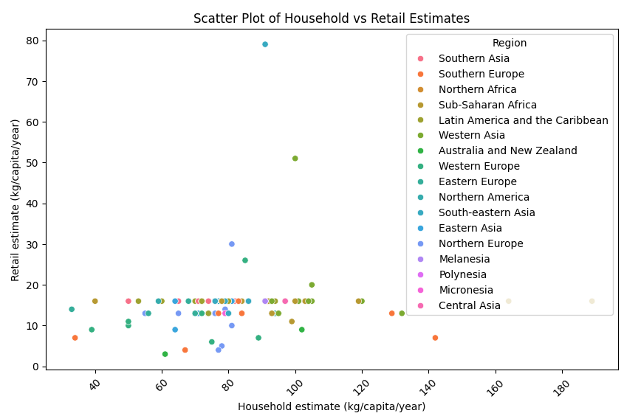
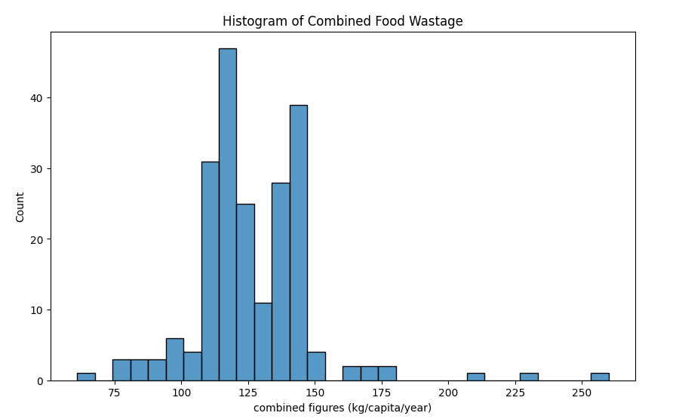
Data Exploration

Slide 12
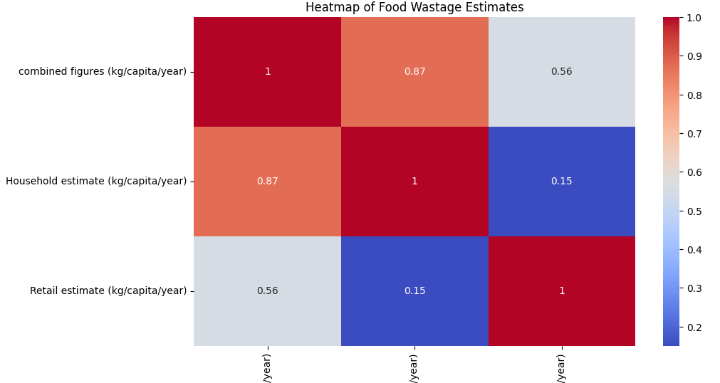
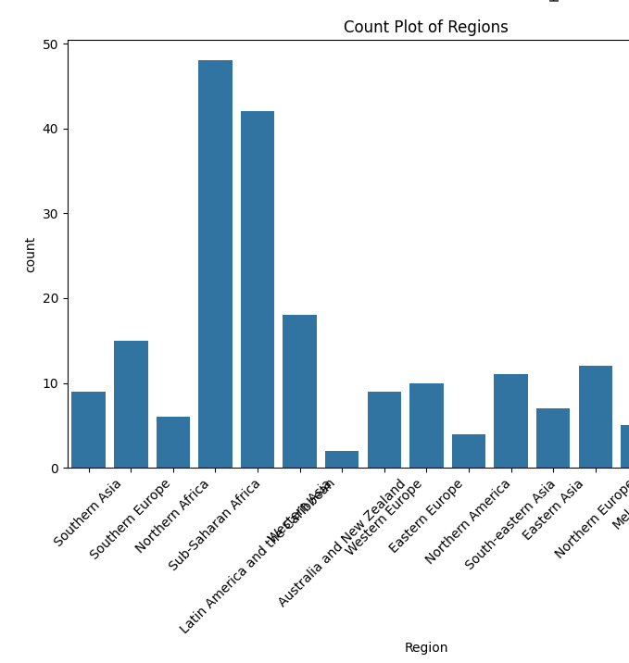
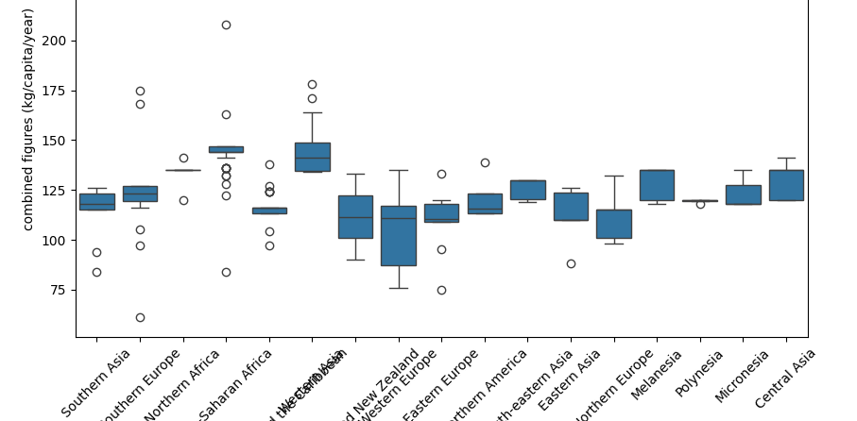

Slide 13
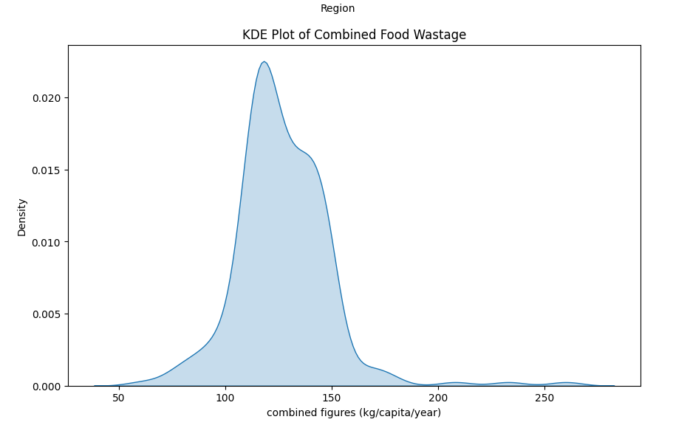
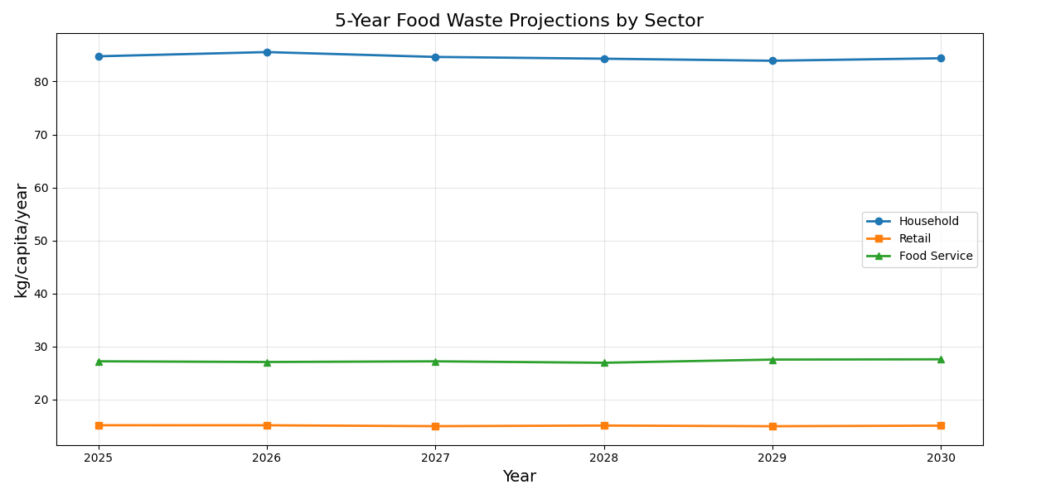
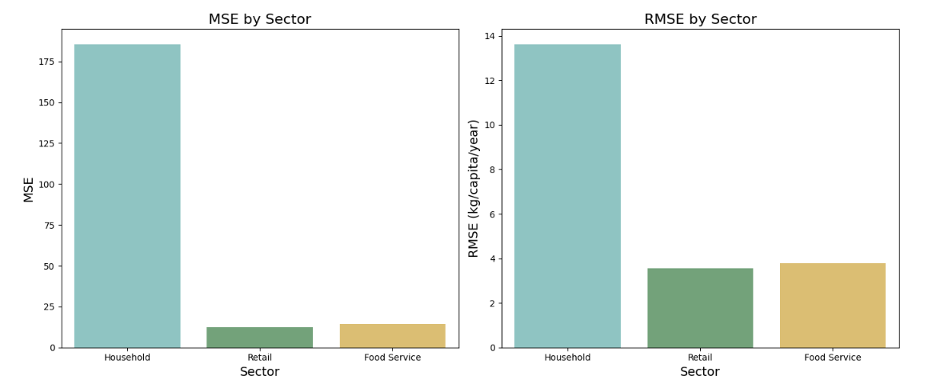
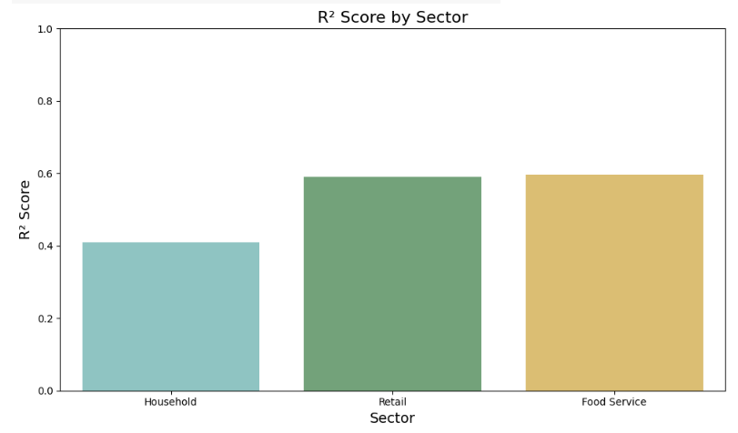

Slide 14
Model Performance
XGBoost regressor performance metrics:
Household Sector: R² = 0.41, RMSE 13.62 kg/capita/year
Retail Sector: R² = 0.59, RMSE 3.55 kg/capita/year
Food Service Sector: R² = 0.60, RMSE 3.79 kg/capita/year
Bar charts comparing R² scores, MSE, and RMSE across sectors

Slide 15
Future Projections
5-year food waste projections by sector 20252030
Predicted trends:
Household waste: 0.09% annual change
Retail waste: 0.10% annual change
Food service waste: 0.28% annual change 2
Line chart visualizing predicted waste generation over time

Slide 16
GitHub Repository
GitHub Repository: Food Waste Analysis Project
Link: https://github.com/GladwinDaniel/Exploratory-Data-Analytics-in-Food-Waste-Prediction
Jupyter Notebooks: Complete analysis including data processing, visualization, modeling
Link:
https://colab.research.google.com/drive/1jUfWBVDGJJP4Srb5MLvwu3z1rPJEWqQp?usp=sharing
Python libraries: pandas, numpy, matplotlib, seaborn, scikit-learn, XGBoost, SHAP
Dataset source and documentation

Slide 17
SHAP SHapley Additive exPlanations) analysis for model interpretability
Force plots showing feature importance for each prediction
Summary plots highlighting key variables influencing waste generation
Explainability insights for policy development
SHAP

Slide 18

Conclusion
Significant regional disparities in food wastage patterns
Household waste represents the largest proportion of overall food waste 84.29 kg/capita/year)
Model predictions show slight decrease in household 0.09%) and retail waste 0.10%) by 2030, but an increase in food service waste 0.28% annually)
Targeted interventions should focus on household waste reduction while monitoring growing food service sector
XGBoost model provides reliable predictions for future waste generation scenarios

Slide 19
References
Food Wastage Dataset. Kaggle
United Nations. 2015. Transforming our World: The 2030 Agenda for Sustainable Development.
United Nations Environment Programme UNEP. Food Waste Index Report.
World Resources Institute WRI . Reducing Food Loss and Waste: Setting a Global Action Agenda.
Gustavsson, J. 2011 . Global Food Losses and Food Waste: Extent, Causes, and Prevention.

