Slide 1
A Lightweight Hybrid CNN-Transformer Model for Smoke Removal in Laparoscopic Surgery Images
Developed by Mohammed Ashlab N (23MIA1081), Dinesh Kumar M (23MIA1102), and Srishreyan S (23MIA1088)
School of Computer Science and Engineering, Vellore Institute of Technology, Chennai

Slide 2
Motivation & Problem Statement
Motivation: The Obscured View
The Challenge: Real-time Desmoking
Minimally invasive laparoscopic surgeries are often hindered by surgical smoke.
Develop an image-based desmoking algorithm that removes smoke efficiently without introducing visual artifacts, suitable for real-time integration into surgical systems.
Smoke obscures anatomical structures, increasing risks to surgical accuracy and patient safety.
Current hardware-based smoke evacuation systems are costly and lack adaptability.

Slide 3








Paper Summary: Progressive Frequency-Aware Network (PFAN)
This work builds upon: "A Lightweight Hybrid CNN-Transformer Model for Smoke Removal in Laparoscopic Surgery Images"
Novel Architecture
GAN Framework
PFAN combines CNNs (local texture) and Vision Transformers (global context) for comprehensive image restoration.
Operates within a Generative Adversarial Network (GAN) framework to enhance realism and image quality.
Superior Performance
Lightweight Design
Achieves high scores in PSNR, SSIM, and CIEDE2000, indicating excellent image reconstruction.
With approximately 629K parameters, PFAN is ideal for embedded medical devices and real-time applications.
Comparative Performance Overview:
Model
PSNR (dB)
SSIM
CIEDE2000
Parameters (K)
Pix2Pix
20.12
0.78
15.23
3000
CycleGAN
21.56
0.81
13.89
5000
DCP
18.90
0.75
16.50
N/A
PFAN
27.95
0.85
10.12
629

Slide 4
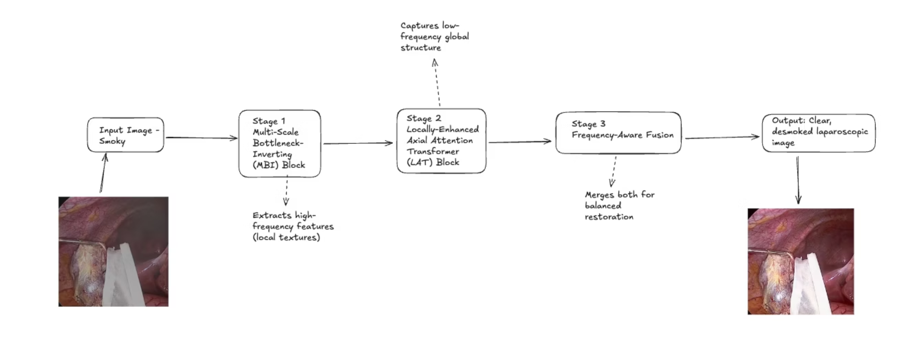
Methodology Flow Diagram: Deconstructing PFAN
The Progressive Frequency-Aware Network (PFAN) processes smoke-affected images through a multi-stage architecture.

Slide 5


Experimental Setup & Training Details
Dataset: Cholec80 Surgical Videos
Source: Cholec80 surgical dataset (80 unique surgeries).
Selection: 660 frames were specifically chosen for synthetic smoke generation.
Smoke Synthesis: Realistic smoke effects were generated using advanced Blender Volumetric Rendering.
Splits: Data was divided into 80% for training, 10% for validation, and 10% for testing.
Training Parameters & Environment
Framework: Developed and trained using PyTorch with CUDA acceleration.
Hardware: Utilized an NVIDIA H200 Tensor Core GPU for efficient computation.
Batch Size: Training was performed with a batch size of 6.
Optimizer: The Adam optimizer was used with a learning rate (LR) of 2×10⁻⁴.
Epochs: The model was rigorously trained for 200 epochs to ensure convergence and performance.

Slide 6
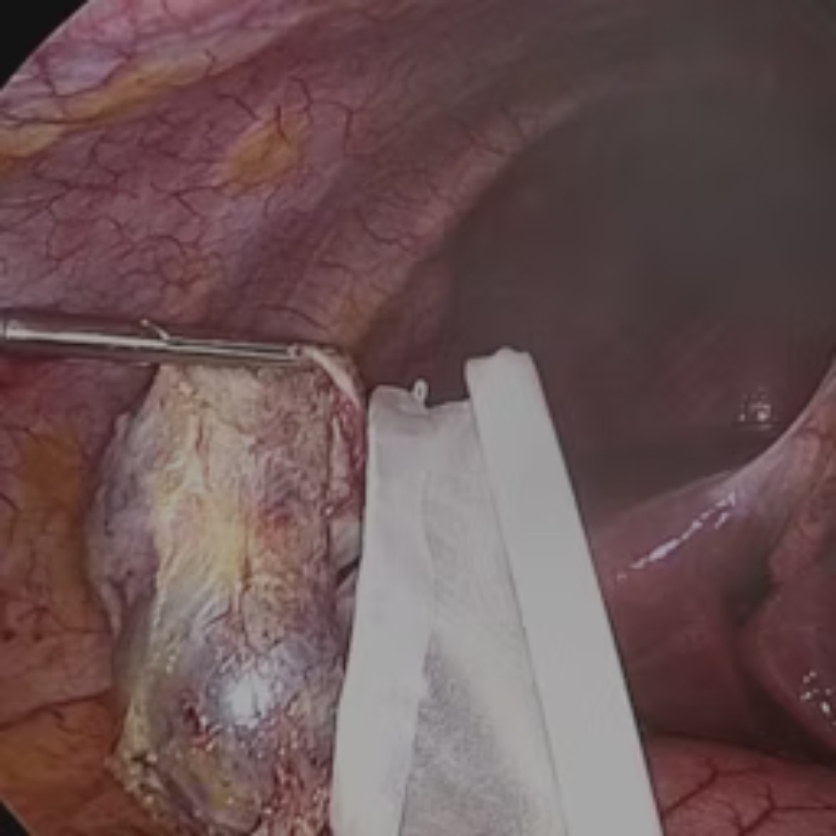
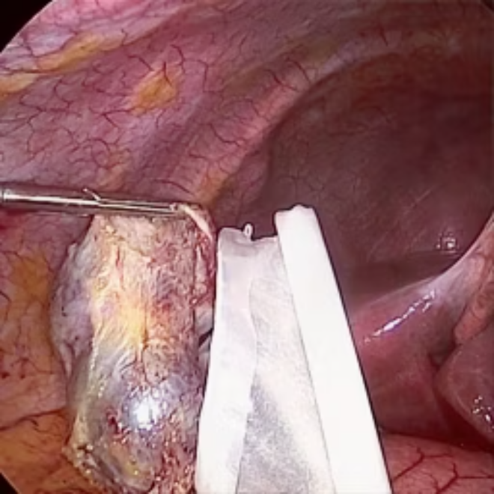
Results: Quantitative Metrics and Visual Observations
Quantitative Performance
Visual Observations
PFAN demonstrates robust performance across key image quality metrics.
The model exhibits stable convergence during training, avoiding oscillations.
Achieves excellent structural preservation, maintaining fine details.
Metric
Value / Trend
Interpretation
Successfully balances realism and clarity in desmoked images.
PSNR
~27.95 dB
High reconstruction quality and fidelity to original image.
SSIM
0.22 – 0.25
Moderate to good structural preservation.
MSE
Stable (~104)
Consistent numeric accuracy with minimal error.
Before vs. After: Visual Desmoking Performance

Slide 7
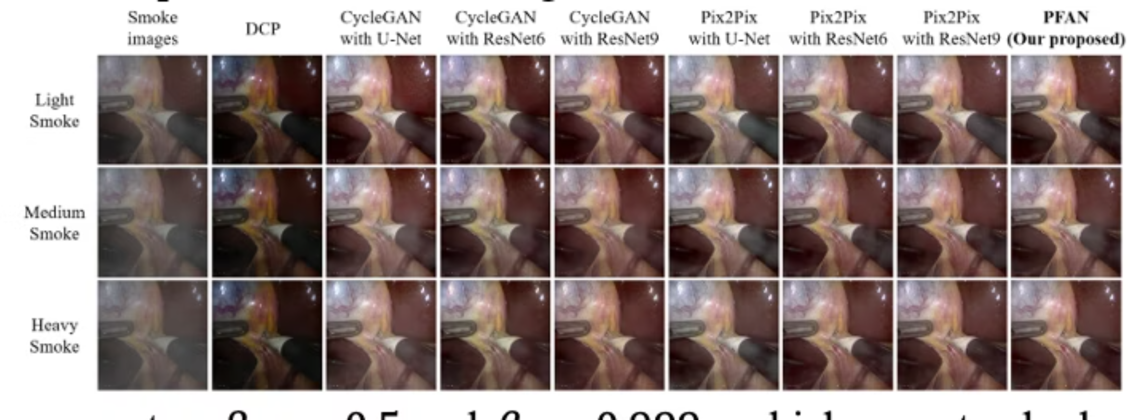

Slide 8
Key Findings: Unlocking Clarity in Surgery
Effective Smoke Removal
Robust Training Stability
Real-time Compatibility
PFAN successfully eliminates surgical smoke while meticulously preserving crucial anatomical structures.
Demonstrated stable GAN training with no signs of overfitting, ensuring reliable performance.
Its lightweight design (~629K parameters) makes it highly suitable for real-time surgical systems.
Hybrid Feature Integration
Benchmark Superiority
Efficiently combines both frequency-domain and spatial features for superior image restoration.
Achieves superior performance metrics compared to existing GAN and CNN baselines.

Slide 9


Future Enhancements: Advancing Surgical Vision
Perceptual Loss Integration
Incorporate perceptual or feature-level loss functions to achieve even higher texture fidelity and visual realism.
Temporal Consistency for Video
Extend PFAN to ensure seamless temporal consistency across video frames, critical for dynamic surgical environments.
Enhanced Synthetic Realism
Improve synthetic smoke generation using advanced physics-based modeling for more realistic training data.
Hardware Optimization
Optimize the model for real-time deployment and inference on specialized surgical hardware.

Slide 10

Conclusion: A Clearer Vision for Laparoscopic Surgery
We have successfully implemented and validated the Progressive Frequency-Aware Network (PFAN) for effective smoke removal in laparoscopic surgery images.
Proven Effectiveness
Innovative Hybrid Approach
Foundation for AI-Assisted Systems
PFAN delivers consistent and high-quality desmoking results on synthetic surgical datasets.
Our approach bridges deep learning with frequency-domain analysis, setting a new standard for image restoration.
This research provides a promising direction for developing advanced AI-assisted medical vision systems.

Slide 11

References:
This presentation draws upon foundational research in generative adversarial networks, vision transformers, and medical image processing.
Goodfellow et al., "Generative Adversarial Networks," NIPS, 2020.
Dosovitskiy et al., "An Image is Worth 16x16 Words: Transformers for Image Recognition at Scale," ICLR, 2020.
Bolkar et al., "Deep Smoke Removal from Minimally Invasive Surgery Videos," ICIP, 2018.
He et al., "Single Image Haze Removal Using Dark Channel Prior," CVPR, 2009.

