Slide 1
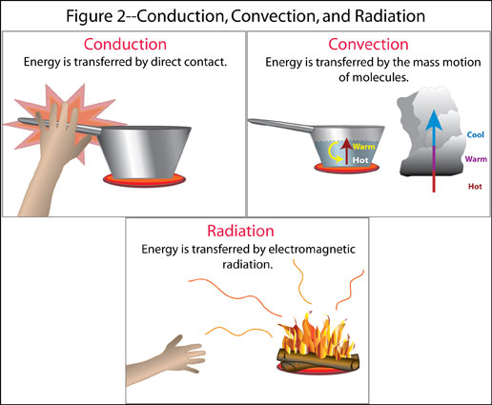
HEAT TRANSFER

Slide 2
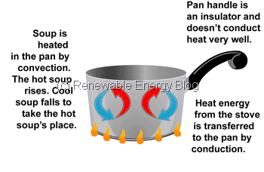
Thermal energy transfer is heat moving from a warmer object to a cooler object.

Slide 3
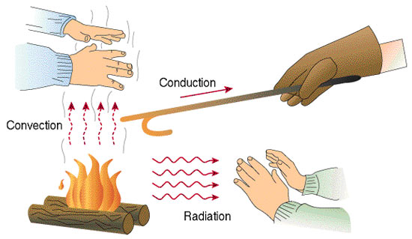
How is Heat Transferred?
There are THREE ways heat can move.
  Conduction
  Convection
  Radiation

Slide 4
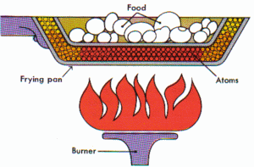
CONDUCTION
Heat is transferred from one particle of matter to another in an object.
Conduction = CONTACT

Slide 5
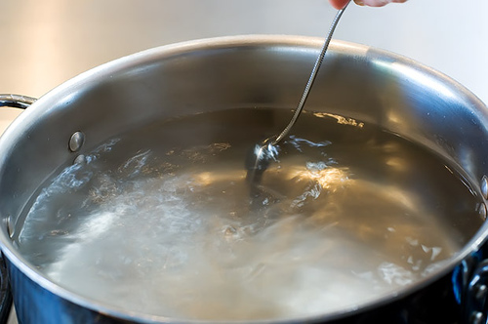
Have you ever…
Touched a metal spoon sitting in a pan of boiling water only to be surprised by HOW hot it is?
What conducts heat better, metal or nonmetal? Why?

Slide 6
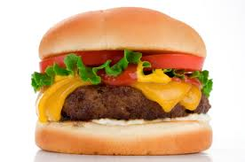
EXAMPLE OF CONDUCTION
A piece of cheese melts as heat is transferred from the meat to the cheese (Contact)

Slide 7
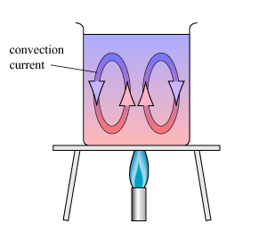
CONVECTION
Convection is the movement that transfers heat within fluids
  Fluids = anything that flows
Heat is transferred by currents within the fluid or gas

Slide 8
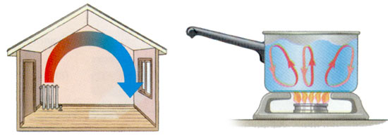
Examples of Convection:
Have you ever noticed that the air on the second floor of your house is warmer than the first floor? Or that water in a pool is cooler at the deep end?
Notes:
When the water at the bottom of a pot is heated, its particles move faster, and they also move farther apart. As a result, the heated water becomes less dense. A less dense fluid will float on top of a more dense one. Therefore, the heated water rises in the pot. The surrounding cooler water flows into its place.
This flow creates the circular motion as seen on the next page, which is known as convection currents.

Slide 9
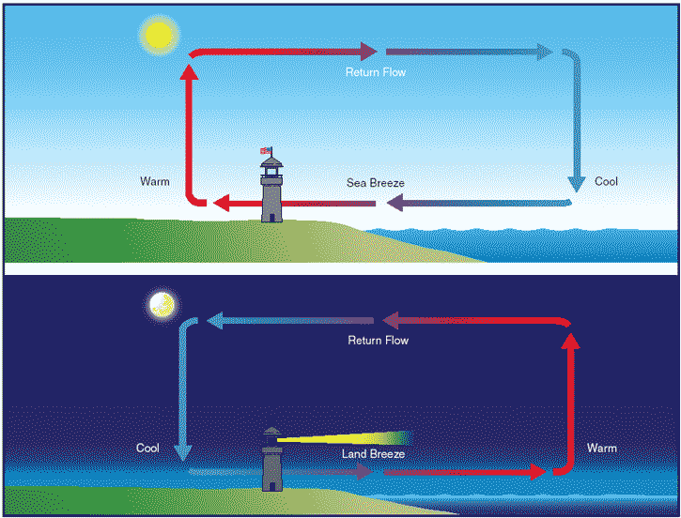
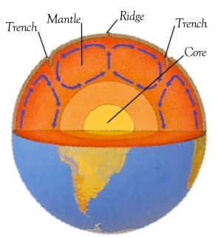
Examples of Convection
Convection currents cause the cooler breezes you experience by a large body of water.
These currents also cause the movement of magma within the earth.

Slide 10

RADIATION
Radiation is the transfer of energy by waves
  What type of waves?
    ELECTROMAGNETIC
Radiation does NOT require matter to transfer thermal energy

Slide 11
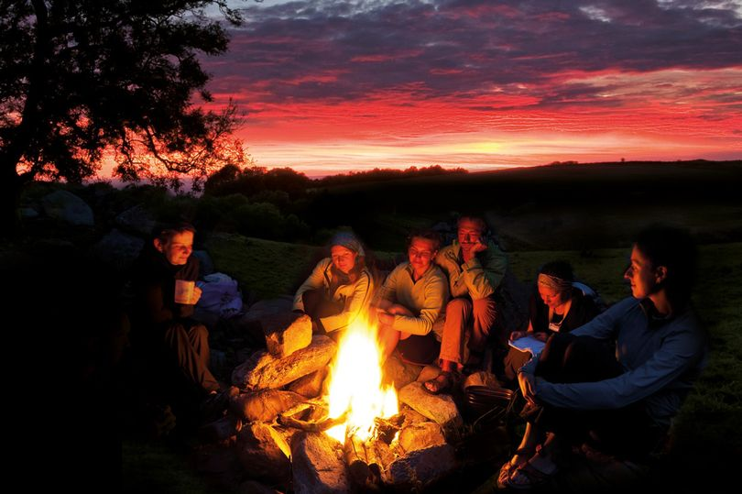
Radiation May Come From Other Sources
Have you ever sat too close to a campfire? You’re enjoying the warmth ….. only to notice that your skin is really warm?

Slide 12
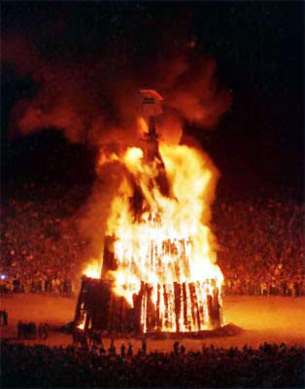
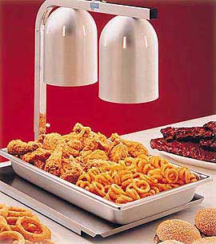
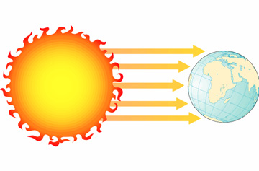
Examples of RADIATION
Fire
Heat Lamps
Sun

Slide 13
As a group come up with two ideas/inventions where conduction, convection or radiation can be used to make society better.
  Does not have to be real, but must be realistic!
  Be able to explain how this type of heat transfer works and makes society better.

