Slide 1
Explain the relationship between a eukaryotic cell and its external environment.
Remember that a eukaryotic cell is one which has membrane bound organelles. There is a distinct nucleus.
Prokaryotic cells are those which do not have distinct membrane bound organelles. This group includes the bacteria.

Slide 2
Explain the relationship between a eukaryotic cell and its external environment.
Eukaryotic cells are affected by a range of biotic and abiotic factors in the environment.
Task - List 5 abiotic and 5 biotic factors which affect the survival of a eukaryotic cell.
Notes:
Text p23, 274-8, 279
Resource Book p156, 163

Slide 3
Explain the relationship between a eukaryotic cell and its external environment.
Abiotic Factors
  Temperature
  Moisture
  Salinity
  pH
  Light
Notes:
Text p23, 274-8, 279
Resource Book p156

Slide 4
Explain the relationship between a eukaryotic cell and its external environment.
Biotic Factors
  Predators
  Parasites
  Vectors
  Foreign Antigens
  Reactions between other cells
Notes:
Text p23, 274-8, 279
Resource Book p156

Slide 5
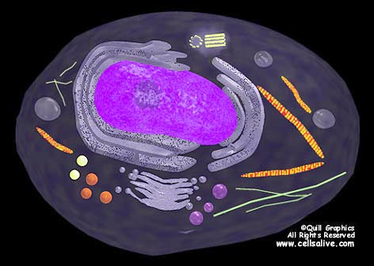
Animal Cell
Notes:
Text p84, 266, 277, 274, 275
Resource Book p162

Slide 6
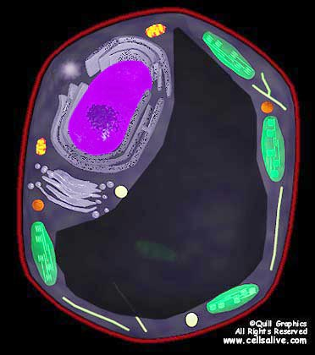
Plant Cell
Notes:
Text p266, 277, 274-6, 275
Resource Book p162, p172

Slide 7
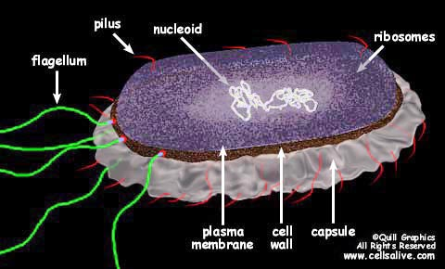
Bacteria Cell
Notes:
Text Book p35, 39-46
Resource Book p168

Slide 8
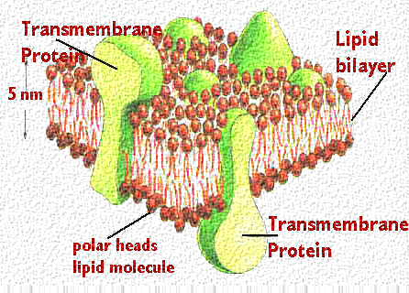
Cell Membrane
The function of the cell membrane is to control the movement of substances into and out of the cell. It is involved in all of the processes of diffusion, osmosis and active transport.
Notes:
Text Book p266-268, 269-73
Resource Book p164, 166, 178

Slide 9
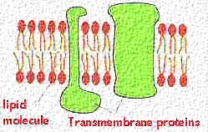
Cell Membrane
The cell membrane is made up of a bi-phospholipid layer. Each unit is hydophillic (water loving) at one end and hydrophobic (water hating) at the other end. The cell membrane also has identifying proteins known as antigens embedded in its outer surface.
Notes:
Text Book p266-268, 269-73
Resource Book p164, 166, 178

Slide 10
Cell Wall
Cells walls are found only in plant cells. They surround the cell membrane and are made of cellulose (complex carbohydrate). The cell wall is important in maintaining the turgidity of plant cells.
Notes:
Text Book p265, 276, 289
Resource Book p164

Slide 11
Nucleus
The nucleus of the cell contains all of the DNA (Deoxyribonucleic Acid) of a cell. This controls the inheritance of the cell. From DNA, mRNA is made in the process known as transcription. This mRNA then leaves the nucleus and is involved in the process of protein sysnthesis in the ribosomes (translation).
Notes:
Text Book p274, 283, 284, 506, 508-9
Resource Book p164

Slide 12
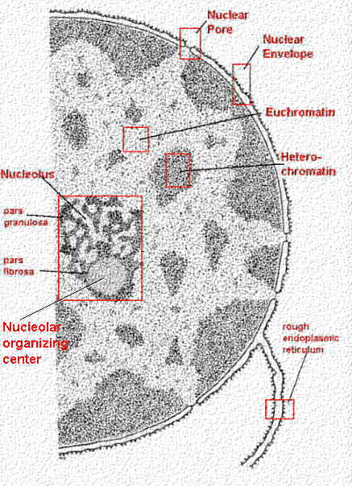
Nucleus
Notes:
Text Book p274, 283, 284, 506, 508-9
Resource Book p164

Slide 13
Nuclear Membrane
The nuclear membrane, like the cell membrane, is a bi-phospholipid layer. It surrounds the nucleus and controls the movement of substances into and out of the nucleus. The membrane is punctuated by nuclear pores which allow the passage of larger molecules such as mRNA.
Notes:
Resource Book p164

Slide 14
Vacuoles
Vacuoles are large membrane bound ‘water sacks’ found in cells. They are much larger in plant cells than animal cells.
In plant cells the vacuoles controls the degree of turgidity in the cell.
Notes:
Text Book p68, 276

Slide 15
Chloroplasts
Chloroplast cells are only found in photosynthetic plant cells. They are the organelle in which the light energy from the sun is converted into chemical energy, in the form of glucose.
Notice that the internal structure of the chloroplasts is made up of numerous membranes in the thylakoids. This increases the surface area available for chemical reactions.
Notes:
Text Book – p66, 514, 300
Resource Book p165

Slide 16
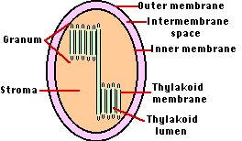
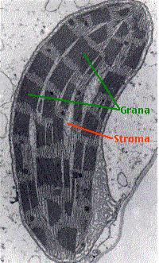
Chloroplasts
Notes:
Text Book – p66, 514, 300
Resource Book p165

Slide 17
Ribosomes
Ribosomes are found on the external surface of the endoplasmic reticulum. They are primarily involved in the the translation of information, contained in mRNA, to polypeptide sequences, which are made up of amino acids. These polypeptide chains are then combined to form proteins for use in the cell and other parts of the body.
Notes:
Text Book p276, 283, 284, 506-7, 511
Resource Book p165

Slide 18
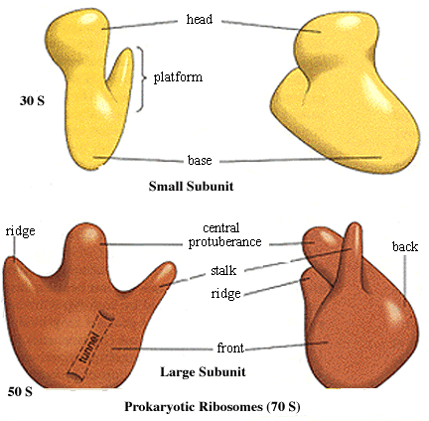
Ribosomes
Notes:
Text Book p276, 283, 284, 506-7, 511
Resource Book p165

Slide 19
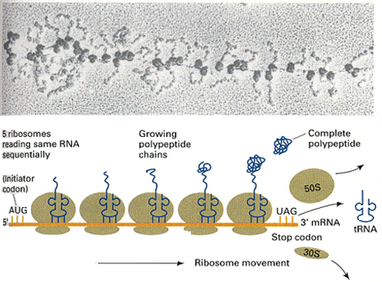
Ribosomes
Notes:
Text Book p276, 283, 284, 506-7, 511
Resource Book p165

Slide 20
Endoplasmic Reticulum
The endoplasmic reticulum in a cell provides transport channels for the movement of mRNA from the nucleus to the ribosomes.
Rough endoplasmic reticulum is so named because of the large number of ribosomes on the outside surface. Smooth endoplasmic reticulum does not have these ribosomes.
Notes:
Text Book p276
Resource Book p165

Slide 21
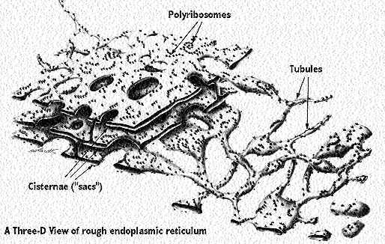
Endoplasmic Reticulum
Notes:
Text Book p276
Resource Book p165

Slide 22
Mitochondria
The mitochondria are commonly known as the power packs of the cell. They are found in both plant and animal cells and are found in greater numbers in cells which have a larger requirement for energy.
The process which takes place in the mitochondria is knows as Respiration and involves the breakdown of glucose to CO₂, H₂O and ATP (Adenosine Triphosphate).
Notes:
Text book p276
Resource Book p165, 194, 196

Slide 23
Mitochondria
The equation for Respiration is:
C₆H₁₂O₆ + 6O₂ → 6CO₂ + 6H₂O
It is important to note that some aspects of the process of respiration take place in the mitochondria while other aspects take place in the cytoplasm.
Please note the large number of folds in the internal membranes of the mitochondria which provide increased surface area for the respiration reactions to take place.
Notes:
Text book p276
Resource Book p165, 194, 196

Slide 24
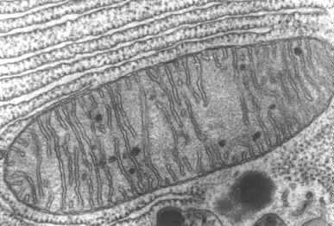
Mitochondria
Notes:
Text book p276
Resource Book p165, 194, 196

Slide 25
Golgi Bodies
Golgi bodies can be regarded as the ‘packaging’ centres of the cell. They are made up of a number of folded membranes arranged as stacks of bags or sacks.
Substances produced in the cell, such as proteins which are required by other cells, are packaged in membranes and transported to the cell membrane where they undergo a process of exocytosis when the contents are expelled from the cell.
Notes:
Text Book p276
Resource Book p165

Slide 26
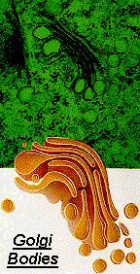
Golgi Bodies
Notes:
Text Book p276
Resource Book p165

Slide 27
Centrioles
The centrioles are an important component of the cell for mitosis. They are responsible for the production of spindle fibres.
Spindle fibres connect to the centromeres of chromosomes and then shorten. This draws the chromosomes to the poles of the cell in preparation for the division of the parent cell into two daughter cells.
Notes:
Text Book p276, 285
Resource Book p165

Slide 28
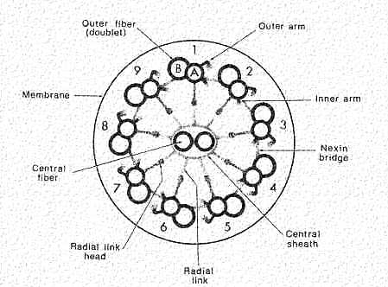
Cilia and Flagella
Flagella are single whip-like projections from a cell which aid in motility.
Cilia can either be responsible for motility or they may be responsible for the movement of substances around the cell.
Notes:
Text Book p40, 52, 53, 277

Slide 29
Cell Structure and Function
What is the name given to the structure of a cell membrane?
Biphospholipid Layer.

Slide 30
Cell Structure and Function
What is the name of the process in which DNA is copied to form mRNA? Why does this process occur?
Transcription. This process occurs so that the original copy of genetic information is not removed from the nucleus. The mRNA represents a copy of the information required for particular proteins to be produced in the ribosomes.

Slide 31
Cell Structure and Function
How do the vacuole and cell wall work together in the functioning of plant cells?
Both the cell wall and vacuole are involved in maintaining the turgidity (water pressure) of plant cells.

Slide 32
Cell Structure and Function
What is the name of the process which takes place in the ribosomes of cells and why is it important for the functioning of cells?
Translation. This is the process whereby information carried on mRNA is read by tRNA. This information is then used to control the sequence of amino acids which are combined to produce polypeptides and ultimately proteins.

Slide 33
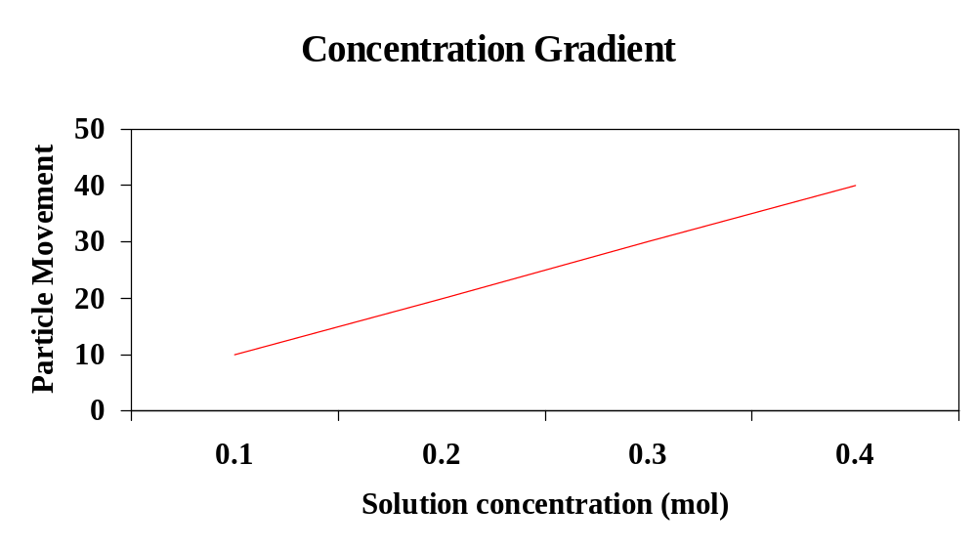
Concentration Gradients
Movement with the concentration gradient
Movement against the concentration gradient

Slide 34
Concentration Gradients
These play a major role in may biological processes, so it is important that you understand how they work.
A concentration gradient occurs when a substance is present in a higher concentration in one place compared with another place.
This imbalance causes the particles to spread out from the high concentration to the low concentration. This is called going with, or along the concentration gradient.
Osmosis, diffusion and facilitated diffusion all move substances with the concentration gradient, and do not use energy to do so. This is called passive transport.
Active transport, like endo- and exocytosis, moves substances against the concentration gradient. These processes require energy

Slide 35
Diffusion
Diffusion is the movement of any dissolved substance or gas from an area of relatively high concentration to an area of relatively low concentration.
This occurs because of the natural movement of particles known as Brownian Motion.
Rates of diffusion are affected by the concentration gradient and temperature particularly.
Diffusion is a form of passive transport.
Notes:
Text Book p270, 335
Resource Book p186

Slide 36
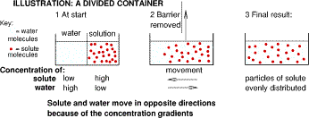
Diffusion
Notes:
Text Book p270, 335
Resource Book p186

Slide 37
Osmosis
Osmosis is the movement of water, through a semi-permeable membrane, from an area of relatively low concentration of solute to an area of relatively high concentration of solute.
It can also be said that water moves through a semipermeable membrane from the hypotonic solution to the hypertonic solution.
Osmosis is a passive form of transport.
Notes:
Text Book p271-2
Resource Book p186

Slide 38
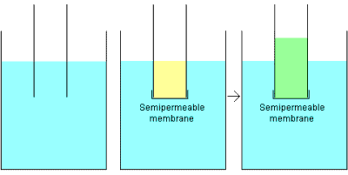
Osmosis
On the left is a beaker filled with water, and a tube has been half-submerged in the water. As you would expect, the water level in the tube is the same as the water level in the beaker. In the middle figure, the end of the tube has been sealed with a "semipermeable membrane" and the tube has been half-filled with a salty solution and submerged. Initially, the level of the salt solution and the water are equal, but over time, something unexpected happens -- the water in the tube actually rises. The rise is attributed to "osmotic pressure.“
Notes:
Text Book p271-2
Resource Book p186

Slide 39
Active Transport
This is the movement of solutes against the concentration gradient. That is, solutes move from an area of relatively low concentration of solution to an area of relatively high concentration of solution.
The important thing to remember is that energy is used to facilitate solutes moving against the concentration gradient.
Active transport requires energy from ATP
Notes:
Text Book p273
Resource Book p188, 190, 191

Slide 40
The Movement of Substances
What is the difference between active and passive transport?
Passive transport is the movement of solutes or solvents which does not rely on the use of energy.
Active transport is the movement of solutes or solvents against the concentration gradient and which relies on the use of energy.

Slide 41
The Movement of Substances
Give a definition of Diffusion.
Diffusion is the movement of any dissolved substance from an area of relatively high concentration to an area of relatively low concentration.

Slide 42
The Movement of Substances
Give a definition of Osmosis
Osmosis is the movement of water, through a semi-permeable membrane, from an area of relatively low concentration or solute to an area of relatively high concentration of solute.

Slide 43
The Movement of Substances
Give a definition of Active Transport
This is the movement of solutes against the concentration gradient. That is, solutes move from an area of relatively low concentration of solution to an area of relatively high concentration of solution.

Slide 44
Endocytosis
This refers to any process in which solids or liquids are actively (using energy) engulfed or absorbed into a cell. The following are forms of endocytosis:
  Pinocytosis is the active movement of liquids into a cell.
  Phagocytosis is the active movement of solids into a cell. This is most often associated with amoeba which form psuedopods. These projects of the cell membrane ultimately surround and engulf solid particles.
Notes:
Text Book p273
Resource Book p191

Slide 45
Exocytosis
This refers to any process in which solids or liquids are actively expelled from a cell. The action of Golgi bodies is an example of exocytosis.
Notes:
Text Book p273
Resource Book p191

Slide 46
The Structure of DNA
This is Deoxyribonucleic acid.
It is a substance which is responsible for the inheritance of information about the characteristics of a cell.
DNA is indirectly (through mRNA and tRNA) translated to provide information on the sequence of amino acids, which form proteins.
Notes:
Text Book p10, 255, 266, 502-503, 504-505, 505-512, 256
Resource Book p204, 206, 218, 222

Slide 47
The Structure of DNA
DNA is primarily formed into a double helix which is thought to be the most efficient means of ‘packing’ large amount of information.
The double helix is made up of two strands of sugar and phosphate molecules connected periodically by pairs of nitrogenous bases.
This is then twisted to form the double helix.
The base pair rule states that the following nitrogenous bases will only ever pair with each other:
  Adenine and Thymine
  Guanine and Cytosine
Notes:
Text Book p10, 255, 266, 502-503, 504-505, 505-512, 256
Resource Book p204, 206, 218, 222

Slide 48
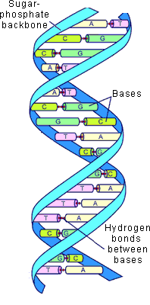
The Structure of DNA
Notes:
Text Book p10, 255, 266, 502-503, 504-505, 505-512, 256
Resource Book p204, 206, 218, 222

Slide 49
Mitosis
Mitosis is the normal division of somatic cells to produce daughter cells which are identical to the original parent cell.
Cells produced via mitosis are diploid (2n).
The function of mitosis is to produce normal body cells for growth and maintenance in organisms.
Notes:
Text Book p9, 67, 285-6, 426, 432
Resource Book p226, 227

Slide 50
The stages of Mitosis
The stages of mitosis, in order, are:
    Interphase – The stage in which DNA begins to condense and form chromosomes.
    Prophase – The stage in which chromosomes are formed and lined up along the equator of the cell.
    Metaphase – Chromosomes are lined up along the equator of the cell, centrioles have formed and spindle fibres have joined to the centromeres of the chromosomes.
    Anaphase – Spindle fibres begin to contract and chromosomes begin to move the the poles of the cell.
    Telophase – Chromosomes are now at the poles of the cell and cytokinesis has begun.
Notes:
Text Book p9, 67, 285-6, 426, 432
Resource Book p226, 227

Slide 51
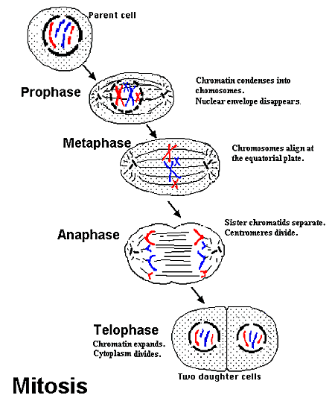
The Stages of Mitosis
Notes:
Text Book p9, 67, 285-6, 426, 432
Resource Book p226, 227

Slide 52
Transcription
This is the process whereby the information carried on the DNA in the nucleus is copied to form mRNA. This mRNA then leaves the nucleus and travels through the endoplasmic reticulum to be involved in the process of protein synthesis.
Notes:
Text Book p283, 284, 506, 508-9
Resource Book p218, 222

Slide 53
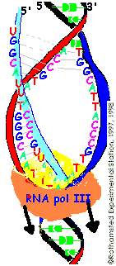
Transcription
As you can see from this diagram, RNA polymerase moves along the DNA strand and ‘unzips’ the two complimentary strands (red and dark blue). Following the base pair rule, new nucleotide bases are then assembled in order to form a strand of mRNA (light blue).
Notes:
Text Book p283, 284, 506, 508-9
Resource Book p218, 222

Slide 54
Translation
Translation (also known as protein synthesis) is the process whereby the genetic information carried on mRNA is used to determine the sequence of amino acids in polypeptide chains.
The information on the mRNA strand is read in codons (groups of three nucleotide bases) by tRNA. Each tRNA codes for a particular amino acid.
These polypeptide chains are then combined to produce proteins.
Notes:
Text Book p283, 284, 506-9
Resource Book p220, 221, 223, 224

Slide 55
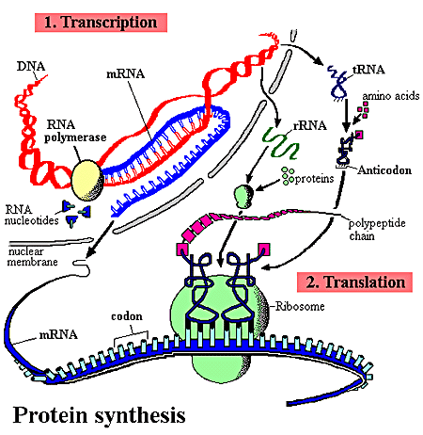
Translation
Notes:
Text Book p283, 284, 506-9
Resource Book p220, 221, 223, 224

Slide 56
DNA and RNA
Why is the process of translation so important to maintaining the integrity of genetic information in the nucleus?
The process of translation allows the cell to make copies of the information carried on strands of DNA in the nucleus. This information is copied onto strands of mRNA which are then involved in the process of protein synthesis in ribosomes. By making copies of the genetic information carried on DNA:
  The genetic information on DNA never leaves the nucleus
  Damage to DNA is reduced
  Only required sections of DNA are copied to form mRNA

Slide 57
DNA and RNA
What is the difference between a codon, anti-codons and triplets?
A triplet refers to a sequence of three nucleotide bases on a strand of DNA.
A codon refers to a sequence of three nucleotide bases on a strand of mRNA.
An anti-codon refers to the sequence of nucleotide bases found on each molecule of tRNA.

Slide 58
DNA and RNA
Each molecule of tRNA is unique to an amino acid. What does this mean?
Each molecule of tRNA codes for a particular amino acid so that each codon section of mRNA matches with a particular anti-codon sequence on the tRNA. Each tRNA has a different anti-codon sequence. As a particular anti-codon sequence bonds with a codon on the mRNA, a particular amino acid in turn bonds with the tRNA and is combined with other amino acids to form a polypeptide chain.

Slide 59
Enzymes
An enzyme is an organic catalyst which speeds up the rate of a reaction without being changed itself.
Reactions can either be anabolic (build up chemicals) or catabolic (break down chemicals)
Enzymes are specific to particular reactions.
It is important to note that enzymes speed up the rate of reactions which would ordinarily occur.
Notes:
Text Book p8, 247, 248, 259-62, 260-1
Resource Book p180, 182, 183

Slide 60
The Lock and Key Model
This model suggests that the shape of the enzyme molecule matches with the substrate molecules.
Each enzyme is said to have an active site which facilitates a bonding of substrate molecules (anabolic) or the breaking of a chemical bond in a molecule to form two smaller molecules (catabolic).
Notes:
Text Book p8, 247, 248, 259-62, 260-1
Resource Book p180, 182, 183

Slide 61
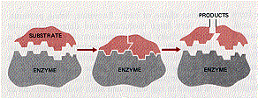
The Lock and Key Model
Notes:
Text Book p8, 247, 248, 259-62, 260-1
Resource Book p180, 182, 183

Slide 62
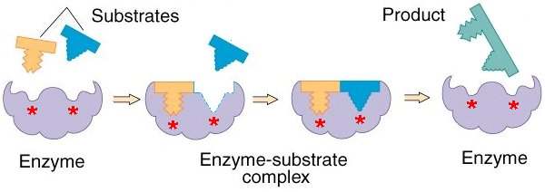
The Induced Fit Model
This has replaced the lock and key model
It is similar in that it relies on the shape of the substrate and enzyme, but is different because it says that the enzyme active site is not rigid, but flexible

Slide 63
Factors affecting Enzyme Action
There are a number of factors which affect Enzyme Action. These are:
Temperature
pH
Enzyme Concentration
Substrate Concentration
Inhibitor Molecules
Notes:
Text Book p8, 247, 248, 259-62, 260-1
Resource Book p180, 182, 183

Slide 64
Effect of temperature
If the temperature in which an enzyme works is too low then there is reduced kinetic energy at the molecular level. This leads to reduced Brownian Motion and as a consequence lower levels of enzyme-substrate reaction.
If the temperature is too high then there is a risk of denaturing the enzymes. This changes their shape and therefore renders them useless as catalysts to specific reactions.
Notes:
Text Book p8, 247, 248, 259-62, 260-1
Resource Book p180, 182, 183

Slide 65
Effect of pH
The pH of an environment also affects the efficiency of enzymes and the rate of reactions.
This is specifically related to the number of H⁺ and OH⁻ ions in the environment. These ions have the effect of varying the bonding patterns in enzyme molecules and therefore changing their shape.
Notes:
Text Book p8, 247, 248, 259-62, 260-1
Resource Book p180, 182, 183

Slide 66
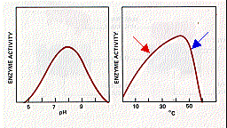
Temperature and pH
Notes:
Text Book p8, 247, 248, 259-62, 260-1
Resource Book p180, 182, 183

Slide 67
Inhibition of Enzyme Action
In some cases other chemicals can affect the action of enzymes. These enzymes may be ‘pollutants’ in the system or they may be inhibitors designed to control the action of enzymes in a feedback system.
The inhibitors can either block the active site on an enzyme (competitive) or bond with the enzyme to change its overall shape (non-competitive).
Notes:
Text Book p8, 247, 248, 259-62, 260-1
Resource Book p180, 182, 183

Slide 68
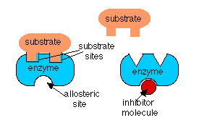
Coenzymes
These are chemicals, which may or may not be proteins which are needed to ‘complete’ the shape of an enzyme. These coenzymes can provide control of the rate of reaction.
Notes:
Text Book p8, 247, 248, 259-62, 260-1
Resource Book p180, 182, 183

Slide 69
Respiration
As mentioned earlier, respiration is the process whereby energy from glucose is converted into ATP for use in various chemical reactions within the cell.
Aerobic respiration occurs in the presence of oxygen and involves the complete breakdown of glucose into ATP, carbon dioxide and water. Anaerobic respiration is the incomplete breakdown of glucose in the absence of oxygen. This results in the production of lactic acid and carbon dioxide in animals, and ethanol in plants and fungi
Less ATP is produced in anaerobic respiration.
Notes:
Text Book p8, 280-3, 304-5, 326, 346
Resource Book p196

Slide 70
Respiration
The process of aerobic respiration yields 34-36 molecules of ATP.
The process of anaerobic respiration yields only 2 molecules of ATP.
Further, lactic acid causes the contraction of muscle fibres and is an inefficient system. It cannot be maintained by the cells indefinitely
Aerobic respiration occurs in the mitochondria while anaerobic respiration occurs in the cytoplasm of cells.
Notes:
Text Book p8, 280-3, 304-5, 326, 346
Resource Book p196

Slide 71
Photosynthesis
Photosynthesis is the process whereby light energy is fixed, via chlorophyll, into chemical energy, in the form of glucose.
The chemical equation for photosynthesis is:
6CO₂ + 6H₂O → C₆H₁₂O₆ + 6O₂ (this occurs in the presence of chlorophyll and sunlight)
Notes:
Text Book p7, 27, 66, 298-9, 305, 279, 301, 302-4
Resource Book p198, 200, 201

Slide 72
Photosynthesis
There are two phases to photosynthesis.
One is light dependent photosynthesis. This occurs when light is available and primarily fixes light energy into a chemical form as electron transfer molecules. This occurs in the grana of the chloroplast
The light independent phase of photosynthesis uses the energy stored in electron transfer molecules (produced during light dependent photosynthesis) to produce glucose. This occurs in the stroma of the chloroplast.

Slide 73
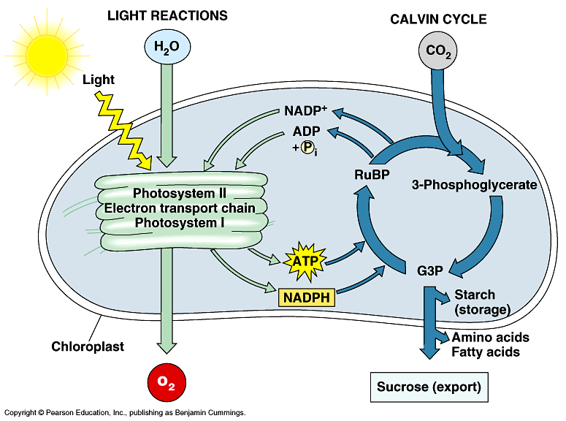
Photosynthesis

