Slide 1


Chemical Bonds

Slide 2
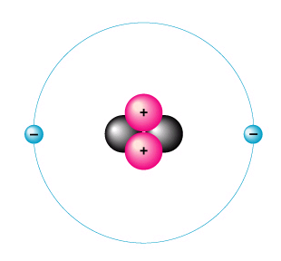
Atom – the smallest unit of matter “indivisible”
Helium
atom

Slide 3
electron shells
Atomic number = number of Electrons
Electrons vary in the amount of energy they possess, and they occur at certain energy levels or electron shells.
Electron shells determine how an atom behaves when it encounters other atoms

Slide 4
Electrons are placed in shells according to rules:
The 1st shell can hold up to two electrons, and each shell thereafter can hold up to 8 electrons.

Slide 5
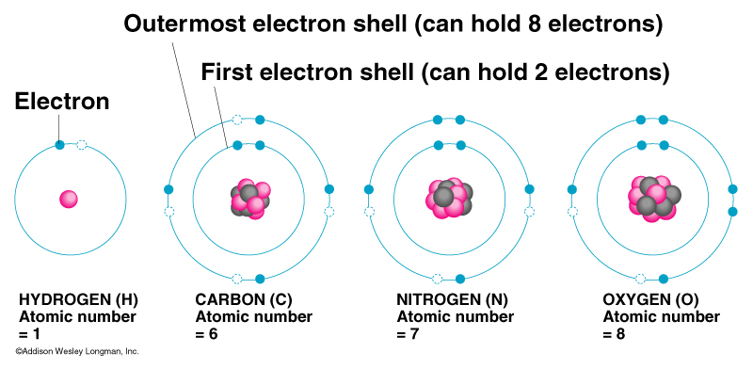
Octet Rule = atoms tend to gain, lose or share electrons so as to have 8 electrons
C would like to
N would like to
O would like to
Gain 4 electrons
Gain 3 electrons
Gain 2 electrons

Slide 6
Why are electrons important?
Elements have different electron configurations
  different electron configurations mean different levels of bonding

Slide 7
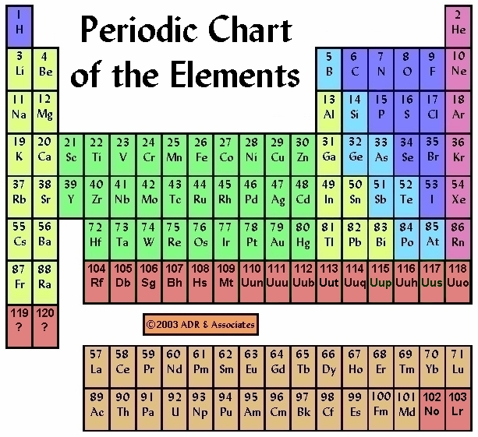

Slide 8
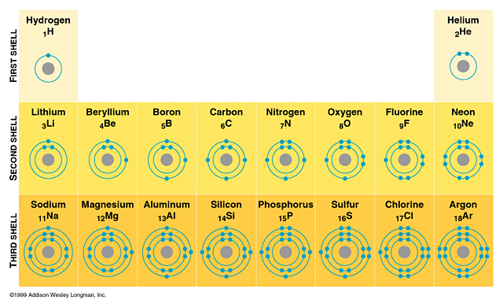

Slide 9
Electron Dot Structures
Symbols of atoms with dots to represent the valence-shell electrons
1 2 13 14 15 16 17 18
H• He:
• • • • • • • • • • •
Li• Be• • B • • C • • N • • O • : F • :Ne :
• • • • • • • •
• • • • • • • • • • •
Na• Mg• • Al• • Si • •P• •S• :Cl • :Ar :
• • • • • • • •

Slide 10
Chemical bonds: an attempt to fill electron shells
Ionic bonds –
Covalent bonds –
Metallic bonds

Slide 11
Learning Check
●
A. X would be the electron dot formula for
1) Na 2) K 3) Al
● 
B.  X  would be the electron dot formula
●
1) B 2) N 3) P

Slide 12
IONIC BOND bond formed between two ions by the transfer of electrons

Slide 13
Formation of Ions from Metals
Ionic compounds result when metals react with nonmetals
Metals lose electrons to match the number of valence electrons of their nearest noble gas
Positive ions form when the number of electrons are less than the number of protons
Group 1 metals ⎯→ ion ¹⁺
Group 2 metals ⎯→ ion ²⁺
Group 13 metals ⎯→ ion ³⁺

Slide 14
Formation of Sodium Ion
Sodium atom Sodium ion
Na • – e⁻ ⎯⎯→ Na ⁺
2-8-1 2-8 ( = Ne)
11 p⁺ 11 p⁺
11 e⁻ 10 e⁻
0 1⁺

Slide 15
Formation of Magnesium Ion
Magnesium atom Magnesium ion
•
Mg • – 2e⁻ ⎯→ Mg²⁺
2-8-2 2-8 (=Ne)
12 p⁺ 12 p⁺
12 e- 10 e⁻
0 2⁺

Slide 16
Some Typical Ions with Positive Charges (Cations)
Group 1 Group 2 Group 13
H⁺ Mg²⁺ Al³⁺
Li⁺ Ca²⁺
Na⁺ Sr²⁺
K⁺ Ba²⁺

Slide 17
Learning Check
A. Number of valence electrons in aluminum
1) 1 e⁻ 2) 2 e⁻ 3) 3 e⁻
B. Change in electrons for octet
1) lose 3e⁻ 2) gain 3 e⁻ 3) gain 5 e⁻
C. Ionic charge of aluminum
1) 3- 2) 5- 3) 3⁺

Slide 18
Solution
A. Number of valence electrons in aluminum
3) 3 e⁻
B. Change in electrons for octet
1) lose 3e⁻
C. Ionic charge of aluminum
3) 3⁺

Slide 19
Learning Check
Give the ionic charge for each of the following:
A. 12 p⁺ and 10 e⁻
1) 0 2) 2+ 3) 2-
B. 50p⁺ and 46 e-
1) 2+ 2) 4+ 3) 4-
C. 15 p⁺ and 18e-
2) 3+ 2) 3- 3) 5-

Slide 20
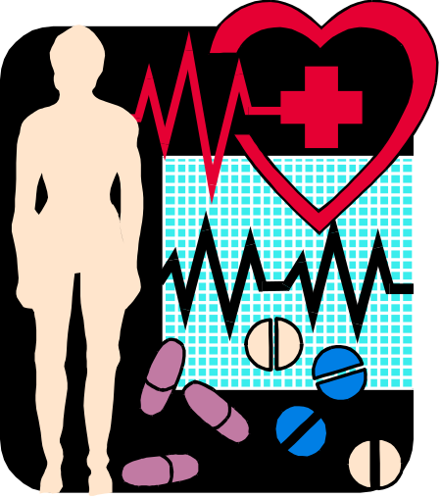
Ions from Nonmetal Ions
In ionic compounds, nonmetals in 15, 16, and 17 gain electrons from metals
Nonmetal add electrons to achieve the octet arrangement
Nonmetal ionic charge:
3-, 2-, or 1-

Slide 21
Fluoride Ion
unpaired electron octet
• • • • 1 -
: F • + e⁻ : F :
• • • •
2-7 2-8 (= Ne)
9 p+ 9 p⁺
9 e- 10 e-
0 1 -
ionic charge

Slide 22
Ionic Bond
Between atoms of metals and nonmetals with very different electronegativity
Bond formed by transfer of electrons
Produce charged ions all states. Conductors and have high melting point.
Examples; NaCl, CaCl₂, K₂O

Slide 23
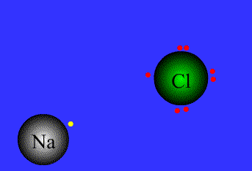

Slide 24
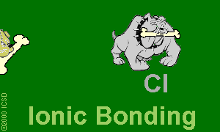
Ionic Bonds: One Big Greedy Thief Dog!

Slide 25
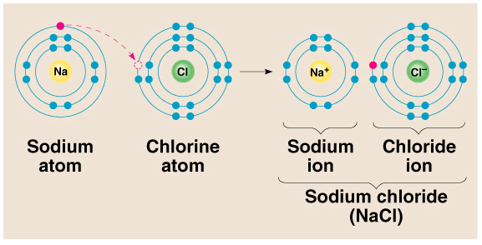
1). Ionic bond – electron from Na is transferred to Cl, this causes a charge imbalance in each atom. The Na becomes (Na+) and the Cl becomes (Cl-), charged particles or ions.

Slide 26
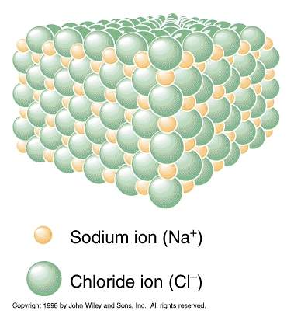
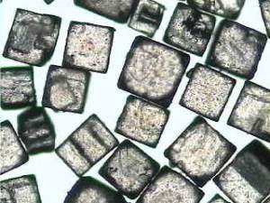

Slide 27
COVALENT BOND bond formed by the sharing of electrons

Slide 28
Covalent Bond
Between nonmetallic elements of similar electronegativity.
Formed by sharing electron pairs
Stable non-ionizing particles, they are not conductors at any state
Examples; O₂, CO₂, C₂H₆, H₂O, SiC

Slide 29
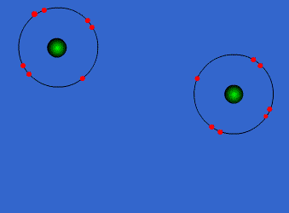
Covalent Bonds

Slide 30
Bonds in all the polyatomic ions and diatomics are all covalent bonds

Slide 31
when electrons are shared equally
NONPOLAR
COVALENT BONDS
H₂ or Cl₂

Slide 32
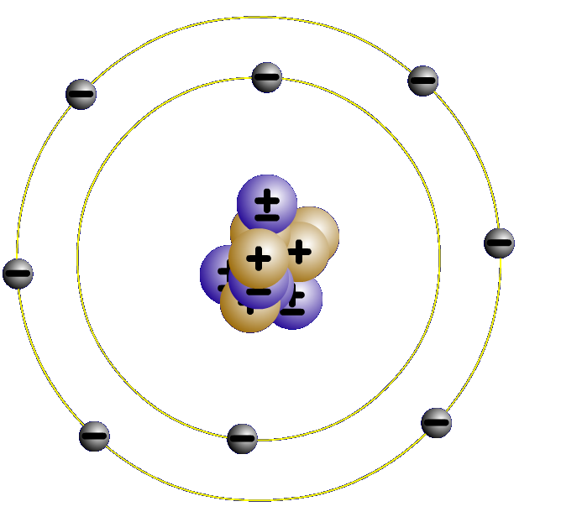
2. Covalent bonds- Two atoms share one or more pairs of outer-shell electrons.
Oxygen Atom
Oxygen Atom
Oxygen Molecule (O₂₎

Slide 33
when electrons are shared but shared unequally
POLAR COVALENT BONDS
H₂O

Slide 34
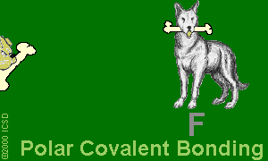
Polar Covalent Bonds: Unevenly matched, but willing to share.

Slide 35
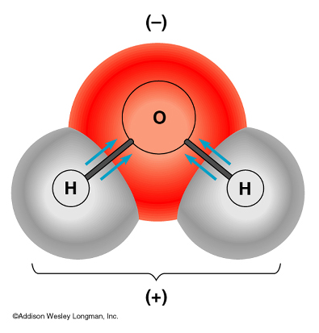
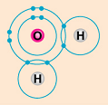
- water is a polar molecule because oxygen is more electronegative than hydrogen, and therefore electrons are pulled closer to oxygen.

Slide 36
METALLIC BOND bond found in metals; holds metal atoms together very strongly

Slide 37
Metallic Bond
Formed between atoms of metallic elements
Electron cloud around atoms
Good conductors at all states, lustrous, very high melting points
Examples; Na, Fe, Al, Au, Co

Slide 38

Metallic Bonds: Mellow dogs with plenty of bones to go around.

Slide 39
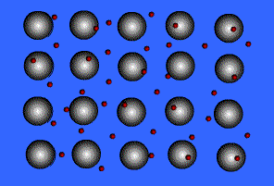
Ionic Bond, A Sea of Electrons

Slide 40

Metals Form Alloys
Metals do not combine with metals. They form
Alloys which is a solution of a metal in a metal.
Examples are steel, brass, bronze and pewter.

Slide 41
Formula Weights
Formula weight is the sum of the atomic masses.
Example- CO₂
Mass, C + O + O
      12.011 + 15.994 + 15.994
      43.999

Slide 42
Practice
Compute the mass of the following compounds round to nearest tenth & state type of bond:
NaCl;
23 + 35 = 58; Ionic Bond
C₂H₆;
24 + 6 = 30; Covalent Bond
Na(CO₃)₂;
23 + 2(12 + 3x16) = 123; Ionic & Covalent

Slide 43



