Slide 1
Avogadro’s number and the Mole
6,022,100,000,000,000,000,000,000 uses for a mole

Slide 2
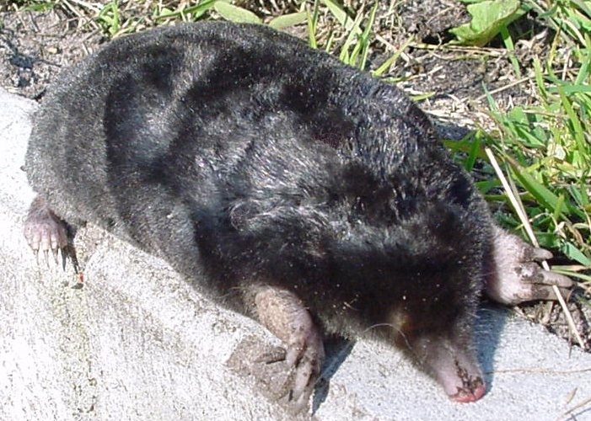
What is a Mole?
A Mole is a burrowing rodent
A mole is a blemish on the skin - sometimes dangerous!
A Mole is a VERY large number of atoms or molecules

Slide 3
Atomic mass
Hydrogen
Helium
Carbon
Mass = 1
Mass = 4
Mass = 12
Proton
Neutron
Electron
} Nucleons

Slide 4
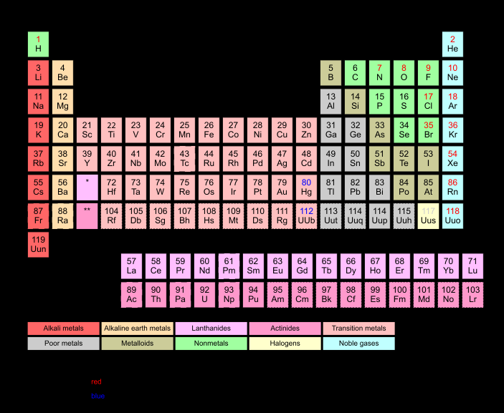

Slide 5
How many atoms?
There are as many atoms in 1gram of hydrogen as there are in 12grams of carbon (graphite) or 56grams of iron.
The actual number of atoms is known as Avogadro’s number
A mole is a substance’s atomic or molecular mass - weighed out in grams!

Slide 6
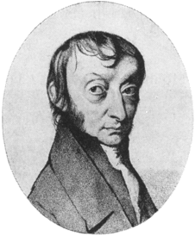
Avagodro’s Number
This is the actual number of atoms or molecules in a mole:-
602210000000000000000000 is far too difficult to write
6.0221 x 10²³ is the same number expressed in scientific notation.
Avogadro 1776-1856

