Slide 1
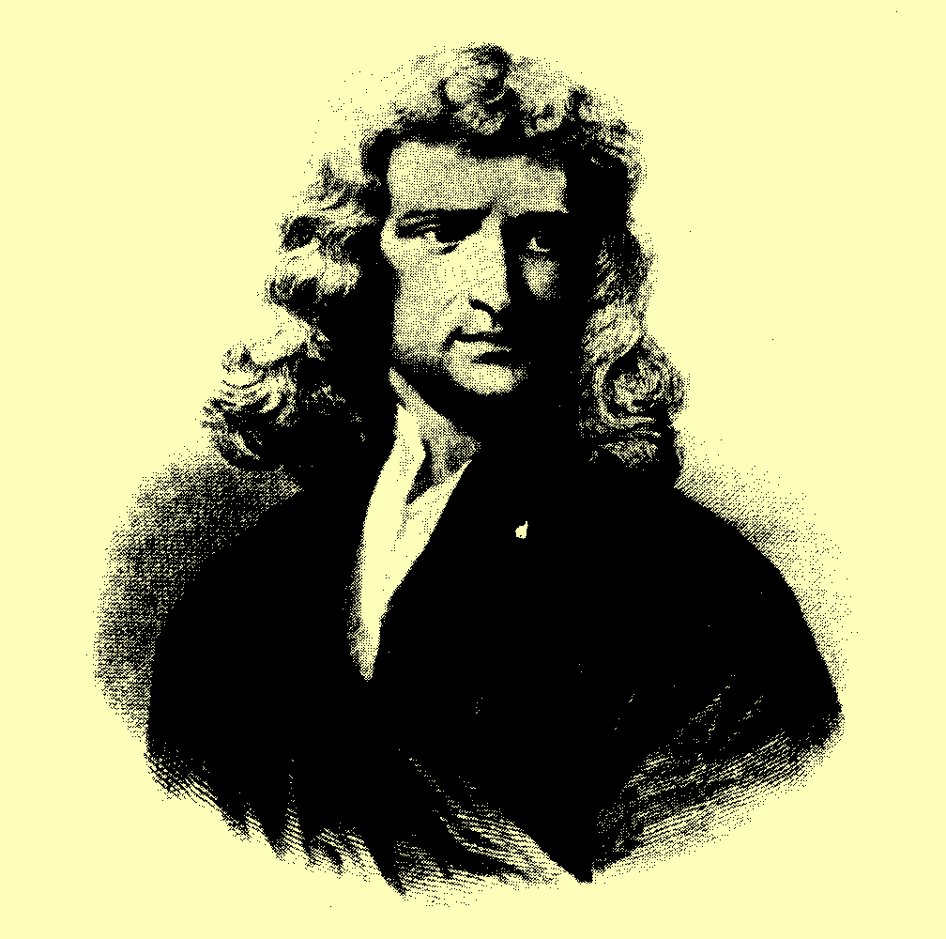

S I R I S A A C N E WTON
(1647 - 1727)

Slide 2


WHEN FORCES ARE NOT BALANCED
A RESULTANT FORCE CHANGES A BODY’S VELOCITY

Slide 3
NEWTON’S SECOND LAW :
“THE RATE OF CHANGE OF MOMENTUM OF A BODY IS DIRECTLY PROPORTIONAL TO THE RESULTANT EXTERNAL FORCES ACTING UPON IT, AND TAKES PLACE IN THE DIRECTION OF THAT FORCE”

Slide 4

FORCE
7
FORCE
7
FORCE
7
FORCE
7
A RESULTANT FORCE PRODUCES A CHANGE
IN A BODY’S MOMENTUM
A RESULTANT FORCE AN ACCELERATION

Slide 5
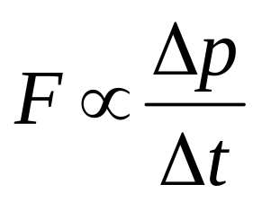
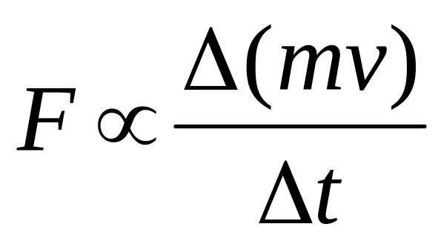
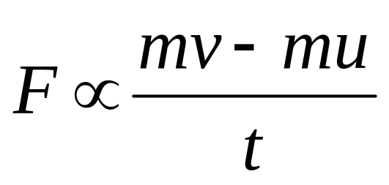
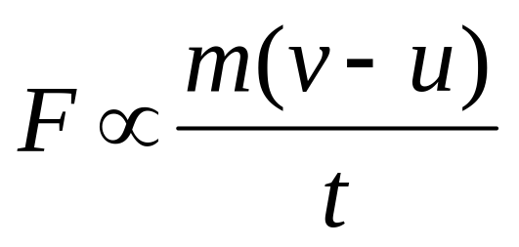
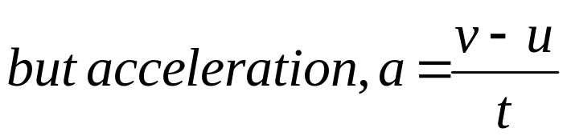

NEWTON 2
If u = initial velocity, v = final velocity and t = time for the change, then
F ma
F = k ma

Slide 6
F = k ma
OUR UNIT OF FORCE, THE NEWTON,
IS DEFINED SO THAT k = 1
ONE NEWTON IS THE FORCE THAT CAUSES A MASS OF 1 kg TO ACCELERATE AT 1 m/s²
F=kma so 1 = k x 1 x 1
so k = 1
F = m a

Slide 7
NEWTON’S SECOND LAW
u n i t s
F in Newtons
m in kilograms
a in metres per second²

Slide 8
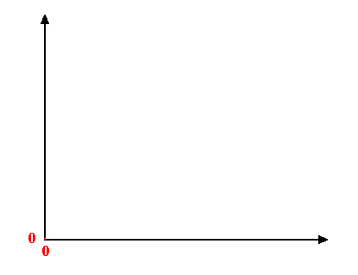
ACCELERATION IS DIRECTLY PROPORTIONAL TO THE APPLIED FORCE
acceleration / ms⁻²
force / N
N.B. - STRAIGHT LINE THROUGH THE ORIGIN

Slide 9
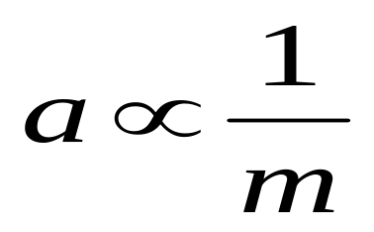
GRAPH OF ACCELERATION VERSUS MASS
acceleration / ms⁻²
mass / kg
F = m a

Slide 10
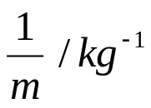
ACCELERATION IS INVERSELY PROPORTIONAL TO MASS OF THE BODY
acceleration / ms⁻²
N.B. - STRAIGHT LINE THROUGH THE ORIGIN

Slide 11

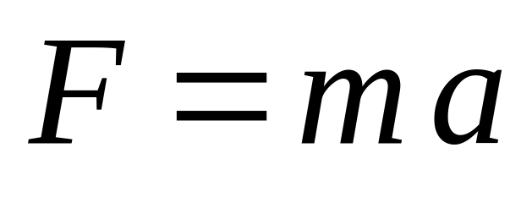
NEWTON’S SECOND LAW IS USED IN TWO FORMS
Where F is the RESULTANT FORCE

Slide 12
QUESTION
A railway engine pulls a wagon of mass 10 tonnes along a level track at a constant velocity. The pull force in the couplings between the engine and wagon is 1000 N.
(A) What is the force opposing the motion of the wagon?
(B) If the pull force is increased to 1400 N and the resistance to movement of the wagon remains constant, what would be the acceleration of the wagon?
The speed is steady, so by Newton’s first law, the resultant force must be zero. The pull on the wagon must equal the resistance to motion. Answer is 1000 N
The resultant force on the wagon is 1400 – 1000 = 400 N .
Acceleration = Force ÷ mass = 400 ÷ 10 000 = 0.04 ms⁻²

Slide 13

IMPULSE
IMPULSE = the product of a force and the time that the force is applied for.
UNITS = Newton seconds , Ns .
Ft = mv - mu
IMPULSE = CHANGE OF MOMENTUM

Slide 14
Force-Time Graphs
The force applied to a body is rarely constant. Physicists tend to consider the force as a function of time and plot a graph of Force versus Time.
force / N
Time / s
Impulse = Area under the graph
= Change in momentum

Slide 15

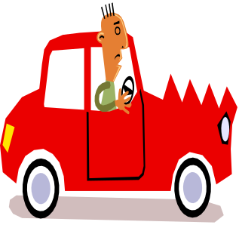
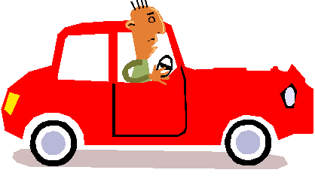
Collision B
Collision A
“I’ve just crashed into a brick wall!”
“I’ve just crashed into a haystack!”
BOTH CARS HAD THE SAME MASS AND WERE TRAVELLING AT THE SAME SPEED
force / N
B
A
Time / s
IDENTIFY WHICH COLLISIONS IS A AND WHICH IS B.
COMMENT ON THE INFORMATION PROVIDED BY THE TWO GRAPHS

