Slide 1
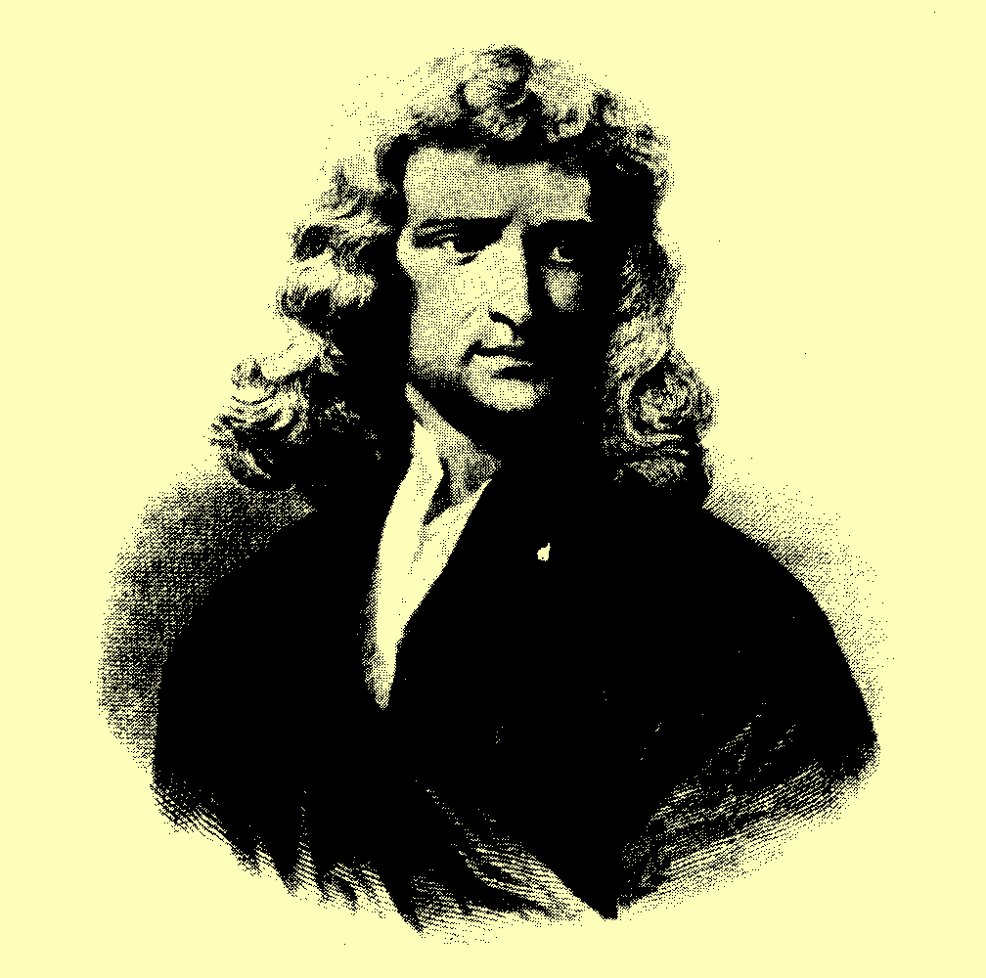
S I R I S A A C N E WTON
(1647 - 1727)

Slide 2


Slide 3
NEWTON’S THIRD LAW :
“ACTION AND REACTION ARE ALWAYS EQUAL AND OPPOSITE”
“IF A BODY A EXERTS A FORCE ON BODY B, THEN B EXERTS AN EQUAL AND OPPOSITELY DIRECTED FORCE ON A”

Slide 4


devishly
clever
I’LL PULL HIM
WELL ACTION AND REACTION ARE ALWAYS EQUAL AND OPPOSITE!!

Slide 5


ACTION AND REACTION ARE ALWAYS EQUAL AND OPPOSITE!!
WELL ACTION AND REACTION ARE ALWAYS EQUAL AND OPPOSITE!!
SO WHY DOES THE GIRL MOVE FASTER?

Slide 6
NEWTON’S THIRD LAW PAIRS
THEY ARE EQUAL IN MAGNITUDE
THEY ARE OPPOSITE IN DIRECTION
THEY ACT ON DIFFERENT BODIES

Slide 7
NEWTON’S THIRD LAW PAIRS
SIMILARITIES
DIFFERENCES
The 2 forces act for the same length of time
The 2 forces act on different bodies
The 2 forces are the same size
The 2 forces are in opposite directions
The 2 forces act along the same line
Both forces are of the same type

Slide 8
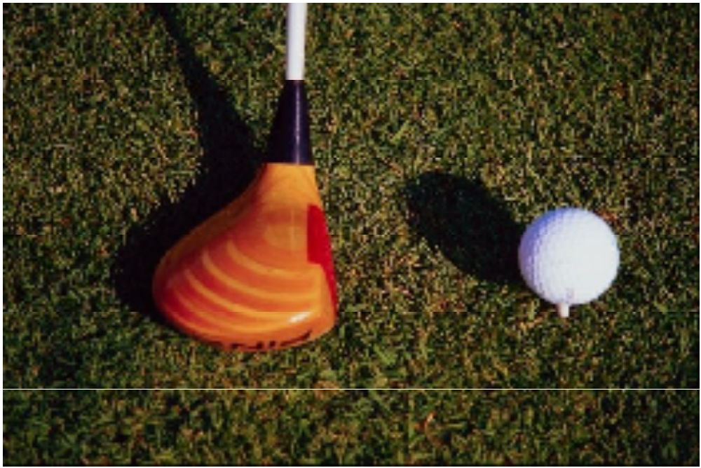
THE CLUB EXERTS A FORCE F ON THE BALL
THE BALL EXERTS A N EQUAL AND OPPOSITE FORCE F ON THE CLUB
F
F

Slide 9
Drawing Free-Body Diagrams
A free-body diagram singles out a body from its neighbours and shows the forces, including reactive forces acting on it.
Free-body diagrams are used to show the relative magnitude and direction of all forces acting upon an object in a given situation.
The size of an arrow in a free-body diagram is reflective of the magnitude of the force. The direction of the arrow reveals the direction in which the force is acting. Each force arrow in the diagram is labeled to indicate the exact type of force.

Slide 10
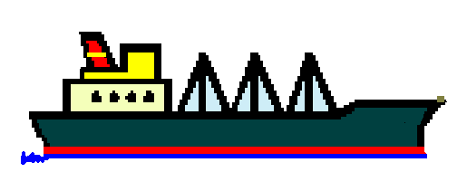
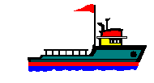
Tug assisting a ship
Free body diagram for the ship
Upthrust [buoyancy]
Thrust from engines
SHIP
Pull from tug
Friction
weight

Slide 11

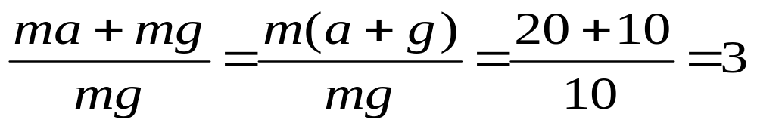
EXAMPLE 1 - A LIFT ACCELERATING UPWARDS
If g = 10 ms⁻², what “g force” does the passenger experience?
The forces experienced by the passenger are her weight, mg and the normal reaction force R.
R
The resultant upward force which gives her the same acceleration as the lift is R – mg.
a = 20 ms⁻²
Apply F = ma
R – mg = ma
Hence the forces she “feels”, R = ma + mg
mg
The “g force” is the ratio of this force to her weight.

Slide 12

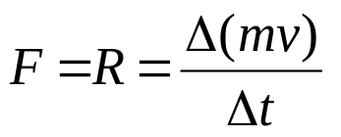
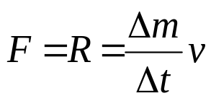
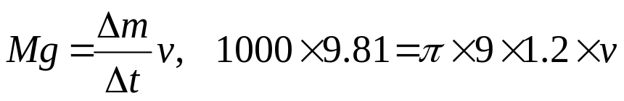
EXAMPLE 2 - A HOVERING HELICOPTER
A helicopter hovers and supports its weight of 1000 kg by imparting a downward velocity,v, to all the air below its rotors.
The rotors have a diameter of 6m. If the density of the air is 1.2 kg m⁻³ and g = 9.81 ms⁻¹, find a value for v.
The force produced in moving the air downwards has an equal and opposite reaction force, R, which supports the weight of the helicopter, Mg.
The force produced in moving the air downwards is given by:
R
but v is constant, so
Mg
v
Mass of air moved per second = π x 3² x 1.2 x v
3m
v = 18.1 m s⁻¹

