Slide 1


Slide 2
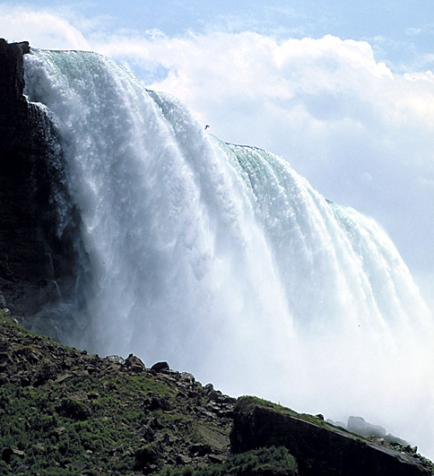

Slide 3


Slide 4


Slide 5


Slide 6


Slide 7

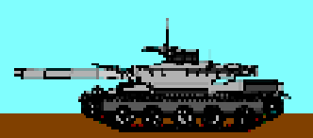

WORK
ENERGY
POWER

Slide 8
WORK IS DONE
WHEN ?
WHEN ?
WHEN ENERGY IS TRANSFORMED FROM ONE FORM TO ANOTHER

Slide 9
UNITS OF WORK & ENERGY ?
mJ
kJ
JOULES
MJ
GJ
Symbol
J

Slide 10
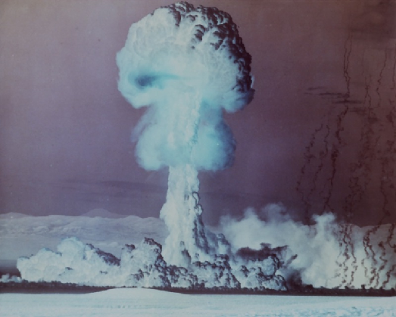




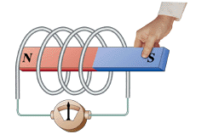

FORMS OF ENERGY
ELECTRICITY
&
MAGNETISM
Gravitational
Potential
HEAT
Chemical
Potential
Sound
LIGHT
Nuclear
kinetic
ENERGY IS A SCALAR

Slide 11
THE PRINCIPLE OF
CONSERVATION OF ENERGY
ENERGY CAN BE CHANGED FROM ONE FORM TO ANOTHER, BUT CAN NEVER BE DESTROYED

Slide 12
heat
heat
potential
chemical
electromagnetism
kinetic
sound
light

Slide 13




What energy changes occur here?

Slide 14
Work (W) is done when a force (F) moves its point of application
WORK DONE = FORCE X DISTANCE MOVED
W = F s
Force F
Force F
Distance s

Slide 15
W = F s . Cos θ
Force F
θ
Distance s

Slide 16
Formula for (gravitational) Potential Energy - E_{P}
Work done = Potential Energy gain
Δh
E_{P} = m g Δh
mg

Slide 17
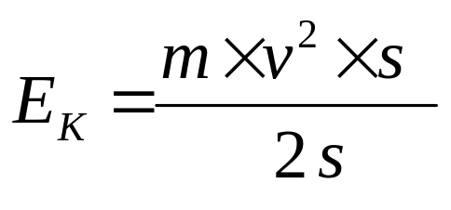
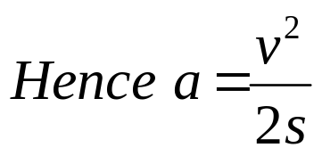
Formula for Kinetic Energy - E_{K}
Final
velocity v
F
Mass m
Initial velocity u =0
s
E_{K} = work done in accelerating to velocity, v. i.e E_{K} = Fs
E_{K} = m a s
as F = ma
v² = u² + 2 as = 2 as [as u = 0]
E_{K} = ½ m v²

Slide 18
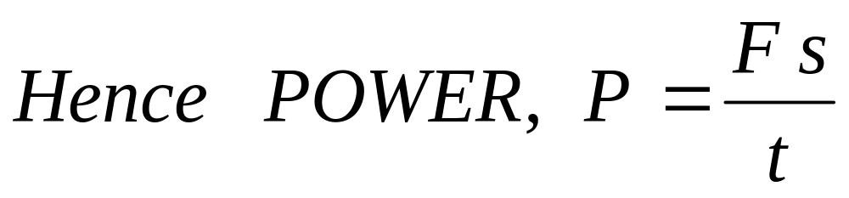
POWER is the
RATE OF DOING WORK
= RATE OF CONVERTING ENERGY
UNITS
JOULES / SECOND = WATTS ( W )

Slide 19
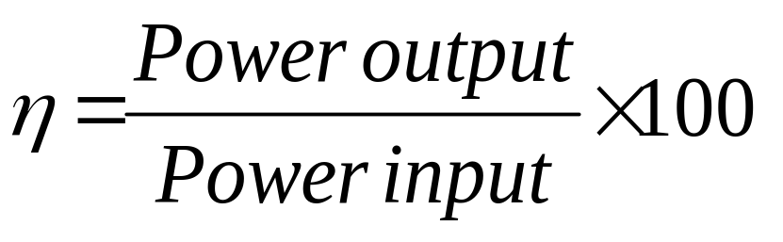
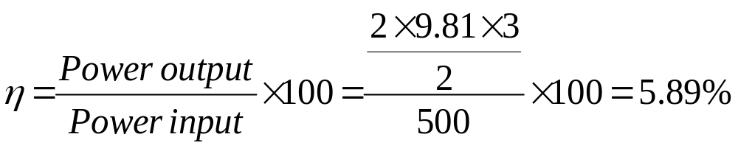
The efficiency [ η ] of a machine is the power output divided by the power input, usually expressed as a percentage.
If a 0.5 kW electric motor lifts a load 2 kg though a distance of 3 m in 2 seconds, its efficiency is given by

Slide 20
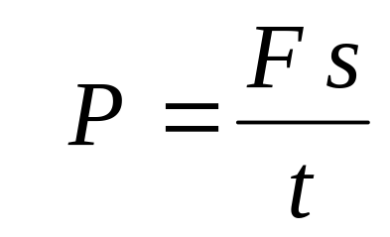
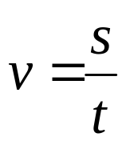
For a vehicle moving at constant velocity, v.
v
F
The power to maintain this velocity is given by :
P = F v
Where F is the driving force of the engine.

Slide 21

FINDING ONE’S POWER
s
Height of step = m
Number of steps =
S = m
My weight in Newtons = N
Time to ascend = s
MY POWER = W or Horse Power
746 W = 1 hp

