Slide 1
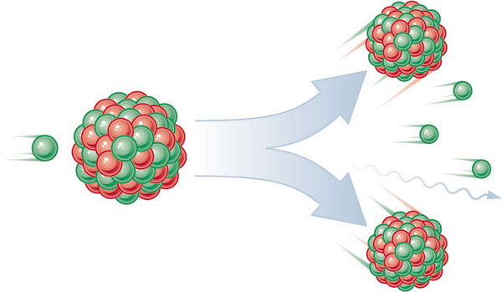
Nuclear Fission & Fusion

Slide 2
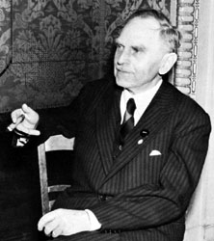
History:
Hahn & Strassman (1939)
Bombarded Uranium-235 samples with neutrons expecting the Uranium-235 to capture neutrons
Instead, the products showed different chemical properties that they could not explain

Slide 3
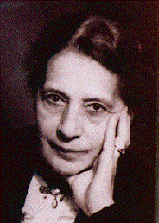
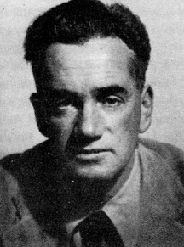
Meitner & Frisch
Explained Hahn & Strassman results.
Instead of heavier Uranium, it had split into smaller elements =
Nuclear Fission

Slide 4
Nuclear Forces
Electric repulsion – ________ charge particles repel each other
same
Strong Nuclear Force – causes protons and neutrons to ________ each other
attract
Stable Nuclei = strong nuclear force is ________ than repulsion force
greater
Unstable Nuclei = strong nuclear force is ________ than repulsion force
less
Have too many or too few neutrons in nucleus
Have more than 83 protons in nucleus
Will decay into a more stable nucleus

Slide 5
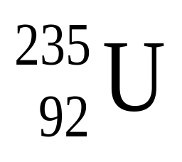
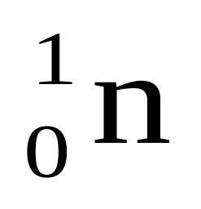
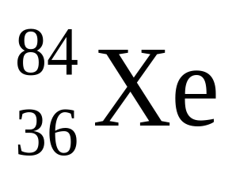

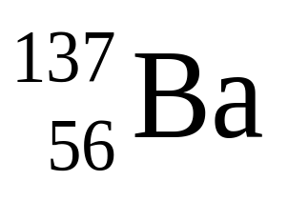
Nuclear Fission
– splitting of heavier nuclei into lighter nuclei.
+
+
+15
+
energy
How much energy? E=mc²
_______= _______ x (_____ _ _____)² c=3.0x10⁸
Energy
mass
speed of light
E=mc² explains _____ _____ (total mass of nucleus is less than sum of individual particles)
mass defect

Slide 6
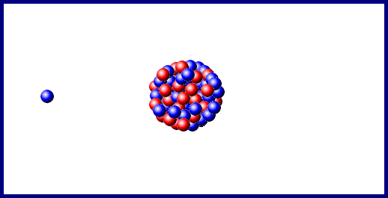

Slide 7
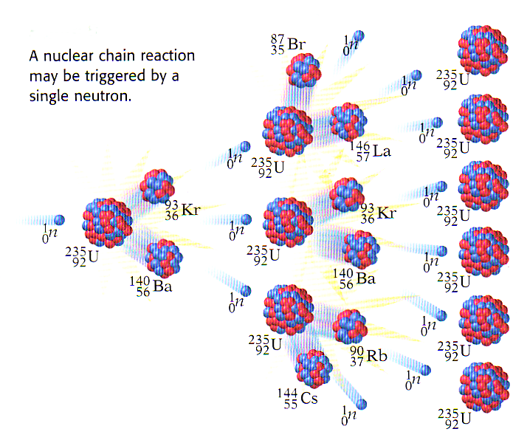
Nuclear Chain Reactions:
Nuclear fission releases more neutrons which trigger more fission reactions
The number of ________ released determines the success of a chain reaction
neutrons

Slide 8
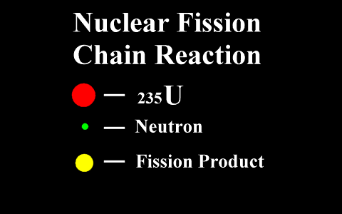

Slide 9
Applications of Controlling Chain Reactions
Atomic Bomb (fission bomb) – Triggering a chain reaction in U-235 or Pu-239
• Must have a minimum amount of radioactive isotope to sustain a chain reaction =_________ _______
CRITICAL MASS
Nuclear Power Plants – Convert heat energy from fission chain reaction into __________.
electricity
control rods
Control chain reaction with ________ _____ that absorb ________ emitted after fission reaction.
neutrons

Slide 10
Nuclear Fusion
- Energy released when two light nuclei combine or fuse
However, a large amount of energy is required to start a fusion reaction:
Need this energy to overcome ________ forces of protons.
Extremely high temperatures can provide start-up energy.
repulsion
More energy in fusing hydrogen that fission of uranium

Slide 11
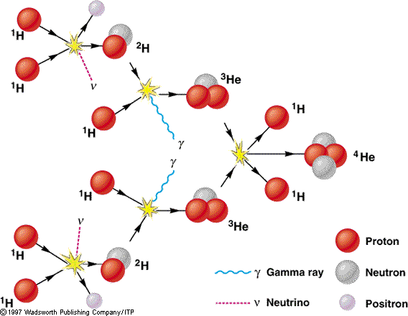
Nuclear Fusion

Slide 12
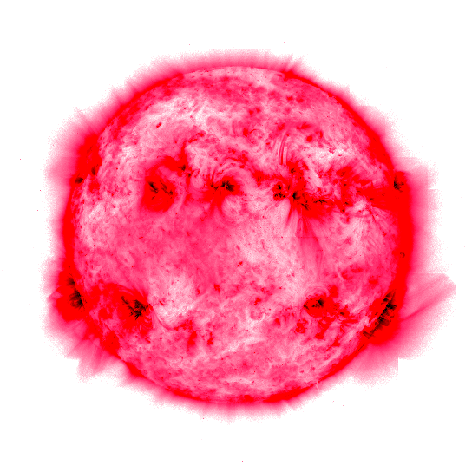
Stars energy is produced through fusion reactions
Fusion occurs until Fe is produced because less energy is released than required to fuse Fe nuclei = _____ ____ ____
Star burns out

Slide 13
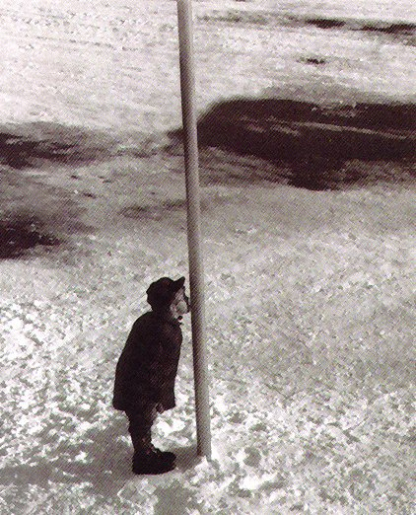
Cold Fusion:
Efforts are being made to start and sustain a fusion reaction at lower temperatures, in other words with a lower amount of input energy

