Slide 1
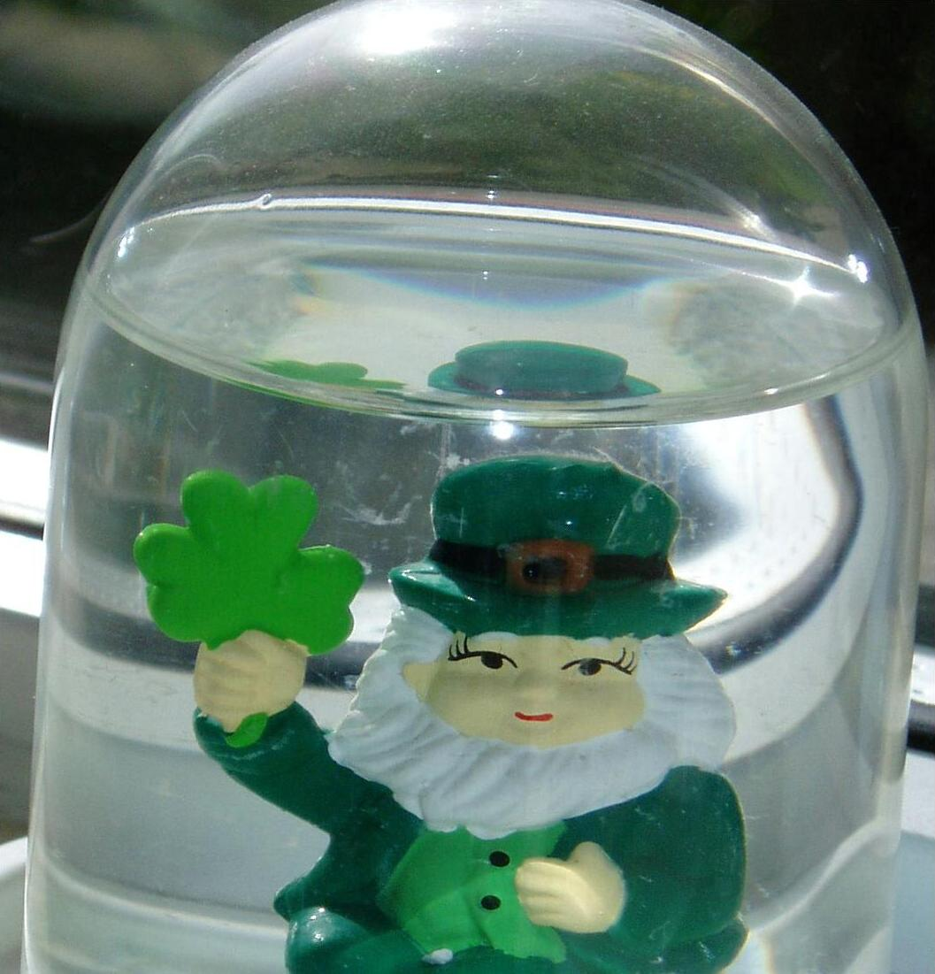
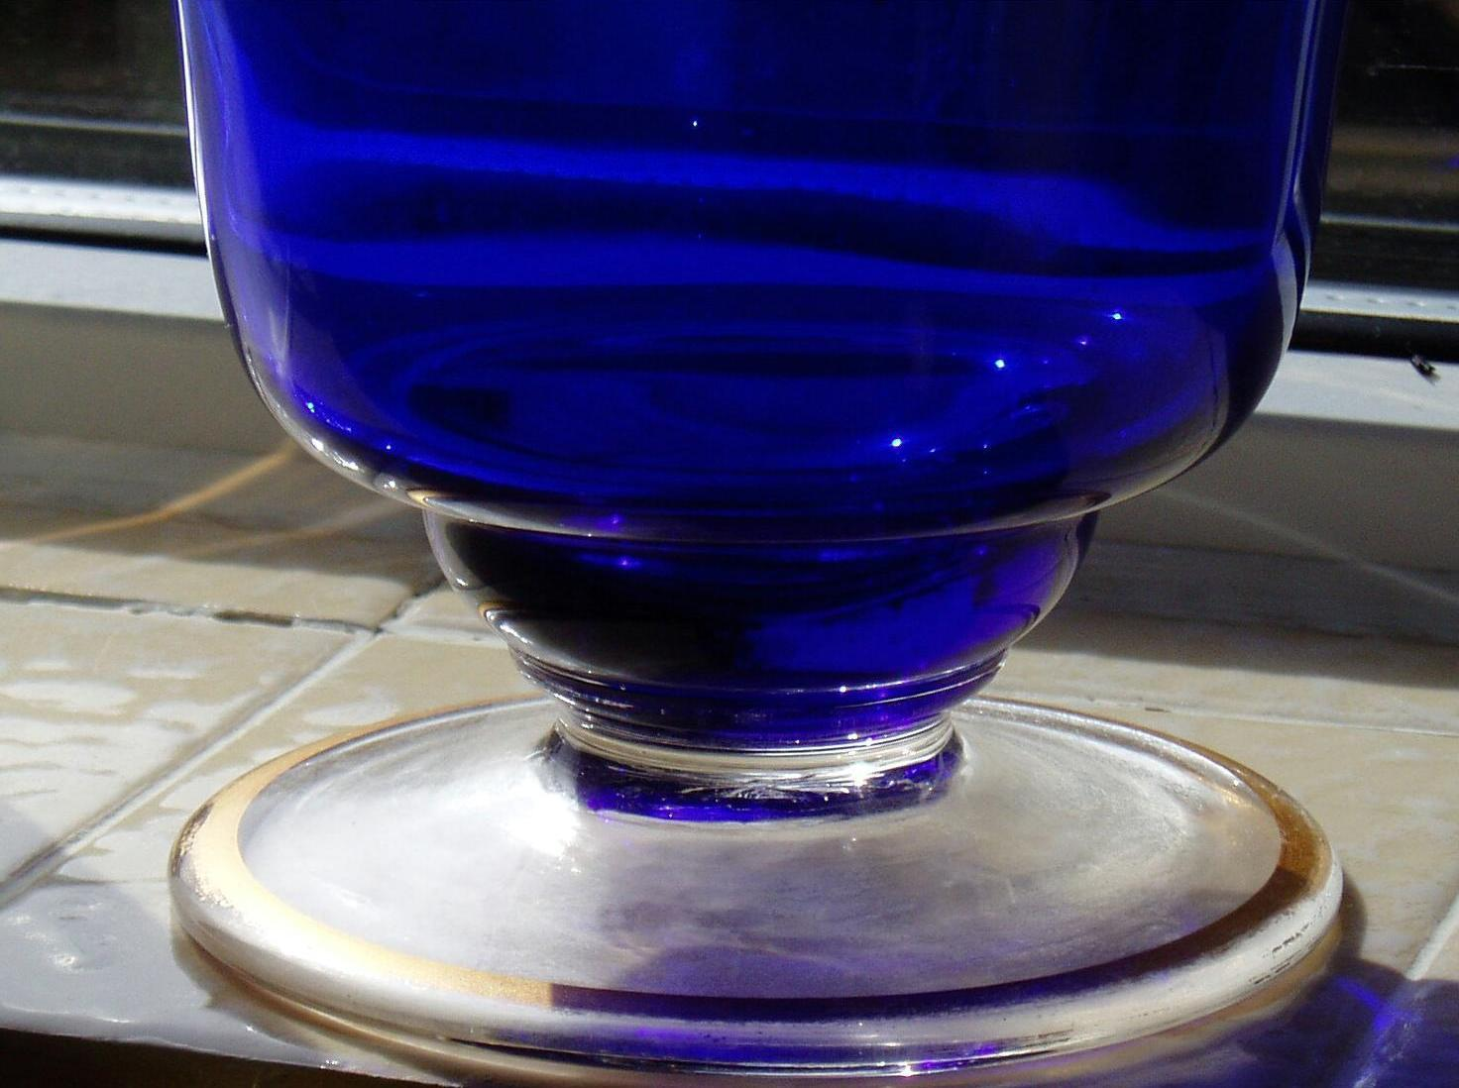
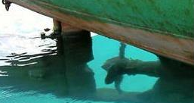
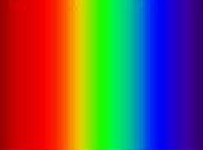
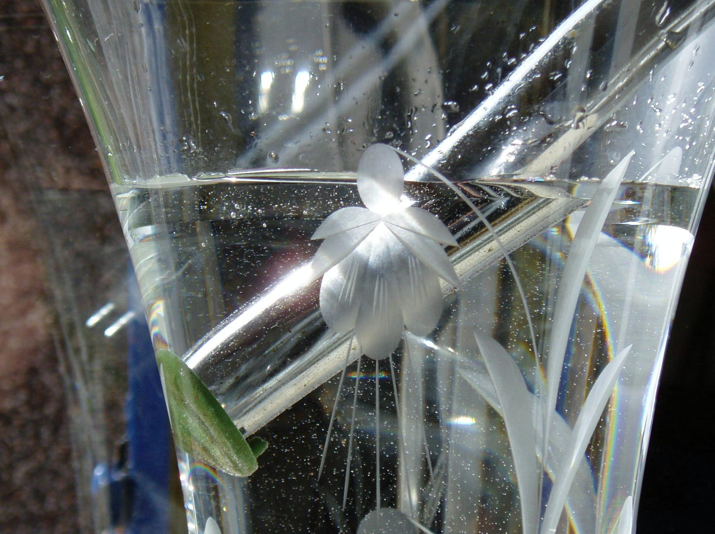
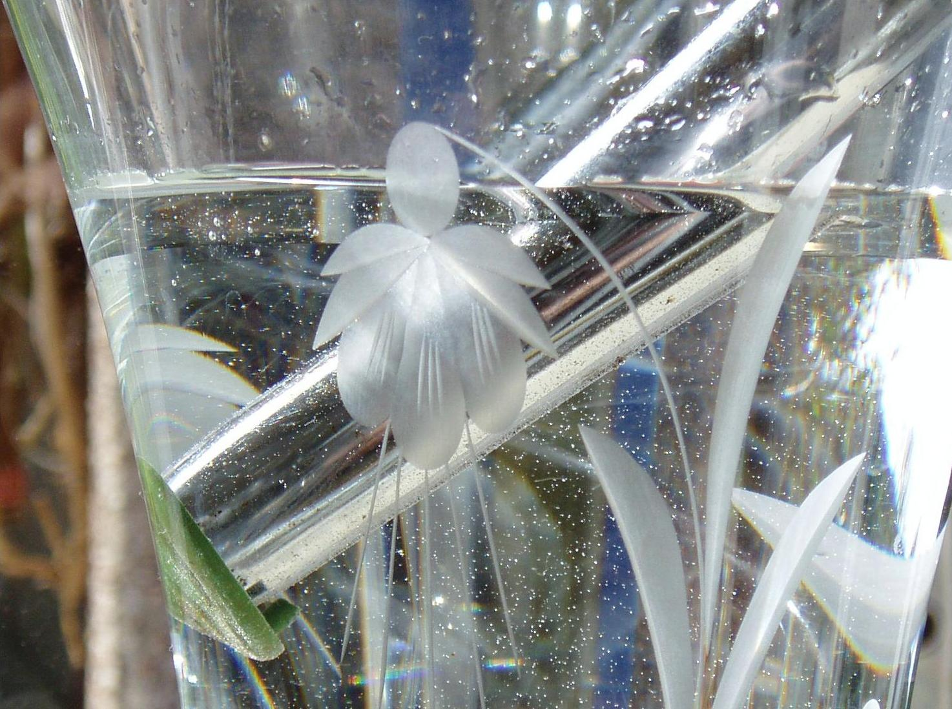
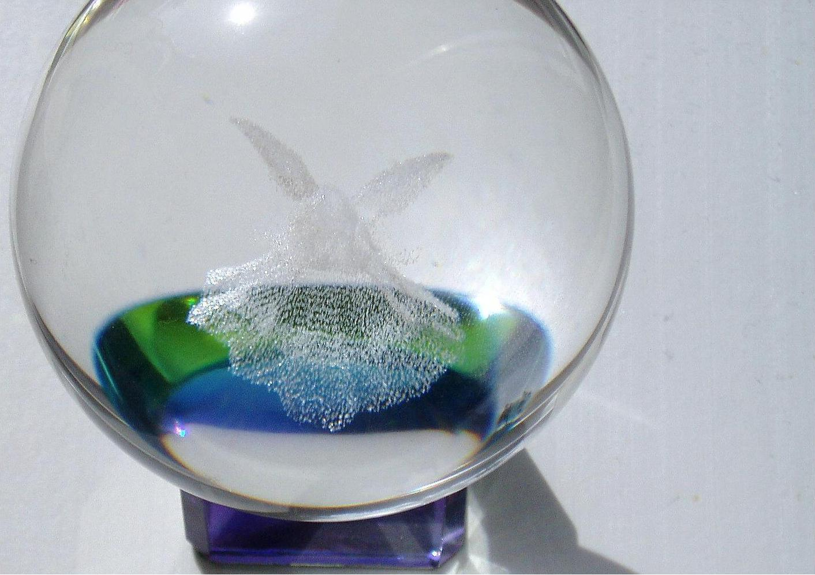
REFRACTION

Slide 2







Refraction is the Bending of Waves due to a Change in Velocity
Refraction is the Bending of Waves due to a Change in Velocity
I wasn’t going to jump anyway
I think we are being watched!

Slide 3
REFRACTION
air
glass / water

Slide 4
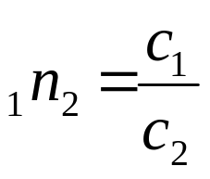
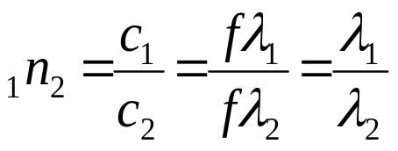

REFRACTIVE INDEX FROM 1 TO 2
Optically less dense medium (1)
Optically denser medium (2)
Waves travel SLOWER
Wavelength REDUCED
Frequency UNCHANGED

Slide 5



LAWS OF REFRACTION
Θ₁ = angle of incidence
Θ₂ = angle of refraction
Incident ray
normal
1
2
Refracted ray
1. The incident ray, the refracted ray and the normal all lie in the
same plane.
2. For two given media, the ratio of the sine of the angle of incidence
to the sine of the angle of refraction is constant.
SNELL’s LAW

Slide 6
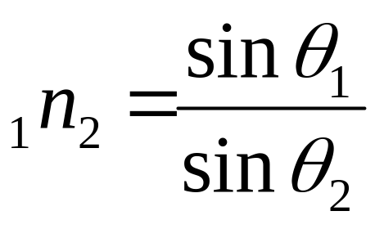
Incident ray
normal
1
2
Refracted ray
SNELL’s LAW

Slide 7
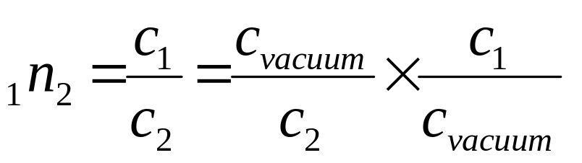
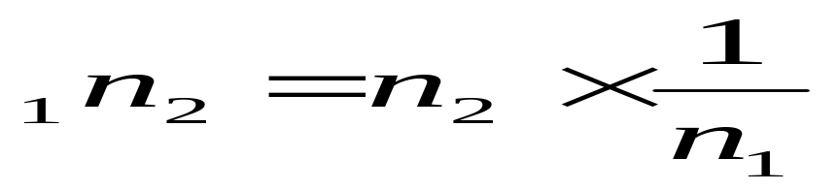
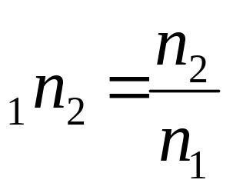
Absolute refractive indices are measured with respect to the velocity of light in a vacuum, which is very nearly the same as the velocity of light in air. [ n_{air} = 1.0008 ]
1
2
What will be the refractive index for rays of light travelling from medium 1 to medium 2, when 1 is not air?
HENCE
SO

Slide 8
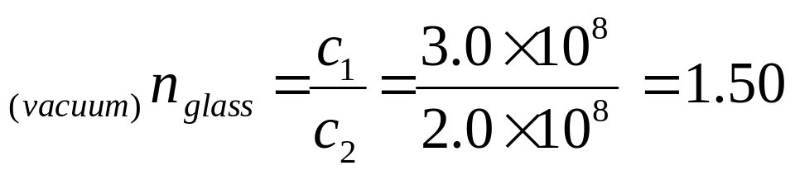
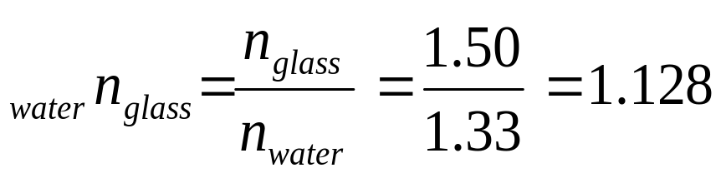
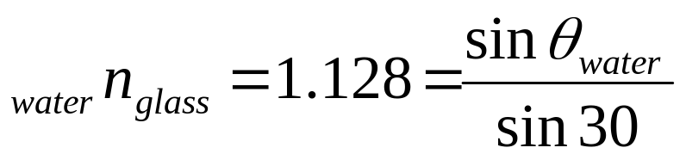
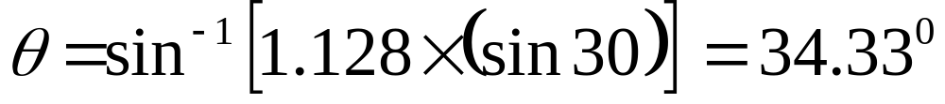
QUESTION
n_{water} = 1.33
c = 3.0 x 10⁸ m s⁻¹
c_{glass} = 2.0 x 10⁸ m s⁻¹
Find angle θ
θ
water
glass
30⁰

Slide 9
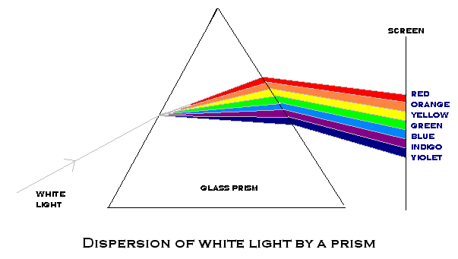
Violet light has a higher refractive index in glass than red light

Slide 10
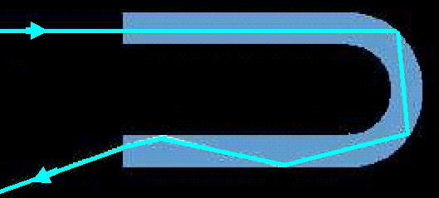
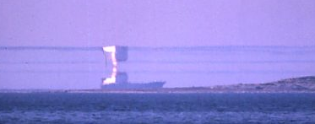
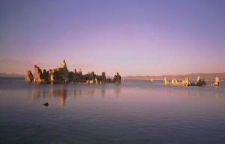
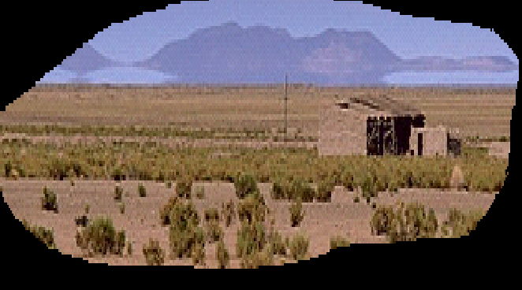
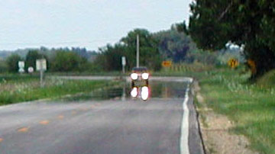
total internal reflection
critical
angle

Slide 11
When light travels from an optically denser medium to a less dense medium, rays are bent away from the normal.
For a larger angle of incidence, more light is reflected as well as the refracted ray being bent further from the normal
When the critical angle, c, is reached it produces an angle of refraction of 90⁰
c
A little light is also reflected.
For angles of incidence greater than the critical angle,
TOTAL INTERNAL REFLECTION occurs.
θ
θ
N.B. The angle of incidence
= The angle of REFLECTION

Slide 12
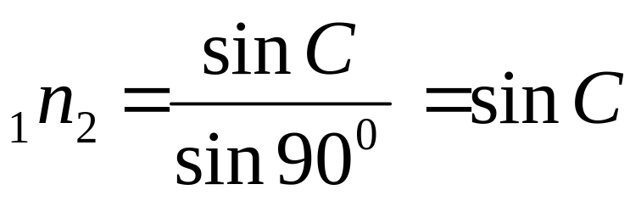
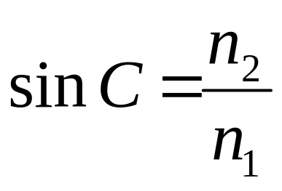
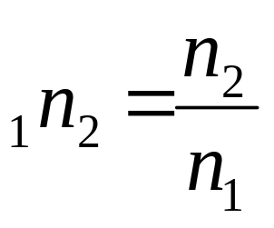
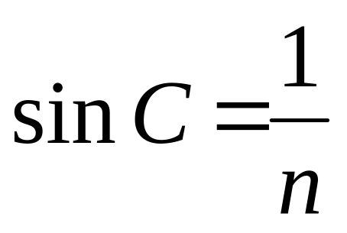
Critical angle depends upon the refractive indices of the media
2
By Snell’s Law
1
C
HENCE
If medium 2 is air, n₂ = 1, and so

Slide 13
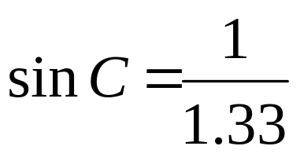
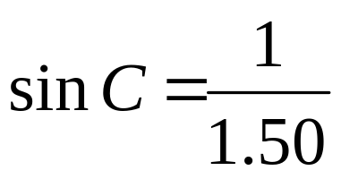
For Water
2
AIR
WATER
C
1
C = 48.8⁰
For Crown Glass
C = 41.8⁰

Slide 14
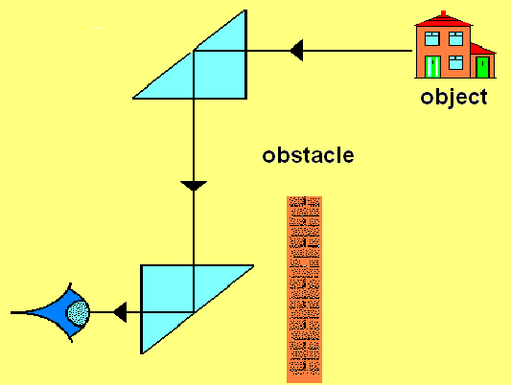
PERISCOPE – two right isosceles prisms
Total internal reflection
45⁰
45⁰
observer
Critical Angle for common glass = 42⁰

Slide 15
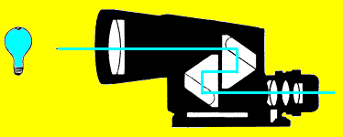
PRISMATIC BINOCULARS
Eyepiece lens
Objective lens

Slide 16



THE MIRAGE
Water
for my hump!
air layers
Hot Desert Sand
Air layers closer to the sand are hotter and less dense. Light from the sky is successively bent until a critical angle is reached and then total internal reflection occurs.
A mirage "water" illusion is seen because the mind initially interprets the light rays reaching our eyes as having come along a straight path originating from the ground. Thus, the image of that patch of sky we see "on the ground" is interpreted as a surface "pool of water."

Slide 17
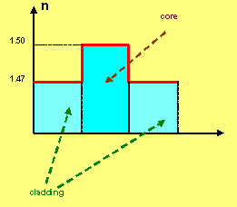
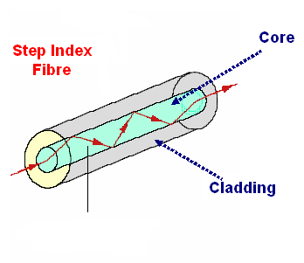
FIBRE OPTICS
Step Index fibre
Core
1.50
STEP INDEX
FIBRE
cladding
core
1.47
Light trapped in fibre core
Diameter around 50 μm
Cladding
A critical angle will exist for rays travelling from the core to the cladding

Slide 18
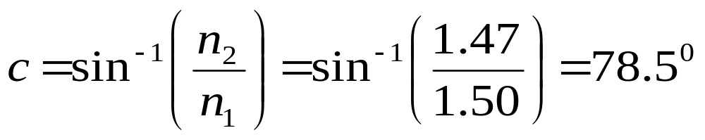
cladding n₂
c
core n₁
Suppose n₁ = 1.50
and n₂ = 1.47,
then
θ
The light entering a fibre end must be inside a 'cone of viewing' if it is to be
transmitted along the fibre, otherwise it passes through the core-cladding boundary because its angle of incidence at this boundary is greater than the critical angle . The
acceptance angle , θ, of the cone of viewing, is given by the equation
sin θ = (n₁²– n₂² )^{1/2} / n_{o}
where n_{o} is the refractive index of the substance outside the fibre.
If the acceptance angle is too small , the cone of viewing is too narrow.

Slide 19
A COHERENT BUNDLE: A bundle of optical fibres in which the relative spatial coordinates of each fibres are the same at the two ends of the bundle. Such a bundle are used for the transmission of images.
A NON-COHERENT FIBRE bundle, as you would expect, does not have this precise matrix alignment since they need only transmit light for illumination purposes. They are cheaper to produce.

Slide 20
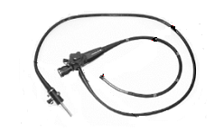
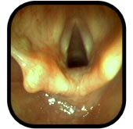
Controls
End probe containing coherent bundle, incoherent bundle, lens and surgical instruments
Eyepiece
ENDOSCOPE
Light injected here
This is an endoscope image of the inside of the throat. The arrows point to the vocal chords

Slide 21
FIBRE OPTIC COMMUNICATIONS
PROBLEM: Input light rays cannot be precisely parallel.
cladding
core
Rays taking different paths will take different times to travel along the fibre, resulting in the jumbling of the signal.
Solution : Monomode fibre only 5μm in diameter

