Slide 1
Wave Term Review

Slide 2
Waves
1) A wave is any disturbance that transmits _____________ through matter and space.

Slide 3
Kinds of Waves
  2) A __________wave is a wave where the material that the wave is in vibrates back and forth along the path that the waves travels.

Slide 4
Kinds of Waves
  3) A _________ wave is a wave where the material that the wave is in moves perpendicular (at right angles) to the direction that the wave is traveling.

Slide 5
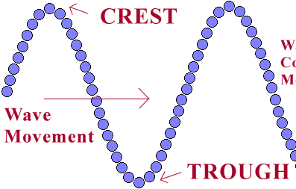
???
???

Slide 6
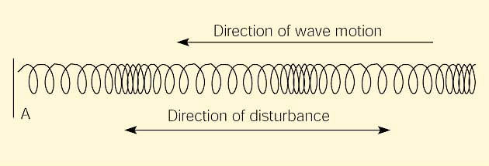
What type of wave is this?

Slide 7

???
???

Slide 8
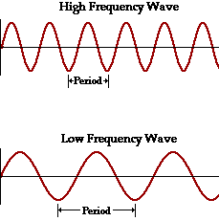
Which wave below has a higher frequency?
A
B

Slide 9
  The maximum distance a wave vibrates from its rest position is called the wave’s _____________.

Slide 10
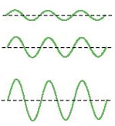
Which one of these waves has a larger amplitude?
A
B
C

Slide 11
  A __________ is the distance from any point on one wave to that same point on the next wave.

Slide 12
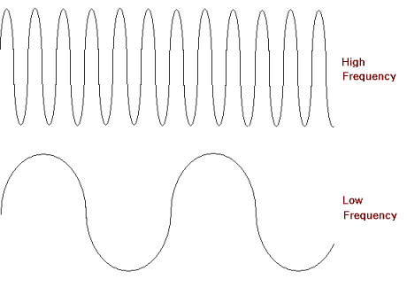
Which one of these waves has a larger wavelength?
A
B

Slide 13
  The number of waves (or cycles) produced in a given amount of time is called the _____________ of a wave.

Slide 14
Which one of these waves has a higher frequency?

Slide 15
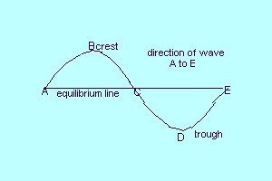
The distance between what two letters is a wavelength (λ)?

Slide 16
Draw a longitudinal wave.
Label a wavelength.
Label a compression and rarefaction.

Slide 17
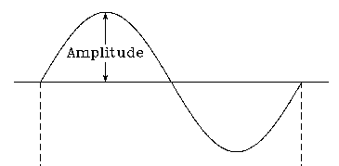
Identify what the arrow is showing.
???

Slide 18
Draw a transverse wave.
Label the crests and troughs.
Label a wavelength.
Label the amplitude.

Slide 19
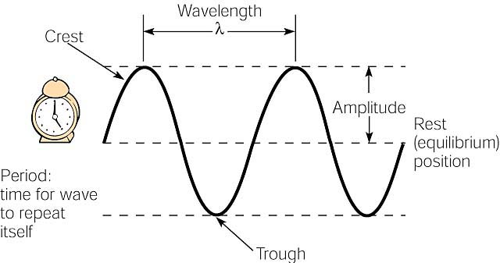
Review

Slide 20
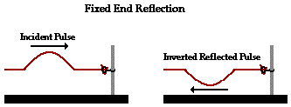
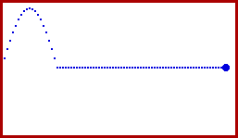
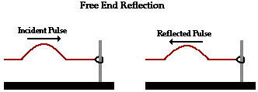
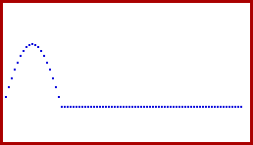
Sound waves are reflected at a boundary.
http://www.surendranath.org/Applets/Waves/Twave02/Twave02Applet.html

Slide 21
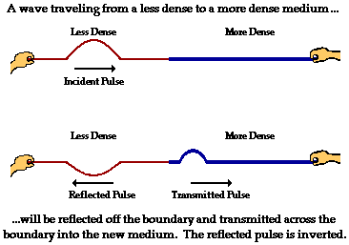
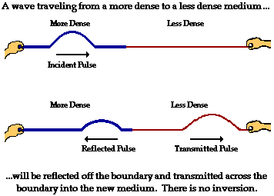

Sound waves are refracted at a boundary.

Slide 22
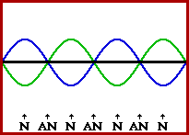
Interference.
  Constructive interference
  Destructive interference

Slide 23




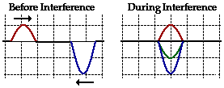
Here’s what is occurring.
(SIM1)
(SIM2)

Slide 24
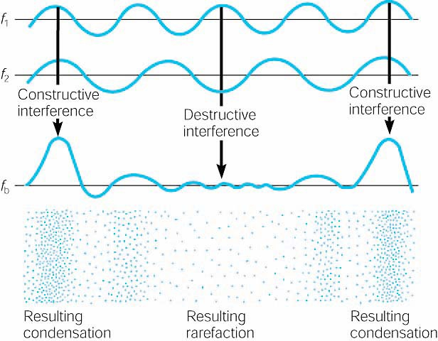
Beating Frequency (SIM1) (SIM2)

Slide 25
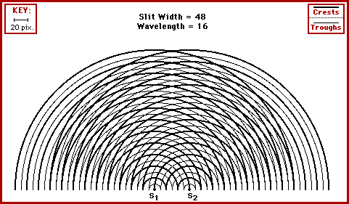
Multiple sound sources interfere (SIM)
Changing separation distance.

Slide 26
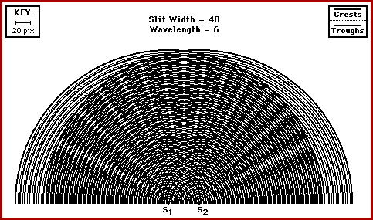
Multiple sound sources interfere.
Changing source frequency.

Slide 27
Resonance.
  All elastic objects have natural frequencies of vibration that are determined by the materials’ compositions and shapes.
  When energy is transferred at the natural frequencies, there is a dramatic increase of amplitude called resonance.
  The natural frequencies are also called resonant frequencies.

Slide 28
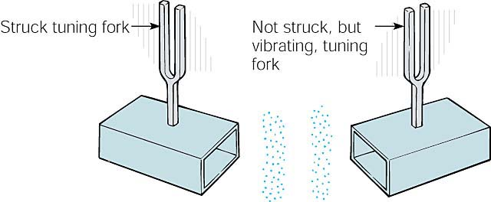
When the frequency of an applied force, including the force of a sound wave, matches the natural frequency of an object, energy is transferred very efficiently. The condition is called resonance.

Slide 29
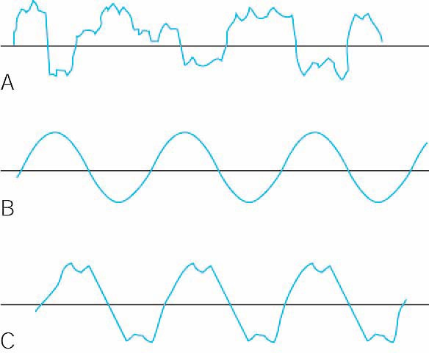
Notes:
(A) noise, (B) pure tones, and (C) musical notes.

Slide 30
Sources of Sounds
Vibrating Strings.
  Standing Waves (animation)
  Nodes and Anti-Nodes
  Fundamental Frequency
    The fundamental frequency determines the _________ of the basic musical note being sounded and is called the ________ harmonic.

Slide 31
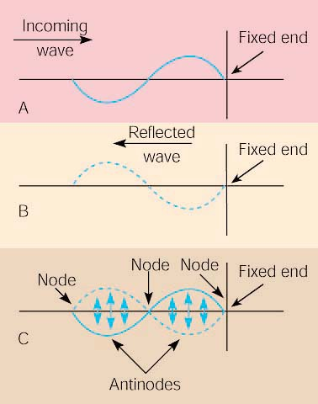
In illustration C:
How many nodes?
How many antinodes?

Slide 32
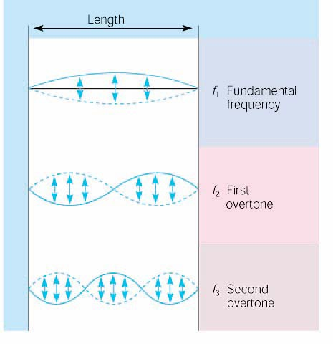
The beginning overtone series for a vibrating string fixed at both ends.
(SIM)

Slide 33
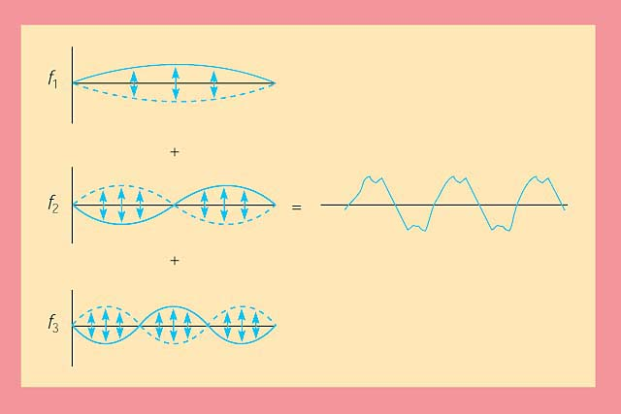
Why do different voices and instruments produce unique sounds?
Timbre (sic) - A combination of the fundamental and overtone frequencies produces a composite waveform with a characteristic sound quality.

Slide 34
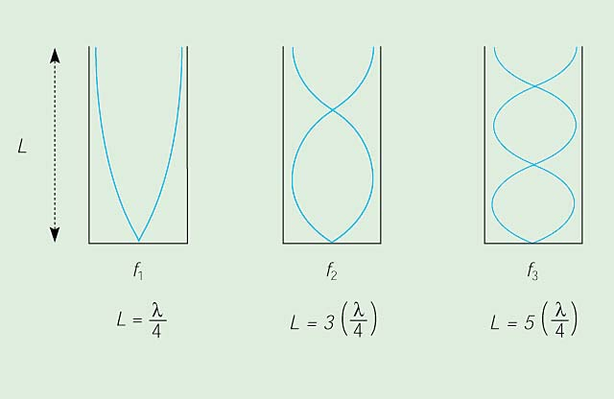
Closed tube

Slide 35
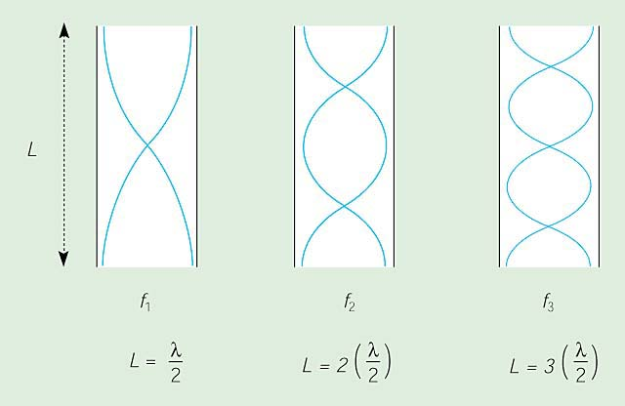
Open tube

Slide 36
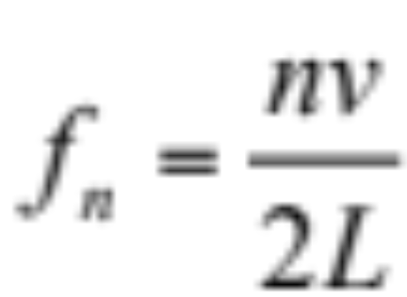
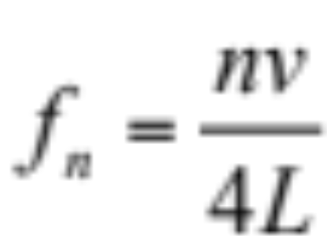
  Overtones for a string (fixed at both ends) or Open Tube (open at both ends)
  Overtones for a closed tube (closed at one end and open at the other)
  SIM1

Slide 37
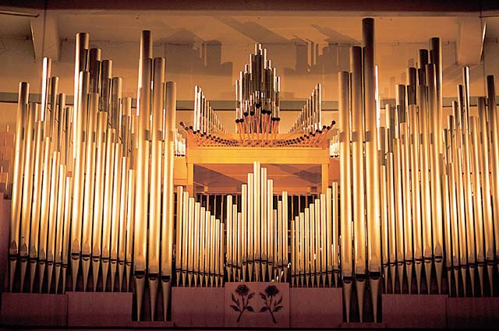
Do nodes or antinodes appear at the open ends of these pipes?
Which pipes produce the longer wavelength? Higher pitch?

Slide 38

Pitch depends on length.
Which trombone has the longer wavelength? Higher pitch?
A B
Do nodes or antinodes appear at the mouthpiece? Bell?

Slide 39
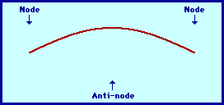
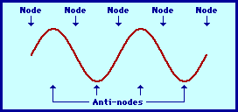
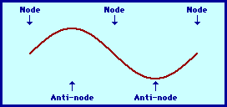
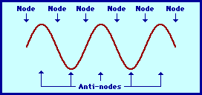
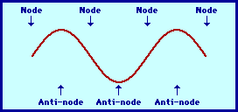
Harmonic Series
1st
4th
2nd
5th
3rd
What kind of tube (open vs closed) would these wave diagrams describe?

Slide 40
Sounds from Moving Sources
  Doppler Effect (Animation)
  Sonic Boom

Slide 41
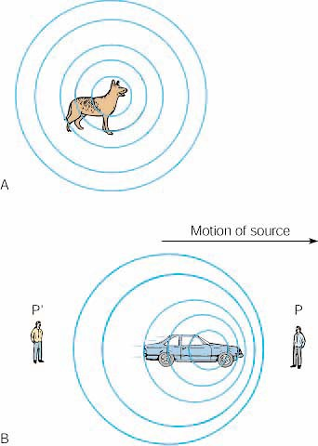
Sound from:
A stationary object
A moving object
(SIM1)
(SIM2)

Slide 42
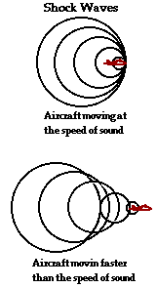
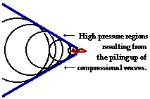
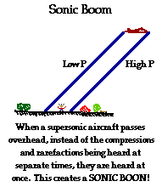

Slide 43
Final Note:
  Mechanical waves and
  Electromagnetic Waves
  are different!

Slide 44
Sources:
Bloomfield, How Things Work.
Krauskopf & Beiser, The Physical Universe. 10th ed.
Tillery, Physical Science. www.physicsclassroom.com

