Slide 1
Electrochemistry: Some Definitions
A Battery: A system which converts chemical energy into electrical energy
More correctly, a battery is an electrochemical cell:
Galvanic Cells convert the energy from spontaneous chemical reactions into electricity
Electrolytic Cells use electricity to drive non-spontaneous chemical reactions

Slide 2
Electrochemistry: Some Definitions
All galvanic cells produce electricity from reactions which involve the transfer of electrons from one species to another
There are two components to each cell – the species donating the electrons, and the species accepting them
We write “half-reactions” to represent these two components, and to explicitly show the transfer of electrons

Slide 3
Electrochemistry: Some Definitions
The oxidation half-reaction shows the species which is donating electrons
The reduction half-reaction show the species which is receiving electrons
We can also write the net reaction (or overall reaction) for the cell, the balanced sum of the two half-reactions

Slide 4
Electrochemistry: Some Definitions
In a nickel-cadmium battery, the reactions look something like this:
Oxidation Cd → Cd²⁺ + 2 e⁻
Reduction Ni³⁺ + e⁻ → Ni²⁺
Net Cd + 2 Ni³⁺ → Cd²⁺ +2 Ni²⁺
Note: The number of electrons given off in the oxidation half-reaction must equal the number gained in the reduction half-reaction
Electrons moving from one place to another – this is electricity
2 x [ ]

Slide 5
Electrochemistry: Some Definitions
Electrodes are electrical conductors in the cell where chemical reactions take place
The anode is the electrode where oxidation takes place
The cathode is the electrode where reduction takes place
The cathode receives the electrons given off at the anode and passes them along
The voltage of the whole cell is the electrical energy that it gives off, measured in volts (V)
The current is the rate at which electrons pass through the cell, measured in amperes (A)

Slide 6
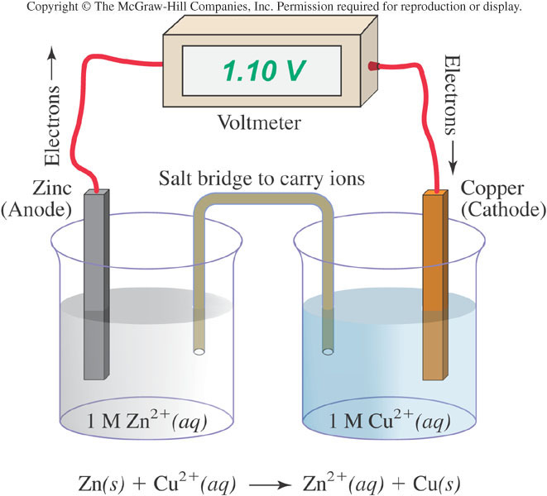
Fig.08.p360

Slide 7
Batteries: The Nickel-Cadmium Battery
In a nickel-cadmium battery, the reactions actually look like this:
Oxidation
Cd(s) + 2 OH⁻ (aq) → Cd(OH)₂(s) + 2 e⁻
Reduction
2NiO(OH)(s) + 2 H₂O(l) + 2 e⁻ → 2Ni(OH)₂(s) + 2 OH- (aq)
Net
Cd(s) + 2NiO(OH)(s) + 2 H₂O(l) → Cd(OH)₂(s) + 2Ni(OH)₂(s)
Note: The number of reactions and the number of electrons hasn’t changed, but we’re more completely describing the physical and chemical form of the electrode components

Slide 8
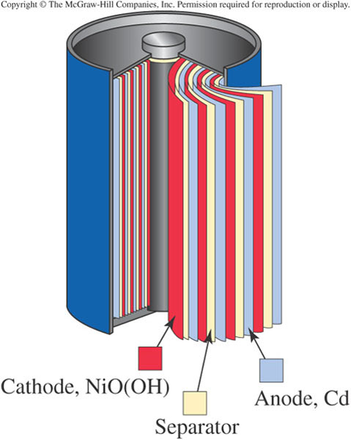
The cell contains a paste of NaOH – this provides the OH⁻ ions needed for the reaction, while also providing a medium to pass charge (electrolyte)
The anode consists of solid metal which is transformed into cadmium hydroxide
The cathode consists of Ni³⁺ ions in a NiO(OH) paste which are transformed into nickel hydroxide

Slide 9
It is because the products of the reaction are solids that the Ni-Cd battery can be recharged
The solid hydroxides are sticky, cling to the innards of the battery, and remain in place.
If current is applied, the reaction can be driven backwards!

Slide 10
Batteries: The Nickel-Cadmium Battery
In a nickel-cadmium battery, we can recharge the battery by applying an electrical current from another source
Cd(s) + 2NiO(OH)(s) + 2 H₂O(l) Cd(OH)₂(s) + 2Ni(OH)₂(s)
But most batteries we use aren’t rechargeable
Why not?
What are the properties of some other typical batteries?

Slide 11
Batteries: The Alkaline Battery
Billions upon billions of alkaline batteries are used each year
They are described by size and shape – AAA to D
Larger batteries have more “stuff”, and thus can run longer
But they all have the same voltage, because they’re all based on the same electrochemical cell

Slide 12
Batteries: The Alkaline Battery
But they all have the same voltage, because they’re all based on the same electrochemical cell
Oxidation
Zn(s) + 2 OH⁻ (aq) → Zn(OH)₂(s) + 2 e⁻
Reduction
2 MnO₂(s) + H₂O(l) + 2 e⁻ → Mn₂O₃(s) + 2 OH⁻ (aq)
Net
Zn(s) + 2 MnO₂(s) + H₂O(l) → Zn(OH)₂(s) + Mn₂O₃(s)

Slide 13
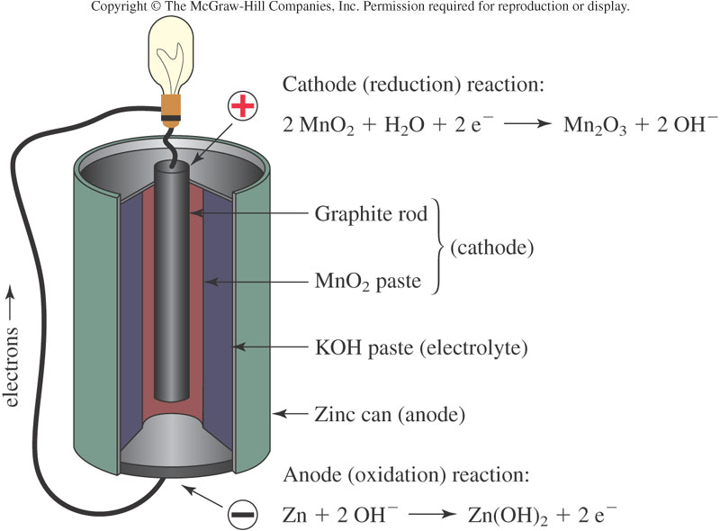
But – the Mn₂O₃ is not sticky, and doesn’t remain attached to the electrode. This battery is not rechargeable

Slide 14
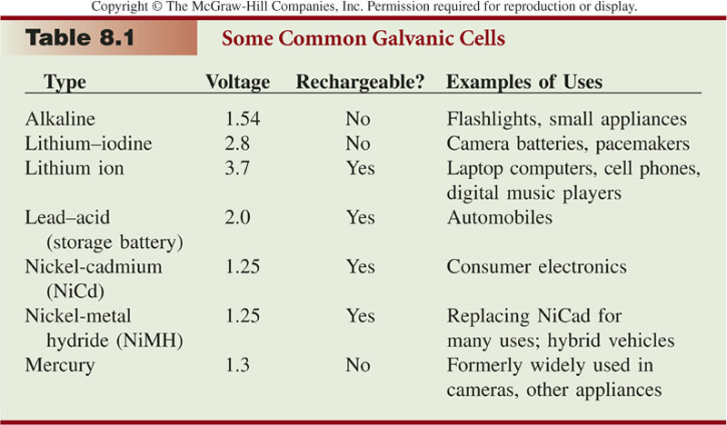
Lithium-iodine batteries are particularly small and lightweight, but also very long-lived
Often used in pacemakers, where they can last for 10 years

Slide 15
Mercury batteries take advantage of the high density of Hg to be quite small: used in watches, hearing aids, calculators, etc.
Phased out in the 80s due to the toxicity of Hg

Slide 16
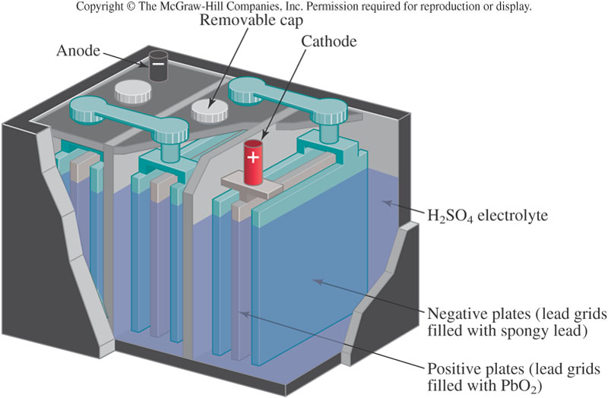
Lead acid accumulator

Slide 17
Batteries: The Lead-Acid Battery
Net:
Pb(s) + PbO₂(s) + H₂SO₄(aq) 2 PbSO₄(s) + 2 H₂O(l)
The overall EMF is cat +1.69, anode +0.36 = 2.05V
The cathode is made of metallic lead, and the anode of lead dioxide
The electrolyte is sulfuric acid
This reaction, too, is reversible.
The lead sulfate product clings to the electrodes, so applied external voltage can reverse the reaction
The 6 lead plates are connected in series to give 12V.

Slide 18
Batteries: The Lead-Acid Battery
Lead-acid batteries are referred to as “storage batteries”, because this charge-discharge cycle is so reliable
These batteries were used in every automobile until quite recently
The battery is discharged in order to start the engine
Once the engine is running and burning gasoline, it turns an alternator which recharges the battery
This process can continue for up to 5 years of normal driving
After that time, enough of the lead sulfate product has been shaken off the plates that it can no longer recharge

Slide 19
Batteries: The Lead-Acid Battery
Lead-acid batteries are also used in environments where vehicles cannot emit combustion products:
Indoor forklifts, golf carts, handicapped carts in airports, wheelchairs
However, lead is an environmental concern!
How do we dispose of the millions and millions of batteries which die each year?
There is a very succesful recycling program in the U.S. – 97% of spent batteries are recycled
But environmentally healthier options are under investigation
A leading contender is the magnesium-acid battery

Slide 20
How does a Fuel Cell work?
A Fuel Cell consists of two catalyst coated electrodes surrounding an electrolyte
One electrode is an anode and the other is a cathode
Notes:
http://www.fuelcells.org/basics/how.html

Slide 21
How does a Fuel Cell work?
The process begins when Hydrogen molecules enter the anode
The catalyst coating separates hydrogen’s negatively charged electrons from the positively charged protons
Notes:
http://www.fuelcells.org/basics/how.html

Slide 22
How does a Fuel Cell work?
The electrolyte allows the protons to pass through to the cathode, but not the electrons
Instead the electrons are directed through an external circuit which creates electrical current
Notes:
http://www.fuelcells.org/basics/how.html

Slide 23
While the electrons pass through the external circuit, oxygen molecules pass through the cathode
There the oxygen and the protons combine with the electrons after they have passed through the external circuit
When the oxygen and the protons combine with the electrons it produces water and heat
Notes:
http://www.fuelcells.org/basics/how.html

Slide 24
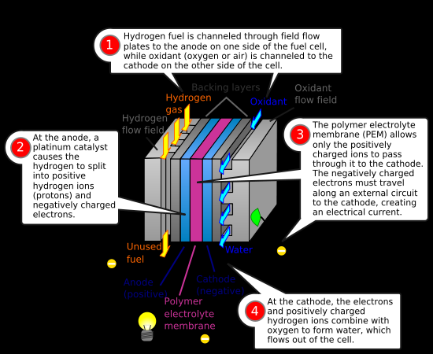

Slide 25
Individual fuel cells can then be placed in a series to form a fuel cell stack
The stack can be used in a system to power a vehicle or to provide stationary power to a building
Notes:
http://www.fuelcells.org/basics/how.html
http://www1.eere.energy.gov/hydrogenandfuelcells/pdfs/doe_h2_fuelcell_factsheet.pdf

Slide 26
Major Types of Fuel Cells
In general all fuel cells have the same basic configuration - an electrolyte and two electrodes
Different types of fuel cells are classified by the kind of electrolyte used
The type of electrolyte used determines the kind of chemical reactions that take place and the temperature range of operation
Notes:
http://www1.eere.energy.gov/hydrogenandfuelcells/fuelcells/fc_types.html#pem

Slide 27
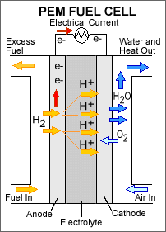
Proton Exchange Membrane (PEM)
  This is the leading cell type for passenger car application
  Uses a polymer membrane as the electrolyte
  Operates at a relatively low temperature, about 175 degrees
  Has a high power density, can vary its output quickly and is suited for applications where quick startup is required making it popular for automobiles
  Sensitive to fuel impurities
Notes:
http://www1.eere.energy.gov/hydrogenandfuelcells/fuelcells/fc_types.html#pem

Slide 28
Direct Methanol (a subset of PEM)
  Expected efficiencies of 40% plus low operating temperatures between 120-190 degrees
  Also uses a polymer membrane as the electrolyte
  Different from PEM because the anode catalyst is able to draw hydrogen from methanol without a reformer
  Used more for small portable power applications, possibly cell phones and laptops
Notes:
http://www1.eere.energy.gov/hydrogenandfuelcells/fuelcells/fc_types.html#pem

Slide 29
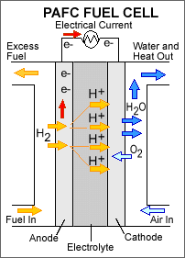
Phosphoric Acid
  This is the most commercially developed fuel cell
  It generates electricity at more than 40% efficiency
  Nearly 85% of the steam produced can be used for cogeneration
  Uses liquid phosphoric acid as the electrolyte and operates at about 450 degrees F
  One main advantage is that it can use impure hydrogen as fuel
Notes:
http://www1.eere.energy.gov/hydrogenandfuelcells/fuelcells/fc_types.html#pem

Slide 30
Molten Carbonate
  Promises high fuel-to-electricity efficiency and the ability to utilize coal based fuels
  Uses an electrolyte composed of a molten carbonate salt mixture
  Require carbon dioxide and oxygen to be delivered to the cathode
  Operates at extremely high temperatures 1200 degrees
  Primarily targeted for use as electric utility applications
  Have been operated on hydrogen, carbon monoxide, natural gas, propane, landfill gas, marine diesel and simulated coal gasification products
Notes:
http://www1.eere.energy.gov/hydrogenandfuelcells/fuelcells/fc_types.html#pem

Slide 31
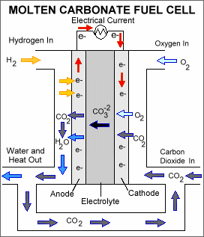
Molten Carbonate Fuel Cell
  Because of the extreme high temperatures, non-precious metals can be used as catalysts at the anode and cathode which helps reduces cost
  Disadvantage is durability
  The high temperature required and the corrosive electrolyte accelerate breakdown and corrosion inside the fuel cell
Notes:
http://www1.eere.energy.gov/hydrogenandfuelcells/fuelcells/fc_types.html#pem

Slide 32
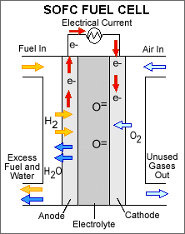
Solid Oxide
  Uses a hard, non-porous ceramic compound as the electrolyte
  Can reach 60% power-generating efficiency
  Operates at extremely high temperatures 1800 degrees
  Used mainly for large, high powered applications such as industrial generating stations, mainly because it requires such high temperatures
Notes:
http://www1.eere.energy.gov/hydrogenandfuelcells/fuelcells/fc_types.html#pem

Slide 33
Alkaline
  Used mainly by military and space programs
  Can reach 70% power generating efficiency, but considered to costly for transportation applications
  Used on the Apollo spacecraft to provide electricity and drinking water
  Uses a solution of potassium hydroxide in water as the electrolyte and operates at 75 -160 degrees
  Can use a variety of non-precious metals as catalyst at the anode and cathode
Notes:
http://www1.eere.energy.gov/hydrogenandfuelcells/fuelcells/fc_types.html#pem

Slide 34
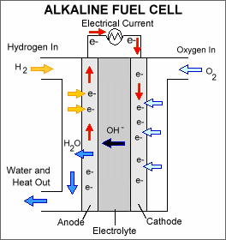
Alkaline Fuel Cell
  Requires pure hydrogen and oxygen because it is very susceptible to carbon contamination
  Purification process of the hydrogen and oxygen is costly
  Susceptibility to poisoning affects cell’s lifetime which also affects the cost
Notes:
http://www1.eere.energy.gov/hydrogenandfuelcells/fuelcells/fc_types.html#pem

Slide 35
Regenerative Fuel Cells
  Currently researched by NASA
  This type of fuel cell involves a closed loop form of power generation
  Uses solar energy to separate water into hydrogen and oxygen
  Hydrogen and oxygen are fed into the fuel cell generating electricity, heat and water
  The water byproduct is then recirculated back to the solar-powered electrolyser beginning the process again
Notes:
http://www1.eere.energy.gov/hydrogenandfuelcells/fuelcells/fc_types.html#pem

