Slide 1
Acid – Base Titration

Slide 2
Prelab question
M_{A} x #H x V_{A} = M_{B} x #OH x V_{B}
M_{A} = 6 M, #H = 2, V_{A} = ?
M_{B} = 0.5 M, #OH = 1, V_{B} = 0.5 L
(6 M)(2)(V_{A}) = (0.5 M)(1)(0.5 L)
V_{A} = (0.5 M)(1)(0.5 L) / (6 M)(2)
V_{A} = 0.25 mol / 12 M
= 0.0208 L
= 20.8 mL

Slide 3
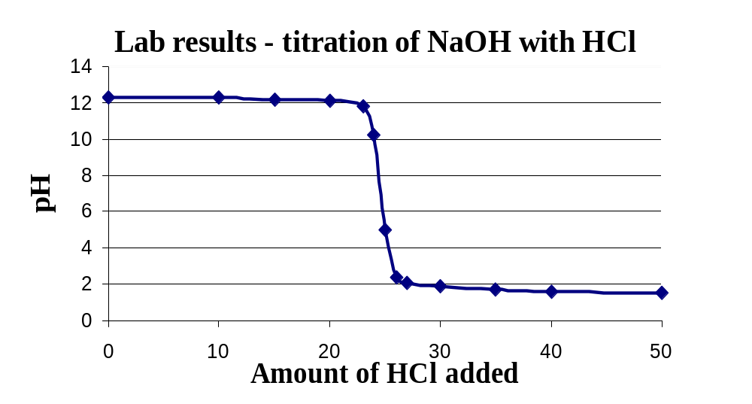
Typical results from experiment

Slide 4
Calculations (0 – 25)
 |  | 0 | 10 | 15 | 20 | 23 | 24 | 25
c | vol (L)
d | HCl mol
e | NaOH
f | Net HCl
g | [OH–]
h | pOH
i | [H+]
j | pH
0.025
0.035
0.040
0.045
0.048
0.049
0.050
0
.0020
.0030
.0040
.0046
.0048
.0050
.0050
.0030
.0020
.0010
.0004
.0002
≈ 0
≈ 0
0.200
0.086
0.050
0.022
0.008
0.004
≈ 0
0.70
1.067
1.301
1.653
2.079
2.389
7
≈ 0
13.3
12.9
12.7
12.3
11.9
11.6
7

Slide 5
Calculations (25 – 50)
 |  | 25 | 26 | 27 | 30 | 35 | 40 | 50
c | vol (L)
d | HCl mol
e | NaOH
f | Net HCl
g | [OH–]
h | pOH
i | [H+]
j | pH
0.050
0.051
0.052
0.055
0.060
0.065
0.075
.0050
.0052
.0054
.0060
.0070
.0080
.0100
≈ 0
≈ 0
.0002
.0004
.0010
.0020
.0030
.0050
≈ 0
7
≈ 0
.0039
.0077
.0182
.0333
.0462
.0667
7
2.4
2.1
1.7
1.5
1.3
1.2

Slide 6
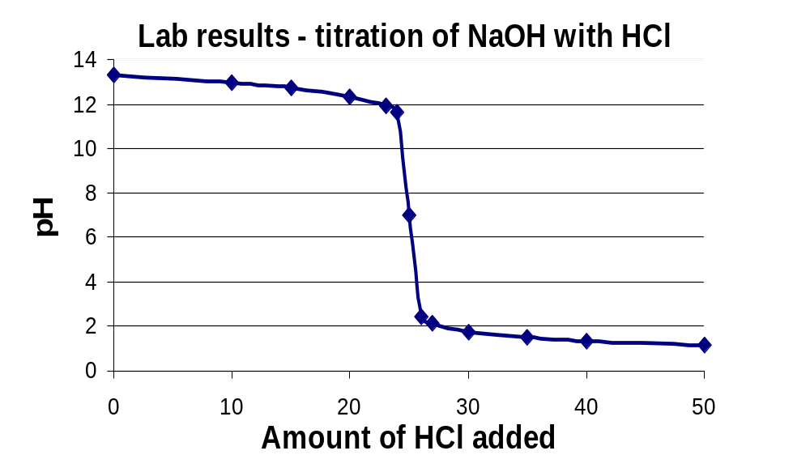
Predicted results

Slide 7
3. Titration: the combination of two solutions in the presence of an indicator; often used to determine the unknown concentration of one of the solutions.
Endpoint: the point when the indicator colour changes (usually the end of the titration)
Equivalence point: The point when the number of equivalents mixed together are the same (in acid-base titrations equivalents refer to the number of moles of H⁺ and OH–)
At 25 mL HCl added the pH changes very rapidly, thus a small error in this region would be the easiest point to get an incorrect value.

Slide 8
5 A)
14
Fewer moles of H₂SO₄ would be required to neutralize 25 mL NaOH, thus the curve would shift left
7
0
0
25
50
5 B)
14
Because we start with pure HCl, then add NaOH the pH starts low then goes high, thus the curve flips
7
0
0
25
50

Slide 9
5 C)
14
A weak base would lower the “base” part of the curve (it’s weak so it has a lower pH), thus yielding a lower (acidic) equivalence point
7
0
0
25
50
5 D)
14
A weak acid would raise the “acid” part of the curve (it’s weak so it has a higher pH), thus yielding a higher (basic) equivalence point
7
0
0
25
50

Slide 10
Refer to table 15.3 (pg. 606)
Bromothymol (6.0 – 7.6) is a better choice than phenolphthalein (8.2 – 10.0) because it’s colour change occurs at a pH that is closer to the equivalence point (7.0)
Phenolphthalein is often used because it is more colourful (thus easier to see)
Any indicator that is close to the expected equivalence point (in this case at a pH of 7) is an acceptable choice.
e.g. Bromocresol purple (5.2 – 6.8), Litmus (4.7 – 8.3), Cresol red (7.0 – 8.8), etc.
Note: A narrow pH range is also preferable.
For more lessons, visit www.chalkbored.com

