Slide 1
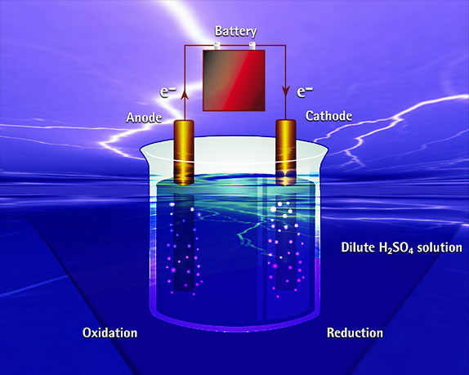
E
L
E
C
T
R
O
L
Y
S
I
S

Slide 2
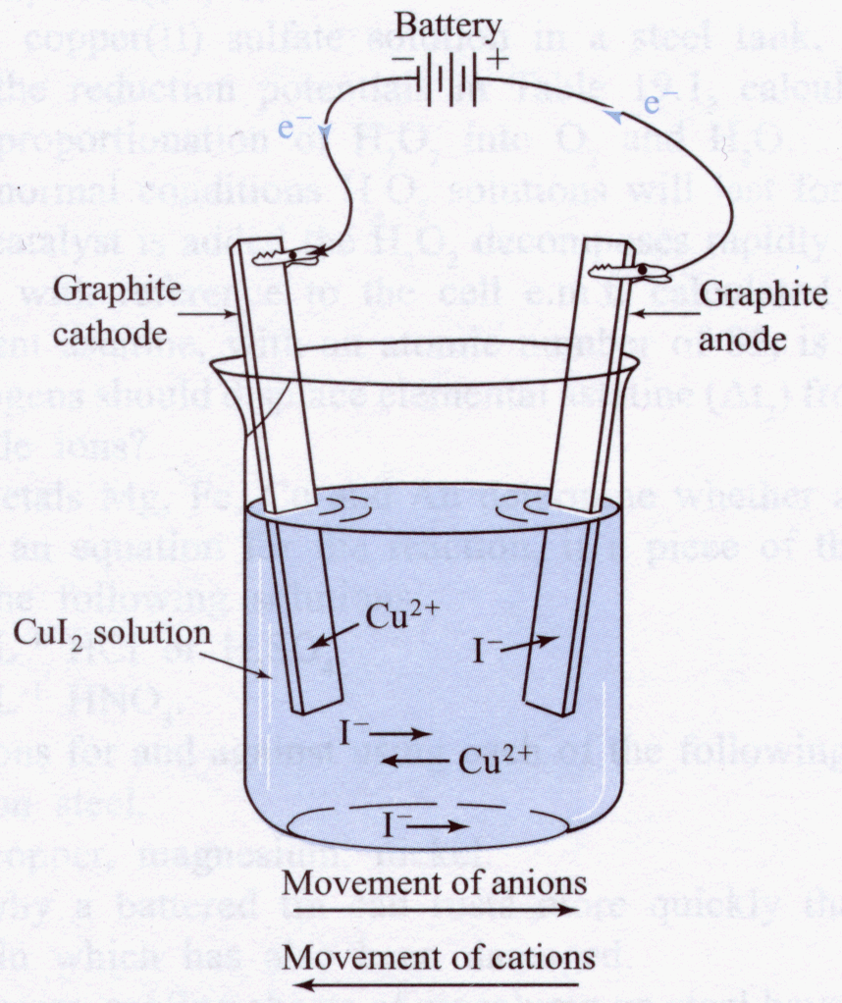
Electrolysis
Of aqueous
Copper iodide

Slide 3
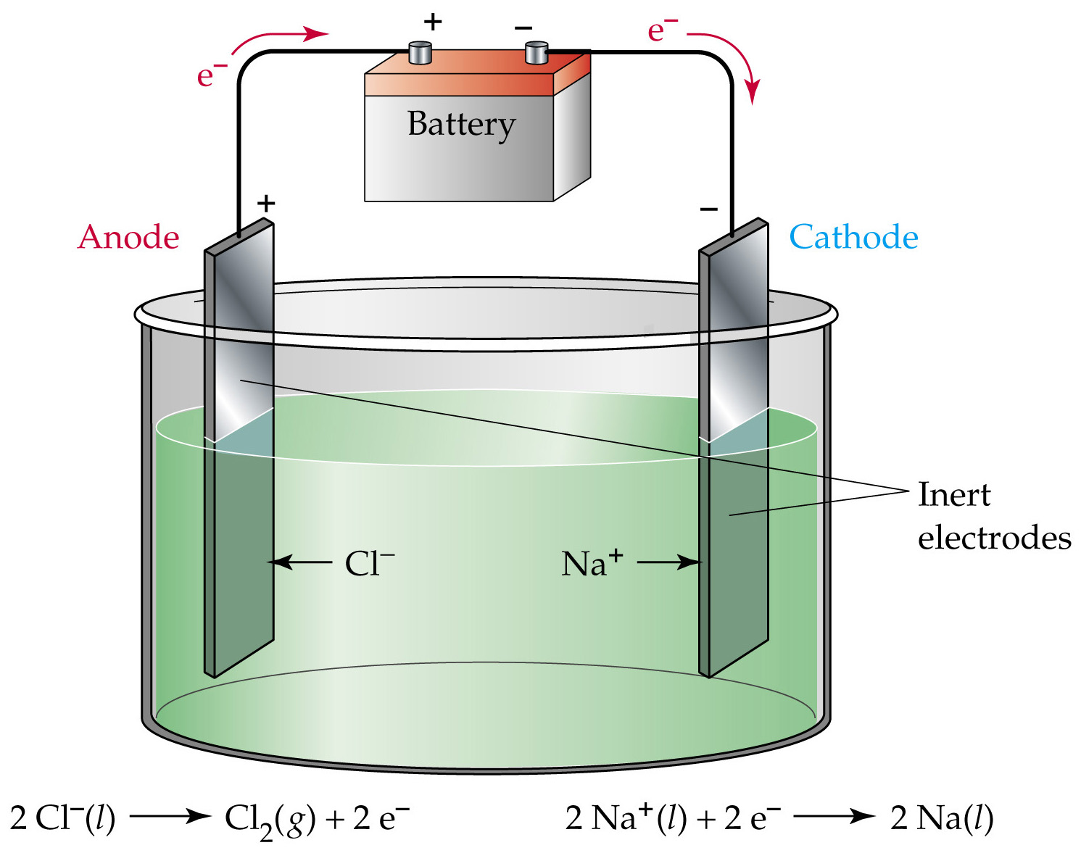
Electrolysis of aqueous sodium chloride
Concentrated NaCl_{(aq)}

Slide 4
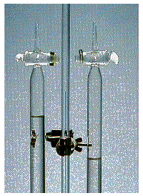
Electrolysis of H₂0
2 H₂0 2H₂ + O₂
O₂
H₂
Stoichiometric ratio of H₂ : O₂ = 2 : 1

Slide 5
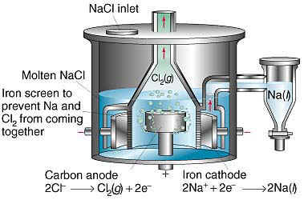
Electrolysis of molten sodium chloride

Slide 6
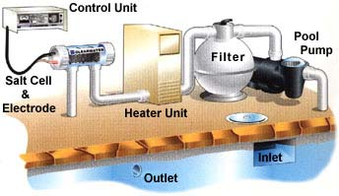
Electrolytic Salt Pool Chlorinator
Cell
Salt in the pool water passes through a cell fitted in the pipe work, where electrolysis produces chlorine gas.
2 Cl⁻  Cl₂ + 2e⁻

Slide 7
Electrolytic Salt Pool Chlorinator
2 Cl⁻  Cl₂ + 2e⁻
The gas dissolves instantly into the water, forming hypochlorous acid and hydrochloric acid.
Cl_{2(aq)} + H2O_{(l)}  H⁺_{(aq)} + Cl⁻_{(aq)} + HClO_{(aq)}
and by the oxidation process reverts back to salt after the chlorine has killed any infection.
HClO_{(aq)} + H⁺_{(aq)} + 2e⁻  Cl⁻_{(aq)} + H2O_{(l)}
Hypochlorous acid is a strong oxidising agent.

Slide 8
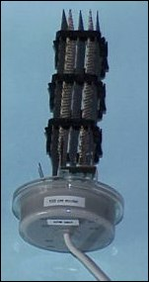
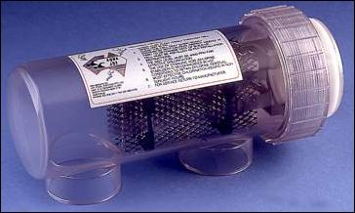
Electrolytic SALT POOL CHLORINATOR
Salt Cell
Salt Cell electrodes

Slide 9
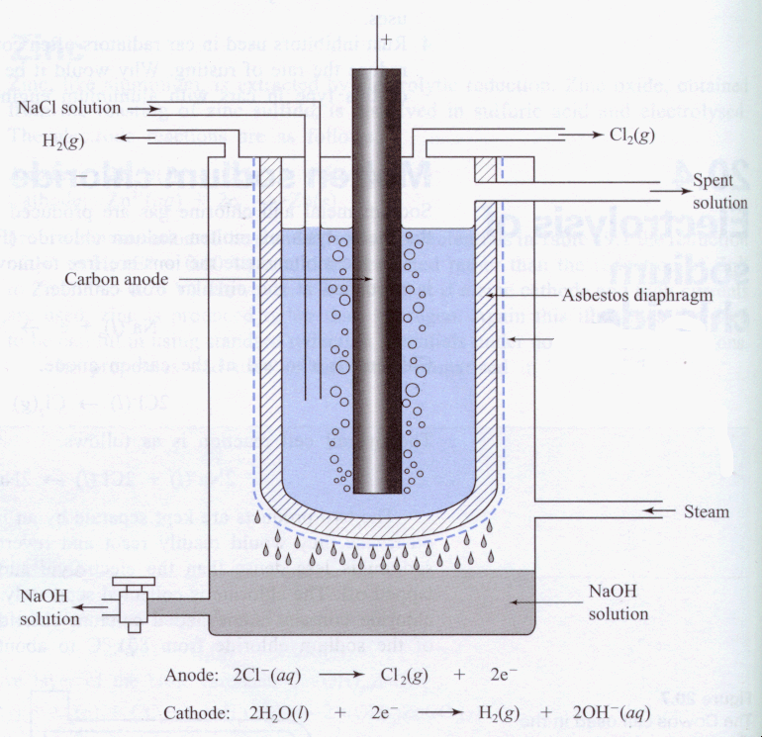
Electrolysis
Of Aqueous
Sodium chloride
Steel mesh cathode

Slide 10
Faraday's laws of electrolysis:
Faraday’s 1st Law may be stated as follows:
"The amount of any substance deposited, evolved, or dissolved at an electrode is directly proportional to the amount of electrical charge passing through the circuit.”
The amount of electricity passing through the circuit in a given time is the number of moles of electrons passing through the circuit in that time, and the charge Q is related to the current I by
The charge on the electron is 1.602 x 10⁻¹⁹ C, and Avogadro's number is 6.023 x 10²³. It follows that one mole of electrons is 9.649 x 10⁴ C. This quantity is known as the Faraday or Faraday's constant (F).
Q = i t

Slide 11
Worked Example of Faraday’s 1st Law
What mass of metallic silver will be deposited from silver nitrate solution when a current of 0.53 A is passed through it for 95 min ?
The total charge, Q, passed through is the product of the
current (in amperes) and the time (in seconds). Thus,
Q = It = 0.53 x 95 x 60 = 3020 C
n(e⁻) = 3020/9.649x10⁴ = 3.13 x 10⁻² moles
Half-reaction of the reduction of silver is: Ag⁺ + e⁻  Ag. This tells us that one mole of electrons will reduce one mole (107.9 g) of silver ions.
Hence the mass of silver produced will be
m(Ag) = n x M = 3.13 x 10⁻² x 107.9 = 3.38 g.

Slide 12
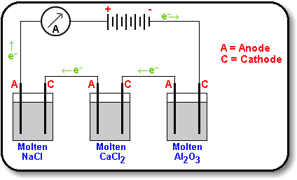
Faraday’s 2nd Law"The mass of different substances produced by the same quantity of electricity are directly proportional to the molar masses of the substances concerned, and inversely proportional to the number of electrons in the relevant half-reaction."
1 Faraday (1 mole of e-) will discharge 9 g Al (1/3 mole), 20 g Ca (1/2 mole) and 23 g Na (1 mole).
The relevant half reactions are:
Al³⁺ + 3e⁻  Al
Ca²⁺ +2e⁻  Ca
Na⁺ + e⁻  Na

Slide 13
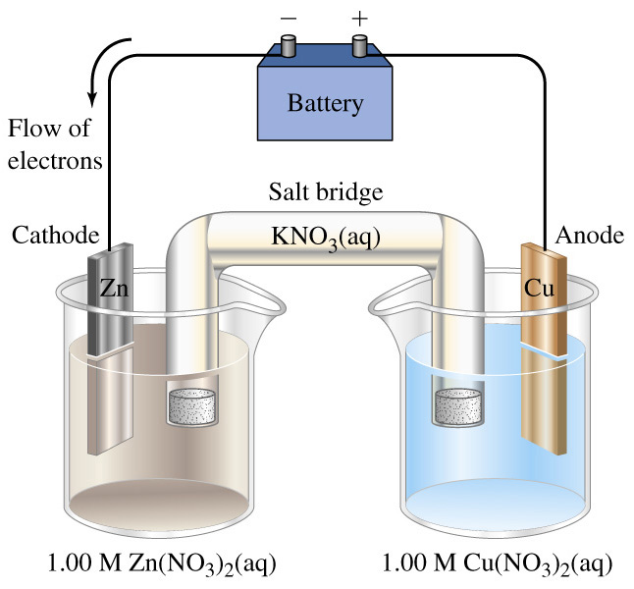

Slide 14
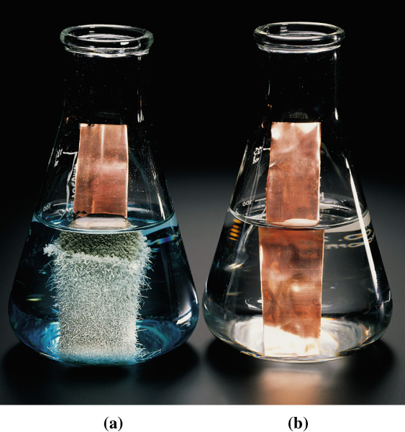

Slide 15
http://www.physchem.co.za/Redox/Electrolysis.htm
More good stuff

Slide 22
End of Slide Show
To Return to Year 12 Tutorial List
Choose Back from Menu above

