Slide 1

General Reaction Types
Year 12 Chemistry.
Section 1 : Inorganic reactions

Slide 2
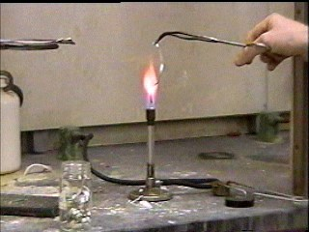
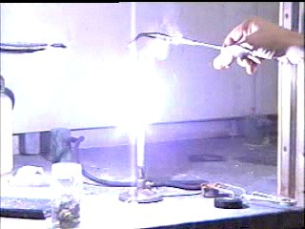
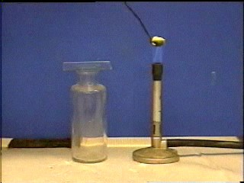
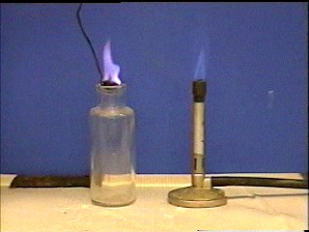
INORGANIC REACTIONS
1. ELEMENT + OXYGEN  OXIDE
Eg.1. 2Mg + O₂  2MgO (a metal oxide, hence basic)
Eg.2. S₈ + 8O₂  8SO₂ (a non-metal oxide, hence acidic)

Slide 3
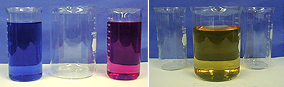
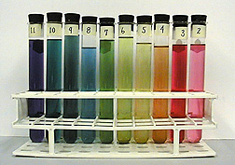
2a. ACID + BASE  SALT + WATER
(acid, (metal oxide, ammonia
non-metal oxide) metal hydroxide)
e.g. HCl + NaOH  NaCl + H₂O

Slide 4
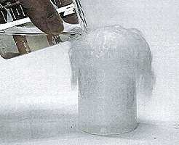
2b. ACID + BASE  SALT + WATER + CARBON DIOXIDE
(acid, (metal carbonate,
non-metal oxide) metal hydrogen carbonate)
e.g. 2HCl + CaCO₃  CaCl₂ + H₂O + CO₂

Slide 5

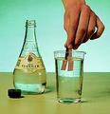
2c. ACIDIC OXIDE + WATER  ACID
(non metal oxide)
e.g. CO₂ + H₂O  H₂CO₃

Slide 6
2d. BASIC OXIDE + WATER  BASE
(metal oxide)
e.g. BaO + H₂O  Ba(OH)₂

Slide 7
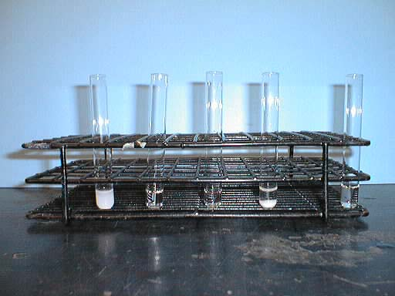
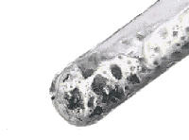
3. ACID + SOME METALS  SALT + HYDROGEN
(above H in activity series)
e.g. 2HCl + Zn  ZnCl₂ + H₂ [Except conc H₂SO₄ and HNO₃ (dil or conc)].

Slide 8
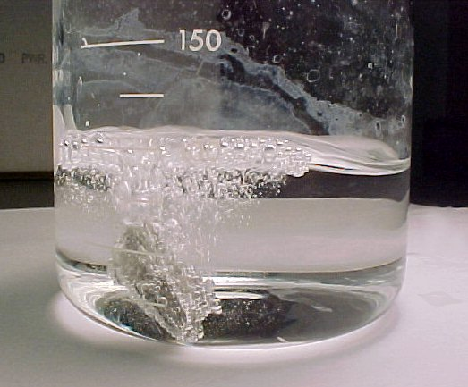
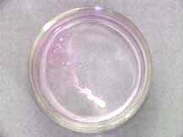
4. REACTIVE METAL + WATER  METAL HYDROXIDE + HYDROGEN
e.g. 2Na + 2H₂O  2NaOH + H₂

Slide 9
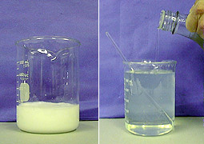
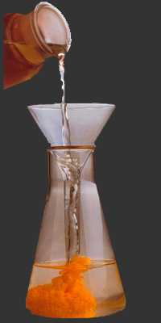
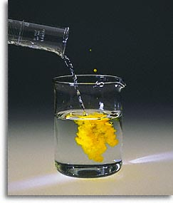
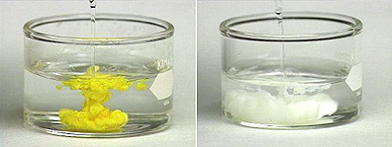
5. PRECIPITATION REACTIONS  occur when solutions containing ions are mixed,
and one of the products is and insoluble compound. (See Chem. Data Sheet).
e.g. AgNO_{3(aq)} + NaCl_{(aq)}  AgCl_{(s)} + NaNO_{3 (aq)}

Slide 10
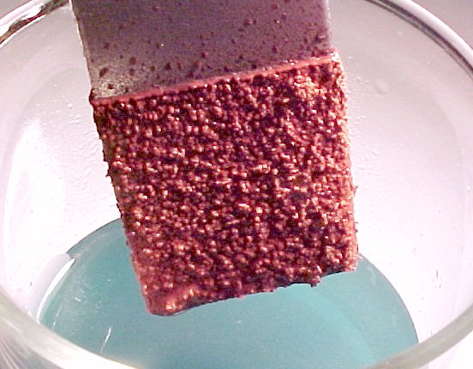
6. METAL DISPLACEMENT  when metal atoms (of a more reactive metal) displace
metal ions (of a less reactive metal) from solution.
e.g. 2AgNO_{3(aq)} + Fe_{(s)}  Fe(NO₃)_{2(aq)} + 2Ag _{(s)}
Zn in CuCl2

Slide 11
7. ACID + METAL SULFIDE  SALT + HYDROGENSULFIDE
e.g. H₂SO₄ + FeS  FeS0₄ + H₂S

Slide 12
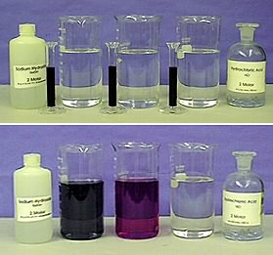
8. REDOX REACTIONS
e.g. Burning magnesium in air
Reduction = gain of electrons O_{2(g)} + 4e⁻  2O²⁻_{(s)}
Oxidation = loss of electrons 2Mg_{(s)}  2Mg²⁺_{(s)} + 4e⁻
Redox : 2Mg_{(s)} + O_{2(g)}  2O²⁻_{(s)} + 2Mg²⁺_{(s)}
In electrolysis : oxidation occurs at the anode & reduction at the cathode.

Slide 13
heat
9. METAL CARBONATE  METAL OXIDE + CARBON DIOXIDE
(not Na₂CO₃ or K₂CO₃)
e.g. CaCO₃  CaO + CO₂

Slide 14
10. METAL HYDROGENCARBONATE   METAL CARBONATE + WATER + CO₂
e.g. 2 NaHCO₃  Na₂CO₃ + H₂O + CO₂
* If heating is strong the carbonate formed may further decompose to the oxide, as in 9. (above)

Slide 15
11. DECOMPOSITION A substance breaks down or decomposes into simpler substances.
e.g. 2 HgO_{(s)}  2 Hg_{(l)} + O_{2(g)}

Slide 16
Amphoteric Substances. These include either metal, oxide or hydroxide of Al, Cr, Zn, Pb, Sn.

Slide 17
12a AMPHOTERIC Substance + ACID  SALT + WATER (as per normal acid base reaction)
Eg. Al₂O_{3(s)} + 3 H₂SO_{4(aq)}   Al₂(SO₄)_{3(aq)} + 3 H₂O_{(l)}

Slide 18
12b Amphoteric Metal + Hydroxide  Complex ion + Hydrogen
Eg. 2 Al_{(s)} + 2 OH⁻_{(aq)} + 6 H₂O_{(l)}   2 [Al(OH)₄]⁻_{(aq)} + 3 H_{2(g)}

Slide 19
12c Amphoteric Metal Oxide + Hydroxide  Complex ion
Eg. Al₂O_{3(s)} + 2 OH⁻_{(aq)} + 3 H₂O_{(l)}   2 [Al(OH)₄]⁻_{(aq)}

Slide 20
12d Amphoteric Metal Hydroxide + Hydroxide  Complex ion
Eg. Al(OH)_{3(s)} + OH⁻_{(aq)}   [Al(OH)₄]⁻_{(aq)}

Slide 21
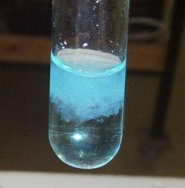
Transition Metal Complexes
13 Transition Metal ion + limited Ammonia Solution  Metal Hydroxide precipitate
Eg. Cu²⁺_{(aq)} + 2 OH⁻_{(aq)}   Cu(OH)_{2(s)}
Addition of more ammonia solution results in the dissolving of the hydroxide and formation of a complex.
Transition Metal ion + excess Ammonia Solution  Metal Ammonia complex
Eg. Cu(OH)_{2(s)} + 4 NH_{3(aq)}   [Cu(NH₃)₄]²⁺_{(aq)} + 2 OH⁻_{(aq)}
The formulae & colour of these complex ions can be found on the Chem. Data Sheet
Oxidising Acid/Metal Reactions NB : Use half-equations to get balanced reaction

Slide 22
14 Dilute Nitric Acid + Metal  Metal Ions + Nitric Oxide + Water
Eg. 3 Mg_{(s)} + 2 NO₃⁻_{(aq)} + 8H⁺_{(aq)}  3 Mg²⁺_{(aq)} + 2 NO_{(g)} + 4 H₂O_{(l)}

Slide 23
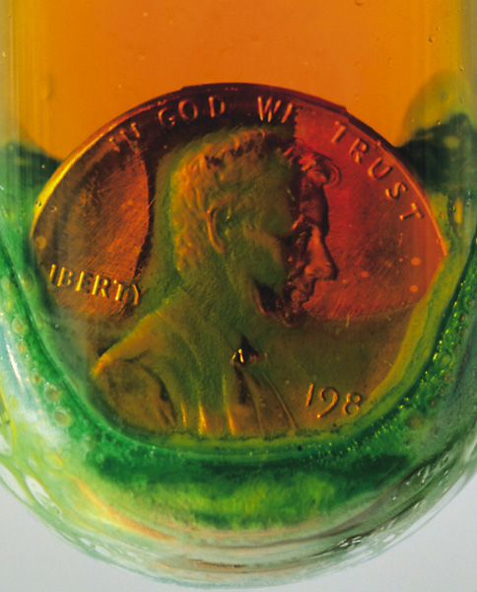
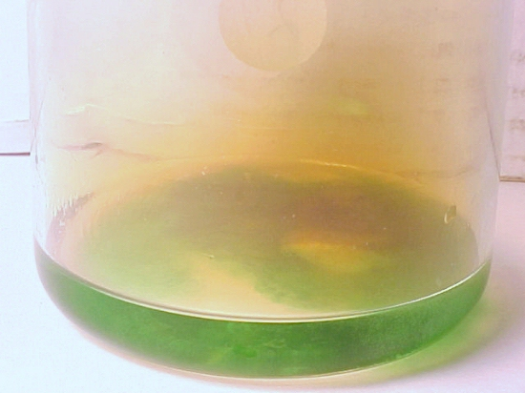
15 Concentrated Nitric Acid + Metal  Metal Ions + Nitrogen Dioxide + Water
Eg. Cu_{(s)} + 4H⁺_{(aq)} + 2 NO₃⁻_{(aq)}  Cu²⁺_{(aq)} + 2 NO_{2(g)} + 2 H₂O_{(l)}

Slide 24
16 Conc. Sulfuric Acid + Metal  Metal Ions + Sulfur Dioxide + Water + Sulfate Ions
Eg. Cu_{(s)} + 2 H₂SO_{4(l)}  Cu²⁺_{(aq)} + SO_{2(g)} + 2 H₂O_{(l)} + SO₄²⁻_{(aq)}

Slide 25
ORGANIC REACTIONS – Year 11
1. HYDROCARBON + OXYGEN  CARBON DIOXIDE + WATER
ie Combustion e.g. C₅H₁₂ + 8 0₂  CO₂ + H₂O

Slide 26
2. Substitution reactions - Alkanes only.
Halogenation RH + X₂ + UV  RX + HX

Slide 27
3. Addition reactions - Alkenes/Alkynes.
Hydrogenation RCH=CH₂ + H₂  RCH₂CH₃
H₂SO₄
Hydrohalogenation RCH=CH₂ + HX  RCHXCH₃
Hydration: Alkene + Water  Alcohol RCH=CH₂ + H₂O  RCOHCH₃

Slide 28
4. CYCLIC HYDROCARBON REACTIONS
Cycloalkanes undergo the same types of reactions as alkanes, eg. Combustion and substitution,
Similarly cycloalkenes and cycloalkynes undergo the same types of reactions as alkenes and alkynes, eg. Combustion and addition.

Slide 29
5. AROMATIC HYDROCARBON REACTIONS
Halogenation Eg. benzene + bromine  bromobenzene + hydrogen bromide
Nitration Eg. benzene + nitric acid  nitrobenzene + water
Alkylation Eg. benzene + 1-chloropropane  propylbenzene + hydrogen chloride

Slide 30
ORGANIC REACTIONS – Year 12
H⁺
6. Alcohol + Carboxylic Acid  Ester + Water
ie. Esterification ROH + R’COOH  RCOOR’ + H₂O

Slide 31
7. 1° Alcohol + MnO₄⁻_{(aq)} + H⁺_{(aq)} "  Aldehyde Acid
RCH₂OH  RCHO  RCOOH

Slide 32
8. 2° Alcohol + MnO₄⁻_{(aq)} + H⁺_{(aq)} "  Ketone
RCHOHR’  RCOR’

Slide 33
9. 3° Alcohol + MnO₄⁻_{(aq)} + H⁺_{(aq)} "  No Reaction
RCH2OH  RCHO  RCOOH

Slide 34
10. Alcohol + Sodium  Alkoxide + Hydrogen
2 ROH + 2 Na  2 RO⁻Na⁺ + H₂

Slide 35
11. Polymerisation
_{Catalyst}
Addition n (CH₂ = CH)  n(---CH2-CH---)  ( CH2-CH ) _{n}
R R R
Condensation n Dicarboxylic Acid + n Diol(or Diamine)  Polymer + 2n H₂O
n(HOOC-R-COOH) + n(HO-R’-OH)  ( OC-R-COO-R’-O ) _{n} + 2n H₂O

Slide 36
12. Saponification fat + Sodium hydroxide  soap + glycerol
CH₂OOCR CH₂OH
CHOOCR + 3NaOH  3RCOONa + CHOH
CH₂OOCR CH₂OH

Slide 37
13. Detergent Production fat + Sodium hydroxide  soap + glycerol
Step 1 : Alkyl benzenes + conc. sulfuric acid  alkylbenzene sulfonic acid
Step 2 : Alkylbenzene sulfonic acid + sodium hydroxide  sodium alkylbenzene sulfonate detergent

