Slide 1

Atomic size

Slide 2
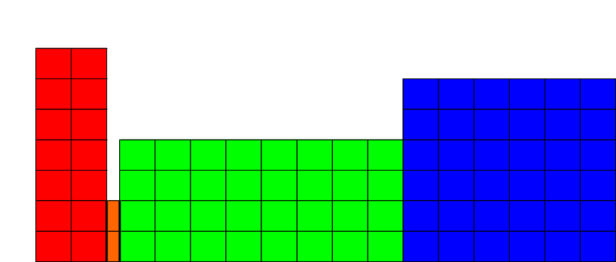
Patterns in Atomic Size
Atomic size refers to the distance that the furthest (valence) electrons are from nucleus
It can affect the properties of atoms & elements
Which
Is
Bigger?
a) Ne or Ar
b) B or C
c) P or Ge
Larger
Larger
Electron configuration for Br: [Ar]4s²3d¹⁰4p⁵, valence electron configuration for Br: 4s²4p⁵.
We often only focus on valence electrons: they are involved in reactions and determine size
Two factors affect size: n and the balance between attractions & repulsions in the atom.

Slide 3
Decreasing Atomic Size Across a Period
As the attraction between the +ve nucleus and the -ve valence electrons ↑, the atomic size ↓.
From left to right, size decreases because there is an increase in nuclear charge and Effective Nuclear Charge (# protons – # core electrons)
Each valence electron is pulled by the full ENC
Li (ENC = 1)
Be (ENC = 2)
B (ENC = 3)
+
+
+
+
+
+
+
+
+
+
+
+

Slide 4
Sizes of ions
Ions are atoms that have either gained or lost electrons (so that the # of electrons is not equal to the # of protons)
The size of an atom can change dramatically if it becomes an ion (reference: pg. 214)
E.g. when sodium loses its outer electron to become Na⁺ it becomes much smaller. Why?
Na⁺ is smaller than Na because it has lost its 3s electron. Its valence shell is now 2s²2p⁶ (it has a smaller value of n)
Changing n values is one explanation for the size of ions. The other is …

Slide 5
Sizes of ions: electron repulsion
Valence electrons push each other away
When an atom becomes a –ve ion (adds an electron to its valence shell) the repulsion between valence electrons increases without changing ENC
Thus, F– is larger than F
9 +

Slide 6
Sizes of ions: electron repulsion
Valence electrons push each other away
When an atom becomes a –ve ion (adds an electron to its valence shell) the repulsion between valence electrons increases without changing ENC
Thus, F– is larger than F
9 +
Sort from largest to smallest: Mg, Mg⁺, Mg²⁺. Explain your answer. Pg. 215 PE 11
pg. 221 6.79, 6.82, 6.83, (6.84), 6.85

Slide 7
Sizes of ions: electron repulsion
Sort from largest to smallest: Mg, Mg⁺, Mg²⁺.
Mg is largest.
Mg⁺ has lost one electron. There is less repulsion between valence electrons (actually none, since there is now only one valence electron). Less repulsion means the valence electron can move closer to the nucleus (i.e. the atom/ion becomes smaller)
Mg²⁺ is the smallest. It has lost both of its 3s electrons. The n value of valence electrons drops from 3 down to 2, making the ion smaller

Slide 8
Pg. 215 PE 11
a) Sn, b) Ga, c) Fe, d) S²⁻
pg. 221
6.79: a) Na, b) Sb
6.82: the largest atoms are in the bottom left, the smallest are in upper right corner
6.83: All have the same number of electrons (with a configuration similar to Ne). Mg²⁺ has the most protons and will therefore be smaller. In order from smallest to largest:
Mg²⁺, Na⁺, Ne, F⁻, O²⁻, N³⁻
6.84: In period 4, for example, electrons are added to the inner 3d shell, not the valence 4s
6.85: a) Na, b) Co²⁺, c) Cl⁻

Slide 9
Ionization energy
Ionization energy is the energy required to remove an electron from a gaseous atom
If n is small & ENC is large, electrons will be difficult to remove (i.e. the IE will be high)
Be
B
+
+
+
+
+
+
+
+
+

Slide 10
Ionization energy
Ionization energy is the energy required to remove an electron from a gaseous atom
If n is small & ENC is large, electrons will be difficult to remove (i.e. the IE will be high)
There are as many IEs as there are electrons
Subsequent IEs are higher than the first because you are removing a -ve charge (electron) from an increasingly +ve atom/ion
Subsequent IEs make a huge jump after the electrons in the outer shell are lost - it is not difficult for Mg to lose 12th and 11th electron, but very difficult for it to lose it’s 10th electron.
If you are asked for a trend in IE, talk about 1st

Slide 11
Electron Affinity
Ionization energy: 6.12, electron affinity: 6.13
Electron affinity is the energy related to adding an electron to a gaseous atom
Represented as X(g) + e– → X–(g)
Whereas IE is: X(g) → X⁺(g) + e–
The trend for EA is the same as that for IE
Imagine an atom with a high IE. It is difficult to remove an electron (due to a small size or high ENC); so, it will also be easy to add a new one
Noble gases do not follow the trend in EA (a filled valence shell makes it energetically unfavorable to add an electron)
PE 12 (pg 217), RE (pg 221) 6.86 – 6.90

Slide 12
Trends in Size, IE, and EA – add to slide 1
IE, and EA are the opposite of atomic radius
Larger
Size
Larger
Ionization energy
Larger
Larger
Electron Affinity
Larger
Larger

Slide 13
Energy: exothermic, endothermic
Energy can be described according to whether we are gaining or losing energy
Endothermic: requires energy (given a + sign)
E.g. lifting a book, removing an electron
Exothermic: gives off energy (given a – sign)
E.g. dropping a book.
IE is positive (it takes energy to remove an e–)
1st EA is negative (energy is given off – i.e. it is energetically favorable to add an electron)
After 1st EA, energy may be required to add electrons to an increasingly negative atom/ion
Note an EA of –200 is greater than –100
For more lessons, visit www.chalkbored.com

