Slide 1


Electronic structure
Notes:
Equipment:
OAC video 0-20
spectroscopes
gas discharge tubes and related equipment

Slide 2
Background: basic structure
6.1: Review (do not have to know details) - shows evidence for the basic atomic model
Sub-atomic particles include: Protons (p⁺), neutrons (n°) and electrons (e–)
n°: neutral, massive, in nucleus, e–: -ve, small mass, orbits, p⁺: +ve, massive, in nucleus
Nucleus is small compared to size of atom
e–
p+
n°
n°
p+
Helium atom is shown
e–

Slide 3
Background: basic structure
Previous slide was a single atom
Let’s look at a compound:
Cl
Na
Notice that the nuclei are far apart
In other words, it’s the electrons that are important in bond formation

Slide 4
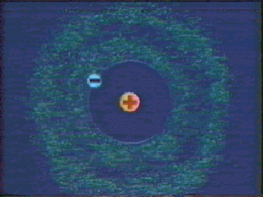
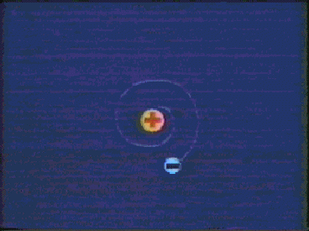
Background: Movie
See movie (0 - 10) 0 - 7: as above
7 - 10: Rutherfords model is in trouble: an “accelerated charge” should fall into nucleus
Bohr revised Rutherford’s model to explain the existance of line spectra for elements…
See Fig 6.10 (pg. 192) or refer to demo (spectroscopes act like prisms to separate light into its component colours)

Slide 5
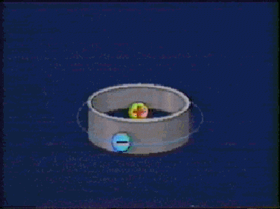
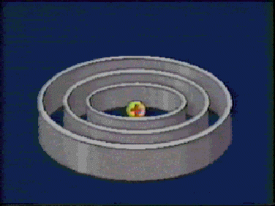
Movie: electron orbits
See movie 10 - 20
10 - 14: Bohr suggests that electrons can only exist in certain orbits

Slide 6
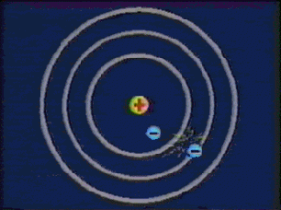
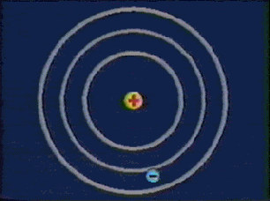
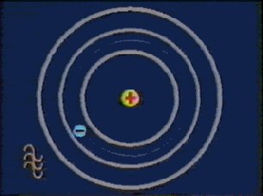
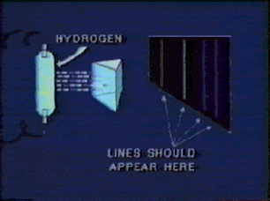
Movie: line spectra
14 -16: Line spectrum result from the release of photons as electrons fall back to lower orbit

Slide 7
Light as a wave
To understand the evidence that led Bohr to his conclusion we must understand something about the nature of light…
Read pg. 188 - 189
light is a type of EM energy and has wave properties
Wavelength and frequency are related by λ x ν = c = 3.00 x 10⁸ m/s
Frequency (or wavelength) determines the type of radiation (Figure 6.7)

Slide 8
Study notes
Point: your “study notes” should be in a form that allows you to study most efficiently:
Question
Answer
Benefit: Allows you to quiz yourself
Benefit: Eventually, you can eliminate questions that you already know, leaving only what you need to know

Slide 9
The speed of EM waves
Which is a radio wave, which is a visible wave (not drawn to relative scale)
Observe what happens as they move through space (at same speed of c)
Visual
Radio

Slide 10
The speed of EM waves
Which is a radio wave, which is a visible wave (not drawn to relative scale)
Observe what happens as they move through space (at same speed of c)
Visual
Radio

Slide 11
The speed of EM waves
Which is a radio wave, which is a visible wave (not drawn to relative scale)
Observe what happens as they move through space (at same speed of c)
Visual
6 Hz
Radio
3 Hz
The longer the wavelength, the smaller the frequency has to be to keep c constant

Slide 12
The speed of EM waves
Q - Which of the following has the higher frequency (fig 6.7, pg.189):
a) visible light or UV (choose one)
b) X-rays or radio waves (choose one)
Q - Which of the following pairs has the longer wavelength:
c) Infrared or Ultraviolet (choose one)
d) Gamma rays or Radio waves (choose one)
For more lessons, visit www.chalkbored.com

