Slide 1
Bohr’s successes and failures:
The wave nature of the electron

Slide 2

Proceed with caution
The next three classes will be the most difficult (conceptually) in the course. Do not get discouraged. It all makes sense once you get through it.

Slide 3
The Photon and Quantum
Read 192-194 (up to “The significance...”)
Introduced to the concept of the photon
light is still traveling as a wave, but not as an unlimited one
Like this
Not this
The energy of a photon is: E = hv
I.e. energy is dependent upon frequency
Pg. 219 - 220, Q. 6.12, 6.19, 6.21, 6.23

Slide 4
Questions
Pg. 219 - 220, Q. 6.12, 6.19, 6.21, 6.23
6.12 - c = λ x v = 3.00 x 10⁸ c-speed of light (in m/s), λ-wavelength (in meters), v-frequency (in Hz)
6.19 - E = hv E-Energy, h-planks constant, v-frequency
6.21 - a) infrared, b) visible, c) x-rays, d) UV
6.23 - The energy associated with one photon

Slide 5
Explaining the line spectrum
Read remainder of pg. 194
The jumps between orbitals have different energies (like jumping between different steps on a staircase)
Energy dictates frequency (E = hν)
frequency dictates type of EM radiation, or type of colour
Conclusion: the different lines of the spectra are explained by the different energies between orbitals

Slide 6
The Bohr model of the atom
Recall that Bohr added to Rutherford’s model the idea of fixed shells
Evidence for Bohr’s Theory came from the existence of line spectra
However, Bohr had difficulty explaining other observations
Study notes

Slide 7
Important aspects of Bohr’s model
Introduced the concept of n
Q - What is n (give name and explain)
A -Quantum number. Basically, it means shell. Each shell has a different quantum number
Introduced the concept of ground state: the lowest energy state of an atom
For hydrogen the ground state is when the electron is in n = 1. Later, elements with more than 2 electrons have ground states where some electrons are in n =2 or higher.

Slide 8
Bohr: testing concepts
Q - How many lines are in the spectrum for H (i.e. how many possible values of E exist)?
A - Theoretically, an infinite number (because n ranges from 1 to infinity) - according to Bohr’s equation (E= -k/n²) if the values of n are infinite than so are the values of E.
Q - Why don’t we see all the lines (2 reasons)
A1 - Some will fall outside the visible spectrum
A2 - The higher the shell, the less likely the electron is to be there. The jumps from some shells (e.g. n = 100 to n = 1) are so infrequent that they are either invisible or practically non- existent

Slide 9
The Wave Nature of Matter
Reference 6.4
Louis de Broglie (1924) suggested that electrons are also waves (not particles)
This can be difficult to comprehend: normally we perceive objects as solid.
The reason objects seem solid is because they have a small wave length…
According to De Broglie: λ = h/mv
All that really matters is that mass is on the bottom, so as mass gets large, λ gets small
small m
large m

Slide 10
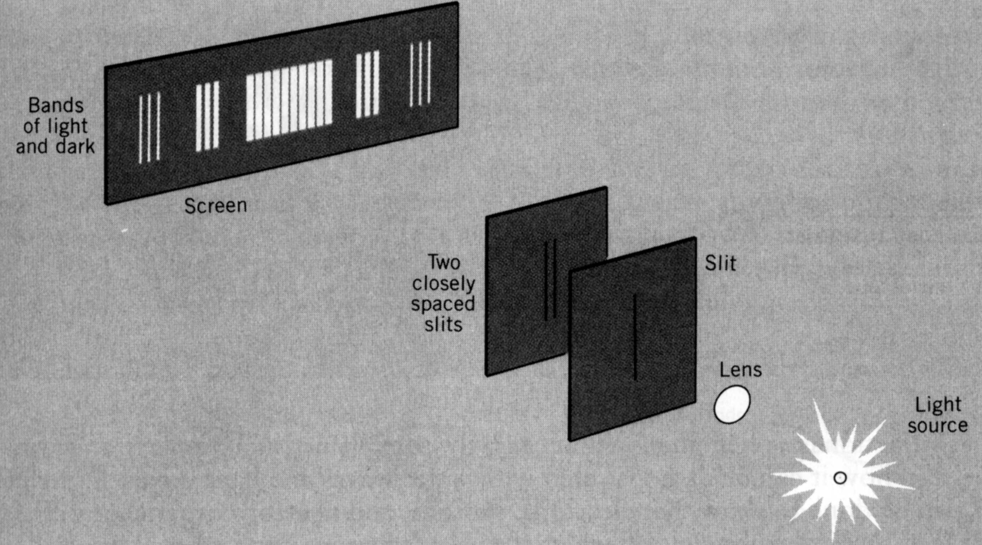
Evidence For Wave Nature
2 lines of evidence show that electrons have wave properties: 1) diffraction pattern of light, 2) electron microscopes
1) Areas of light and dark indicate typical interference pattern of waves such as water waves
Fig 6.16

Slide 11
2) The Electron Microscope
The wavelength determines the resolution of a microscope
A) Visible light has a wavelength of ≈500 nm
B) Electrons have a wavelength of ≈0.005 nm
A shorter wavelength means waves cannot slip pass edges of a sample, thus yielding a sharper image
A
B
Read 6.4, Do 6.33, 6.34 on Pg. 220.

Slide 12
Answers - pg. 220
6.33 - Massive objects have such small wavelengths that they appear to be solid
6.34 - Diffraction is the characteristic interference pattern of waves (fig. 6.16). The fact that electrons show a diffraction pattern indicates that they are waves.
For more lessons, visit www.chalkbored.com

