Slide 1
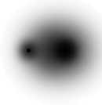
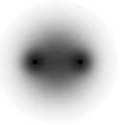
Electronegativity
δ⁺
δ–
δ⁰
δ⁰
H
Cl
H
H

Slide 2
Electronegativity
δ⁺
δ–
Electronegativity describes how electrons are shared in a compound
Consider the compound HCl
H
Cl
The electron clouds represent where the two electrons in the HCl bond spend their time (sizes of atoms are not being shown)
The shared electrons spend more time around Cl than H. In other words Cl is more electronegative than H.

Slide 3
Electronegativity table
The relative attraction for electrons is summarized in figure 7.11 (pg. 255)
These numbers are derived from several factors including EA, IE, ENC, atomic radius
You do not need to understand where the numbers come from
You need to know that a high number means the element has a greater pull on electrons
You will also need to calculate the difference between values to estimate the % ionic or % covalent character of a bond
PE 12 (pg. 256). Reference: 7.10.

Slide 4
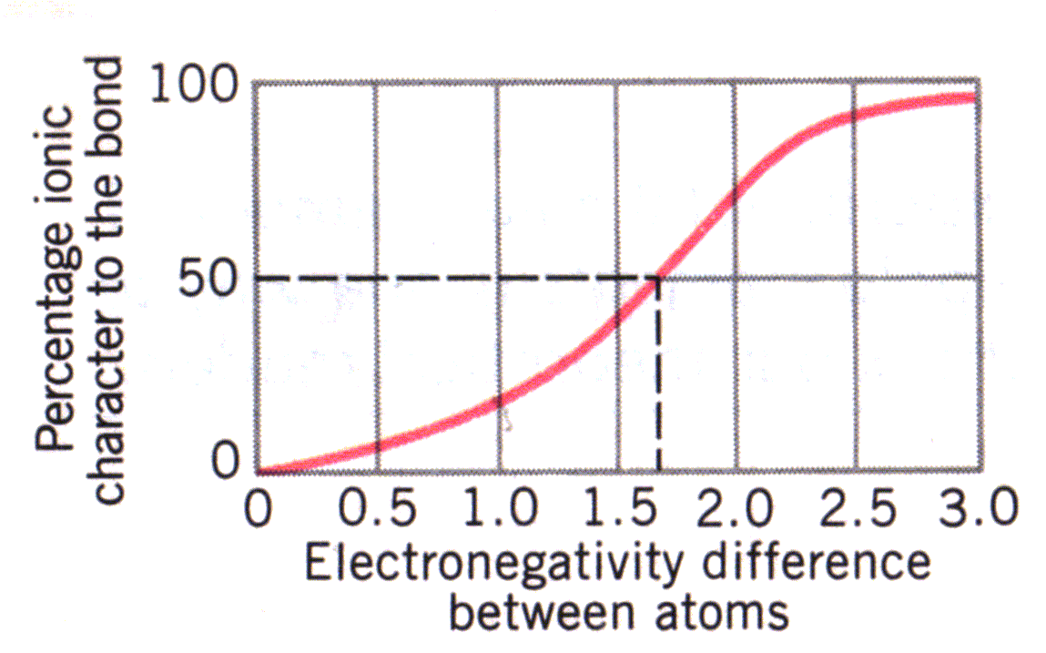
Answers

Slide 5
Calculating EN differences
The first step in defining the polarity of a bond is to calculate electronegativity difference (Δ EN)
Δ EN = EN large - EN small
E.g. for NaCl, Δ EN = 2.9 - 1.0 = 1.9
Next, estimate from fig 7.12 the % ionic character: about 65% (60 - 70%)
Q-Give the % ionic character for MgO, CH, HCl
MgO = 3.5 - 1.3 = 2.2 … 80% ionic (75-85)
CH = 2.5 - 2.1 = 0.4 … 7% ionic (5 - 10)
HCl = 2.9 - 2.1 = 0.8 … 20 % ionic (15-25)
Note if % ionic is 20%, then % covalent is 80%

Slide 6
Defining polarity
For our purposes we will define polarity in the following fashion: 0-10 % is non-polar, 10-50% is polar (covalent), 50%+ is ionic
This is a crude estimate. In reality, the only non-polar bond between 2 atoms occurs in diatomic molecules (O₂: Δ EN = 3.5 - 3.5 = 0)
Q - what is the polarity of the bonds in MgO, CH, HCl?
MgO = 80% ionic = ionic
CH = 7% ionic = non-polar
HCl = 20 % ionic = polar covalent

Slide 7
Polarity in molecules
A bond that you calculate to be polar may not be polar if the molecule is symmetrical
Imagine a tug-of-war between atoms of the same strength around a central atom
The pull in one direction is the bond polarity or “bond dipole”. The overall/molecular polarity is also known as “dipole moment”
If the pull is the same from all directions then the electrons are not attracted to one atom over another and the molecule is non-polar
Read 7.11 (bottom of 256 - 259) including the examples. Complete the worksheet.

Slide 8
Polarity in molecules: Examles
 | NH₃ | NH₄⁺ | BrCl
Lewis Structure
ΔEN of bonds
Bond polarity
Symmetrical molecule?
Polarity
For more lessons, visit www.chalkbored.com

