Slide 1
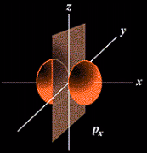
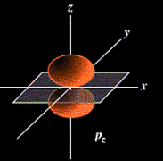
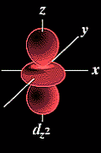
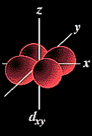
Shapes and Orientations of Orbitals

Slide 2
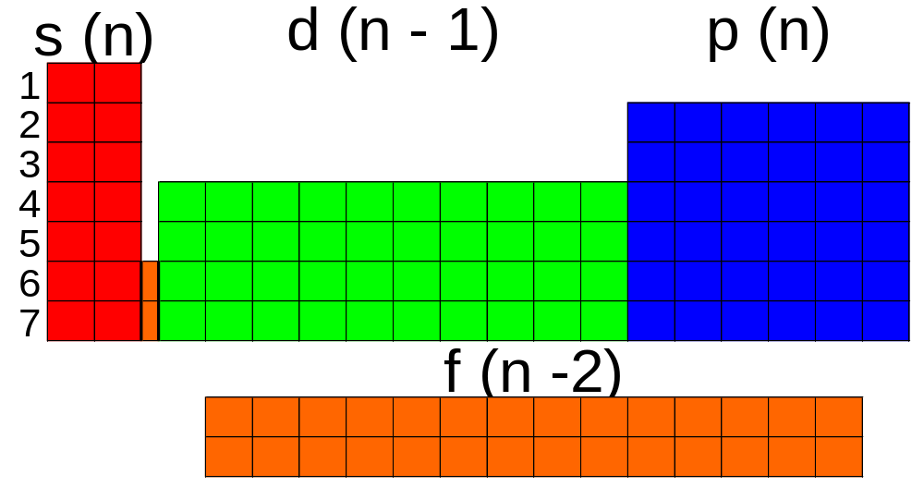
Periodic table arrangement
the quantum theory helps to explain the structure of the periodic table.
n - 1 indicates that the d subshell in period 4 actually starts at 3 (4 - 1 = 3).

Slide 3
Periodic table and quantum theory
The 2, 6, 10, 14 columns of the periodic table correspond to s (l=0, m_{l}=0), p (l=1, m_{l}= -1,0,1), d (l=2, m_{l}= -2,-1,0,1,2) and f (-3,-2,-1,0,1,2,3)
See fig. 6.21 (pg. 208) and fig. 6.22 (pg. 209)
Note that electron configurations are true whether we are speaking of an atom or ion: 1s²2s²2p⁶ describes both Ne and Na⁺
Q – based on figure 6.22 what are the shorthand electron configurations for Br–, Sn, Sn²⁺, Pb?
A – [Ar]4s²3d¹⁰4p⁶, [Kr]5s²4d¹⁰5p², [Kr]5s²4d¹⁰,
[Xe]6s²4f¹⁴5d¹⁰6p² or [Xe] 4f¹⁴5d¹⁰6s²6p²
Periodic tables

Slide 4
Unusual electron configurations
Look at your value for Cu ([Ar]4s²3d⁹).
The actual value for Cu is [Ar]4s¹3d¹⁰… why?
The explanation is that there is some sort of added stability provided by a filled (or half-filled subshell).
Read 6.8 (pg. 207 - 8)
The only exceptions that you need to remember are Cr, Cu, Ag, and Au.
The inner transition elements also do not follow expected patterns. However, we do not address this in OAC chemistry.

Slide 5

Heisenberg’s uncertainty principle
Electrons are difficult to visualize. As a simplification we will picture them as tiny wave/particles around a nucleus.
The location of electrons is described by: n, l, m_{l}
n = size, l = shape, m_{l} = orientation
Heisenberg showed it is impossible to know both the position and velocity of an electron.
Think of measuring speed & position for a car.
Slow
Fast

Slide 6
Heisenberg’s uncertainty principle
The distance between 2+ returning signals gives information on position and velocity.
A car is massive. The energy from the radar waves will not affect its path. However, because electrons are so small, anything that hits them will alter their course.
The first wave will knock the electron out of its normal path.
Thus, we cannot know both position and velocity because we cannot get 2 accurate signals to return.

Slide 7
Electron clouds
Although we cannot know how the electron travels around the nucleus we can know where it spends the majority of its time (thus, we can know position but not trajectory).
The “probability” of finding an electron around a nucleus can be calculated.
Relative probability is indicated by a series of dots, indicating the “electron cloud”.
90% electron probability/cloud for 1s orbital (notice higher probability toward the centre)

Slide 8
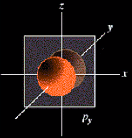
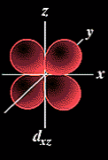
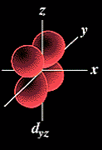
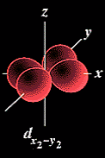
Summary: p orbitals and d orbitals
p orbitals look like a dumbell with 3 orientations: p_{x}, p_{y}, p_{z} (“p sub z”).
Four of the d orbitals resemble two dumbells in a clover shape. The last d orbital resembles a p orbital with a donut wrapped around the middle.

Slide 9
Movie (10) (oa20) - now you need to know shapes
Each subshell (1s, 3p, 2d, 5f, 1g, etc.) has a specific shape derived from mathematics.
As we move to higher, the shapes get stranger
You need to know 1s, 2s, 3s, 2p (x3), 3d (x5)
Read 6.10 (pg. 210 -212)
Q -How many shells are shown in Fig 6.24 ‘3s’
Q- Which orbitals do not contain nodes?
Q- Explain why a p sub-shell has the different orientations it does (refer to quantum numbers).
Q- Why does s have only one orientation?
Q- How far do the probabilities extend from the nucleus (for 1s for example)?
Q- Why do we represent the electron’s position as a probability?

Slide 10
n
l
m_{l}
m_{s}
1
0(s)
0
3d
ENERGY
4s
2
0(s)
0
1(p)
3p
-1,
0,
1
3s
3
0(s)
0
2p
1(p)
-1,
0,
1
2s
2(d)
-2,
-1,
0,
1,
2
1s
4
0(s)
0
Movie: periodic table of the elements: t10-20

Slide 11
Testing concepts
Q- How many shells are shown in Fig 6.24 ‘3s’
A- Just one (the 3s). In an atom containing a 3s subshell both of the other s orbitals would also be present (superimposed on 3s).
Q- Which orbitals do not contain nodes?
A- Just the 1s subshell/orbital.
Q- Explain with reference to quantum numbers why it makes sense that a p subshell has the different orientations it does.
A- For p (l=1), m_{l} can be -1,0,1. These three orbitals correspond to the three possible orientations of p. Recall that ml = orientation.

Slide 12
Testing concepts
Q- Why does s have only one orientation?
A- Because it’s spherical (or because it has only one value for m_{l}).
Q- How far do probabilities extend from the nucleus (for 1s for example)?
A-Theoretically, infinitely. Orbital shapes show where the electron will be 90% of the time.
Q- Why do we represent the electron’s position as a probability?
A- Heisenberg’s uncertainty principle shows we cannot know both position and velocity.
For more lessons, visit www.chalkbored.com

