Slide 1
The structure of the periodic table

Slide 2
Shorthand electron configurations
Recall that we can indicate position of electrons via orbital diagrams or electron configurations.
Fitting 100 or more electrons into this pattern becomes cumbersome.
We can write shorthand electron configurations…
Read remainder of 6.7 (pg. 206 - 207). PE 7.

Slide 3
Shorthand electron configurations
Because electrons fill orbitals in a regular pattern, we can shorten the work of writing electron configurations by using the preceding noble gas as a template
We write the highest shell last to indicate the “valence electrons” - i.e. those furthest out (involved in bonding and chemical reactions)
We can represent shorthand electron configurations of the noble gasses 2 ways: E.g. Ar = 1s²2s²2p⁶3s²3p⁶ = [Ne]3s²3p⁶ = [Ar]
Use [Ne]3s²3p⁶ for this course

Slide 4
Periodic table assignment
Complete handout (without aid of periodic table at the front of the room) write shorthand configurations as described (spot checked)
Above 5 (B) = p¹ (1), Above 27 (Co) = d⁷ (1)
Beside 70(Yb)= 4f (1), Beside 18(Ar)= 3p (1)
For 32 = [Ar]4s²3d¹⁰4p² or [Ar]3d¹⁰4s²4p² (1)
For 37 = [Kr]5s¹ (1), For 89 = [Rn]5f¹7s² (1)
85=[Xe]4f¹⁴5d¹⁰6s²6p⁵ or [Xe]6s²4f¹⁴5d¹⁰6p⁵ (1)
First two columns, only, same colour (1)
Legend (1)

Slide 5
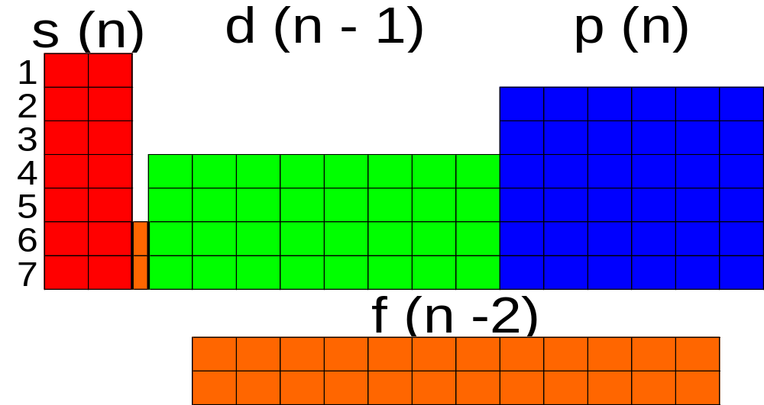
Periodic table arrangement
the quantum theory helps to explain the structure of the periodic table.
n - 1 indicates that the d subshell in period 4 actually starts at 3 (4 - 1 = 3)

Slide 6
Periodic table reading
Read 6.9 (pg. 208 - 210). PE 8 - 10.
Notice the difference between shorthand electron configurations and electron configurations for the valence shell …
E.g. Se (Z = 34) has a shorthand configuration of [Ar]4s²3d¹⁰4p⁴
Configuration of its valence shell is 4s²4p²
Ignore 3d¹⁰ (it doesn’t have the largest n value)
We focus on valence electrons at times because it is only the outermost electrons that are involved in chemical reactions

Slide 7
Unusual electron configurations
Look at your value for Cu ([Ar]4s²3d⁹)
The actual value for Cu is [Ar]4s¹3d¹⁰… why?
The explanation is that there is some sort of added stability provided by a filled (or half-filled subshell)
Read 6.8 (pg. 207 - 8)
The only exceptions that you need to remember are Cr, Cu, Ag, and Au
The inner transition elements also do not follow expected patterns. However, we do not address this.
For more lessons, visit www.chalkbored.com

