Slide 1
Polymers
Polymers are long molecules made up of many
repeating units.

Slide 2
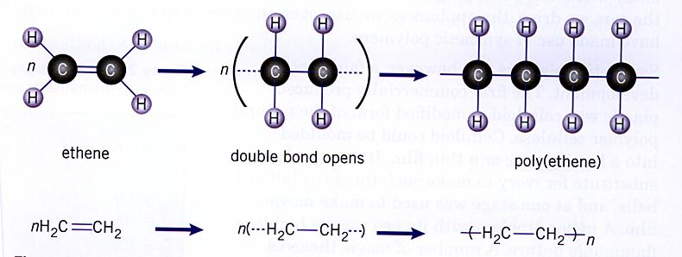
Addition polymerisation
An initiator or catalyst is added to a monomer that contains
a double bond. The double bond converts to a single bond
and this allows the monomer units to join together.
Irwin, Farrelly, Vitlin, Garnett. Chemistry Contexts 2 (2nd ed) HSC. Pearson Education Australia 2006. Page 14.

Slide 3
Polyethene (polyethylene)
What is the empirical formula for polyethene?
CH2
Polyethylene was discovered accidentally in 1933 by two
scientists investigating high pressure gas reactions.
There are two forms of the polymer – low density polyethylene
LDPE and high density polyethylene HDPE.
The difference in properties of these two forms are dependent
on the degree of branching of the polymer chains. In LDPE the
degree of branching is greater and this reduces the dispersion
forces between the strands. Therefore the plastics have relatively
low melting points.

Slide 4
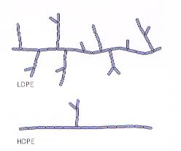
Polyethene contd…
Uses of LDPE include GLAD Wrap, rubbish bin bags and milk
containers.
HDPE’s durability and toughness
make it an ideal material for the
manufacture of children’s toys,
plastic buckets, lunch boxes and
rubbish bins.
Irwin, Farrelly, Vitlin, Garnett. Chemistry Contexts 2 (2nd ed) HSC. Pearson Education Australia 2006. Page 23.

Slide 5
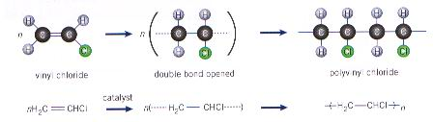
PVC – an addition polymer
Polyvinyl chloride is made from the monomer chloroethene
(commonly called vinyl chloride). Pure PVC is not a particularly
useful plastic as it is hard and brittle and tends to decompose when
heated. The inclusion of additives have greatly extended its
range of uses.
Irwin, Farrelly, Vitlin, Garnett. Chemistry Contexts 2 (2nd ed) HSC. Pearson Education Australia 2006. Page 14.

Slide 6
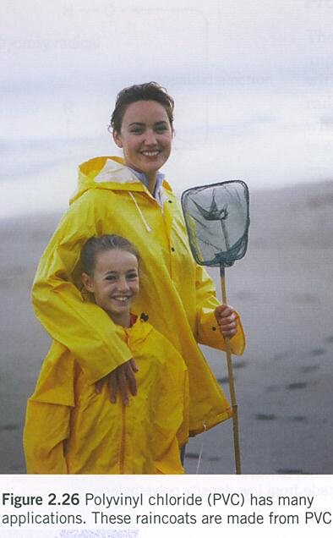
Uses of PVC
Depending on the additives used PVC can
be rigid as in water pipes used for
reticulation and plumbing or flexible like a
garden hose.
Because it is impervious to oils and most
organic materials, PVC is used to make
bottles to hold these materials.
Irwin, Farrelly, Vitlin, Garnett. Chemistry Contexts 2 (2nd ed) HSC. Pearson Education Australia 2006. Page 26.

Slide 7
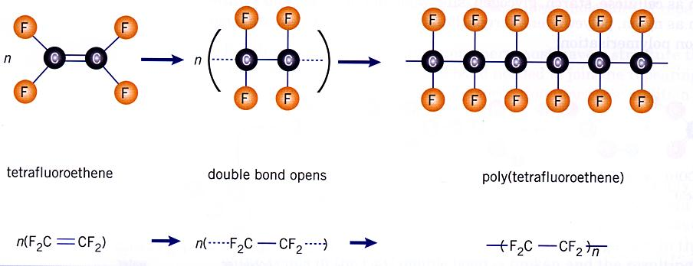
Another addition polymer
Irwin, Farrelly, Vitlin, Garnett. Chemistry Contexts 2 (2nd ed) HSC. Pearson Education Australia 2006. Page 16.

Slide 8
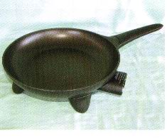
Teflon
The trade name for polytetrafluoroethene is Teflon. It is most
commonly known as the non stick surface on fry pans but is
also used to treat carpets and fabrics to make them stain resistant
and for making artificial body parts.
Non-stick fry pans are coated with
pigmented Teflon – pure Teflon is
White.
Smith, D., Monteath, S, Gould, M and Smith, R. (2006) Chemistry in Use Book 2.. McGraw-Hill Australia, Sydney.p103.

Slide 9
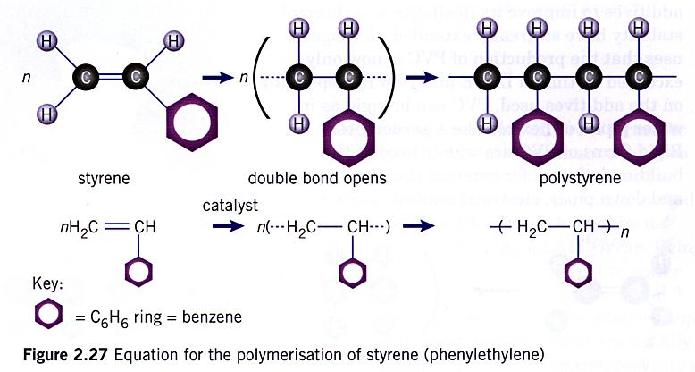
Another addition polymer
Irwin, Farrelly, Vitlin, Garnett. Chemistry Contexts 2 (2nd ed) HSC. Pearson Education Australia 2006. Page 26.

Slide 10
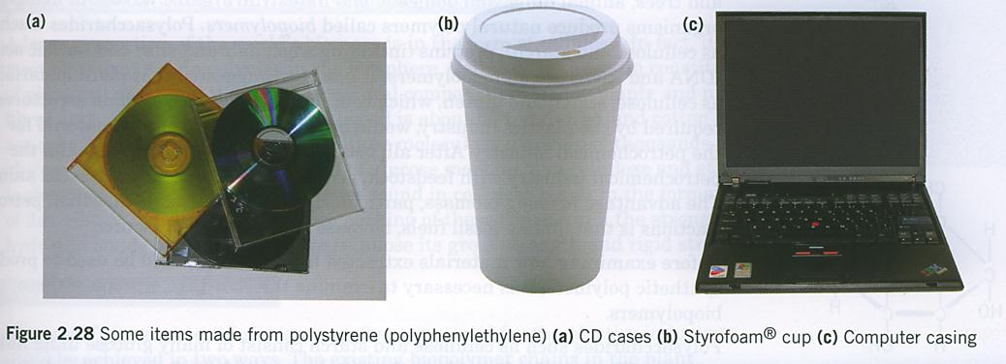
Uses of polystyrene
Irwin, Farrelly, Vitlin, Garnett. Chemistry Contexts 2 (2nd ed) HSC. Pearson Education Australia 2006. Page 27.

Slide 11
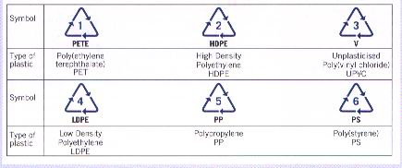
Recycling plastics
Six polymeric materials account for 66% of all plastics used
but currently not all of these can be recycled. Currently most
councils are able to recycle only code groups 1,2 and 3.
Irwin, Farrelly, Vitlin, Garnett. Chemistry Contexts 2 (2nd ed) HSC. Pearson Education Australia 2006. Page 31.

Slide 12
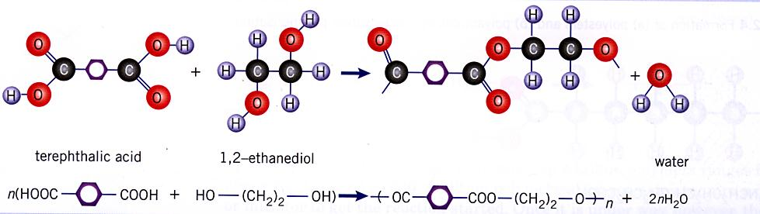
Condensation polymerisation
React a diol with a dicarboxylic acid to produce a polyester
Example
Irwin, Farrelly, Vitlin, Garnett. Chemistry Contexts 2 (2nd ed) HSC. Pearson Education Australia 2006. Page 16.

Slide 13
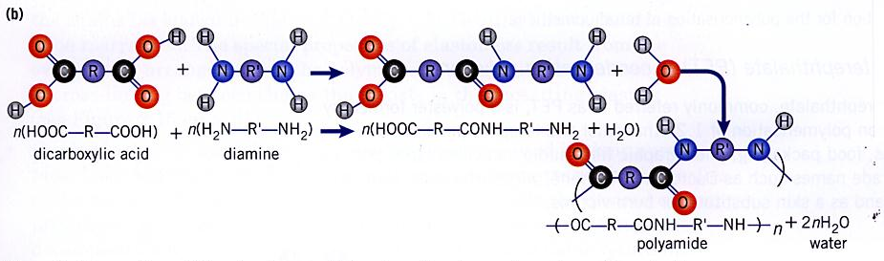
Another condensation polymer
Irwin, Farrelly, Vitlin, Garnett. Chemistry Contexts 2 (2nd ed) HSC. Pearson Education Australia 2006. Page 15.

Slide 14

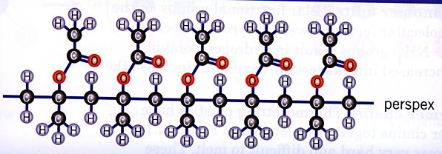
Test Yourself
Draw the structural formula of the monomer that forms each
of the following addition polymers.
Irwin, Farrelly, Vitlin, Garnett. Chemistry Contexts 2 (2nd ed) HSC. Pearson Education Australia 2006. Page 18.

Slide 15
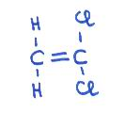
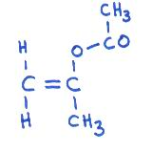
Answers
Polyvinyliedine chloride
Perspex

Slide 16
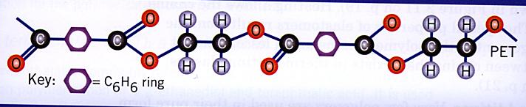
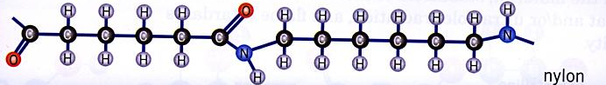
Test Yourself contd
Draw the monomers that form each of the following
condensation polymers.
Irwin, Farrelly, Vitlin, Garnett. Chemistry Contexts 2 (2nd ed) HSC. Pearson Education Australia 2006. Page 18.

Slide 17
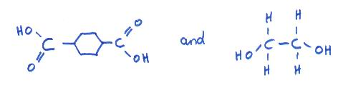
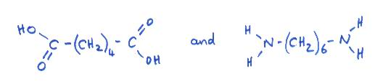
Answers
PET
nylon

Slide 18
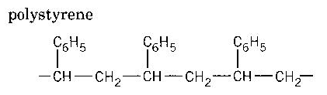
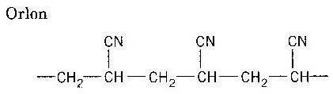
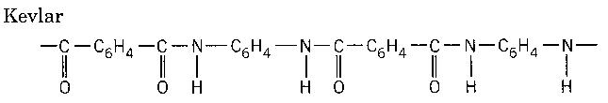
Test Yourself contd
Deduce the structure of the monomers used to prepare the
following polymers.
Irwin, Farrelly, Vitlin, Garnett. Chemistry Contexts 2 (2nd ed) HSC. Pearson Education Australia 2006. Page 37.

Slide 19
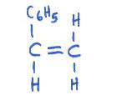
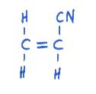
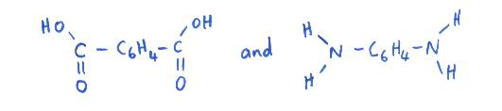
Answers
polystyrene
Orlon
Kevlar

Slide 20
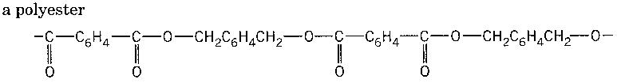
Test Yourself contd…

Slide 21
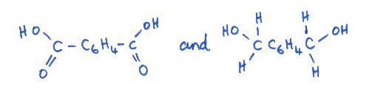
Answers
A polyester

Slide 22
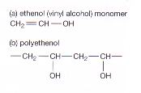
Dissolving polymers
In hospitals there is a risk of infection from soiled laundry if it is
improperly handled. This risk can be minimised if the articles to
be laundered are handled less. One way of doing this is placing the
laundry in plastic bags that will dissolve in the wash.
One dissolving plastic is called polyethenol also called
poly vinyl alcohol.
Smith, D., Monteath, S, Gould, M and Smith, R. (2006) Chemistry in Use Book 2.. McGraw-Hill Australia, Sydney.p106

Slide 23
Dissolving polymers
Is there anything about the structure of poly vinyl alcohol
that suggests it would dissolve in water?
The presence of many –OH groups provides opportunity
for H-bonding to occur between the polymer and the water
molecules. This provides solute-solvent interactions that
are of equivalent strength to the interactions within the solvent
and within the solute.

Slide 24
Test Yourself
WATP 2002
1(a) Write the name of an addition polymer.
(b) Write the name and draw the structure of the monomer
used to produce (a)
2. The following represents the repeating sequence of a condensation
polymer: -OCCH2COO(CH2)2O-
Which of the following represents the pairs of monomers
which produced the above polymer?
a) CH2OH and HOOC(CH2)2COOH
b) HOOCCH2COOH and HO(CH2)2OH
c) HOCH2OH and HOOC(CH2)OH
d) (HO)2CCH(OH)2 and (HOOC)2CH2(COOH)2

