Slide 1

Instagram Dashboard
Suvajit Dulal Jana
3001336

Slide 2
About
This project was aimed to make an application for an individual or business. In the business of all money, time is the most important asset of any organisation is to save them inefficient and cleverly will lead the org from making a profit as well as popularity
This application will help most organization, influencer and content creators to predict, how their account will progress and growth along the time.

Slide 3
Technologies used
NumPy :- to perform algebraic expression on the data
Pandas :- to load and manipulate data frame
Matplotlib :- to built and plot graph
Sklearn :- to perform various functions such as creating a confusing matrix, implementing models splitting data into test and train data, calculating prediction.
Seaborn :- to plot various interactive graphs.
Streamlit :- to show all work on a web browser

Slide 4
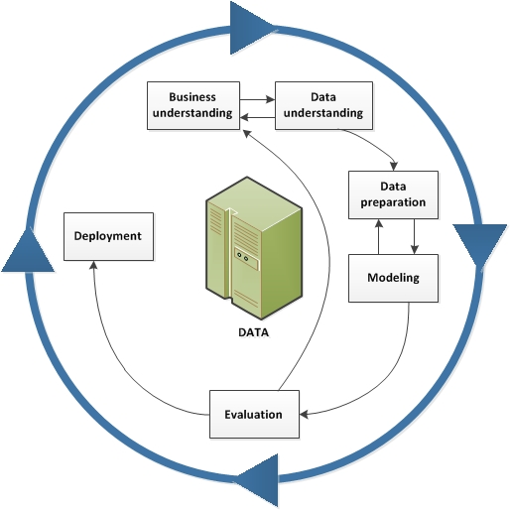
Methodology
Business Understanding:
The more the individual/businesses get connected to people the more they earn goodwill and popularity in the market.
Data Understanding:
To collect the data, we have built a crawler who crawls through the internet and scrape the data and prepare one CSV file for further process.
Data Preparation:
We have used a dataset with more the 5000 variable and 21 attributes.

Slide 5
Methodology (cont.)
Model
The whole data is divided into two part that is training set and testing set into 9:1 ratio the random data is select to make both sets. The attributes on both data set go through a generalisation factor log(1+x) to genialise the dataset.
Evaluation
the trained model is then tested here to check the accuracy of the model. The testing dataset is used here to calculate the accuracy.
Deployment:
Here, a application was built with streamlit libraby. A GUI has been made where all the result and graphs are showed.

Slide 6
Conclusion
In this project enterprises, multi-million companies, etc. can use this extract data information for the commercial purpose. This application work as a third party where an organisation can gather information like count follower, followings, trends, tags, etc. this gathered information helps them to choose a suitable celebrity, person, individual for their advertising and marketing purpose. Even this help gather an audience and promote their product or services on a suitable page using trendy tags.

Slide 7
Future Work
Would like make this application fast
Optimize the model
Rebuild a GUI with more information to be showed
Implement Natural Language processing (Sentiment analysis) on comments

Slide 8
Thank You

