Slide 1
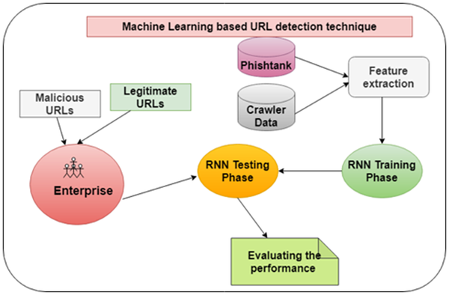
Fig 3. Research framework.
Dutta AK (2021) Detecting phishing websites using machine learning technique. PLOS ONE 16(10): e0258361. https://doi.org/10.1371/journal.pone.0258361
https://journals.plos.org/plosone/article?id=10.1371/journal.pone.0258361

