Slide 1
Anotode
The Web Annotator

Slide 2
Group Members
CS -01
Avi Aryan 201451070
2. Chahat Jain 201451061
3. Sunil Yedla 201451033
4. Manikanta 201451022
5. Mukesh 201451060
6. Abhilash 201451031
7. Manohar Reddy 201451024
8. Saurabh Nitnaware 201451017
9. Monika Maheswari 201451062

Slide 3
What is Anotode?
Anotode is a web-integrated annotation tool and note taking application.
With it, you can highlight and store any information you find on the web.
We have web and android apps to make the platform usable on any system possible.

Slide 4
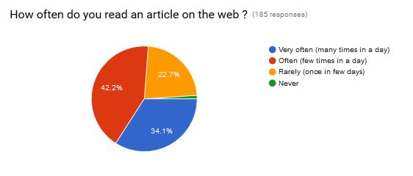
The survey: People like to read from the web

Slide 5
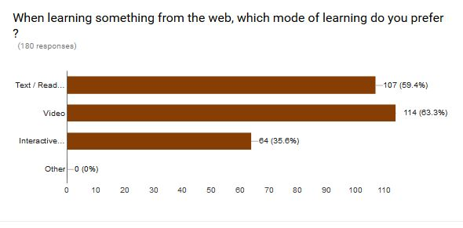
The survey: Text based reading is popular method of learning

Slide 6
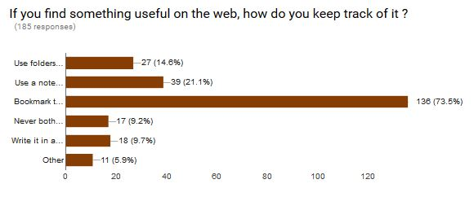
The survey: Is Bookmarking the only option?

Slide 7
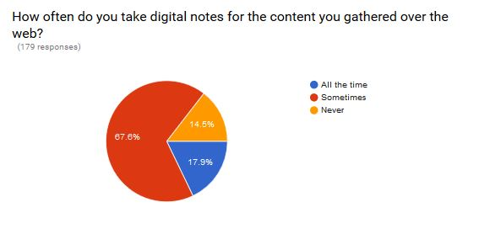
The survey: Popularity of digital notes

Slide 8
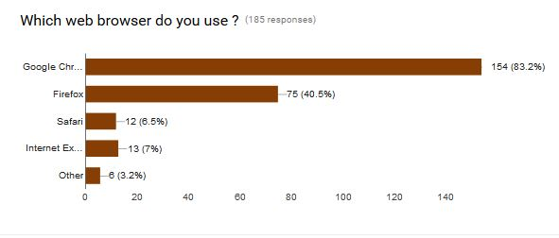
83% people voted for Chrome!

Slide 9
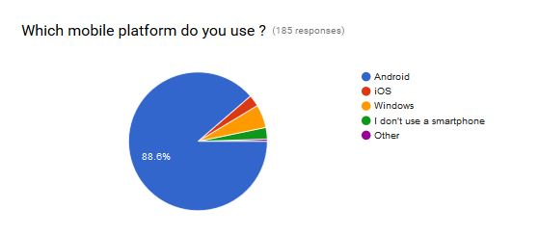
Android OS is most popular

Slide 10
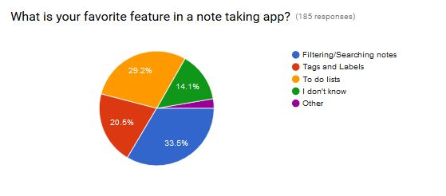
What people like in note-taking application

Slide 11
Features
Highlight the selected text from Chrome app
Sync across all the devices.
Add a new custom note
A website to view the all the highlights
Add tags and category to distinguish the highlighted text.
Search
Export the highlighted data
Add comments for the highlighted text.

Slide 12
Implementation
Android SDK has been used to implement the Android app
NodeJS with MongoDB has been used to implement the backend
AngularJS has been used implement the frontend
Chrome APIs to implement the chrome extension.

Slide 13
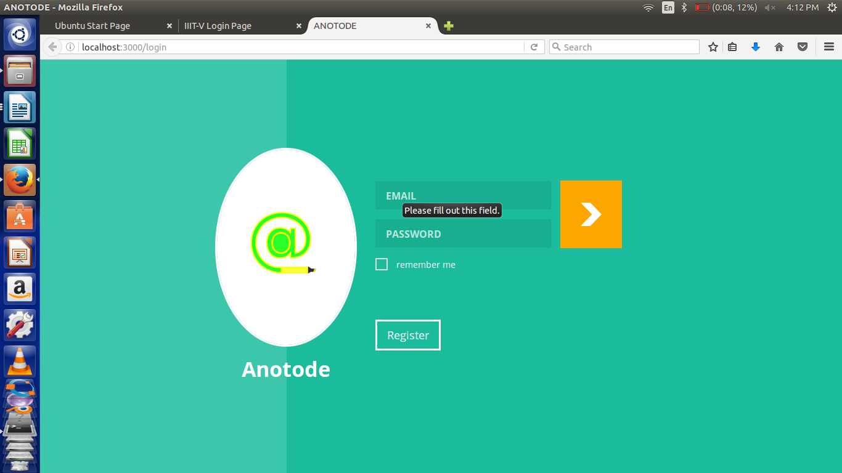
Notes:
Screen shot of Anotode website.

Slide 14
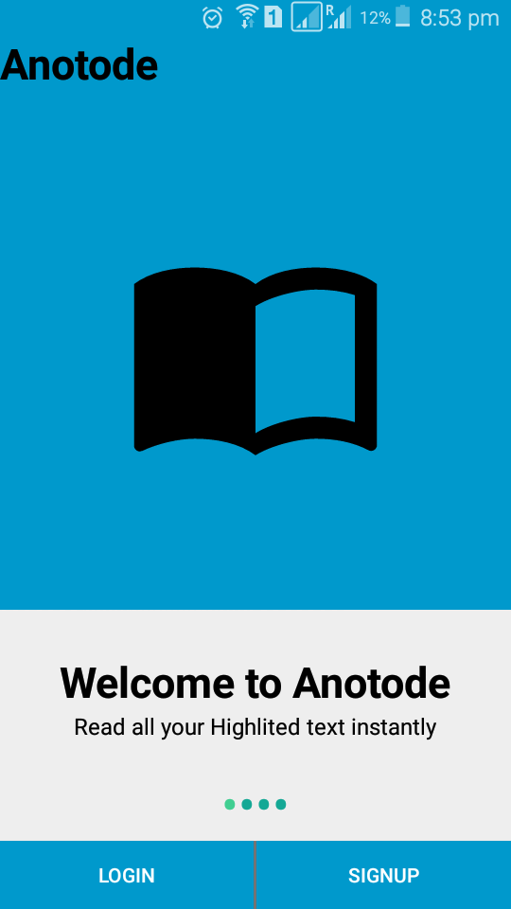
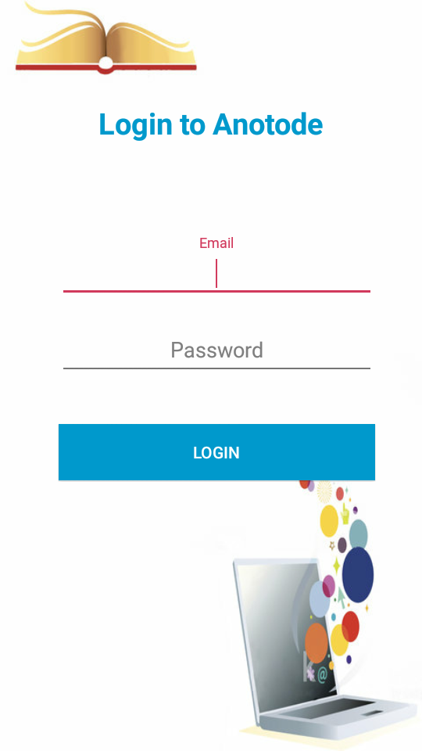
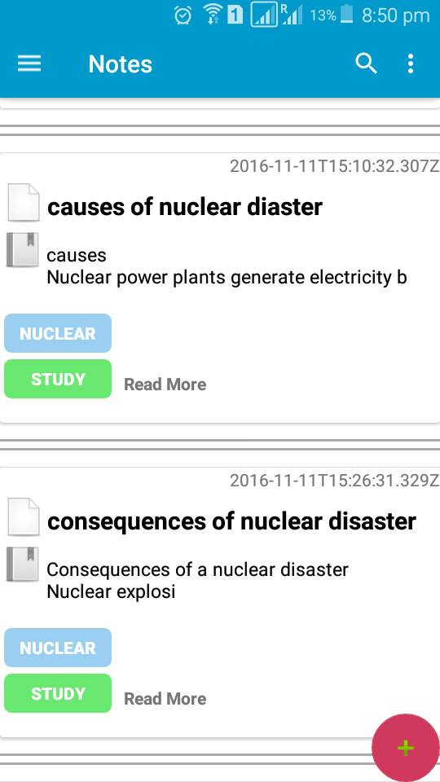
a
a
Notes:
Screenshot of Anotode Android app

Slide 15
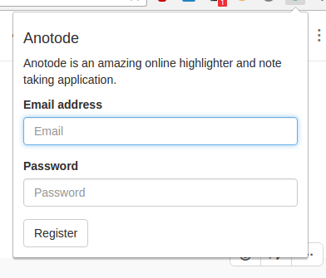
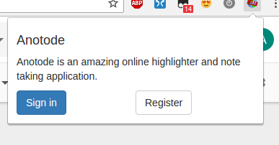
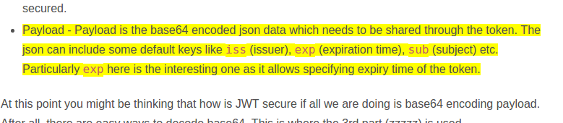
a
a
Notes:
Screenshot of Anotode Chrome extension.

Slide 16
Project Status
All the planned features have been implemented except the following:
Browser extension for Firefox - Because of a recent change in Firefox Addon SDK, our estimates went wrong and we weren’t able to make it working.

Slide 17
Future Scope
Browser extension has to be implemented in Firefox, Safari as well.
Share a highlight publicly.
“Explore” - Find and save ideas that other find interesting.
Making the tags and category more versatile so that we can discover the content that we like based on our preferences

Slide 18
Lessons Learnt
Working with members of a the team in a coordinated manner.
Time management between the project and other subjects.
Importance of documentation in the software development process.
Find a way to collaborate different point of views and get a concluded result for any topic or issue.
Setting up clear and realistic deadlines.

Slide 19
Conclusion
Developing Anotode was a challenging and exciting experience for us. The project gave us a better understanding and insight about software engineering.
Also the project experience provided with an insight into approach of developing a software which doesn’t compromise on quality also enables the team to deliver the product in timely and cost effective manner.
We gained considerable experience, especially in terms of understanding and developing solutions to problems.

Slide 20
Thank You.

