Slide 1
Jeffry Richter
Distributed Cloud Apps

Slide 2
Agenda
Why Cloud Apps
Embracing Failure
Orchestrators

Slide 3
1. Why Cloud Apps
In this section we are discussing the necessity to change our kind of thinking about applications.

Slide 4
1.1 Client 1.2 Demand
These two paragraphs are self-explanatory.
Last years business transformed significantly. And new rules are coming to software world as well.
You need to start considering your application not like an isolated application for internal usage in a prepared (sterile) environment, but like an application which works with different demand with different kind of clients.
Hints:
Different clients, different authorization and integration types, different needs;
Different demand in different time zones, you need to run and warm your apps BEFORE your clients start using your app;

Slide 5
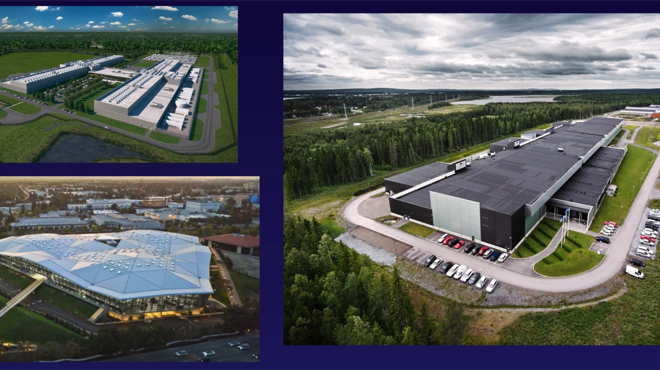
1.3 Data Center
On-premise Data Centers are no longer fit you in a long term.
Security Standards (also known as Perimeter)
Infrastructure resilience(Tier1 – Tier2 – Tier3)
For all business-critical applications. You shouldn’t worry about infrastructure at all, but you have to have an ability to influence on your DC and infrastructure.

Slide 6
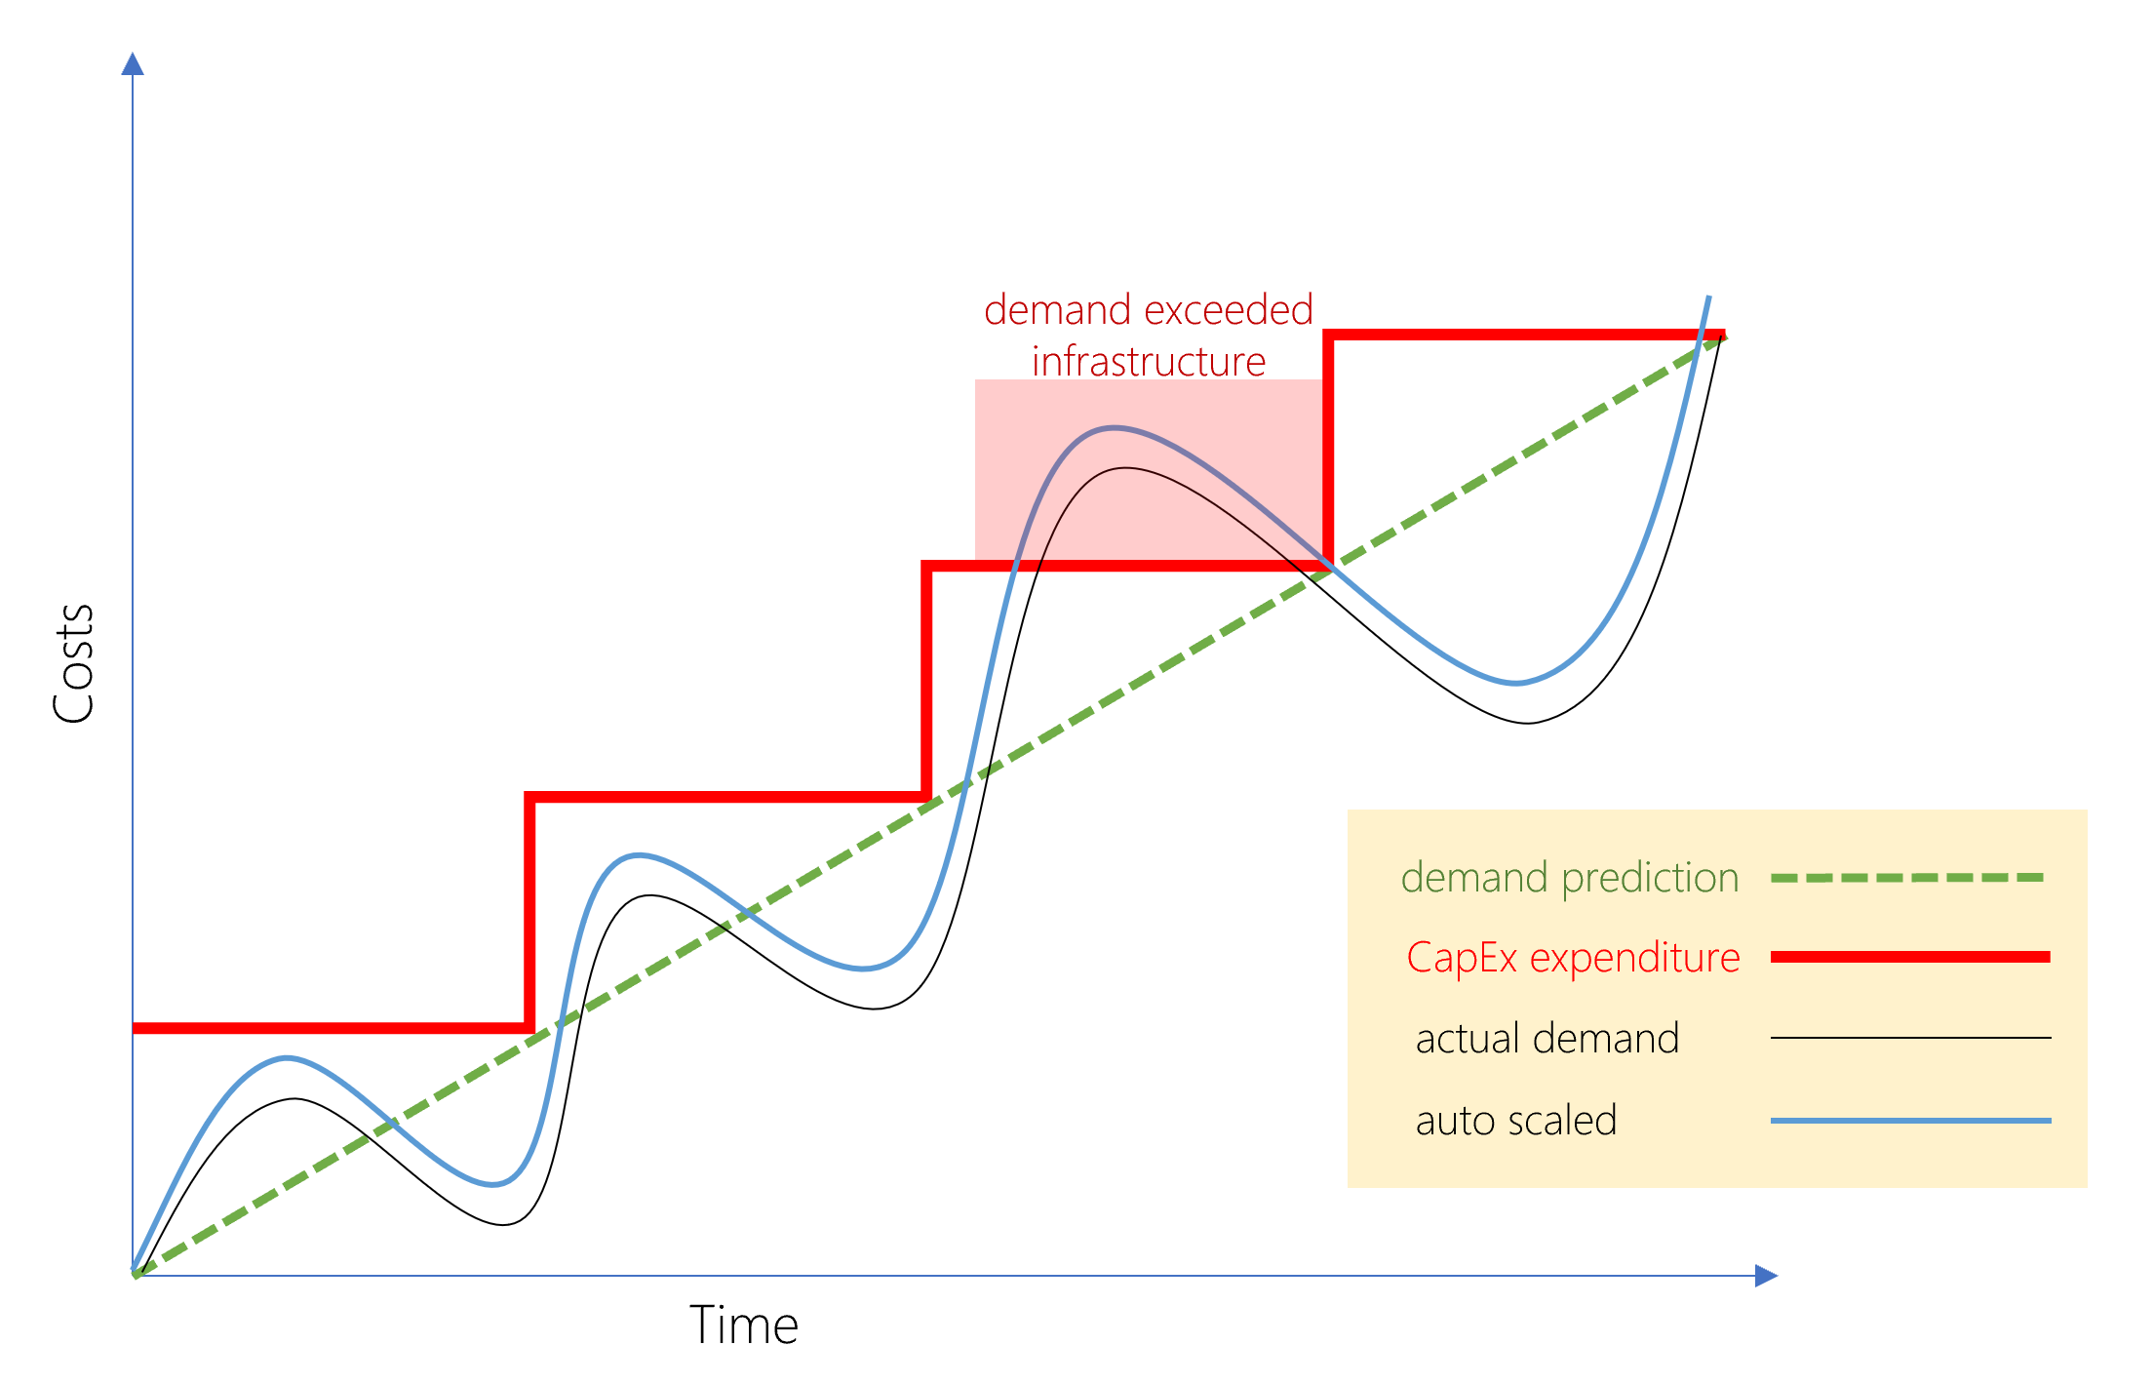
1.3 Data Center
4) Control over Infrastructure
Your neighbors hosted nearby shouldn’t affect your application anyhow
5) CapEx vs OpEx (in other words – how to cut your costs for application running with a different demand)

Slide 7
1.4 Operation
Regarding operation you need to know only one thing:
If you think development is the most expensive part of the application, you are totally wrong. The most expensive part is supporting.
Hosting, updating, fixing.
The more you can automate – the cheaper application will be.
Hints:
CI\CD;
Automatic testing;
Environment control (Azure Insights, AWS CloudWatch).

Slide 8
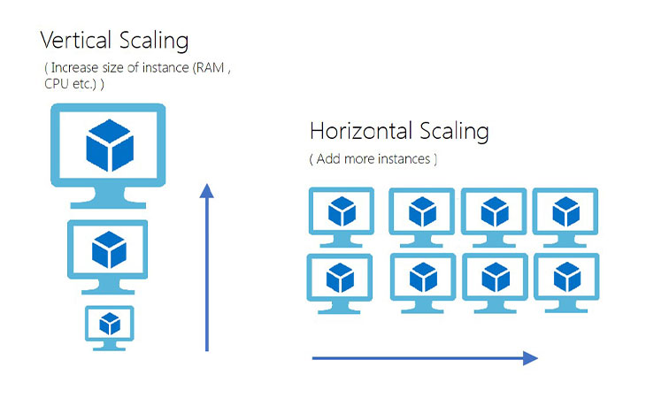
1.5 Scale
Two kinds of scaling you need to support.
Vertical Scaling (Up-Down scaling)
Horizontal Scaling (In-Out scaling)
Nowadays you need to consider and use both to meet business requirements and constrains.
Think about it like about the minimum of performance you need to keep for spikes (in a certain day timeframe)

Slide 9
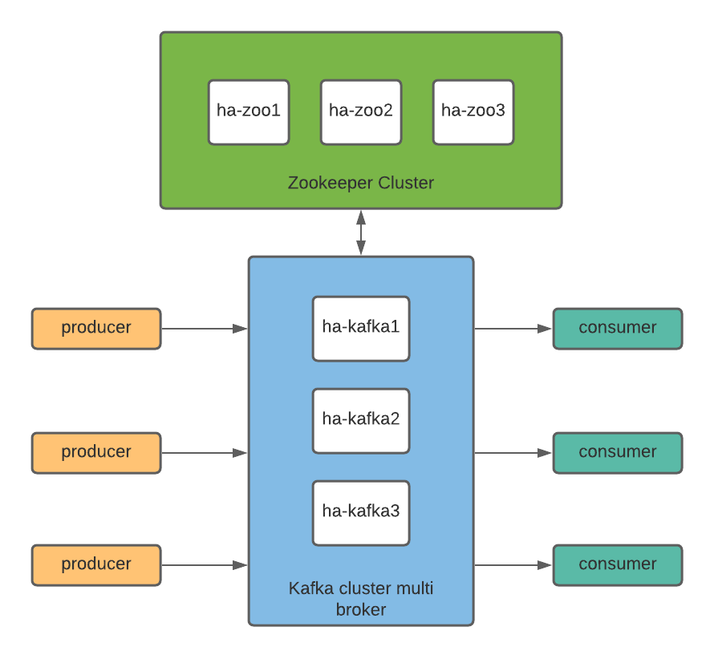
1.6 Failure
Richter mentioned about our old tradition to handle all exceptions;
We are handling all our exceptions trying to collect the information about happened event. (Rare negative events)
Nowadays we need along with that we need to control the data corruption and state. (Negative events will highly likely happen and you need not to rollback your data but to be prepared for that)
Example:
Messaging system with HA (Kafka) and your master is down
In distributed system your message weren’t handled properly on the previous step.
Data consistency (CAP Theorem), RTO & RPO

Slide 10
1.7 Machine Loss
Fleet of standardized machine may let you replace your down machine with a new one. It’s especially important for mission-critical applications which have to run 24\7.
Options you have here:
IaaS – replace your machine (AWS EC2 \ AWS ECS \ Azure Virtual Machine) in a moment;
PaaS-SaaS-CaaS – have you application instances on several machines which let you improve your availability;
Hint:
Think about it like about application\data availability.

Slide 11
2. Embracing Failures
Richter splits Reasons (or factors) of service failing onto three groups:
Code issues: Developer errors and unhandled events
We may operate with our production application wrong:
DevOps activities, Scale-In;
Running 2+ versions of application in parallel but not willing to support the previous version of code
Orchestration: moving your running code from one machine to another may happen not seamlessly.
Hardware issues

Slide 12
2. Embracing Failures
What to do:
Assuming failures on application design level, handling them
Orchestrate the virtual level, not physical.
Automatic retry policy for operations;
Handling dead-letters in messaging systems;
Select proper strategy for messaging (Exact Once, At Least Once, At Most Once);
No single point of failure
Run multiple instances and replicate the data ( select the proper consistency as well: Strong vs Eventual vs Basic)
https://hackernoon.com/eventual-vs-strong-consistency-in-distributed-databases-282fdad37cf7
https://www.scylladb.com/glossary/eventual-consistency/

Slide 13
3. Orchestrating
To start speaking about (virtual) orchestrating we need to understand what virtualization options we have:
Hardware virtualization
Hardware Box
Containerized Application
Containerized Application with Orchestrator

Slide 14
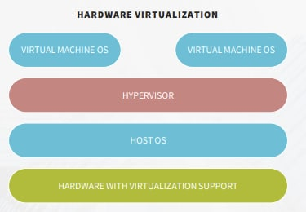
3.1 Hardware Virtualization
The oldest type of virtualization. It lets you run your virtual machines and each of them is under Hypervisor control of your HOST Operational System.
Each VM has its own OS. Full or cut version, but fully operational.
Level 1 of virtualization.
Example: VMWare.

Slide 15
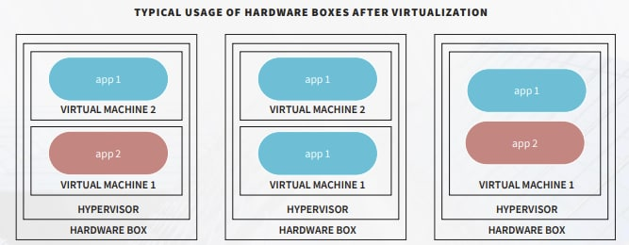
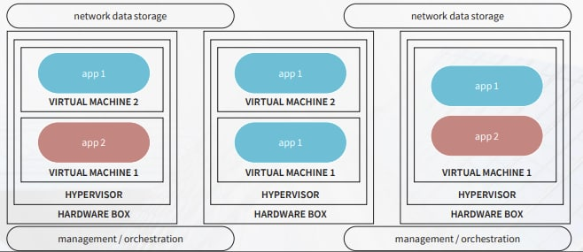
3.2 Hardware Box
This concept is about application isolation. How to isolate applications from one another, on which level.
Level 1.5 of virtualization.
Example: VMMare + Dropbox
OR

Slide 16
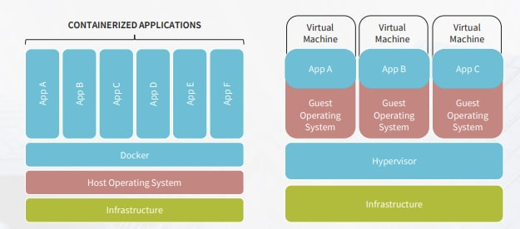
3.3 Containerized Application
You may get rid of hosting OS for each application. Instead, you need a mechanism to interact with your Host OS:
Through Hypervisor
Avoiding Hypervisor
Level-2 of Virtualization
Example: Docker
PS: We still have an issue here. We are hosting our application on Physical devices. And our application are not able to use additional processor time if our processor is busy

Slide 17
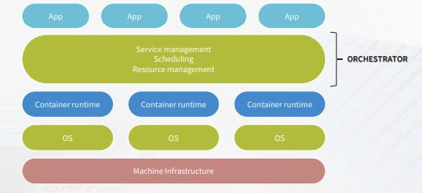
3.3 Orchestrator
You may Orchestrate your applications on the container’s level. Run them, kill them etc.
Level 2.5 of Virtualization
Example: Docker Swarm

Slide 18
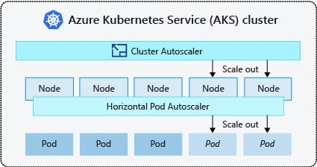
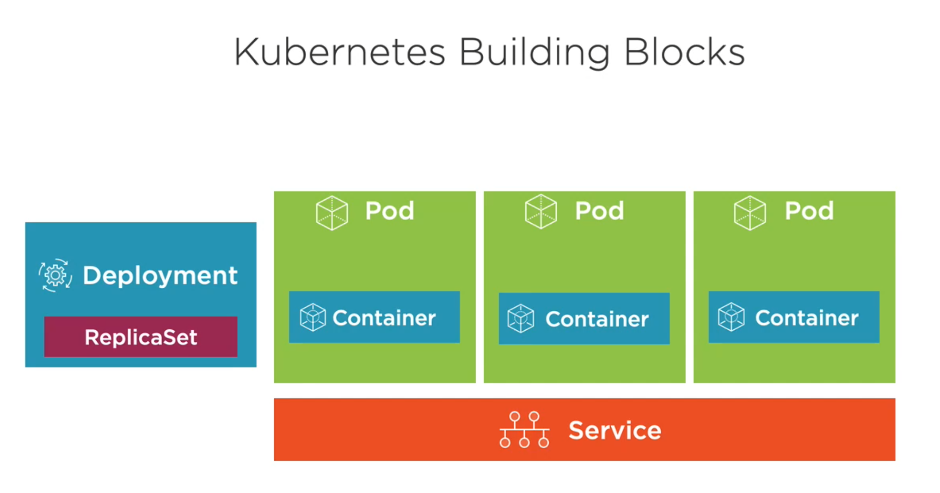
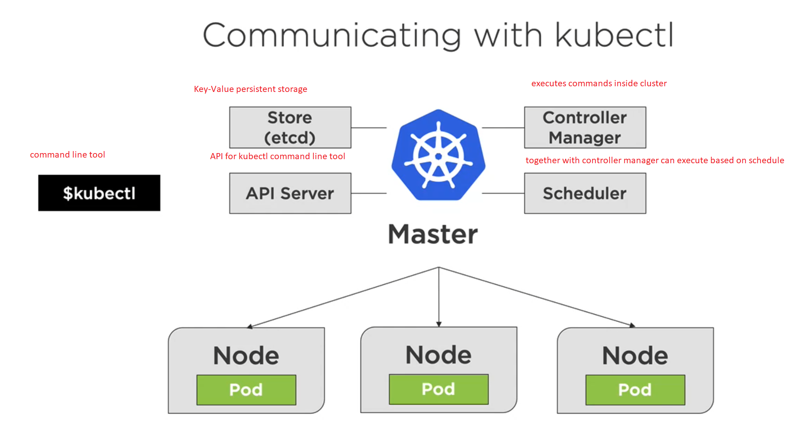
3.3 Orchestrator
You may Orchestrate your applications and operate with orchestrator through API. You may add the state control of your application pool.
Level 3 of Virtualization
Examples:
Kubernetes, Openshift

