Slide 1
OpenAI as a part of a business-critical mission
Introduction
Workshop
Guidance
Generated by ChatGPT on 75%

Slide 2
Table of content
01
Idea of this Workshop
08
Azure Function
02
Target Audience
09
Integrate PowerAutomate
03
Applications we are building
04
Intro to LLM models
05
Environment Setup
06
Generate React& API Poco
07
Console App

Slide 3
Idea of this Workshop
ChatGPT is a powerful and rapidly expanding area of AI technology that opens up myriad possibilities for conversational applications. By exploring this technology, software engineers and delivery managers can gain valuable insights
on how to build interactive conversational applications and explore exciting new ways
to improve user experience.
With the potential to drastically improve human and machine communication, ChatGPT is a valuable and necessary area of knowledge for any aspiring software engineer or delivery manager.
Target Audience
This presentation is tailored to the needs of Delivery Managers, Software Engineers, and other professionals who may not yet be familiar with OpenAI and LLM models. Attendees will walk away with a greater understanding of both OpenAI and LLM models, relevant use cases, product features and capabilities, and strategies for incorporating them into their projects.

Slide 4
Intro to ChatGPT & other OpenAI models
LLM (Long-Term Memory) models are a type of machine-learning algorithm based on a deep-learning architecture. LLM models have the ability to store and recall data from long-term memory, enabling them to more accurately predict output based on input. At OpenAI, there are three different types of LLM models available: Transformer, GPT-2, GPT-3, and recently released GPT-4.
The Transformer model encodes text, GPT-2 generates text, and GPT-3 learns to understand and generate human language better. These models are extremely powerful and can be used to create applications ranging from natural language processing to automated customer support.
ChatGPT (Ada, Davinci, Curie, Babbage, etc.)
Codex (create & analyze code)
Dall-e (create images using prompt)
Midjourney (create images using prompt)
OpenSource models https://github.com/cocktailpeanut/dalai

Slide 5
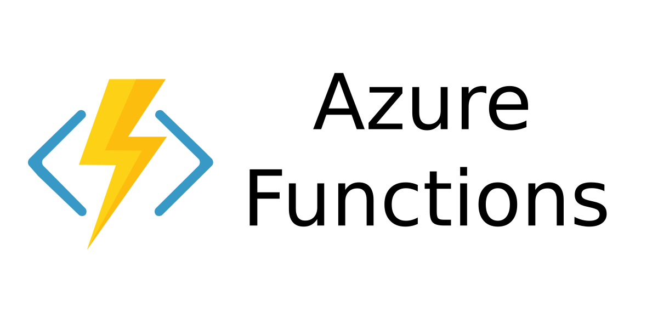


Applications and scenarios we are covering today:
Our first application we are going to build with ChatGPT will be a console application which will allow us to interact with ChatGPT directly from our own application.
Our second application we will be creating with ChatGPT is an Azure Function that allows us to extend the functionality of ChatGPT in the cloud.
The third application that we are going to create with ChatGPT is a PowerAutomate that can be used to automate workflows and tasks with ChatGPT.

Slide 6
Environment Setup & Prerequisites
Create account in OpenAPI (5$ granted for free)
  Create your ApiKey: https://platform.openai.com/account/api-keys
  Register account in OpenAI: https://platform.openai.com/docs/api-reference
Prepare access to Azure Cloud
Prepare Code Editor (Any IDE, any language)
Microsoft Accounts:
  Login to Teams using work account: https://www.microsoft.com/en/microsoft-teams/log-in
  Login to PowerAutomate using work account : https://make.powerautomate.com/

Slide 7
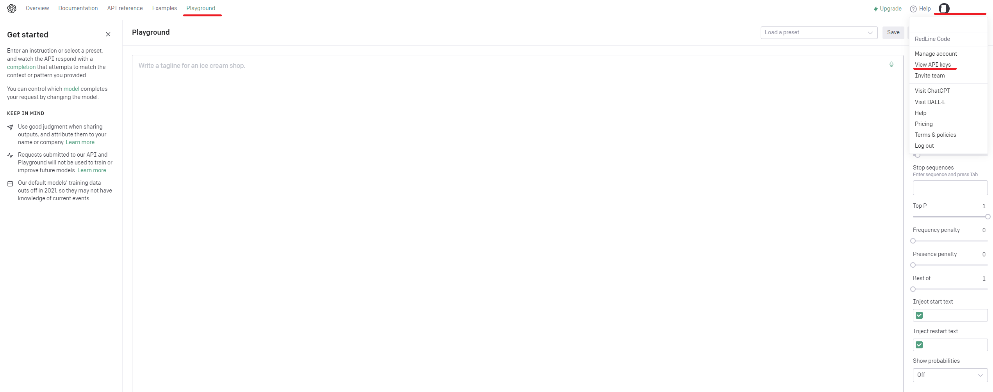
OpenAI Access
Vitis OpenAI page and sign up: https://openai.com/
Visit OpenAI ApiKeys page: https://platform.openai.com/account/api-keys
Create a token which will be needed later;
Open their playground: https://platform.openai.com/playground

Slide 8
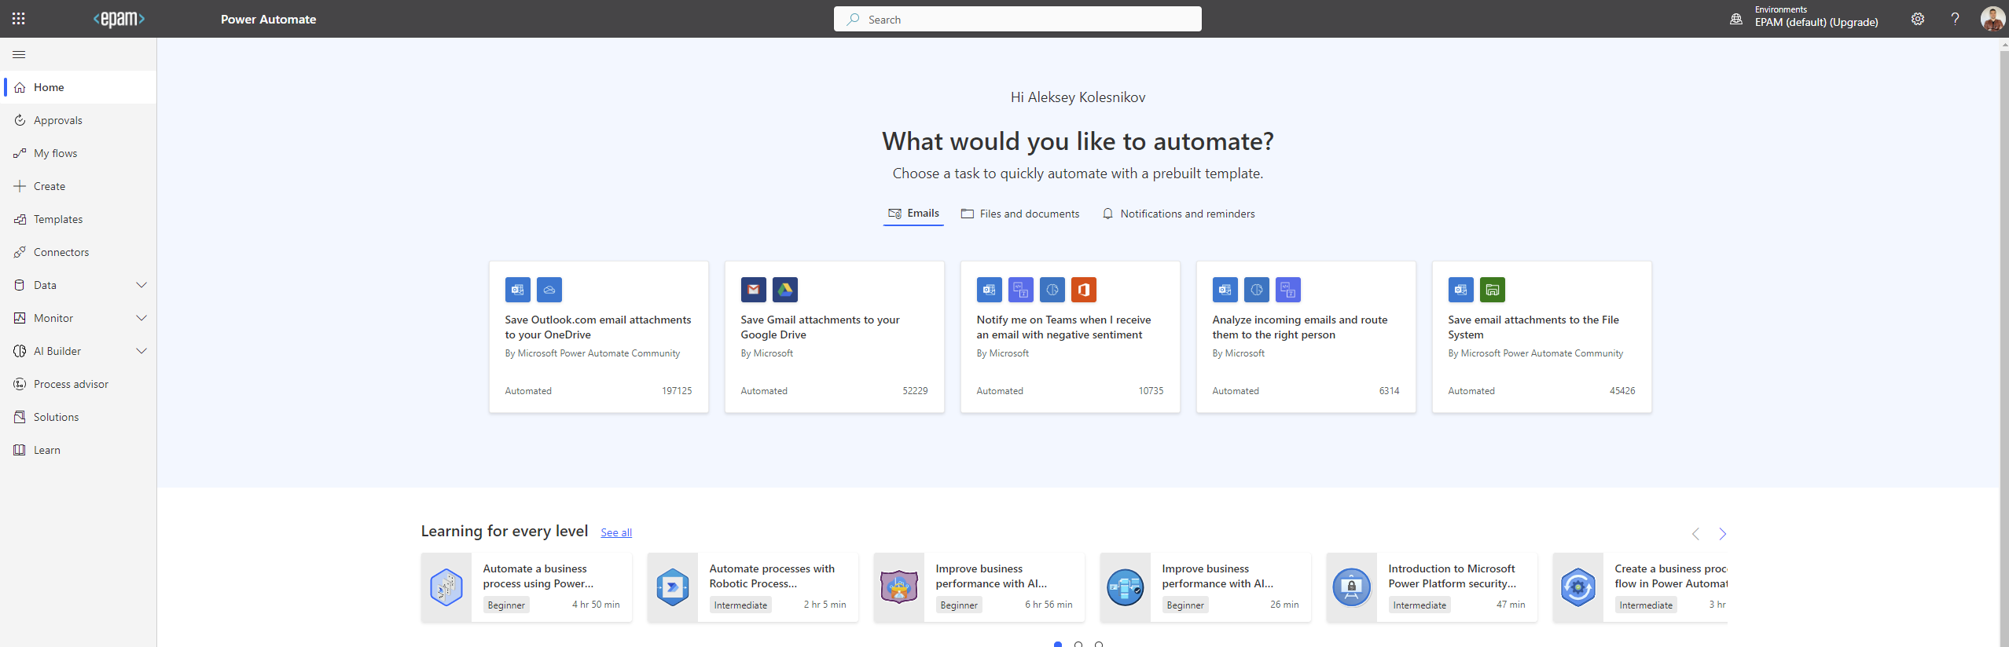
PowerAutomate
Visit https://make.powerautomate.com/ and login using your working account

Slide 9
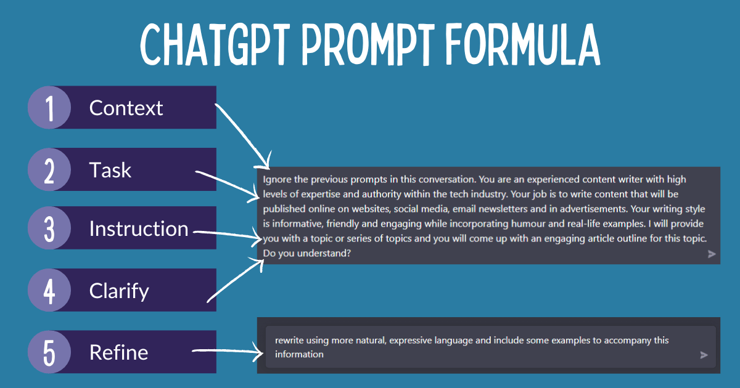
Prompt recommendations
Creating a good prompt for ChatGPT requires a bit of creativity and sensitivity. When crafting a prompt, the context should be provided for the bot to understand its goal in the interaction. This includes including important details surrounding the situation, such as the characters involved, the setting, or any given objectives.
The prompt should be concise yet specific in order to not overwhelm the bot with too much information. Additionally, questions should be formulated in a way that allows the bot to answer in a conversational manner, such as using both the prompt and the context to develop a dialogue. The structure of the prompt should be organized in a way that allows the bot to seamlessly transition from one point to the next, and to avoid any interruption.
Additionally, the prompt can include an optional back story, allowing the bot to have more depth in its responses and to elaborate further on the conversation. Finally, the prompt should have an actionable outcome, such as a call to action or response that can be used to further conversations. By following these steps, one can create a prompt that ChatGPT can use to interact with users in a meaningful way.
When sending prompts to ChatGPT, it is important to include detailed information about the desired outcome of the code, such as the specific functionality, language, frameworks, and libraries that you want the code to incorporate. Additionally, you should provide examples of code that achieves similar things to what you are trying to do. By providing as much detail as possible in the prompt, ChatGPT can better understand and process the request.

Slide 10
Poco API
Prompt:
> I am a software engineer, and I am willing to create an API which meets the following criteria:
API web-service application exposes three endpoints:
get endpoint which returns the current date and time beautifully formatted;
get endpoint which returns the current year;
get endpoint which return the current weekday;
post endpoint which echo posted message
Application should log everything Use modern C# language.
Don't miss importing datetime at the beginning of script! Don't use html-templates, all html code should be inside C# code as plain strings. Use dotnet core writing code.
Make sure it doesn't have errors. Skip code explanation
PS: Didn’t satisfy with results? Ask ChatGPT to update your code, change the approach or something.

Slide 11
Testing Poco API
Prompt:
> Considering previously generated code, add tests to this code using nUnit and Mock library. Put all needed mocks and stubs to the constructor of the test class. All test names should use modern naming notation with underscores and should explain what behavior is expected.
PS: You also may ask to put some changes to previously generated response or generate new one not considering previous attempt.

Slide 12
React MVVM Builder
Try to follow step by step guide and generate your React MVVM structure and functions:
https://martinfowler.com/articles/2023-chatgpt-xu-hao.html

Slide 13
React MVVM Builder
Recommendations:
Split your task onto parts. Give him the full context of what you are building, what you expect and from what steps its job will consisft of.
Request Code and Tests separately. Otherwise, if answer does not satisfy you need to generate more information again which cost you more time and money.
Limitations:
Using ChatGPT “complete” or “chat” variations you need to know that after some time ChatGPT loses the context. You must refresh the context saying to generate again already generated code or re-enter you entered previously. Might be useful if you make pauses in interactions with ChatGPT.

Slide 14
Application 2. Console App
Create Console App which sends request to OpenAI with prompts regarding command you need to apply and copies it to your buffer.
Prompts structure:
httpClient.DefaultRequestHeaders.Add("Authorization", "Bearer <INSERT YOUR OPENAPI TOKEN HERE>");
var content = new StringContent("{\"model\": \"text-davinci-003\", \"prompt\": \"" + args[0] +
"\", \"temperature\": 1, \"max_tokens\": 100}", Encoding.UTF8, "application/json");
In addition:
TextCopy.ClipboardService will help you to put the ChatGPT answer to your clipboard
Example: https://github.com/Glareone/OpenAI-and-ChatGPT-meet-.Net/tree/main/ChatGPT

Slide 15
Application 3. Azure Function
Transform you Console application into Azure Function and deploy it to Azure.
Example: https://github.com/Glareone/OpenAI-and-ChatGPT-meet-.Net/blob/main/ChatGPT.AzureFunction/ChatGPT.AzureFunction/ChatGPT.AzureFunction/HttpTrigger.cs
PS: You may ask ChatGPT to write you all needed code and just deploy this code to Azure or AWS.

Slide 16
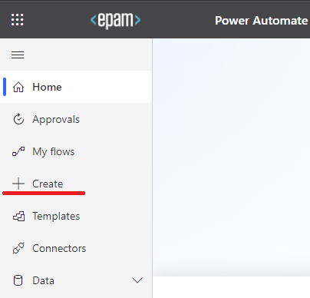
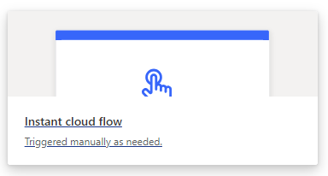
Application 4. Integration with PowerApp
Power Automate (formerly known as Microsoft Flow) is a cloud-based automation tool used to create workflows that bridge different applications or services using a simple drag-and-drop interface. The tool can be used to automate processes such as creating a task when a customer record is modified, sending notifications of pending tasks, or copying data from one application to another.
Our goal for this task: Integrate recently created AzureFunction with PowerAutomate
Visit: https://make.powerautomate.com/
Click “+ Create” to create a new workflow

Slide 17
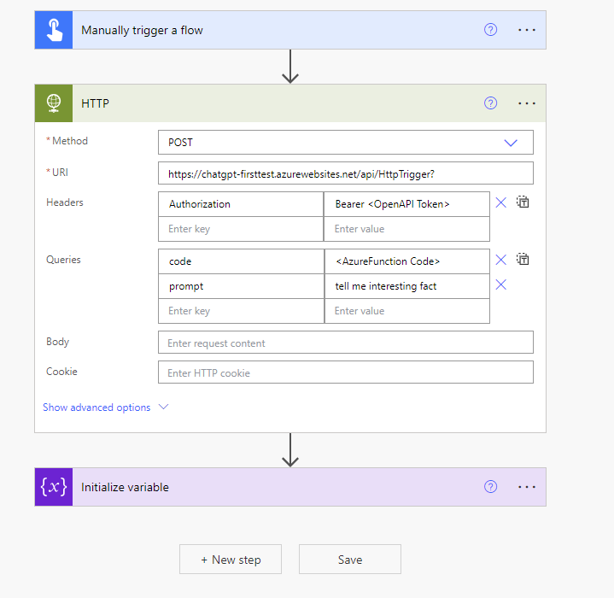
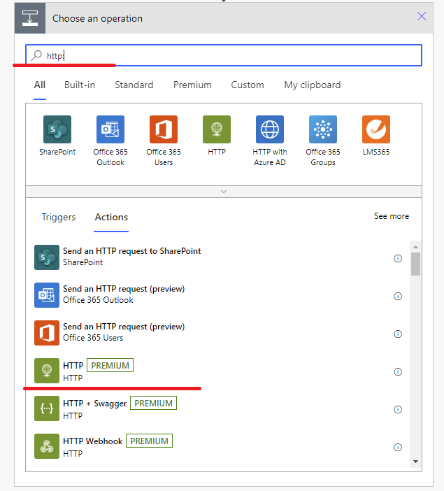
Application 4. Integration with PowerApp. Part1
First, we need to create Manually Triggered Flow which makes a call to our AzureFunction:

Slide 18
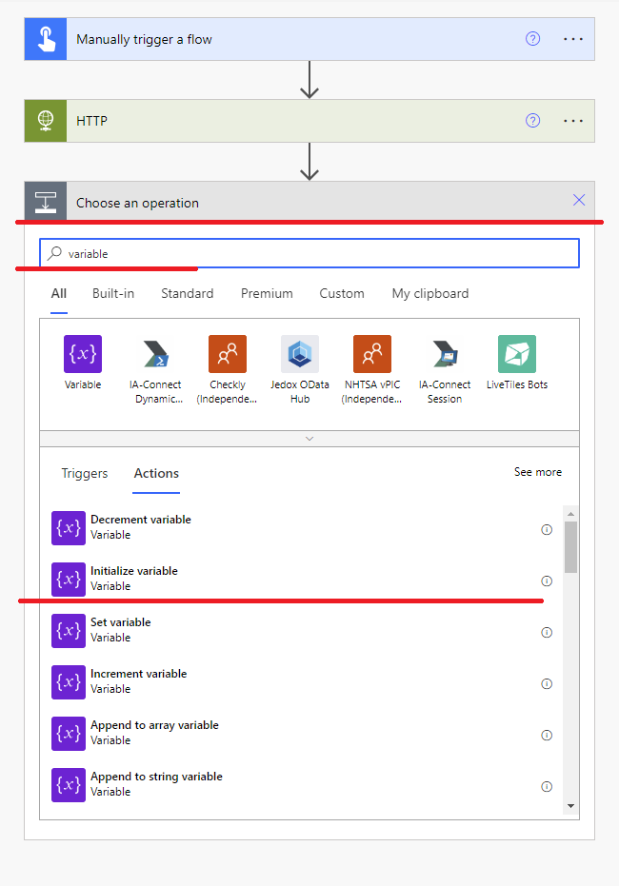
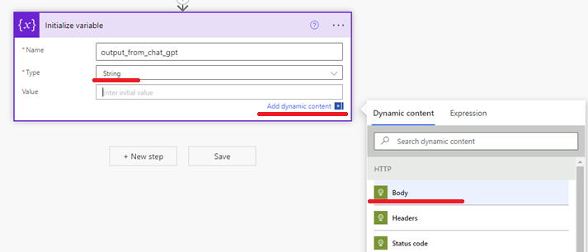
Application 4. Integration with PowerApp. Part1
After that we need to get response and put it into variable:

Slide 19
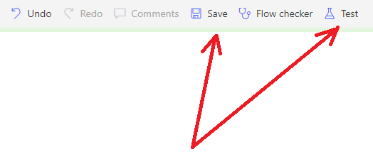
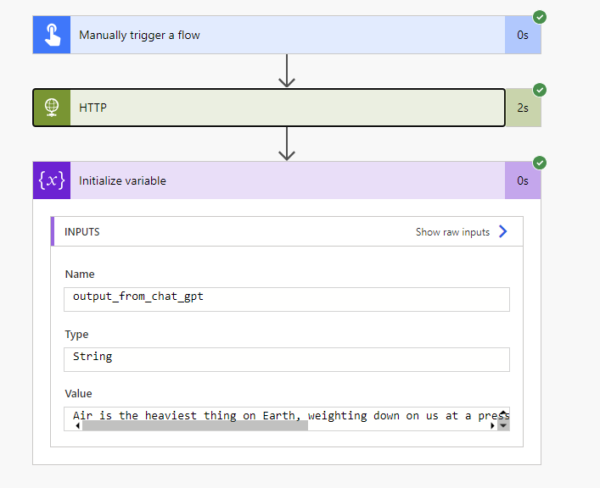
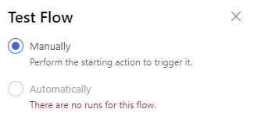
Application 4. Integration with PowerApp. Part1
Let’s Save and Test our integration!

Slide 20
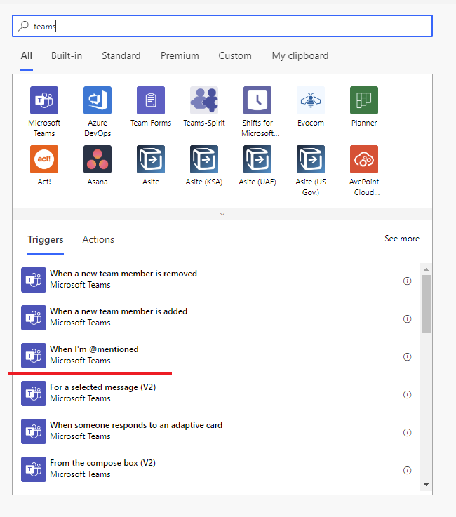
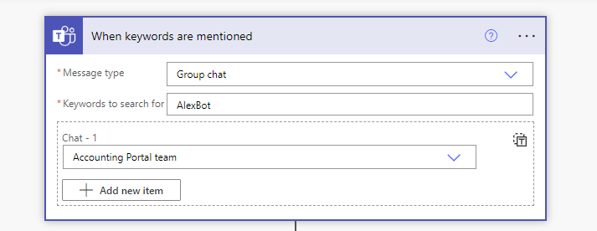
Application 4. Integration with PowerApp. ChatBot
Let’s create another integration. Now our trigger will be Teams:

Slide 21
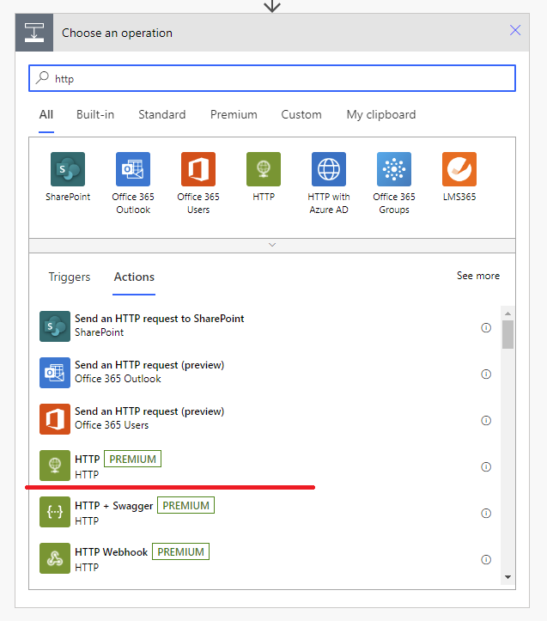
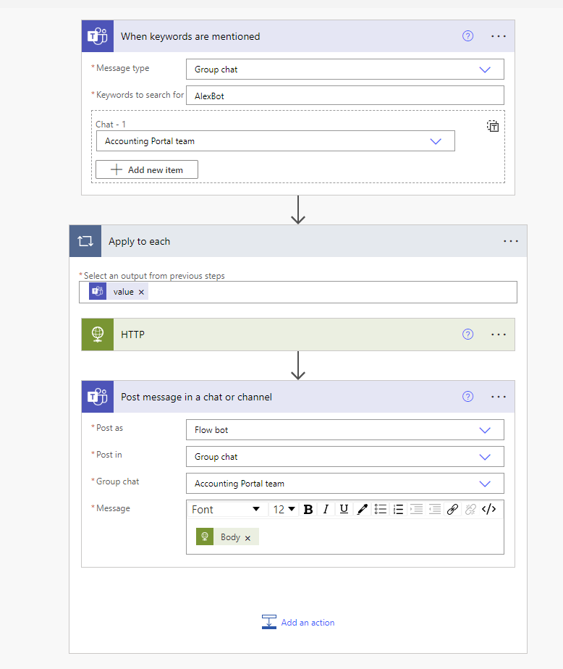
Application 4. Integration with PowerApp. ChatBot
Of course we need to send http request as we did in our previous part and send response back:

Slide 22
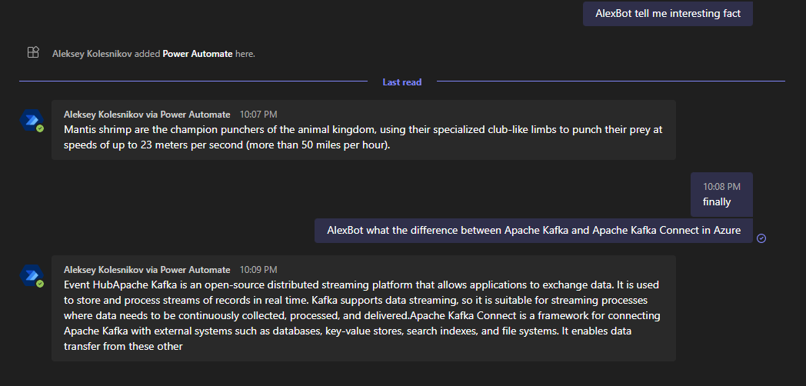
Application 4. Integration with PowerApp. ChatBot
And Result:

Slide 23
Other ideas you may apply on your project
Automatic fixes for your code based on SonarQube and your handler;
Renovate bot – increment image version in your Kubernetes deployment.yaml script and create PR when your PR merged to DEV branch;
Convert your code from one language to another (Auto code conversion, quite often case nowadays);
Co-reviewer – check logic and naming conventions in PR;
System analysis – may help you to create rationale and compare different technologies in terms of efforts or further system throughput;
Junior Developers education – review their code, automatically recommend updates;
Onboarding – update your Documentation step by step taking into account changes you have made recently;
Cover letter creator;
Outlook integration – handle automatically all mails in which specific techs or problems mentioned;
Messages & Emails Proofreader.

Slide 24
Wrap up. Useful links.
Simplify and update your prompt to lower the number of used tokens but not affecting its quality. https://github.com/stephentoub/Tokenizer
How ChatGPT works inside: https://writings.stephenwolfram.com/2023/02/what-is-chatgpt-doing-and-why-does-it-work/?fbclid=IwAR0eV1C7bPYQeEX0BbmqR_8zAFTgf4S5q-bEXoG3ZK7fmxgMICj-QqW6ZWM
Generative AI Learning Path, Google Cloud Skill Boost Platform: https://www.cloudskillsboost.google/paths/118

