Slide 1
OpenAI as a part of a business-critical mission
Introduction
Workshop
Guidance
Generated by ChatGPT on 50%

Slide 2
Contents
01
Idea of this Workshop
06
Warm up. Generate Poco Apps
02
Target Audience
07
Interaction. Azure Functions
03
Environment Setup
08
Integration. PowerAutomate
04
Intro to LLM models
05
Applications we are building

Slide 3
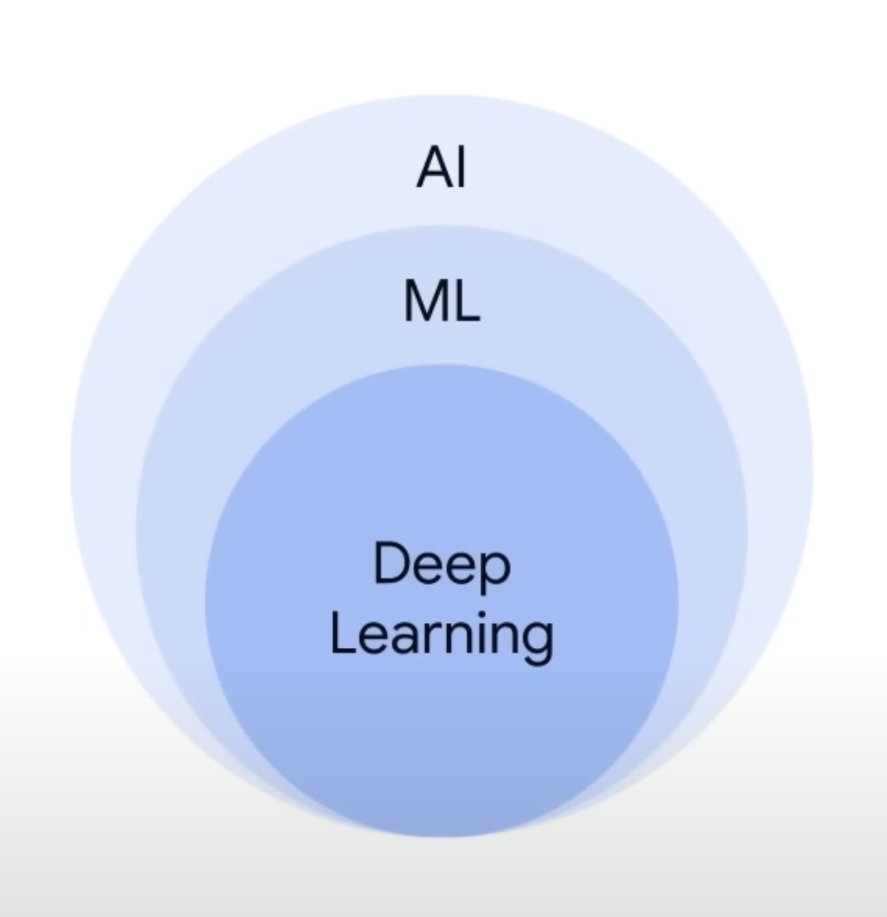
Idea of this Workshop
During this workshop, we will explore the world of generative AI capabilities:
What and how you could interact with ChatGPT
How ChatGPT output differs based on ChatGPT version
How to make API calls to OpenAI platform and to EPAM Dial
How to integrate into real workflows

Slide 4



Target Audience
Delivery Managers
Developers
QA Engineers

Slide 5
Environment Setup & Prerequisites
Create account in OpenAPI is you are going to continue using ChatGPT
Create your ApiKey: https://platform.openai.com/account/api-keys
Register account in OpenAI: https://platform.openai.com/docs/api-reference
Api-key to EPAM Dial for lab purposes: will be shared on the lab
Prepare access to Azure Cloud if you are willing to deploy Azure Function on your own
Prepare Code Editor (Any IDE, any language, but examples are written in C#)
To use EPAM Chat you need to be connected to the VPN
All examples used for this workshop could be found here
Microsoft
Accounts:
Login to Teams using work account: https://www.microsoft.com/en/microsoft-teams/log-in
Login to PowerAutomate using work account: https://make.powerautomate.com/

Slide 6
Manage getting access to OpenAI & EPAM Dial
Vitis OpenAI page and sign up: https://openai.com/
Check that you get an access to the playground at https://platform.openai.com/playground
Visit OpenAI ApiKeys page to issue the token https://platform.openai.com/account/api-keys
Create a token, save it in a secure place, do not commit it with your code to the remote repository
If you have no access to OpenAI platform you can use EPAM Dial
EPAM Dial API Key for this workshop will be provided additionally.
EPAM Chat is available for all employees using VPN at https://chat.lab.epam.com/

Slide 7

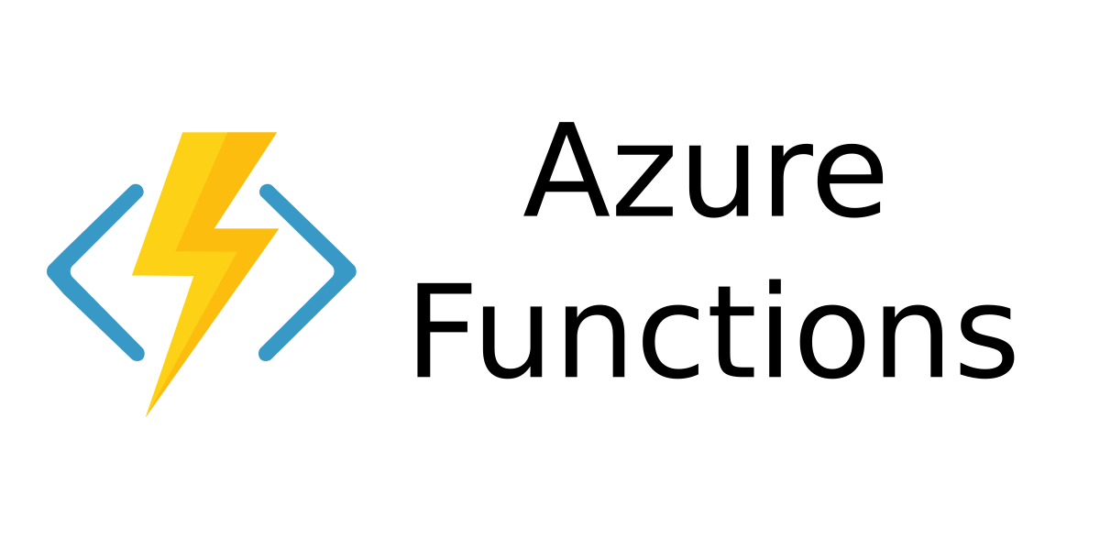

Applications and scenarios we are covering today:
Our first application is about creating an Azure Function which communicates with ChatGPT. We are checking different communication options;
Check how to work with EPAM Dial - ChatGPT which is running in our isolated environment;
The third application that we are going to create with ChatGPT is a PowerAutomate that can be used to automate workflows and tasks with ChatGPT;

Slide 8
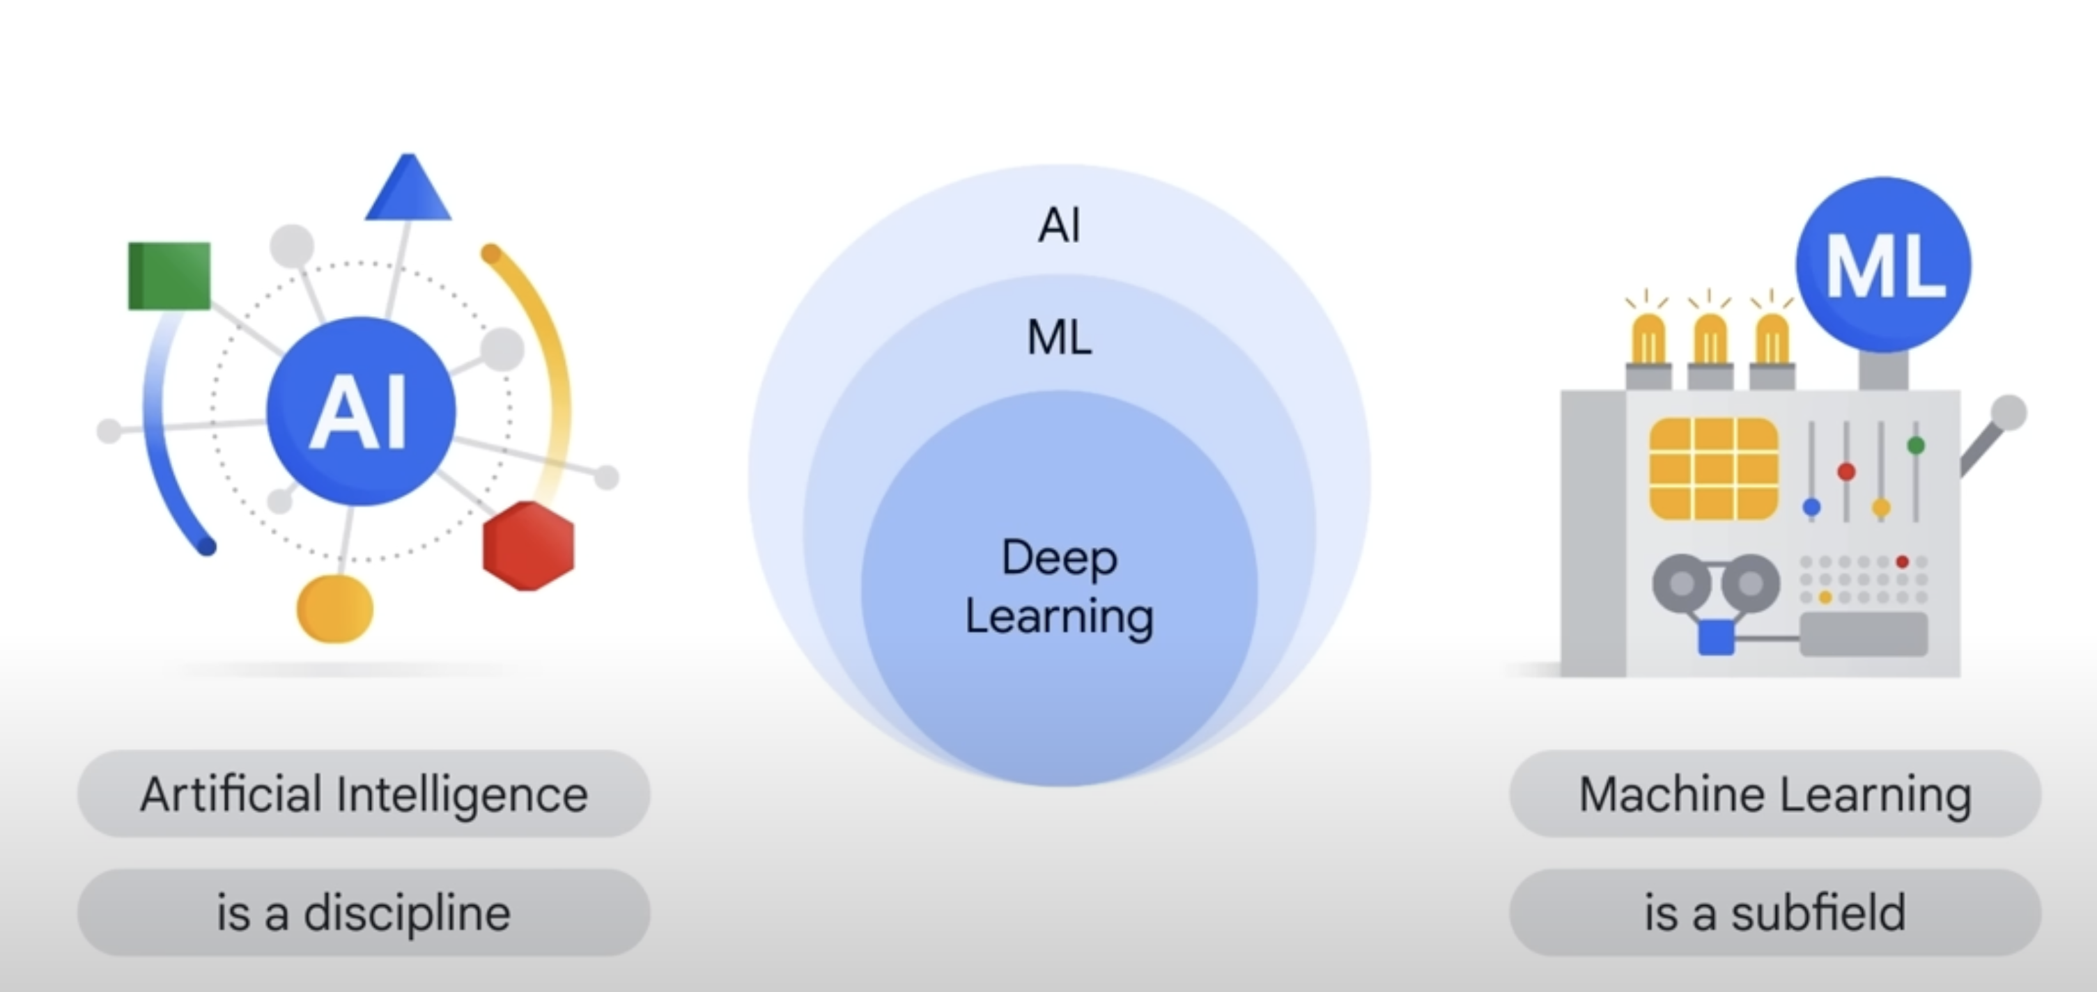
Intro to ChatGPT & other OpenAI models

Slide 9
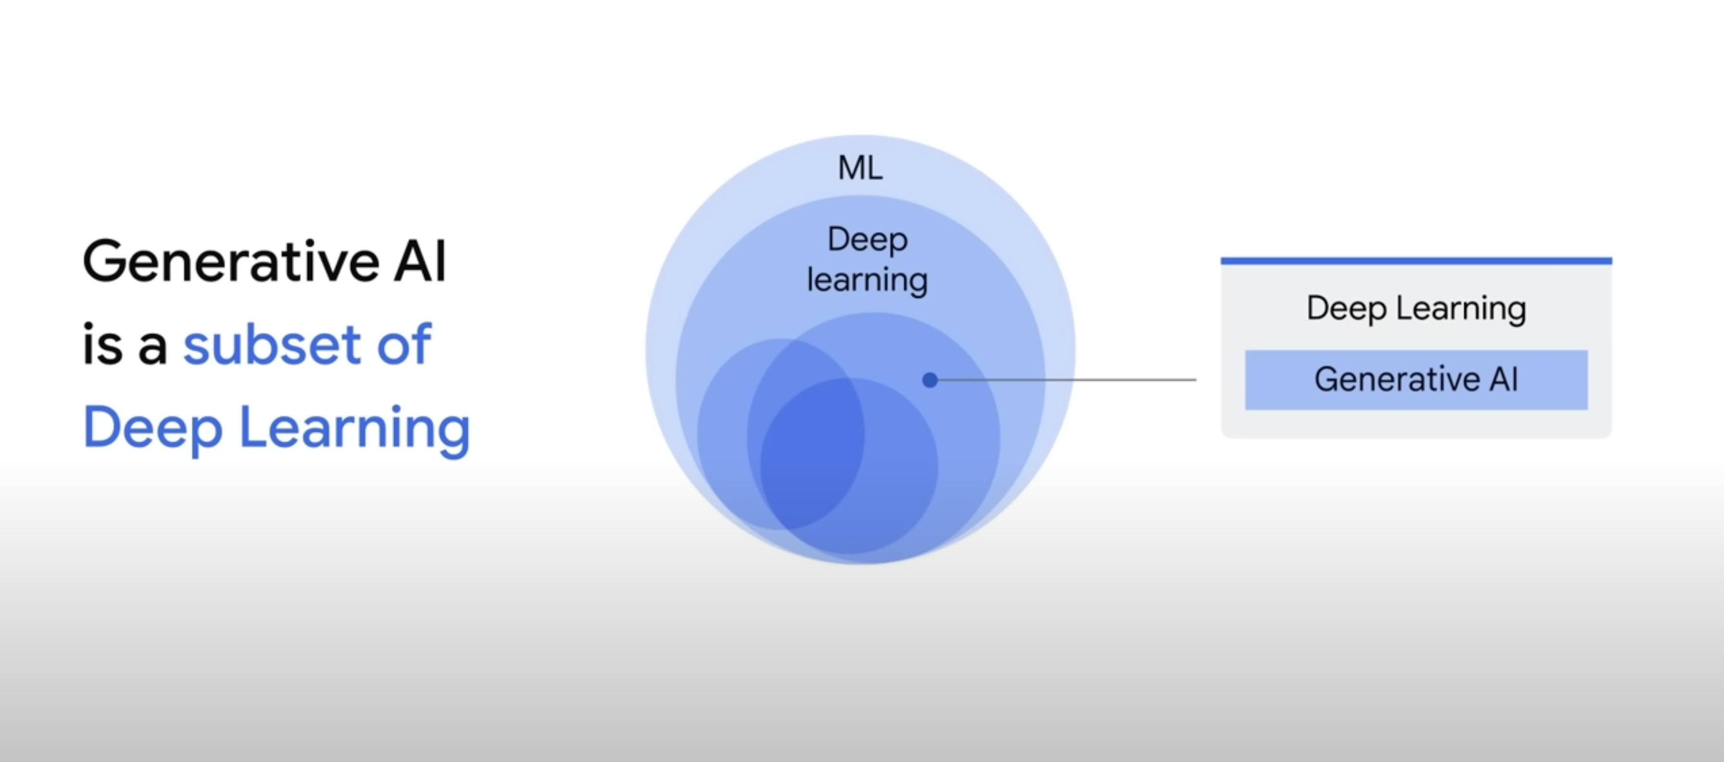
Supervised and Unsupervised models

Slide 10
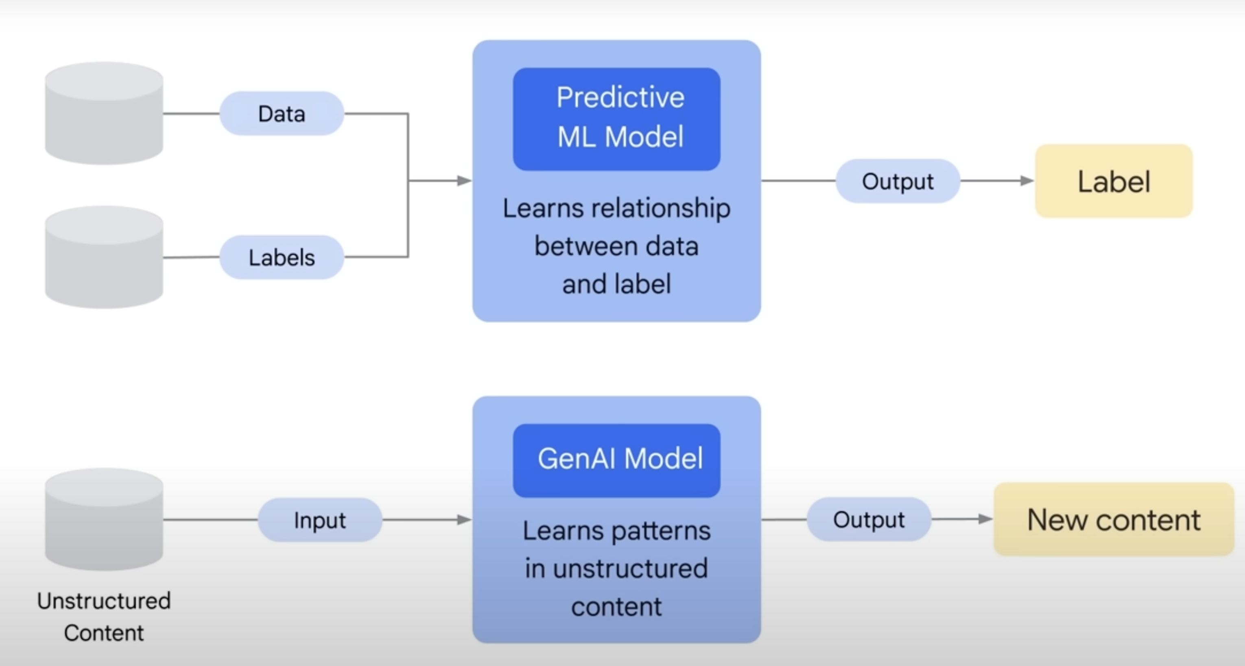
Generative and Predictive models

Slide 11
Intro to ChatGPT & other OpenAI models
LLM (Long-Term Memory) models are a type of machine-learning algorithm based on a deep-learning architecture. LLM models have the ability to store and recall data from long-term memory, enabling them to more accurately predict output based on input. At OpenAI, there are plenty different types of LLM models available, but the most popular now is gpt-3.5-turbo and recently released gpt-4.
ChatGPT (Ada, Davinci, Curie, Babbage, etc.)
Codex (create & analyze code)
Dall-e (create images using prompt)
Midjourney (create images using prompt)
OpenSource models https://github.com/cocktailpeanut/dalai

Slide 12
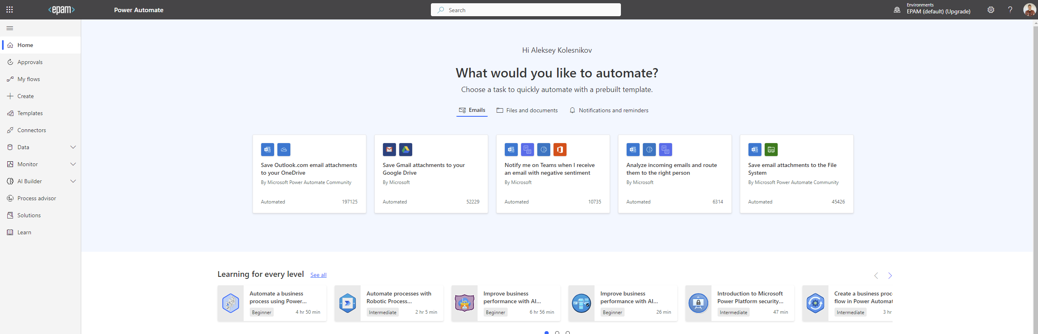
Check in
PowerAutomate
Visit https://make.powerautomate.com/ and login using your working account

Slide 13
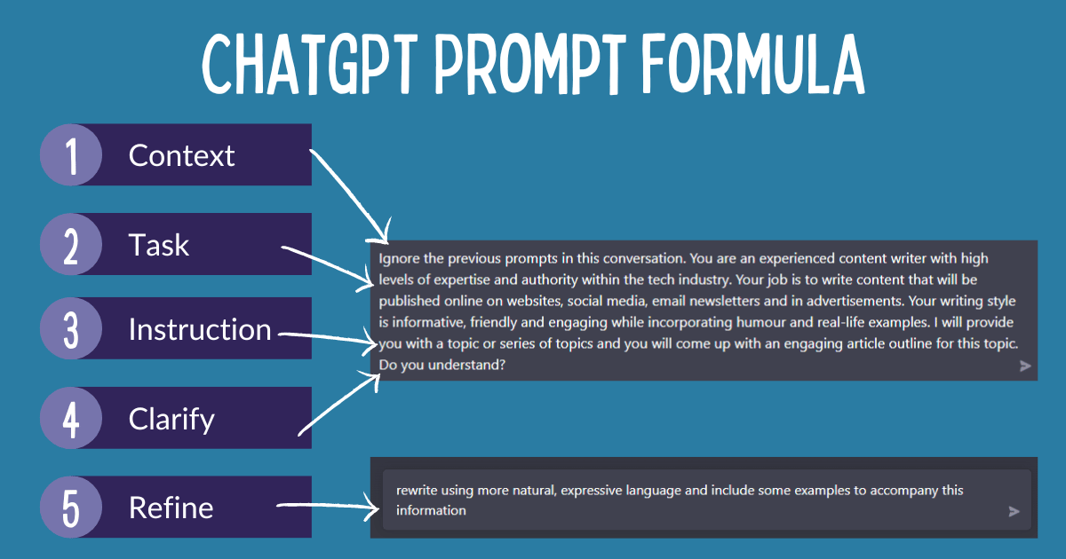
Prompt recommendations
Creating a good prompt for ChatGPT requires a bit of creativity and sensitivity. When crafting a prompt, the context should be provided for the bot to understand its goal in the interaction. This includes including important details surrounding the situation, such as the characters involved, the setting, or any given objectives.
The prompt should be concise yet specific in order to not overwhelm the bot with too much information. Additionally, questions should be formulated in a way that allows the bot to answer in a conversational manner, such as using both the prompt and the context to develop a dialogue. The structure of the prompt should be organized in a way that allows the bot to seamlessly transition from one point to the next, and to avoid any interruption.
Additionally, the prompt can include an optional back story, allowing the bot to have more depth in its responses and to elaborate further on the conversation. Finally, the prompt should have an actionable outcome, such as a call to action or response that can be used to further conversations. By following these steps, one can create a prompt that ChatGPT can use to interact with users in a meaningful way.
When sending prompts to ChatGPT, it is important to include detailed information about the desired outcome of the code, such as the specific functionality, language, frameworks, and libraries that you want the code to incorporate. Additionally, you should provide examples of code that achieves similar things to what you are trying to do. By providing as much detail as possible in the prompt, ChatGPT can better understand and process the request.

Slide 14
Good & Bad Prompt
We are creating a bot for BMW Dealership which sells cars in Poland and Lithuania. We need to provide a natural conversation experience with questions and answers.
Context – Task – Instruction
> We represent a BMW dealership operating in Lithuania and Poland. We are in the process of establishing a communication channel to aid our clients in choosing a car that aligns with their specific needs and preferences. You will be assuming the role of an assistant in this scenario. All client inquiries will be relayed to you. At the onset of each conversation, it is imperative to extend a warm greeting to the client, clarify your identity as an AI-based assistant, and express your readiness to assist them in their quest for a new vehicle that perfectly complements their lifestyle, preferences, and requirements.
What’s missed?
> Facilitate a dialogue that simulates a natural interaction, employing interrogative prompts to guide the user throughout their investigative journey.

Slide 15
Warm up. Poco API
Using our EPAM AI capabilities let’s play a bit with prompting and different versions of ChatGPT!
Under VPN visit https://chat.lab.epam.com/ , select ChatGPT3.5 and ChatGPT4, then apply the following prompt to both:
> I am a software engineer, and I am willing to create an API project which meets the following criteria:
API web-service application exposes three endpoints:
get endpoint which returns the current date and time beautifully formatted;
get endpoint which returns the current year;
get endpoint which return the current weekday;
post endpoint which echo posted message
Use modern C# language and .Net6.
Application should log how web service handles operations.
Don't miss importing datetime at the beginning of script!
Don't use html-templates, all html code should be inside C# code as plain strings.
Make sure it doesn't have errors.
Skip all explanations and generate the response which contains only the code.

Slide 16
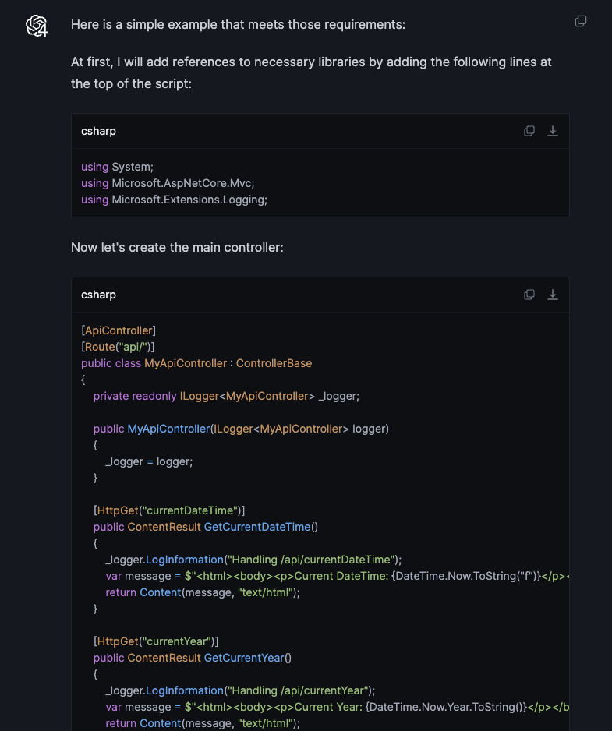
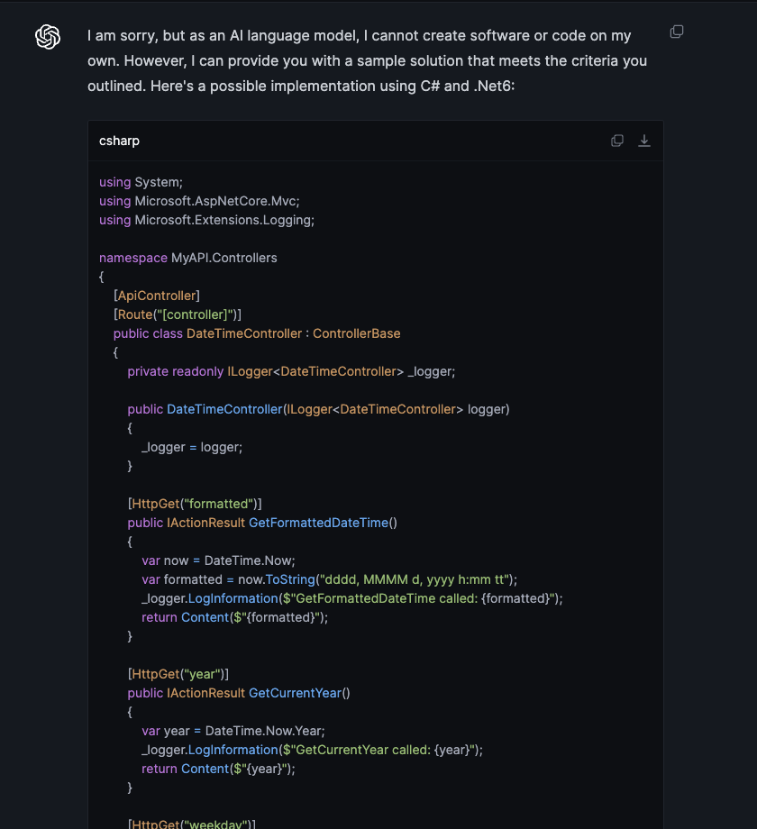
Warm up. Poco API
Different results.
ChatGPT may ignore recommendations. It can ignore even temperature changes.

Slide 17
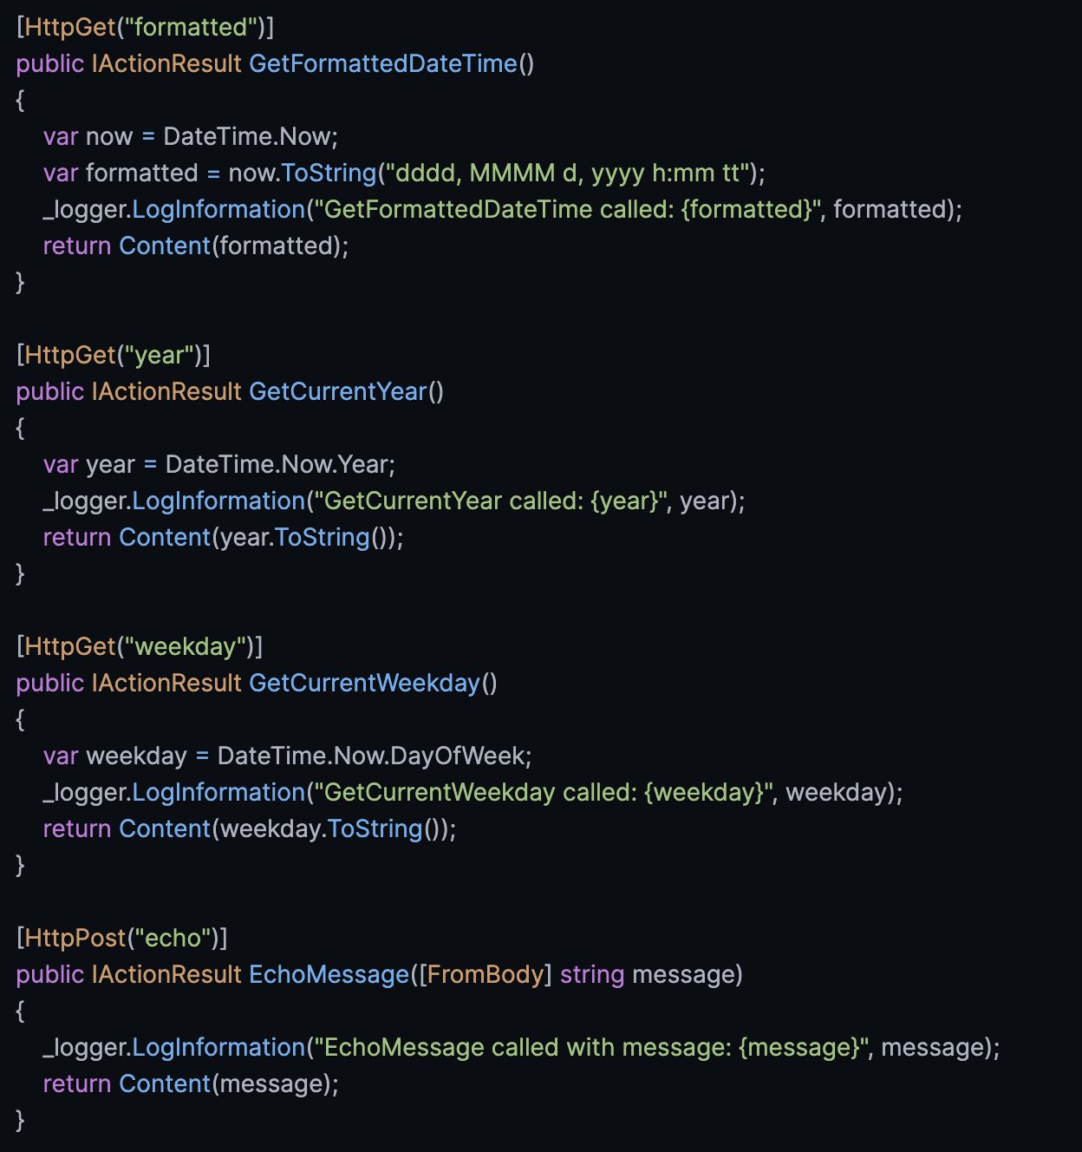
Warm up. Poco API
Let’s tune our code a bit.
> Considering the code you generated in the previous step, transform Controller class you generated and get rid of all html tags if they are presented.

Slide 18
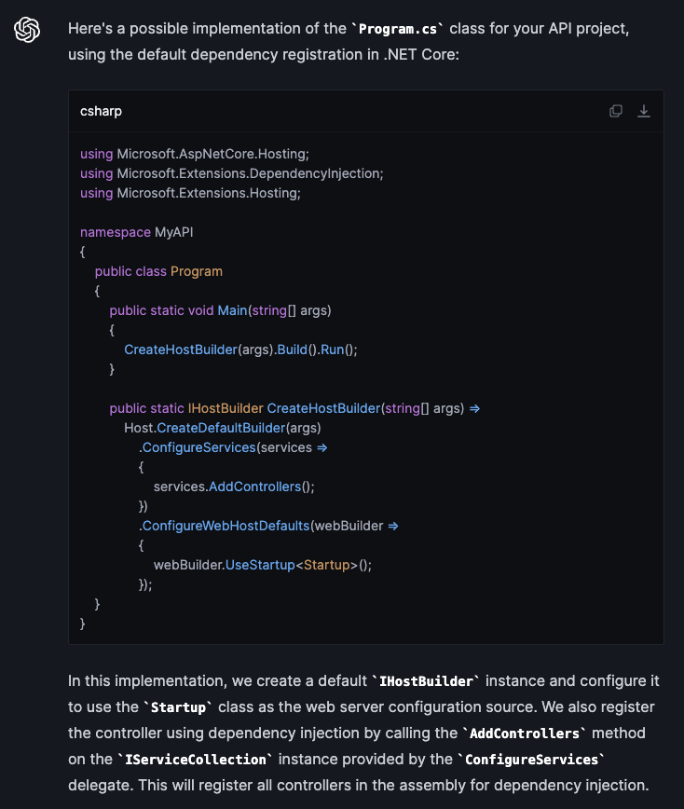
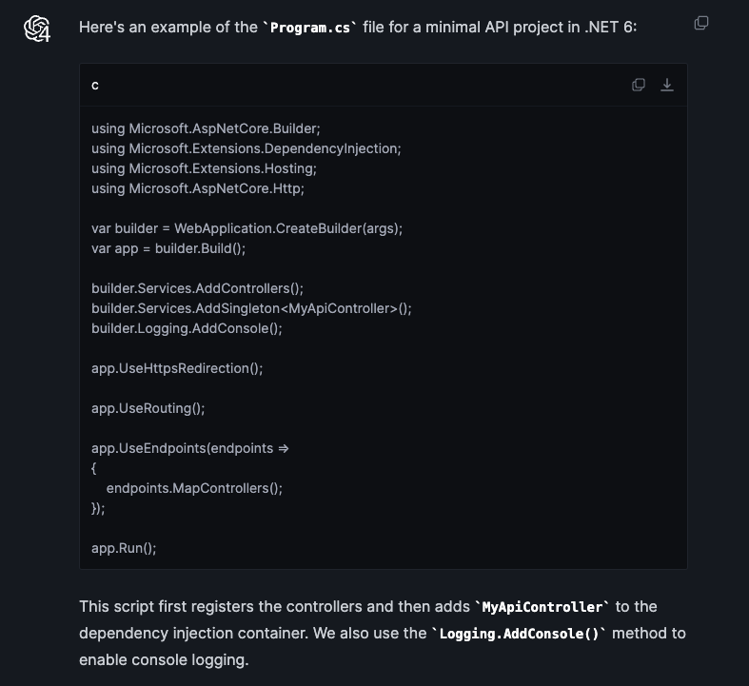
Warm up. Poco API
Let’s create a program.cs file for our API service.
> Considering the code you generated in the previous step, generate Program.cs class to be which is the main entrance of the application. Use default Dependency Container. Register controller using Dependency Injection.

Slide 19
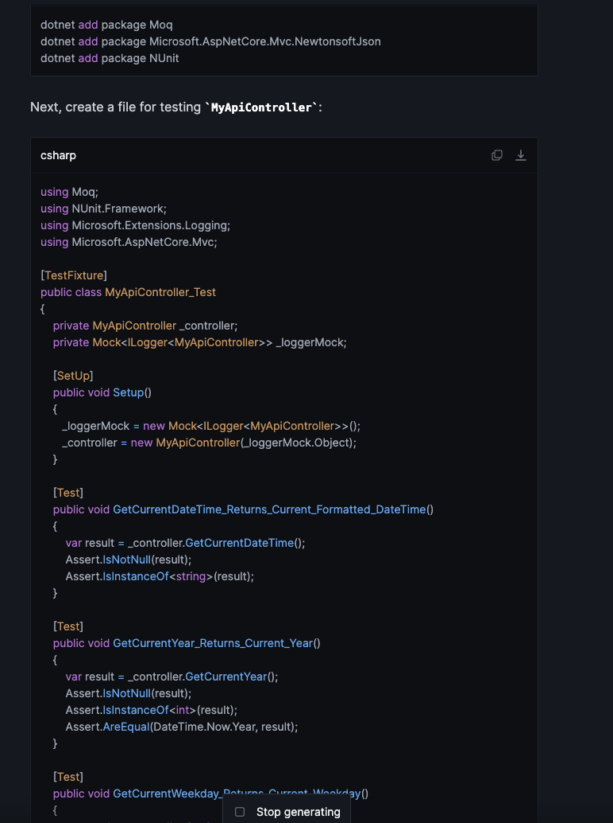
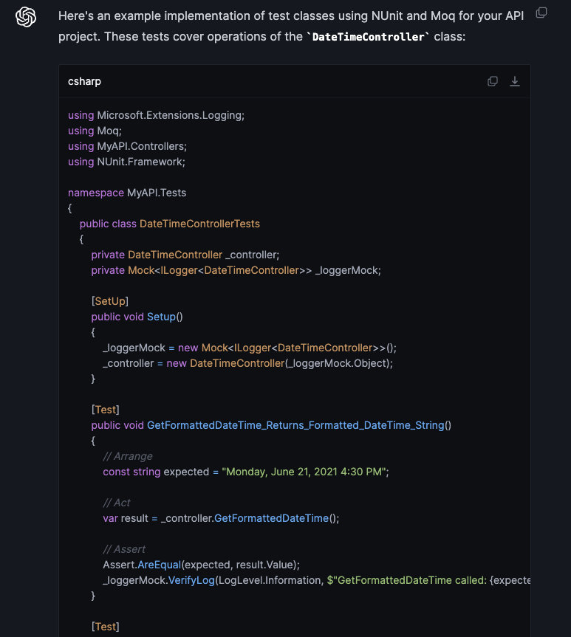
Warm up. Testing Poco API
Now let’s try to create tests!
> Considering previously generated code, add tests to this code using nUnit and Mock library. Put all needed mocks and stubs to the constructor of the test class. All test names should use modern naming notation with underscores and should explain what behavior is expected.

Slide 20
Application 1. Azure Function
We are going to organize simple Azure Function which will communicate with OpenAI & EPAM Gen-AI
OpenAI ChatGPT Completion example on Github
OpenAI ChatGPT Chat example on Github
EPAM Gen-AI ChatGPT Chat example on Github
OpenAI ChatGPT Chat with Redis example on Github
PS: You may ask ChatGPT to write you all needed code and just deploy this code to Azure or AWS. Let’s try to do that.

Slide 21
Azure Function
& OpenAI Completion
  To send a prompt to OpenAI you need:
  Organize your request body;
  Assign Bearer token you OpenAI issued to you;
  Send the request to endpoint. Keep in mind that there is different endpoints based on request type: completion and chat
Completion is a type of interaction wherein a singular request yields a solitary response. Contrary to a conversational format, it represents the most rudimentary communication modality, serving as our initial point of commencement.
  Create a prompt which asks ChatGPT3.5 or ChatGPT4 to generate an Azure Function \ AWS Lambda.
  Gather all details you need to specify and provide it to ChatGPT on your own.
  Use v1/completions endpoint which is obsolete, but still working

Slide 22
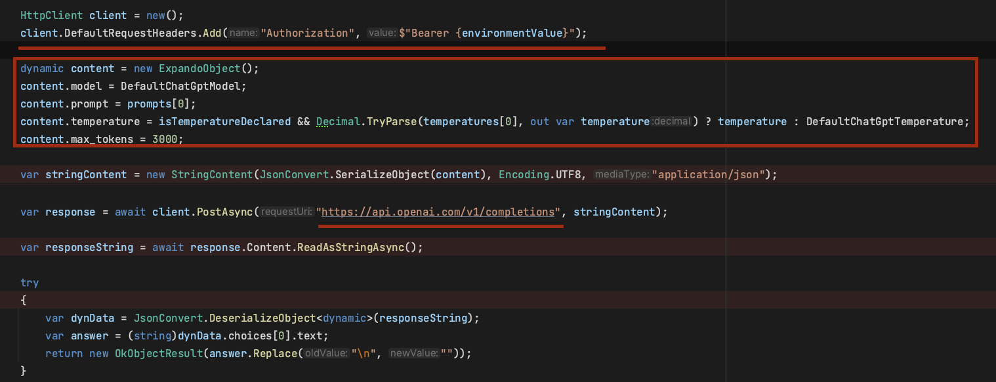
Azure Function
& OpenAI Completion
To send a prompt to OpenAI you need:
Organize your request body;
Assign Bearer token you OpenAI issued to you;
Send the request to endpoint. Keep in mind that there is different endpoints based on request type: completion and chat
Create a prompt which asks ChatGPT3.5 or ChatGPT4 to generate an Azure Function \ AWS Lambda.
Gather all details you need to specify and provide it to ChatGPT on your own.
Use v1/completions endpoint which is obsolete, but still working

Slide 23
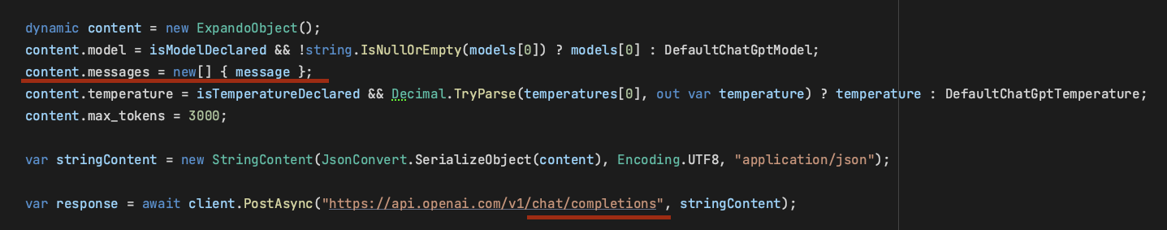
Azure Function
& OpenAI Chat
To send a prompt to OpenAI you need:
Organize your request body;
Assign Bearer token you OpenAI issued to you;
Send the request to endpoint. Keep in mind that there is different endpoints based on request type: completion and chat
Let’s create another function, now to v1/chat/completions.
The difference from the previous version:
Instead of sending a message in a single invitation, you send the invitation naturally organized as a chat, noting who owns which messages.
“completion” is obsolete, still works but no future updates expected. Therefore, it’s better to use chat

Slide 24
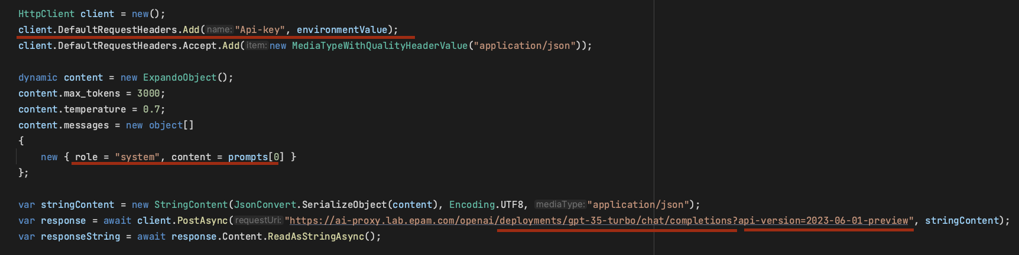
Azure Function & EPAM Dial Chat
To send a prompt to OpenAI you need:
Organize your request body;
Assign Bearer token you OpenAI issued to you;
Send the request to endpoint. Keep in mind that there is different endpoints based on request type: completion and chat
Let’s create a third function to EPAM Dial!
To send a prompt to EPAM Dial you need to use a bit another endpoint, another header, but the rest is the same.
With EPAM Dial you can use EPAM issued API Keys and your personal OpenAI keys as well

Slide 25




Azure Function & Cache
As you might see our application has no idea about any requests we sends earlier. It means in case we want to let chatGPT know what we sent before we need to store our previous requests in Cache
There is 2 strategies for caching – in-memory caching or using a separate 3rd –party instance and library as Redis
Strategies to bring context with you:
In-memory cache – not great candidate for Stateless & Serverless applications
Redis – good candidate to be a distributed cache
Persistence Storages: MongoDB, CouchDB, Cassandra, Firebase. Analytics & hierarchical context
LLM plugins – plugin which enriches your calls to LLM Model such as LangChain
Chatbot frameworks like Rasa

Slide 26

Azure Function & Cache
As you might see our application has no idea about any requests we sends earlier. It means in case we want to let chatGPT know what we sent before we need to store our previous requests in Cache
There is 2 strategies for caching – in-memory caching or using a separate 3rd –party instance and library as Redis
While in-memory caching is easy to implement, in-memory caching in serverless applications is anti-pattern and is not recommended because you cannot synchronize cache state between functions.

Slide 27
Azure Function & Cache
As you might see our application has no idea about any requests we sends earlier. It means in case we want to let chatGPT know what we sent before we need to store our previous requests in Cache
There is 2 strategies for caching – in-memory caching or using a separate 3rd –party instance and library as Redis
Let’s use the following prompt and generate code for Azure Function to call Redis for Data
> I am software engineer who writes Azure Function using C# and which needs to call Redis Cache located in Azure Cloud. Write a code to get and write records to Azure Redis Cache. Unique keys for Redis should come from the request’s query.
Azure Function with Redis could be downloaded from here

Slide 28
Azure Function & Cache
Let’s use the following prompt and generate code for Azure Function to call Redis for Data
> I am software engineer, and I wrote Azure Function which communicates with OpenAI API using chat completion option. Create a method which creates connection to Redis instance using StackExchange library. Use lazy initialization.

Slide 29
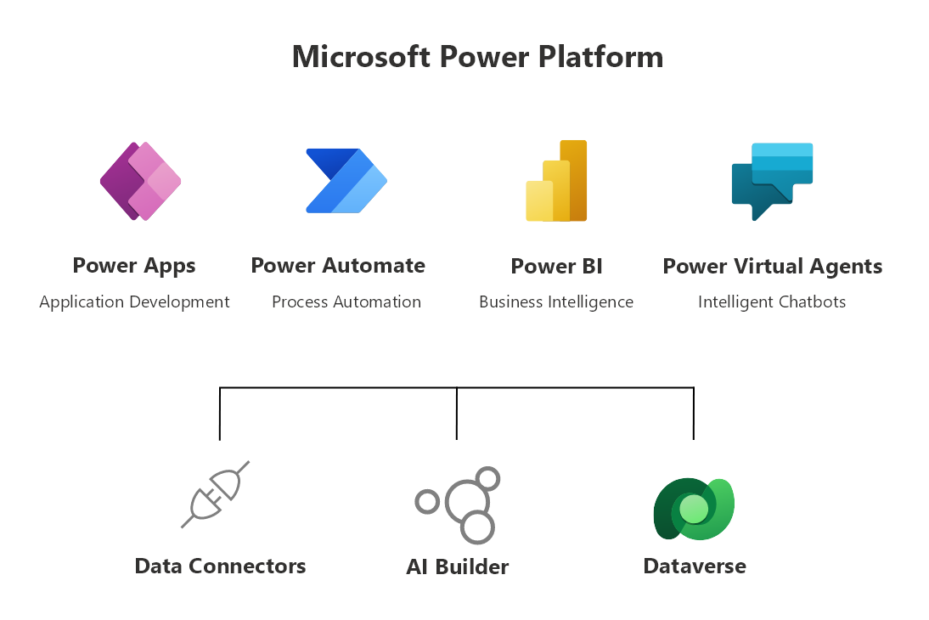
Application 2. Integrate with PowerAutomate

Slide 30
Application 2. Integrate with PowerAutomate

Slide 31
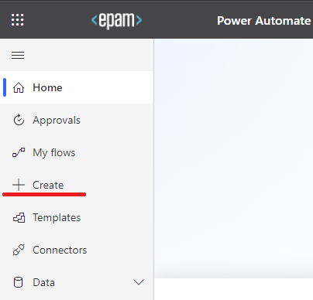
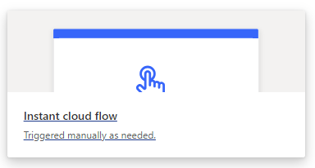
Application 2. Integrate with PowerAutomate
Power Automate (formerly known as Microsoft Flow) is a cloud-based automation tool used to create workflows that bridge different applications or services using a simple drag-and-drop interface. The tool can be used to automate processes such as creating a task when a customer record is modified, sending notifications of pending tasks, or copying data from one application to another.
Our goal for this task: Integrate recently created AzureFunction with PowerAutomate
Visit: https://make.powerautomate.com/
Click “+ Create” to create a new workflow

Slide 32
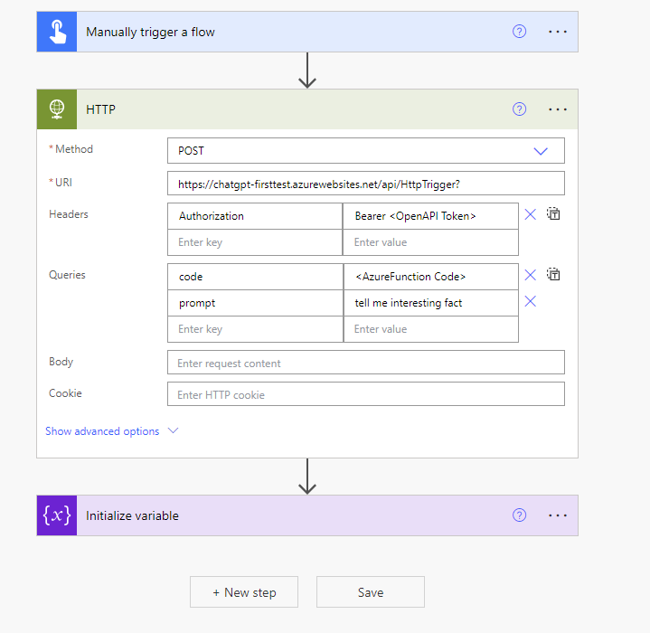
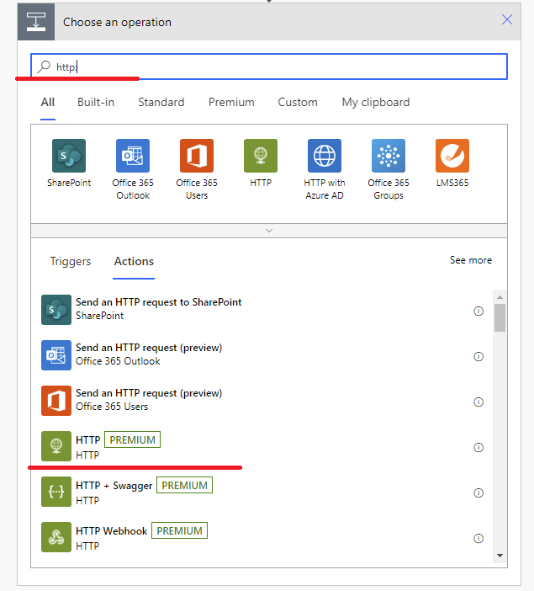
Application 2. Integrate with PowerAutomate. Simple Call
First, we need to create Manually Triggered Flow which makes a call to our AzureFunction

Slide 33
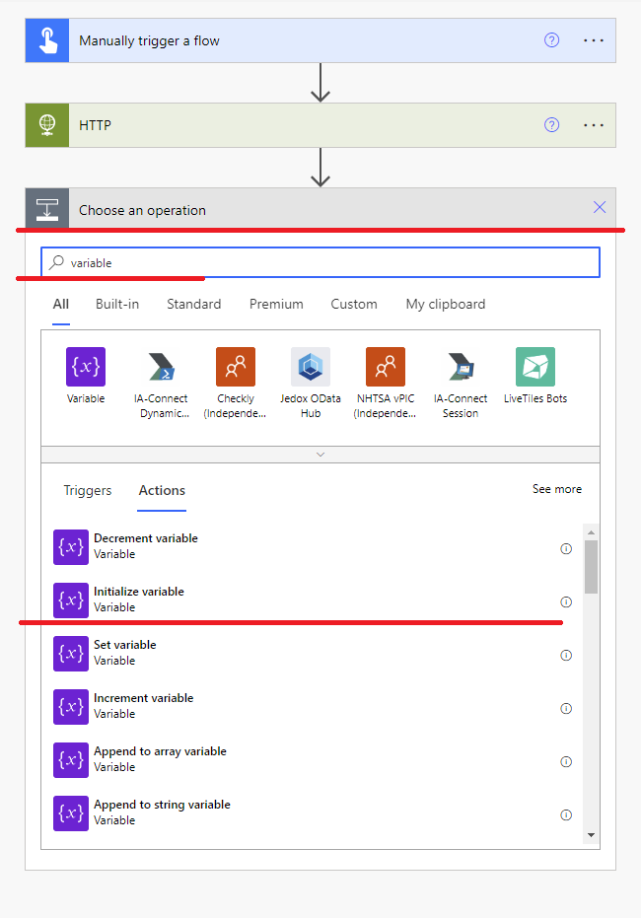
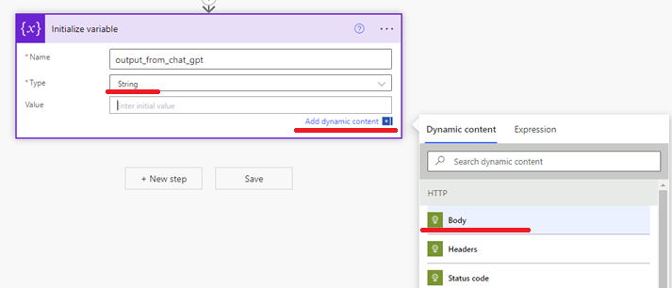
Application 2. Integrate with PowerAutomate. Simple Call
After that we need to get response and put it into variable

Slide 34
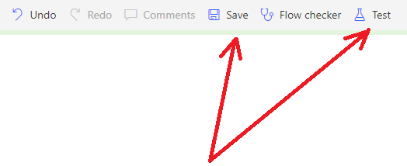
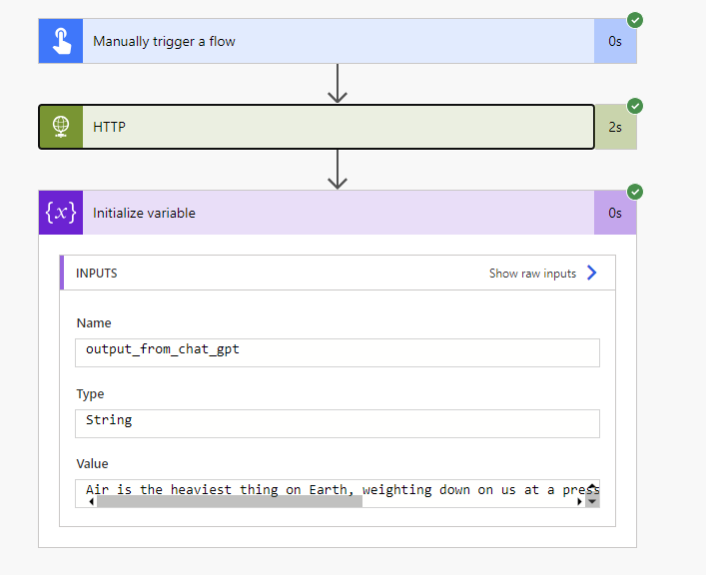
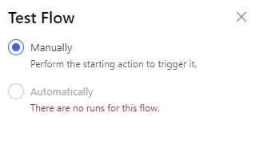
Application 2. Integrate with PowerAutomate. Simple Call
Let’s Save and Test our integration!

Slide 35
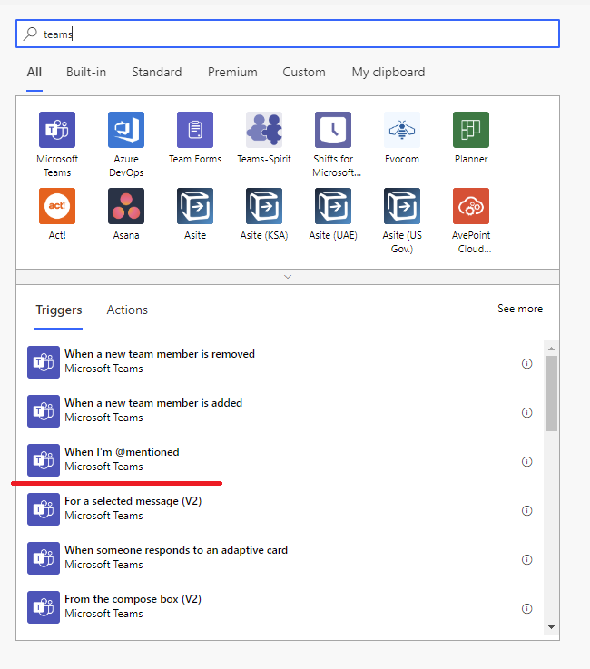
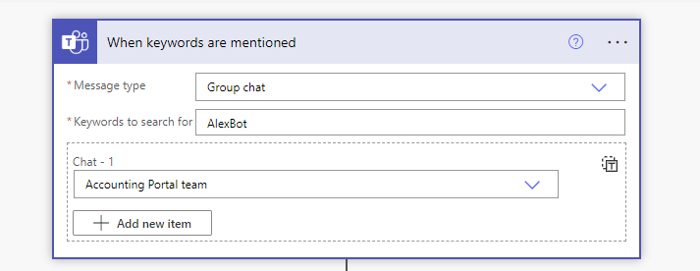
Application 2. Integrate with PowerAutomate. ChatBot
Let’s create another integration. Now our trigger will be Teams.
On the first step, We are getting Message Objects.

Slide 36
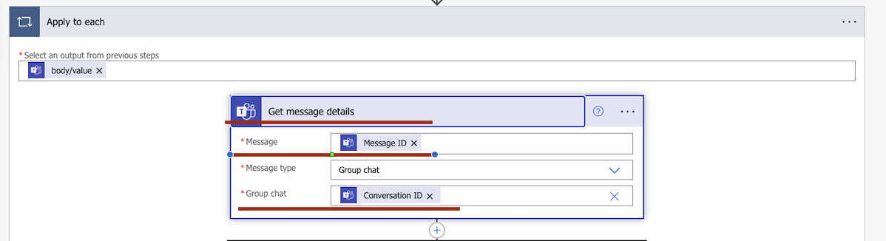
Application 2. Integrate with PowerAutomate. ChatBot
Next, we need to get Message Body. To do that – need to use GetMessageDetails.
Here you need to specify Body, Message ID and Conversation ID expression elements.
Please note that you apply this within ApplyToEach operation

Slide 37
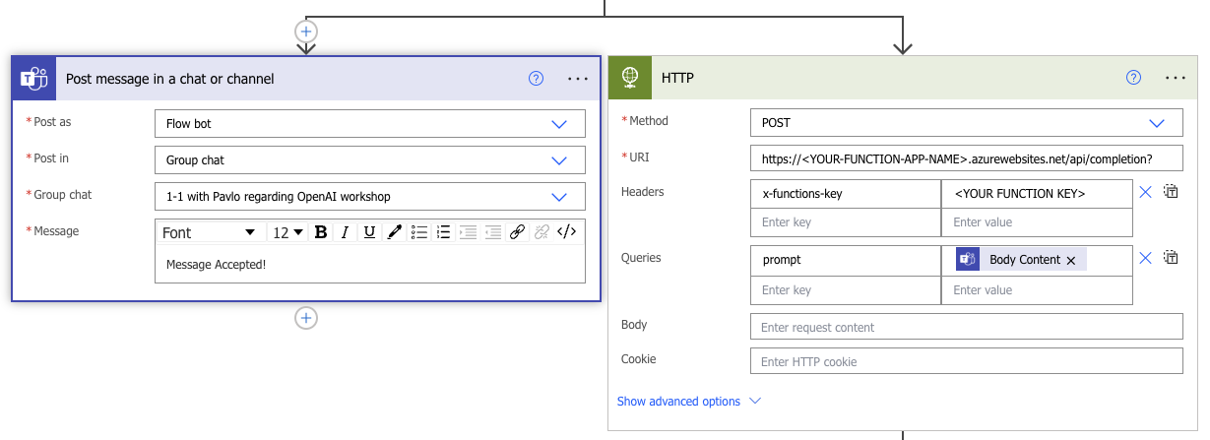
Application 2. Integrate with PowerAutomate. ChatBot
On the next step we do the following:
Immediately send the anwer that message is accepted.
And we send the request to our Azure Function as it was done in the previous flow.
To make two parallel operations just click + symbol twice and use HTTP and Post Message in a Chat

Slide 38
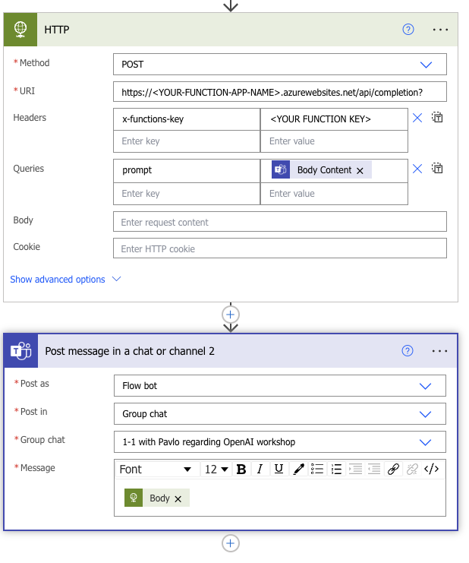
Application 2. Integrate with PowerAutomate. ChatBot
Now we just need to send back the ChatGPT’s answer.
Put Body expression in Post message - Message

Slide 39
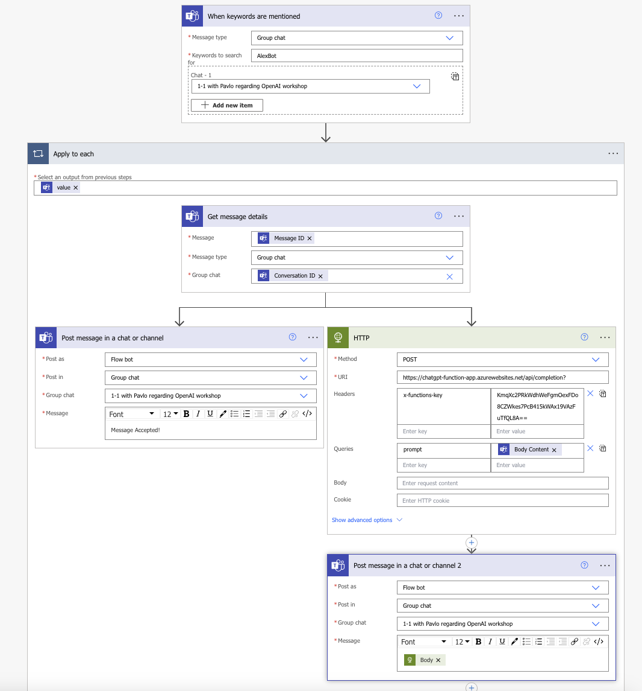
Application 2. Integrate with PowerAutomate. ChatBot
When it’s done it should look like that:

Slide 40
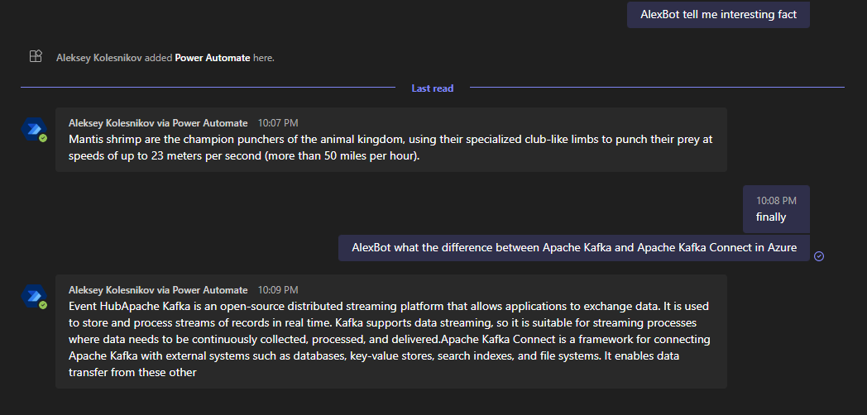
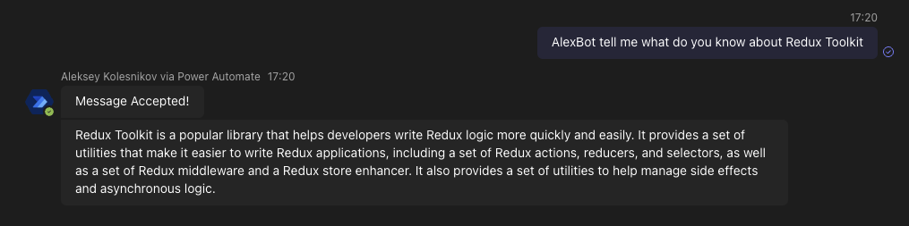
Application 2. Integrate with PowerAutomate. ChatBot
And Result you may see below:

Slide 41
Other ideas you may apply on your project
Automatic fixes for your code based on SonarQube and your handler;
Renovate bot – increment image version in your Kubernetes deployment.yaml script and create PR when your PR merged to DEV branch;
Convert your code from one language to another (Auto code conversion, quite often case nowadays);
Co-reviewer – check logic and naming conventions in PR;
System analysis – may help you to create rationale and compare different technologies in terms of efforts or further system throughput;
Junior Developers education – review their code, automatically recommend updates;
Onboarding – update your Documentation step by step considering changes you have made recently;
Cover letter creator;
Outlook integration – handle automatically all mails in which specific techs or problems mentioned;
Messages & Emails Proofreader.

Slide 42
Wrap up. Useful links.
Simplify and update your prompt to lower the number of used tokens but not affecting its quality. https://github.com/stephentoub/Tokenizer
How ChatGPT works inside: https://writings.stephenwolfram.com/2023/02/what-is-chatgpt-doing-and-why-does-it-work/?fbclid=IwAR0eV1C7bPYQeEX0BbmqR_8zAFTgf4S5q-bEXoG3ZK7fmxgMICj-QqW6ZWM
Generative AI Learning Path, Google Cloud Skill Boost Platform: https://www.cloudskillsboost.google/paths/118

