Slide 1
Generative AI Exploring OpenAI Role in Leveraging Generative AI for Applications
Introduction
Workshop
Guidance
by Aleksey Kolesnikov
Generated by ChatGPT on 50%

Slide 2
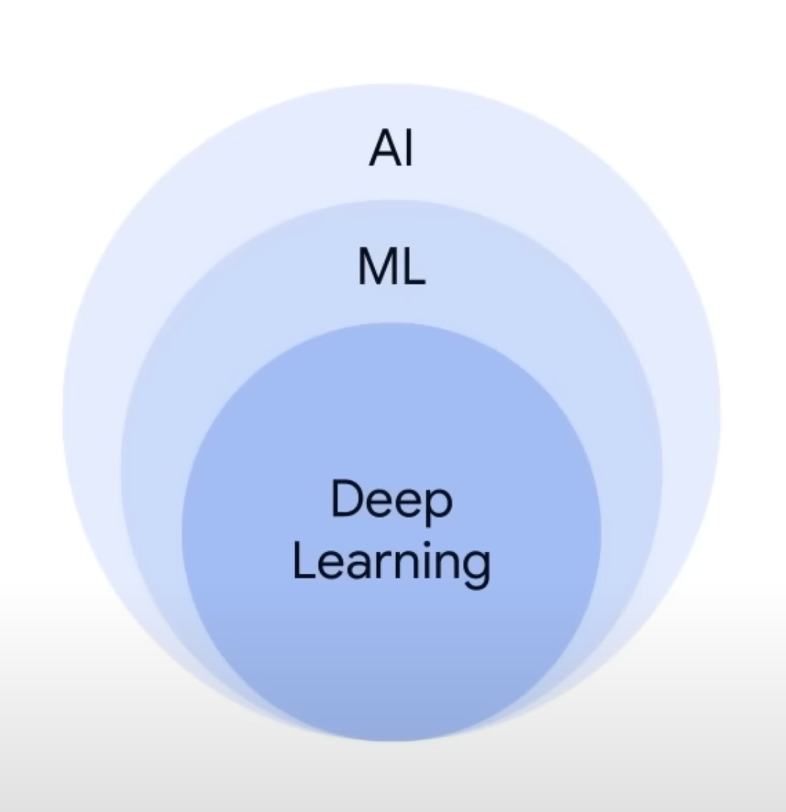
Idea of this Workshop
During this workshop, we will explore the world of generative AI capabilities:
What and how you could interact with ChatGPT
How ChatGPT output differs based on ChatGPT version
How to make API calls to OpenAI platform and to EPAM Dial
How to integrate into real workflows

Slide 3
Manage getting access to OpenAI, Bard AI, Edge Chat
Vitis OpenAI page and sign up: https://openai.com/
Check that you get an access to the playground at https://platform.openai.com/playground
Visit OpenAI ApiKeys page to issue the token https://platform.openai.com/account/api-keys
Create a token, save it in a secure place, do not commit it with your code to the remote repository

Slide 4
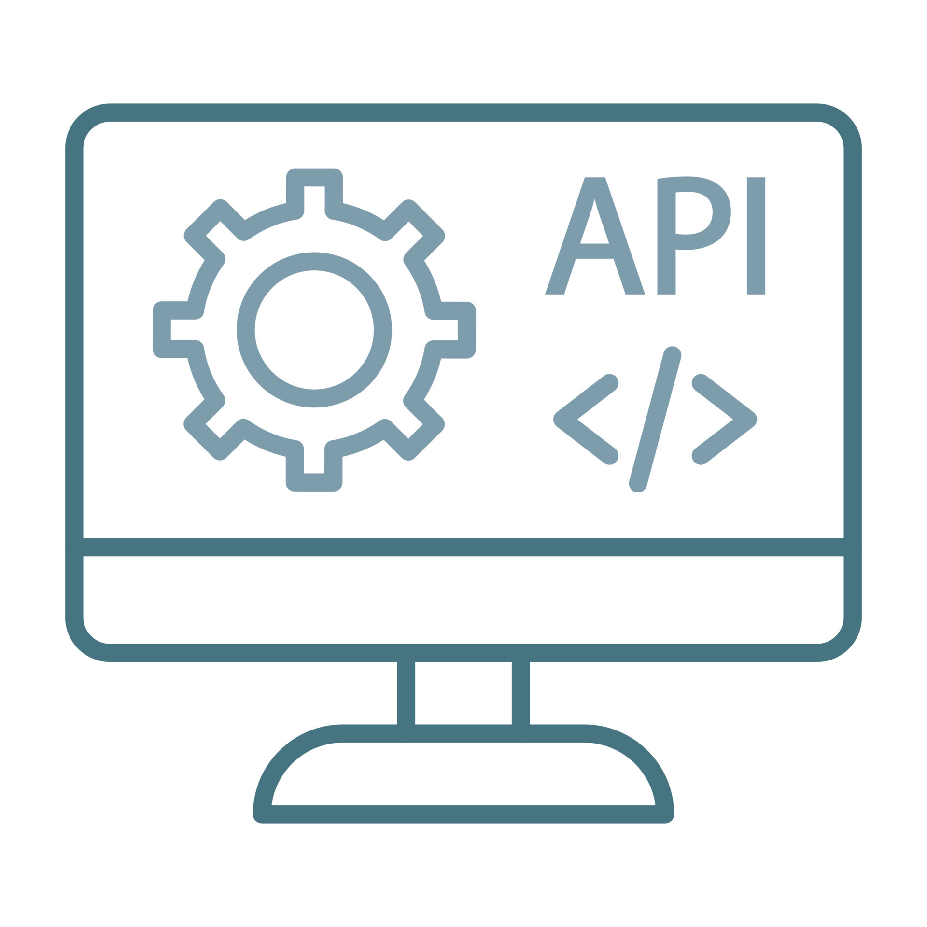
Applications and scenarios we are covering today
Console Command Helper which communicates with OpenAI endpoints using Completion
AI Assistant which communicates with OpenAI using Chat

Slide 5
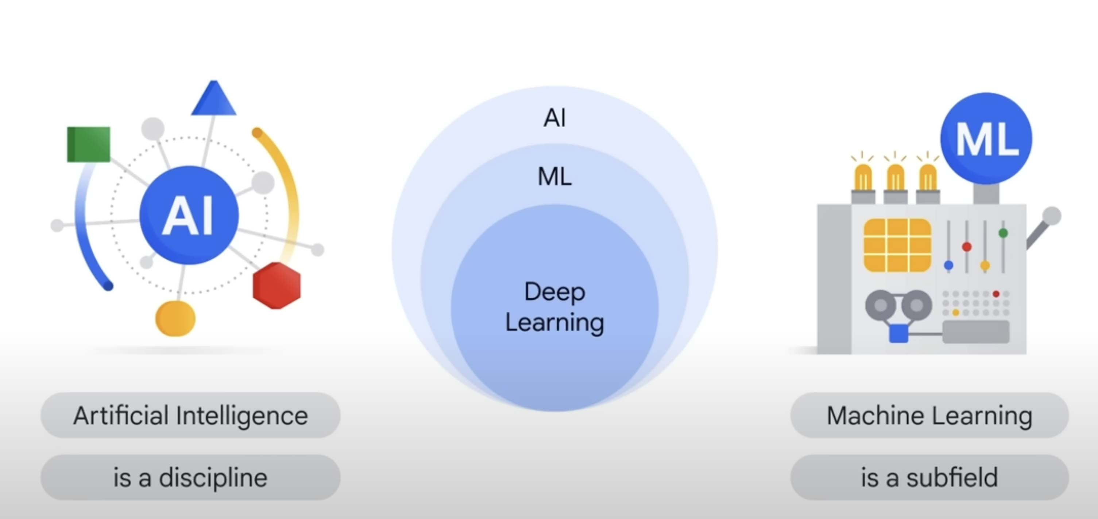
Difference between AI and ML

Slide 6
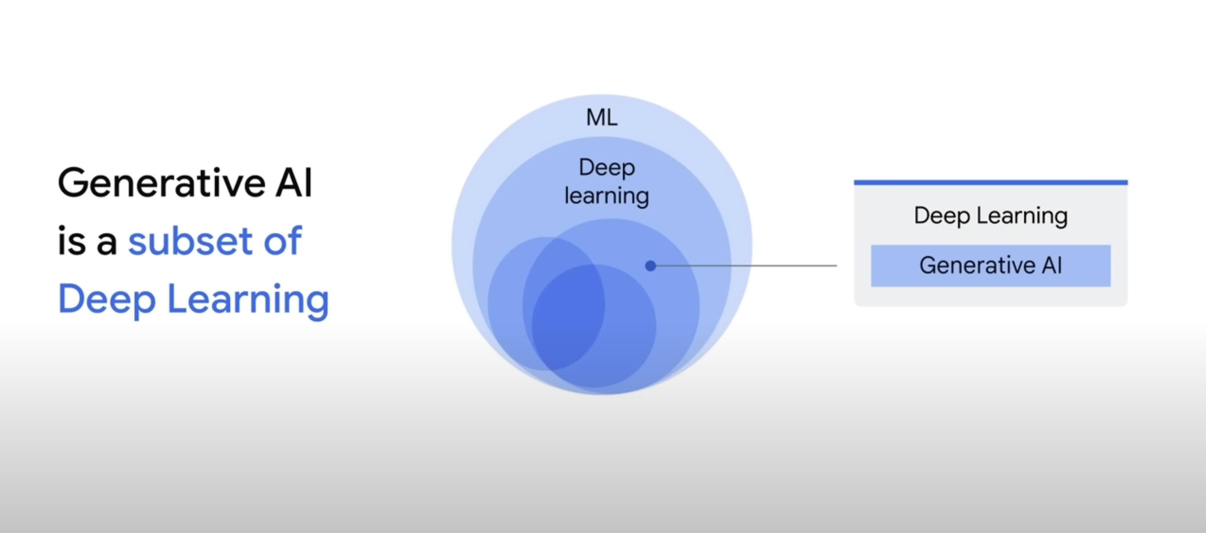
Supervised and Unsupervised models

Slide 7
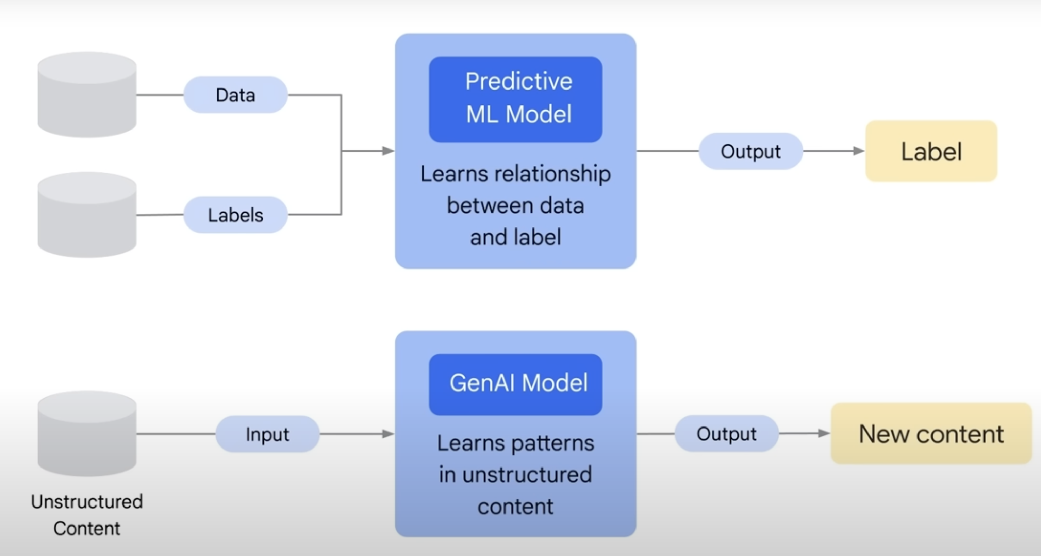
Generative and Predictive models

Slide 8
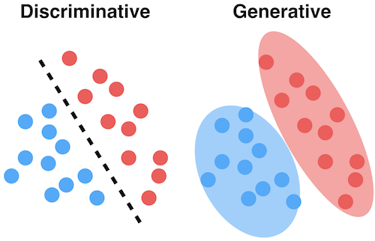
Discriminative Model
Logistic regression: Logistic regression can be considered the linear regression of classification models. The main idea behind both the algorithms is similar, but while linear regression is used for predicting a continuous dependent variable, logistic regression is used to differentiate between two or more classes.
Support vector machines: This is a powerful learning algorithm with applications in both regression and classification scenarios. An n-dimensional space containing the data points is divided into classes by decision boundaries using support vectors. The best boundary is called a hyperplane.
Decision trees: A graphical tree-like model is used to map decisions and their probable outcomes. It could be thought of as a robust version of If-else statements.

Slide 9
Generative Model
Bayesian network: Also known as Bayes’ network, this model uses a directed acyclic graph (DAG) to draw Bayesian inferences over a set of random variables to calculate probabilities. It has many applications like prediction, anomaly detection, time series prediction, etc.
Autoregressive model: Mainly used for time series modeling, it finds a correlation between past behaviors to predict future behaviors.
Generative adversarial network (GAN): It’s based on deep learning technology and uses two submodels. The generator model trains and generates new data points and the discriminative model classifies these ‘generated’ data points into real or fake.

Slide 10
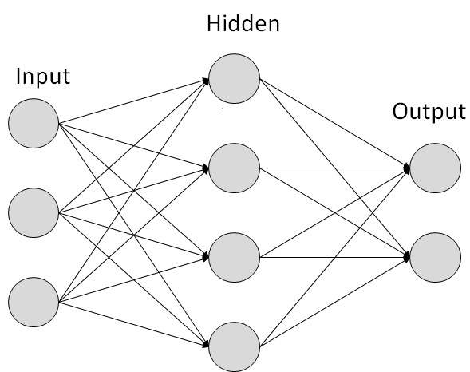
Within Deep Learning models
In Deep Learning, hidden layers are essentially the 'brains' of the neural network. These are the layers between the input layer and the output layer. These hidden layers have neurons that process the input data, extract the relevant features, and gradually produce the output.
The depth of the learning model, meaning the number of layers, allows complex patterns and relationships to be learned.

Slide 11
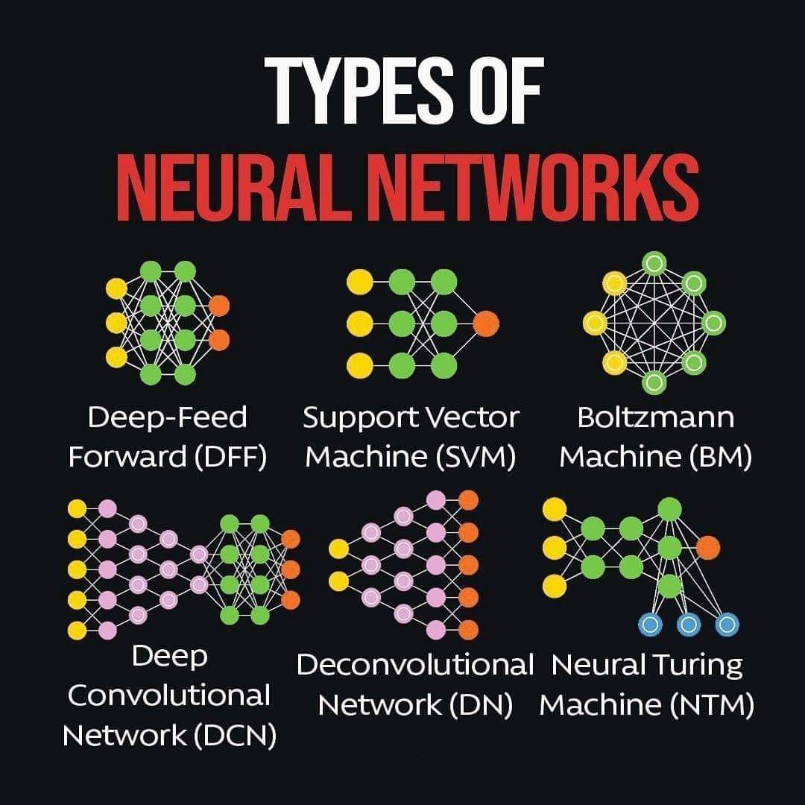
Types of models
Boltzmann Machines: These networks learn probabilistic representations through hidden units. They're effective for unsupervised learning tasks but training them can be computationally intensive, and it's challenging to scale them up for larger datasets.
Deep Convolutional Networks: These are primarily used in image processing, where they excel at identifying spatial hierarchies or patterns. They perform exceptionally well on visual data, thanks to their ability to take advantage of spatial information. However, convolutional layers can be hard to interpret, and they require significant data and computational power.

Slide 12
Types of models
Deep Feed-Forward Networks: Also known as Multi-Layer Perceptrons (MLPs), these networks pass information in one direction, from input to output, performing transformations through hidden layers. They can handle diverse types of data and tasks, but the downside is that they do not consider temporal or spatial aspects of data.
Support Vector Machines (SVMs): SVMs are used mostly for classification tasks and work by finding the best hyperplane that separates different classes. The advantage of SVMs is their efficiency with high-dimensional data; however, they can struggle with larger datasets and aren't suitable for nuanced tasks like pattern recognition.

Slide 13
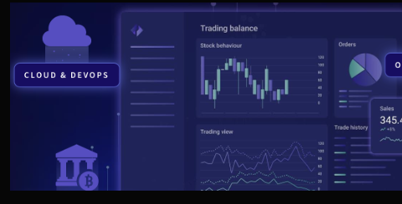
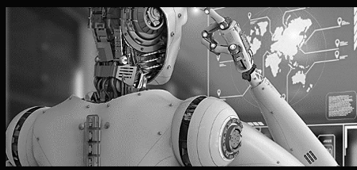
Practical expertise in traditional and emerging AI Technologies for Human Resources
Advanced Analytics
Computer Vision
Natural Language Processing
Document validation and processing
Fraud detection
Calculation issues detection
Workflow balancing
AI Route optimizations
Digital Twin. Simulation & Optimization
Vehicle analysis and service prediction
QA & Defect detection. Inspection
Operation and demand analysis
Delivery Verification.
Medical health checks
Virtual AI-assistant
Multilanguage data extraction
AI Supervisor
Inventory Management Assistant
Responsible ai
HCI-AI ( Human AI- interaction)
Operational AI
Discriminative & Generative AI
Privacy Preserving ML
Ethical AI
AI Model Governance
Risk & Lifecycle Management
NQL – Natural Query Language to speak to your warehouse and it will respond
Document access, data comparison
Follow up from meetings and calls
AI products delivery, AI Scale
Integration into Existing Infrastructure
End-to-end data integration
Quality &Responsible AI frameworks integration
Integration with other AI-based tools
Customer Support
Supplier Collaboration
Semantic & Natural Language Search
Compliance & Regulatory assistance
Notes:
Investigation of Human-AI Interaction Dynamics: Scientific exploration of HCI paradigms with AI systems, emphasizing the modeling of interaction patterns, system responses, and user behavior analytics.
Cognitive Processing in AI Mediated Interactions: Applying cognitive psychology principles to examine human cognition, perception, and behavior in the context of AI interfaces, leading to the development of cognitive models for enhanced human-AI synergy.
Adaptive Interface Design in Intelligent Systems: Rigorous investigation into machine learning and AI-driven interface adaptability, with a focus on developing systems that can understand, learn from, and adapt to individual user inputs and behavioral patterns.
HCI Research & Validation: Leveraging a fusion of methodologies from computer science, cognitive psychology, and design sciences to conduct research and validation tests. The goal is to generate empirical data and build theoretical models that drive advancements in human interactions with diverse AI systems.

Slide 14
ChatGPT & other OpenAI models
Different models: Ada, Davinci, Curie, Babbage, etc
Codex -create & analyze code
Dall-e 3 - create images using prompt
Midjourney - create images using prompt
OpenSource models https://github.com/cocktailpeanut/dalai

Slide 15
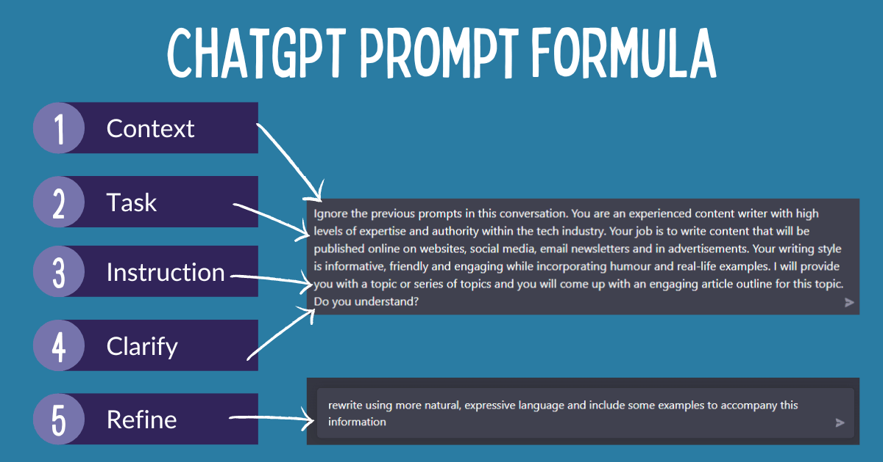
Prompt recommendations
Creating a good prompt for ChatGPT requires a bit of creativity and sensitivity. When crafting a prompt, the context should be provided for the bot to understand its goal in the interaction. This includes including important details surrounding the situation, such as the characters involved, the setting, or any given objectives.
The prompt should be concise yet specific in order to not overwhelm the bot with too much information. Additionally, questions should be formulated in a way that allows the bot to answer in a conversational manner, such as using both the prompt and the context to develop a dialogue. The structure of the prompt should be organized in a way that allows the bot to seamlessly transition from one point to the next, and to avoid any interruption.
Additionally, the prompt can include an optional back story, allowing the bot to have more depth in its responses and to elaborate further on the conversation. Finally, the prompt should have an actionable outcome, such as a call to action or response that can be used to further conversations. By following these steps, one can create a prompt that ChatGPT can use to interact with users in a meaningful way.
When sending prompts to ChatGPT, it is important to include detailed information about the desired outcome of the code, such as the specific functionality, language, frameworks, and libraries that you want the code to incorporate. Additionally, you should provide examples of code that achieves similar things to what you are trying to do. By providing as much detail as possible in the prompt, ChatGPT can better understand and process the request.

Slide 16
Good & Bad Prompt
We are creating a chatbot for BMW Dealership which sells cars in Poland and Lithuania. We need to provide a natural conversation experience with questions and answers helping clients select a new car based on their preferences.
Context –> Task –> Instruction
We represent a BMW dealership operating in Lithuania and Poland. We are in the process of establishing a communication channel to aid our clients in choosing a car that aligns with their specific needs and preferences. You will be assuming the role of an assistant in this scenario. All client inquiries will be relayed to you. At the onset of each conversation, it is imperative to extend a warm greeting to the client, clarify your identity as an AI-based assistant, and express your readiness to assist them in their quest for a new vehicle that perfectly complements their lifestyle, preferences, and requirements.
What’s missed?
Facilitate a dialogue that simulates a natural interaction, employing interrogative prompts to guide the user throughout their investigative journey.

Slide 17
Warm up. Poco Console App
Using our EPAM AI capabilities let’s play a bit with prompting and different versions of ChatGPT!
Under VPN visit https://platform.openai.com/playground , select ChatGPT3 Davinci, interaction - completion:
I am a C# software engineer, and I am willing to create a console application project which meets the following criteria: application exposes consumes one of four commands:
1) send back the current date and time beautifully formatted;
2) send back the current year beautifully formatted;
3) send back the current weekday beautifully formatted;
4) send back the formatted message we send to the application.
Use modern C# language and .Net6.
Application should log how web service handles operations.
Don't use html-templates, all html code should be inside C# code as plain strings.
Make sure it doesn't have errors.
Skip all explanations and generate the response which contains only the code.

Slide 18
Warm up. Poco Console App
Now let's experiment with hallucination and maximum length in tokens.
How do these changes affect the output?

Slide 19
Warm up. Poco Console App
Let’s convert the C# code to Python using the following prompt:
Convert written application into Python

Slide 20
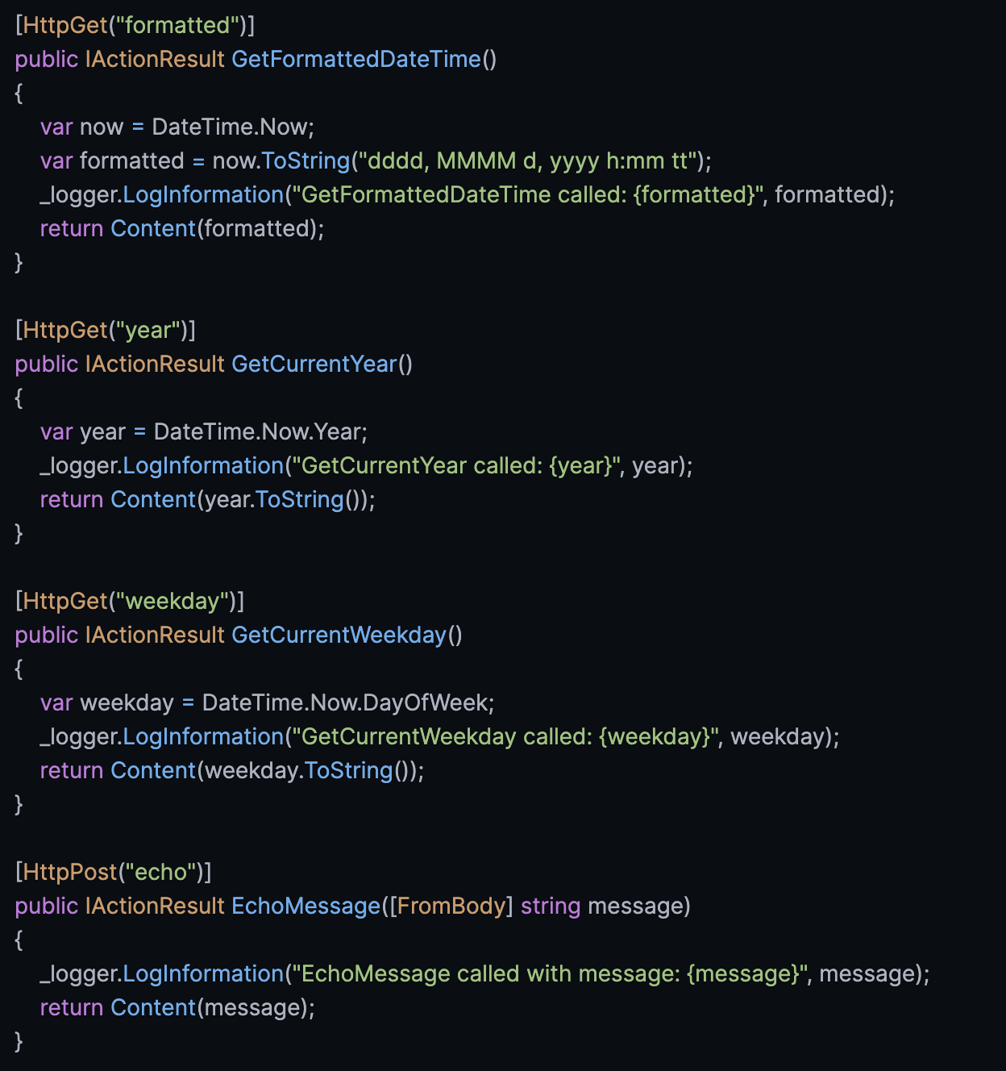
Warm up Poco API
Let’s tune our code a bit.
Considering the code you generated in the previous step, convert it to Web API Controller class for C# Web API project. Organize 4 endpoints which will handle our requests.

Slide 21
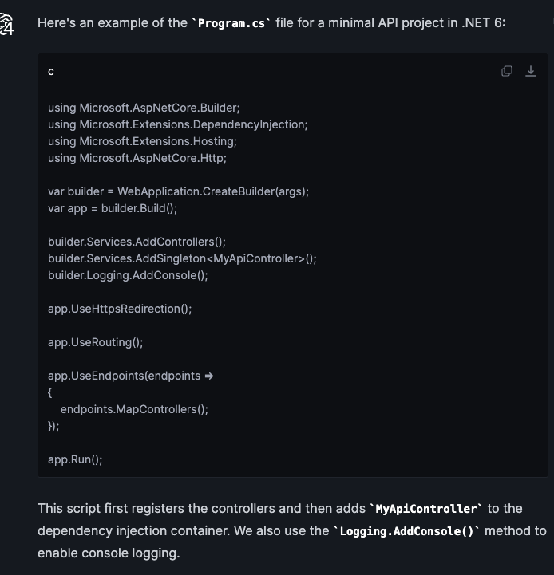
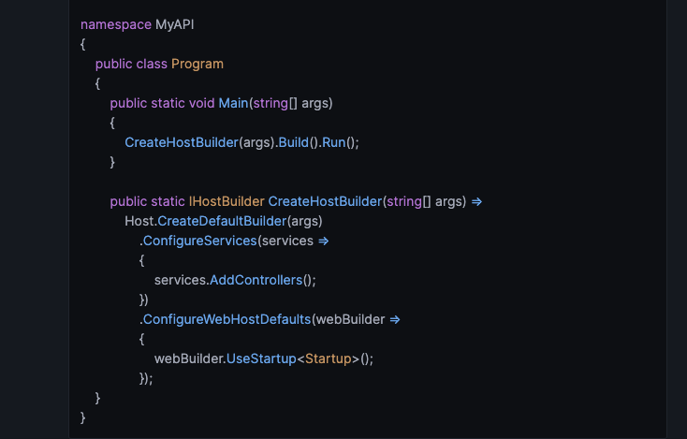
Warm up. Poco API
Let’s create a program.cs file for our API service using ChatGPT 3.5 or ChatGPT 4.
Considering the code you generated in the previous step, generate Program.cs class to be which is the main entrance of the application. Use default Dependency Container. Register controller using Dependency Injection.

Slide 22
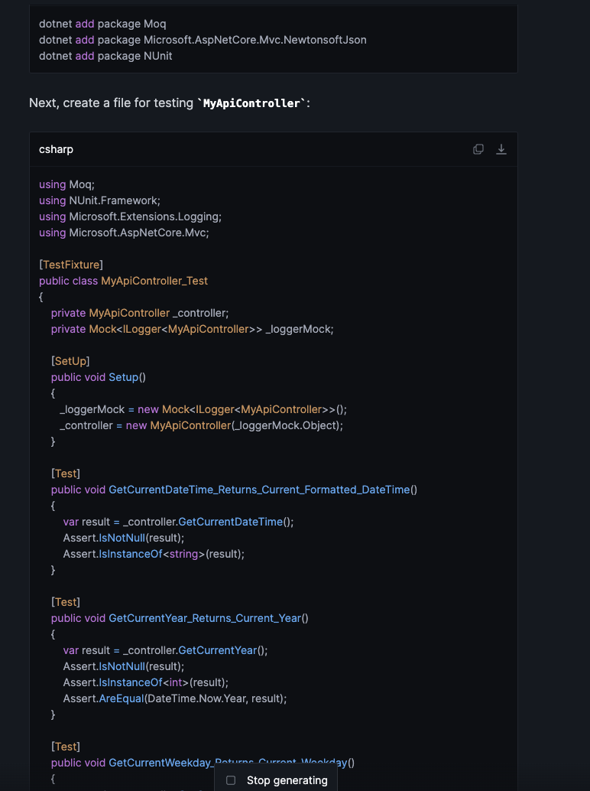
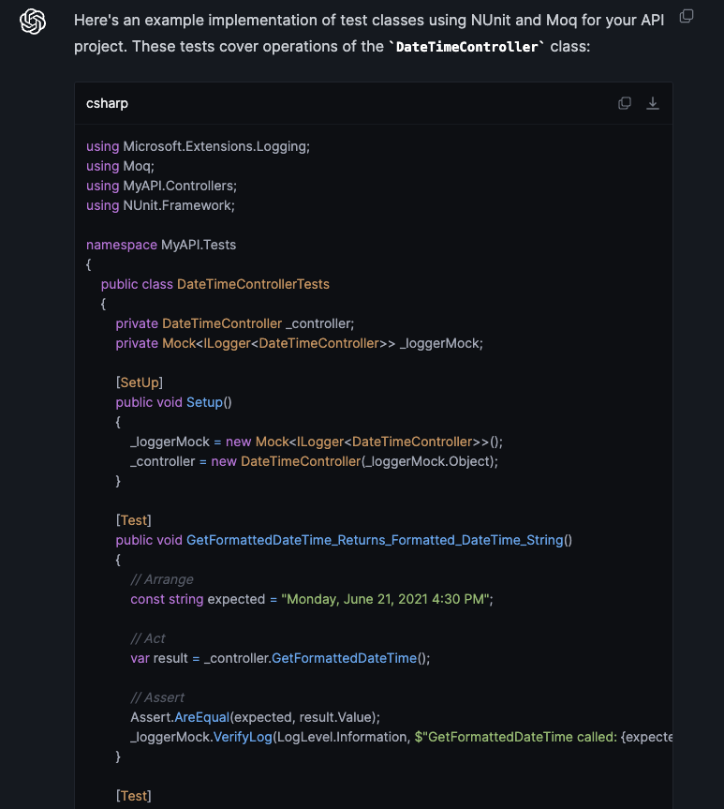
Warm up. Testing Poco API
Now let’s try to create tests!
Considering previously generated code, add tests to this code using nUnit and Mock library. Put all needed mocks and stubs to the constructor of the test class. All test names should use modern naming notation with underscores and should explain what behavior is expected.

Slide 23
Application 1. Command Helper
We are going to organize simple Azure Function which will communicate with OpenAI & EPAM Gen-AI
OpenAI ChatGPT Completion example on Github
OpenAI ChatGPT Chat example
PS: You may ask ChatGPT to write you all needed code. Let’s try together.

Slide 24
OpenAI Completion
Single Request – Single Reponse option.
Obsolete, but still working
Uses simple ChatGPT 3 model, for example davinci
Completion is a type of interaction wherein a singular request yields a solitary response. Contrary to a conversational format, it represents the most rudimentary communication modality, serving as our initial point of commencement.
Let’s send to OpenAI.
We need:
“Authorization” Header
Properly organized body with the following fields: model, prompt, temperature, max_tokens.
“Post” request

Slide 25
Console App & OpenAI Completion
To send a prompt to OpenAI you need:
Organize your request body;
Assign Bearer token you OpenAI issued to you;
Send the request to endpoint. Keep in mind that there is different endpoints based on request type: completion and chat
Let’s ask ChatGPT generating required application?
What problems might we face?
Insufficient details in prompt!
I am C# developer. I am willing to create Console Application which sends "completion" type requests to OpenAI API. This application should have httpClient which sends requests. Properly organize an object I need to send to OpenAI API.
Use v1/completions endpoint.
Add Default Authorization Header where we need to set up our OpenAI Token.
Content should be the following: new StringContent("{\"model\": \"text-davinci-003\", \"prompt\": \"" + args[0] +
"\", \"temperature\": 1, \"max_tokens\": 100}", Encoding.UTF8, "application/json");
Use TextCopy.ClipboardService to copy the command ChatGPT recommends.
Write comments in Console what when application receives answer from OpenAI Api.

Slide 26
Console App & OpenAI Completion
To send a prompt to OpenAI you need:
Organize your request body;
Assign Bearer token you OpenAI issued to you;
Send the request to endpoint. Keep in mind that there is different endpoints based on request type: completion and chat
What If we will be more specific?
I am C# developer. I am willing to create Console Application which sends "completion" type requests to OpenAI API. This application should have httpClient which sends requests. Properly organize an object I need to send to OpenAI API.
Use v1/completions endpoint.
Add Default Authorization Header where we need to set up our OpenAI Token.
Content should be the following: new StringContent("{\"model\": \"text-davinci-003\", \"prompt\": \"" + args[0] +
"\", \"temperature\": 1, \"max_tokens\": 100}", Encoding.UTF8, "application/json");
Use PostAsync operation.
Use ExpandoObject or organize a class which will represent the content I sent you in String Content.
Use Newtonsoft.Json or any other C# library for serialization and deserialization.
Deserialize the response.
Use TextCopy.ClipboardService to copy the command ChatGPT recommends.
Write comments in Console what when application receives answer from OpenAI Api.

Slide 27
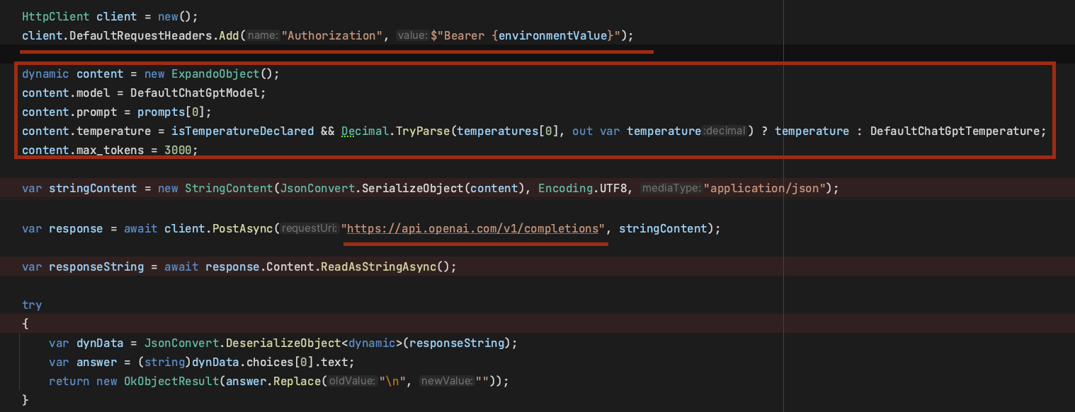
Console App & OpenAI Completion
To send a prompt to OpenAI you need:
Organize your request body;
Assign Bearer token you OpenAI issued to you;
Send the request to endpoint. Keep in mind that there is different endpoints based on request type: completion and chat
Gather all details you need to specify and provide it to ChatGPT on your own.
Use v1/completions endpoint which is obsolete, but still working

Slide 28
OpenAI Chat
Supports different actors in the communication: user and system
Provides natural conversation
The difference from the previous version:
Instead of sending a message in a single invitation, you send the invitation naturally organized as a chat, noting who owns which messages.
Another body.
Supports context!
Supports modern OpenAI models like ChatGPT 3.5 and ChatGpt 4.
Let’s experiment in Postman first!

Slide 29
Console App & OpenAI Chat
To send a prompt to OpenAI you need:
Organize your request body;
Assign Bearer token you OpenAI issued to you;
Send the request to endpoint. Keep in mind that there is different endpoints based on request type: completion and chat
Let’s create another function, now to v1/chat/completions.
The difference from the previous version:
Instead of sending a message in a single invitation, you send the invitation naturally organized as a chat, noting who owns which messages.
“completion” is obsolete, still works but no future updates expected. Therefore, it’s better to use chat.

Slide 30
Console App & OpenAI Chat
To send a prompt to OpenAI you need:
Organize your request body;
Assign Bearer token you OpenAI issued to you;
Send the request to endpoint. Keep in mind that there is different endpoints based on request type: completion and chat
Let’s create another function, now to v1/chat/completions.
The difference from the previous version:
Instead of sending a message in a single invitation, you send the invitation naturally organized as a chat, noting who owns which messages.
“completion” is obsolete, still works but no future updates expected. Therefore, it’s better to use chat.
We need to store somewhere the requests we send before and OpenAI answers. They will be our context.

Slide 31
Console App, Chat, and Context!
As you might see our application has no idea about any requests we sends earlier. It means in case we want to let chatGPT know what we sent before we need to store our previous requests in Cache
There is 2 strategies for caching – in-memory caching or using a separate 3rd –party instance and library as Redis
Strategies to bring context with you:
In-memory cache and Dictionary – good simple option for our ConsoleApp.
Redis – good candidate to be a distributed cache
Persistence Storages: MongoDB, CouchDB, Cassandra, Firebase. Analytics & hierarchical context
LLM plugins – plugin which enriches your calls to LLM Model such as LangChain
Chatbot frameworks like Rasa

Slide 32
Console App, Chat, and Context!
As you might see our application has no idea about any requests we sends earlier. It means in case we want to let chatGPT know what we sent before we need to store our previous requests in Cache
There is 2 strategies for caching – in-memory caching or using a separate 3rd –party instance and library as Redis
Let’s Experiment!
Update previously generated code adding a simple dictionary which will play a cache role in my application.
Key should be unique
Value should be a json structure which should look like an array of openAI chat messages and should represent a list of all messages previously sent to OpenAI and received from it.
After receiving new answer, put the question we send to OpenAI and answer to respective dictionary cell.

Slide 33
Thank you!

