Slide 1
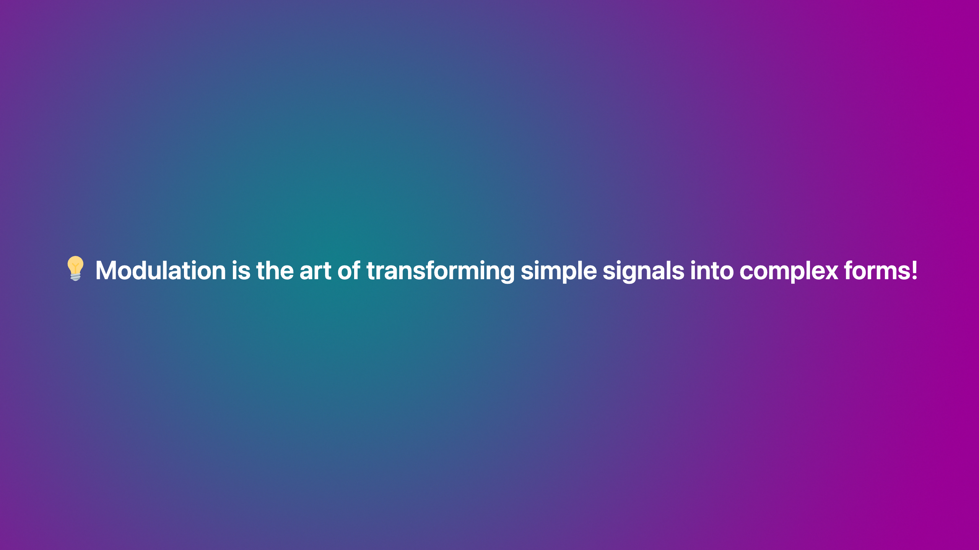

Slide 2

Notes:
transition: fade <style scoped>a { color: #eee; }</style> This is presenter note. You can write down notes through HTML comment.

Slide 3
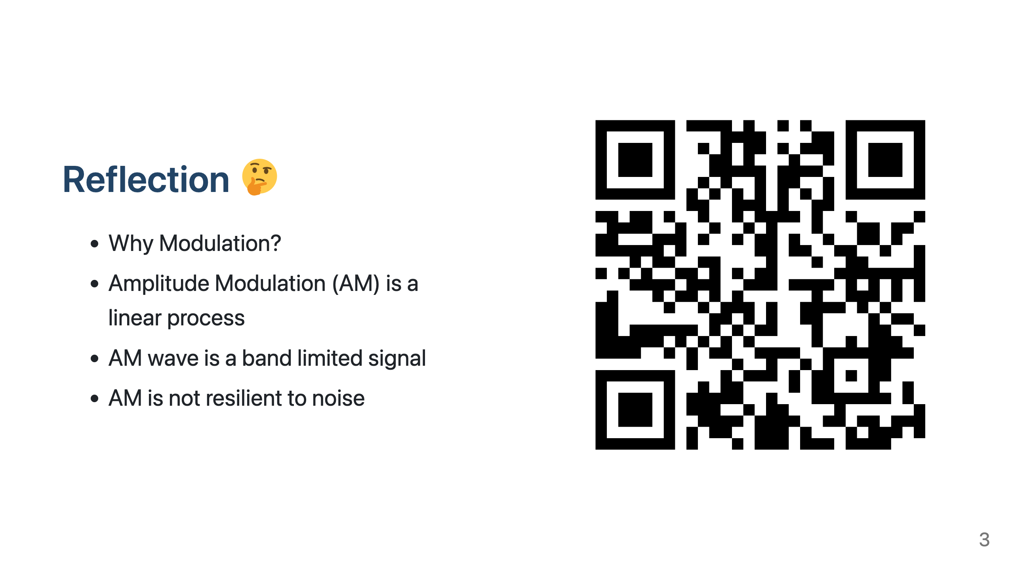
Notes:
Need to change the QR code here

Slide 4


Slide 5
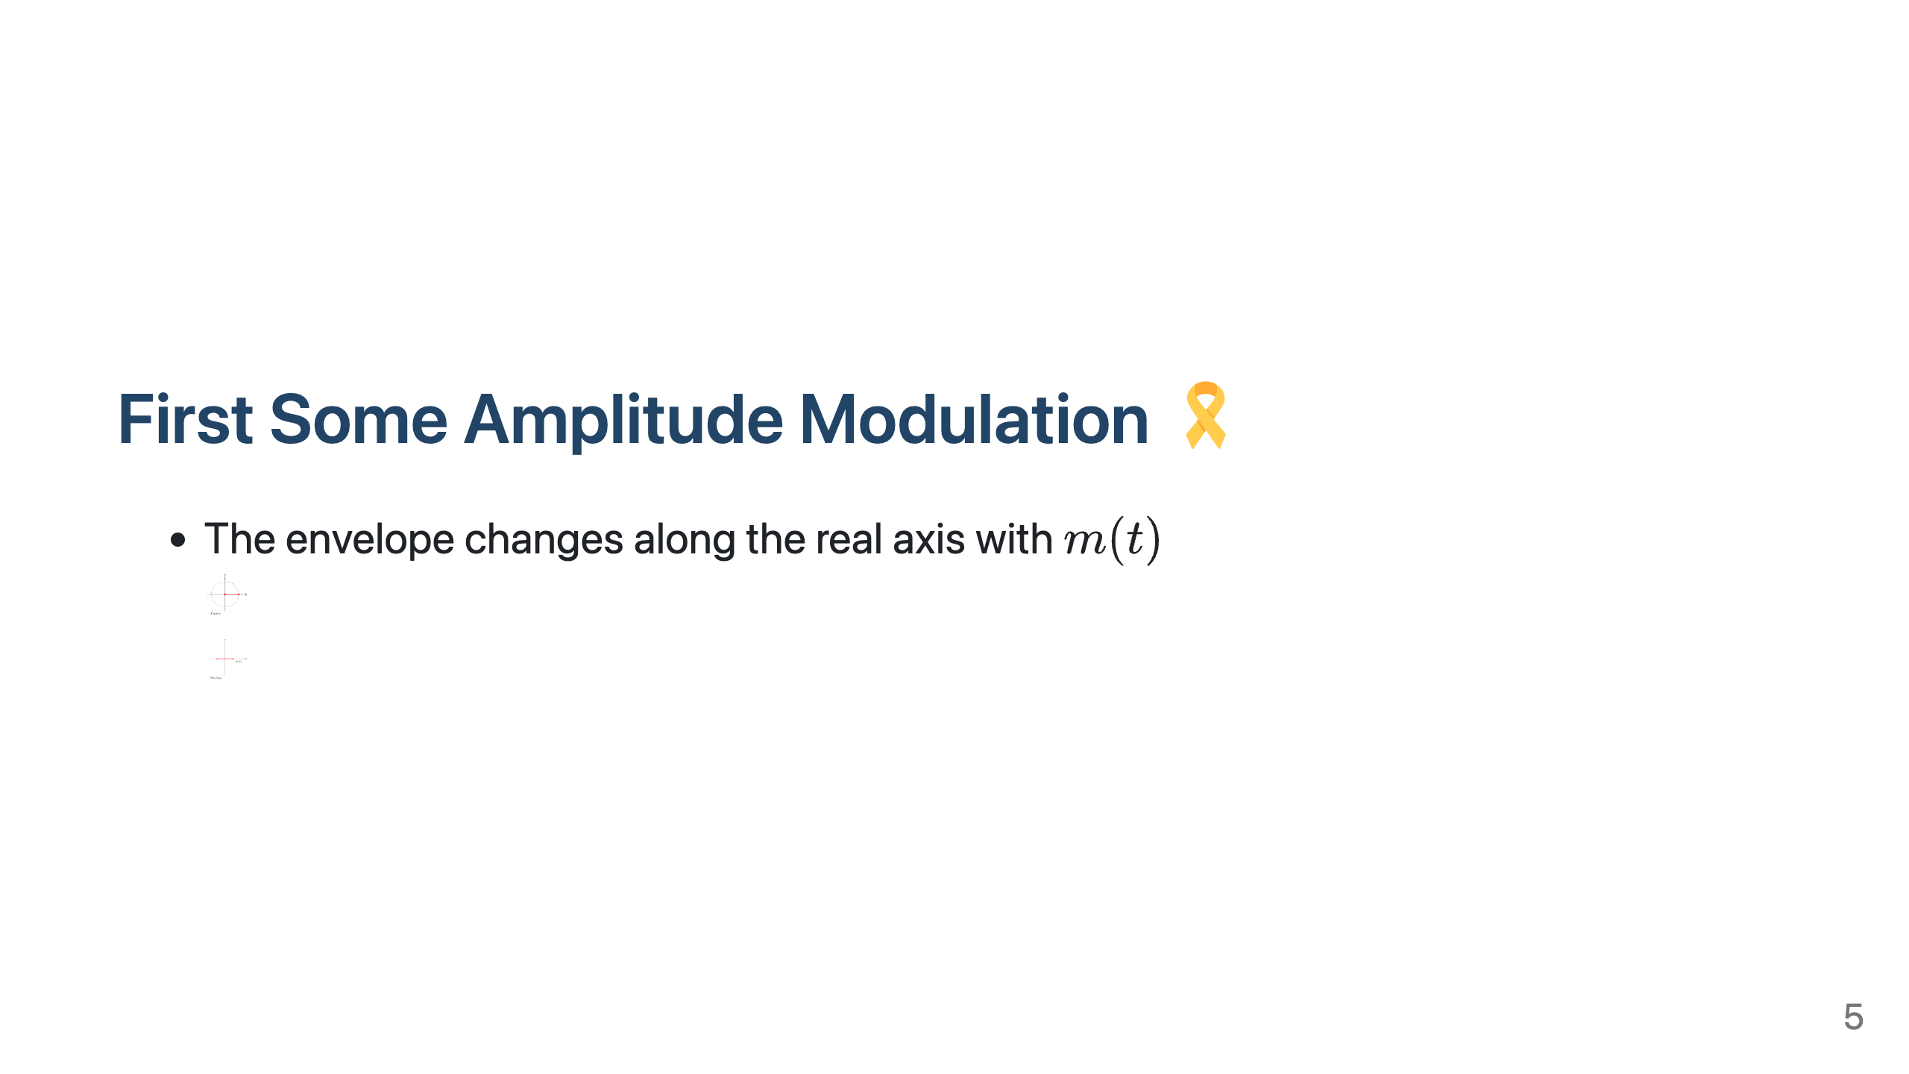
Notes:
Setting size to 32x32 px Setting size to 32x32 px

Slide 6


Slide 7


Slide 8


