Slide 1

Notes:
--- # UESTC HN 1005 - Introductory Programming Lecture 0 + 1 — Course Information Dr Hasan T Abbas transition: fade <style scoped>a { color: #eee; }</style> This is presenter note. You can write down notes through HTML comment.

Slide 2


Slide 3
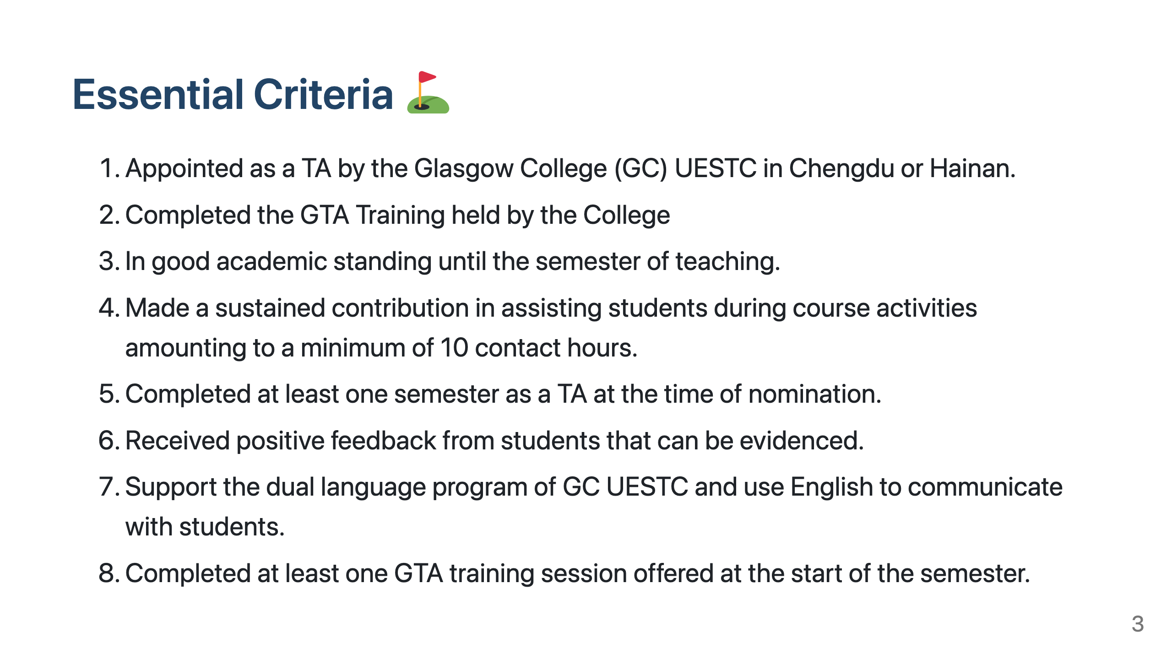

Slide 4


Slide 5
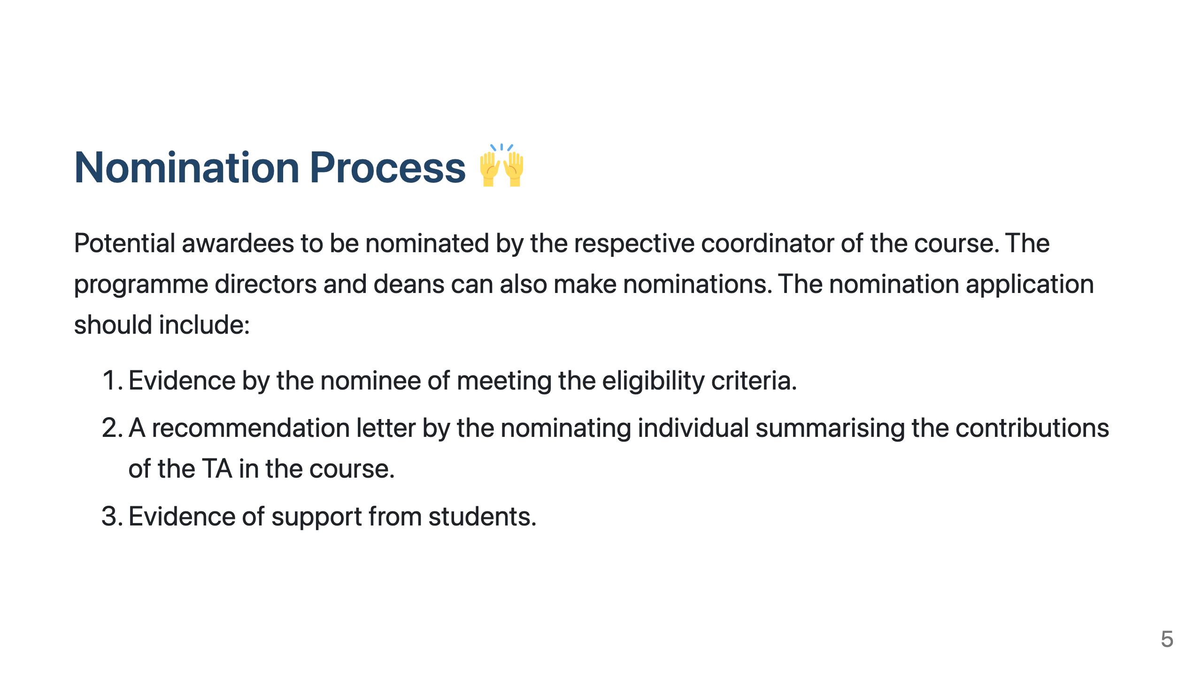

Slide 6
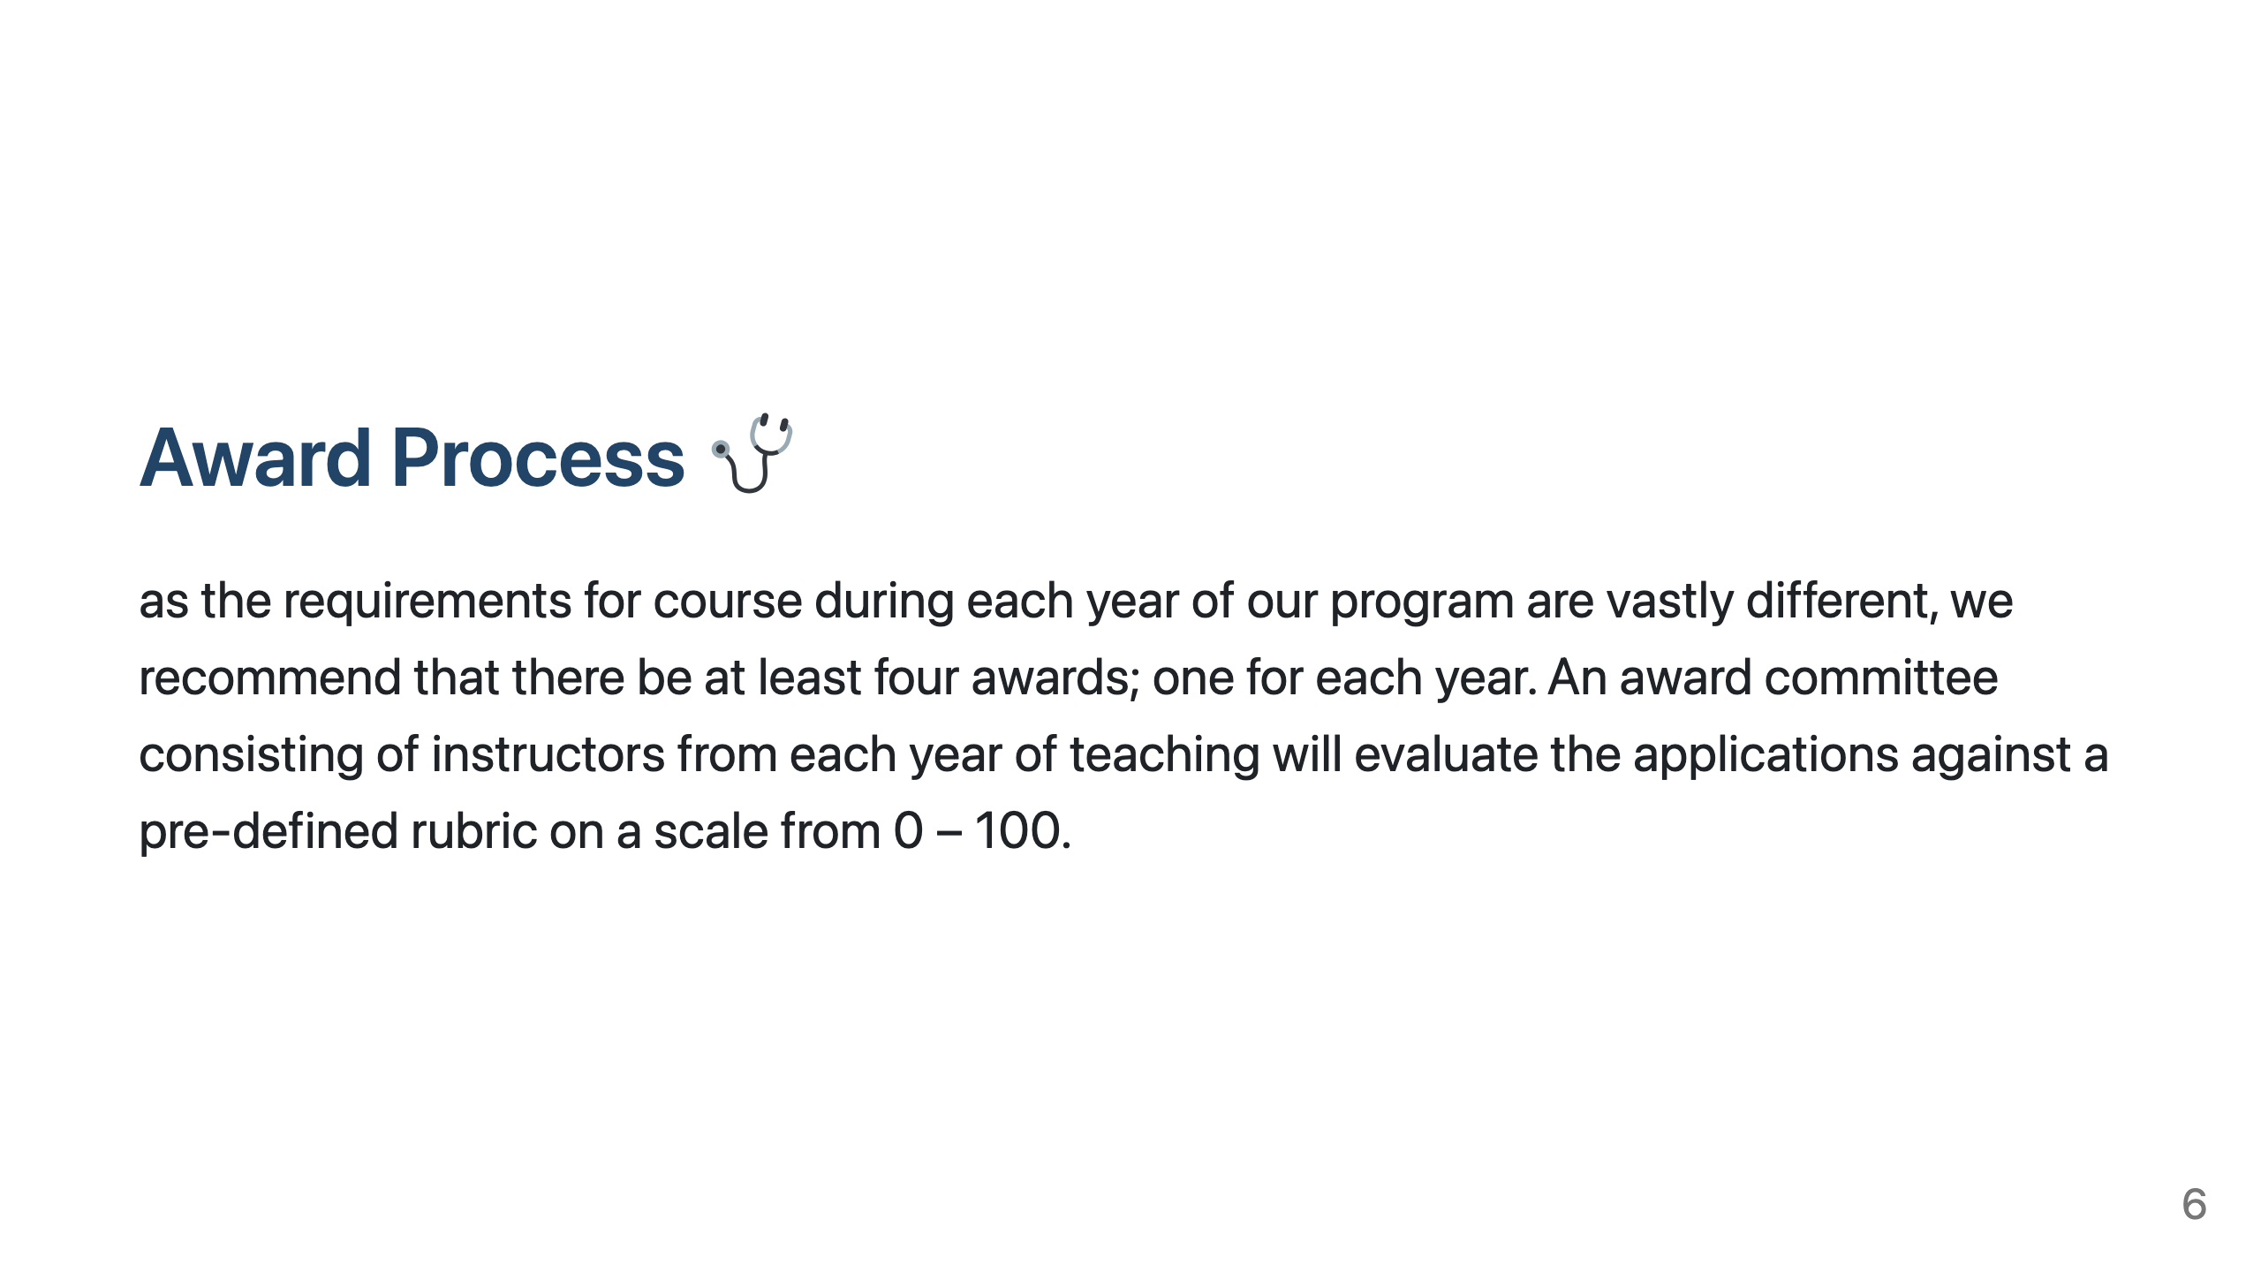

Slide 7


Slide 8


