Slide 1
Accessibility Digital Trail
By us
Notes:
8-10min total
6-8 presentation, 2-4min questions

Slide 2
What does it do then?

Slide 3
Features
Select if you have a disability
Go to the exhibit and scan its QR code
Enjoy your trip! (Tailored to your needs)
Notes:
idea is very simple so users will figure it out, easy!

Slide 4
Let’s see what we have...

Slide 5
Why will it work?
What did we solve?
What can still be achieved?

Slide 6
Issues you mentioned
How to make it used and assess if enough people use it?
How to improve the experience for people with sight and hearing impairment?
How to provide more information about exhibits?
How to make it accessible in different languages?
How to provide additional support for younger people?
How to know if someone requires assistance?
How did we address them?

Slide 7
Hearing impairment
Transcript of the exhibit provided so you can easily read it... or listen to it!
User can connect their hearing aid to their phone they can use text-to-speech!

Slide 8
Hearing impairment
If an exhibit has some audio track then those files could be added and played from here! Other disabilities: text-to-speech might be also valuable for children and dyslexic people who struggle to read longer texts

Slide 9
Sight impairment
Not fully implemented features…. yet (but some are!)
You can open exhibit’s page and listen to the description thanks to the text-to-speech! This works!
All the changes happening on the screen could be read
Navigating could be implemented by voice recognition

Slide 10
Requesting assistance
We also thought about:
Requesting assistance being done by using in-built chat message system (shell already implemented).

Slide 11
Requesting assistance
We also considered including:
Information about nearest accessibility points being provided based on the current location
Showing your current location on a map (can be relative to exhibit id which is easily accessible through json!).
Which can easily happen upon extending the current solution.

Slide 12
Other accessibility issues
To be thought through and implemented… but
Using different languages could be addressed by changing the description accordingly
Alternative description could be shown for groups such as children so it is simplified or with more appropriate links (easily implementable through our json)
This could be done by assigning tags (e.g. “child”)
Notes:
we were thinking of assigning tags which will then be processed

Slide 13
Other accessibility issues
You can define if an exhibit is certain disability friendly (Also easily definable through our json!).
Thus when browsing the exhibit’s info page webapp can show if it is suitable for the user or not (for example considering epilepsy).
Notes:
randomised

Slide 14
Usage and assessment of it
Everyone can use it and is encouraged to (extra info included!)
We can just store the usage and check how many people use the web app as the percentage of all people visiting the centre
We can easily collect feedback by placing a link to a survey inside the app/as a QR code at the exit
As people are already using the app, they will be more eager to provide feedback
Info about the exhibits could be shared to friends to promote science!
Notes:
we can track usage for each exhibit to see what user profile has

Slide 15
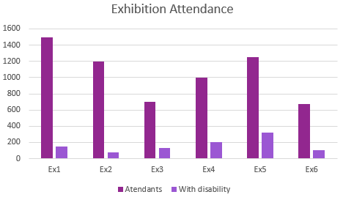
Data Analytics
Possible data that may be collected and hosted on some sort of back end.
App currently has features that will allow for easy collection of such data

Slide 16
Extendability
Easy to collect information by adding a database and counting number of app uses, number of registered disabilities etc.
Easy to increase functionality of exhibit descriptions through adding tags and editing json.
Text to speech extendable with Google speech API.
Scalability only limited by application code thanks to Flask!

Slide 17
Q&A

