Slide 1

Code For Good 2015
Team 1
Adam, Baldeep, Bogdan, Ross, Vitalij

Slide 2
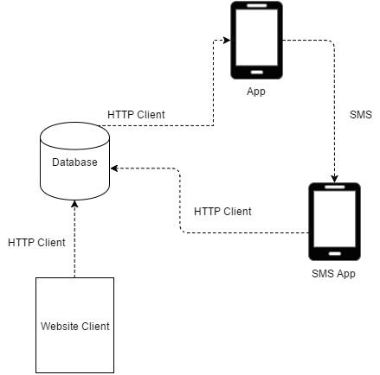
Overview
Mobile Application
Website
Central Database
SMS data service

Slide 3
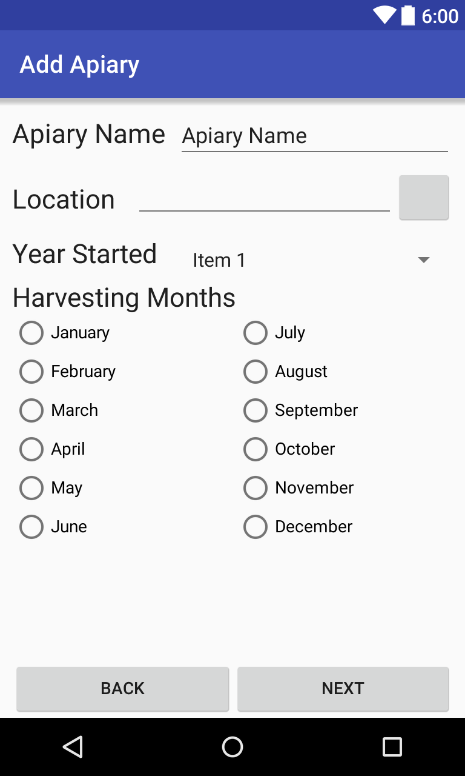
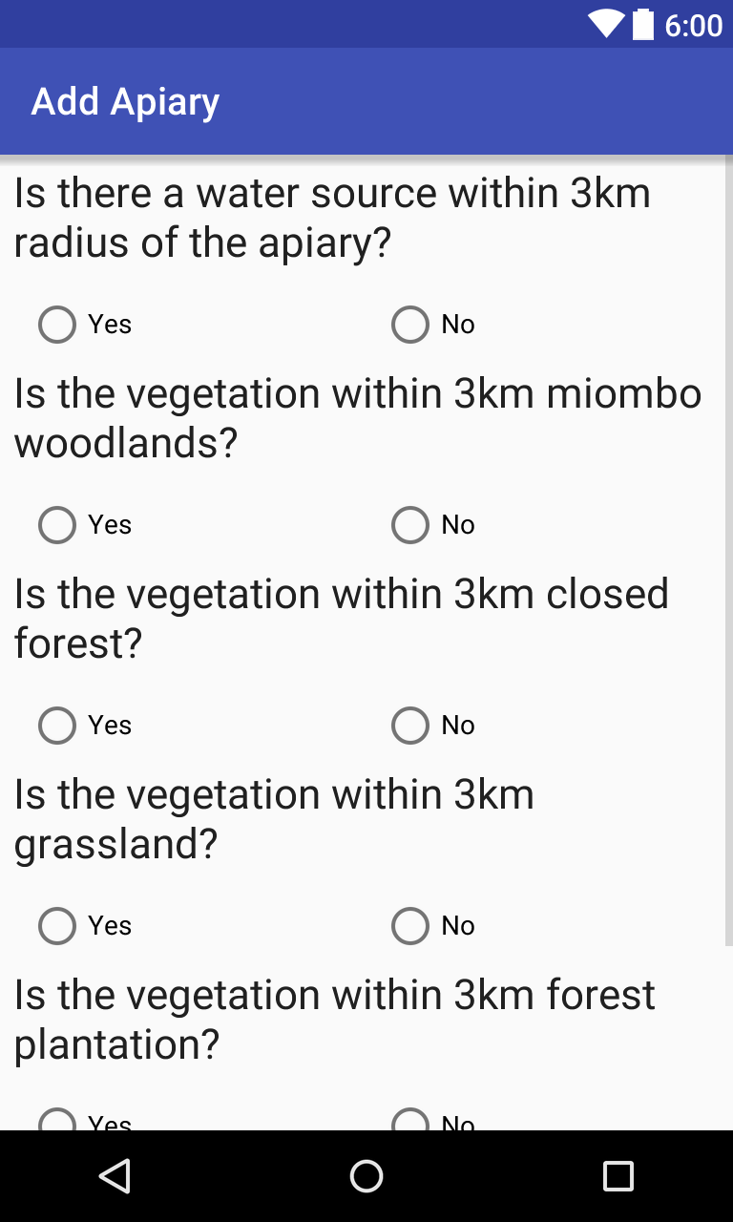
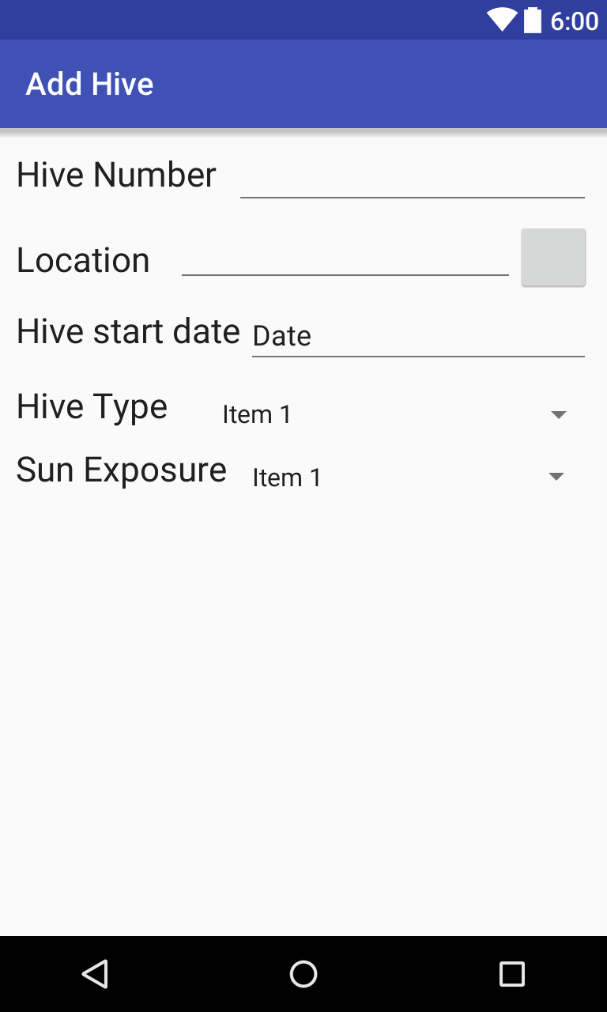
Mobile App

Slide 4
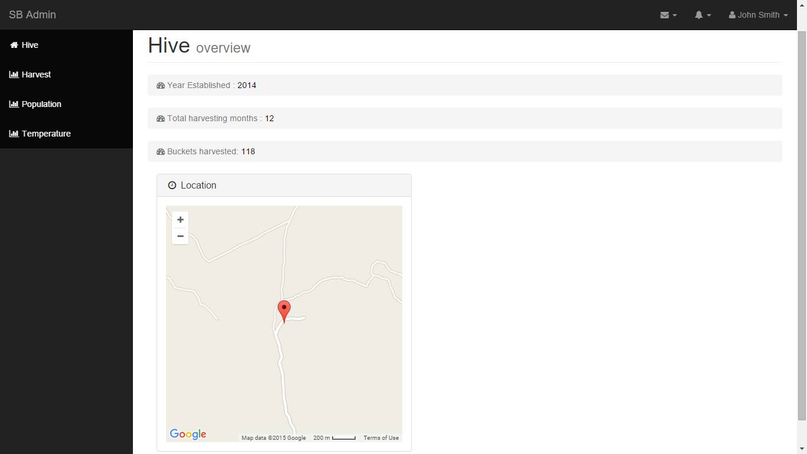
Web App

Slide 5
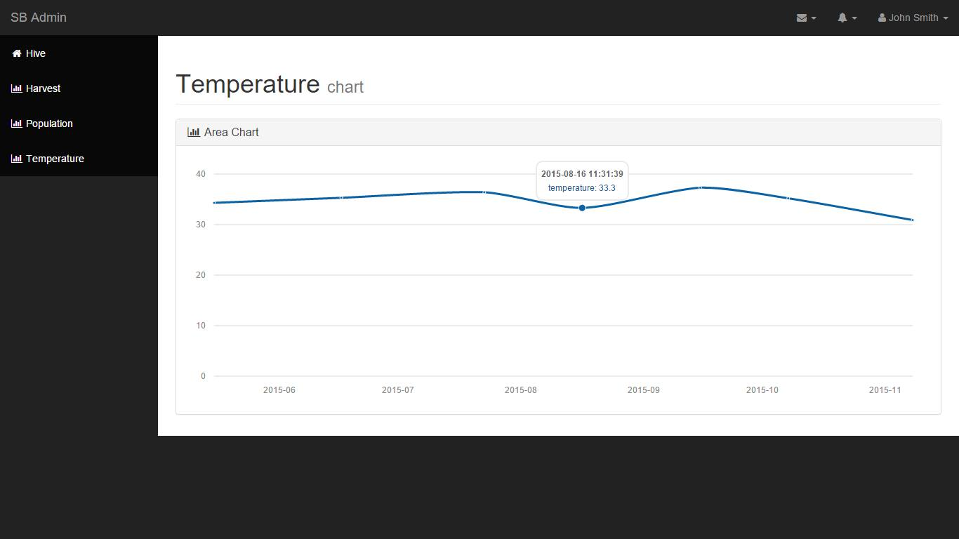
Web App

Slide 6
Further plans
Finalising Mobile App
Incorporate SMS feature
Implement authorisation and encryption features
Notes:
x

Slide 7
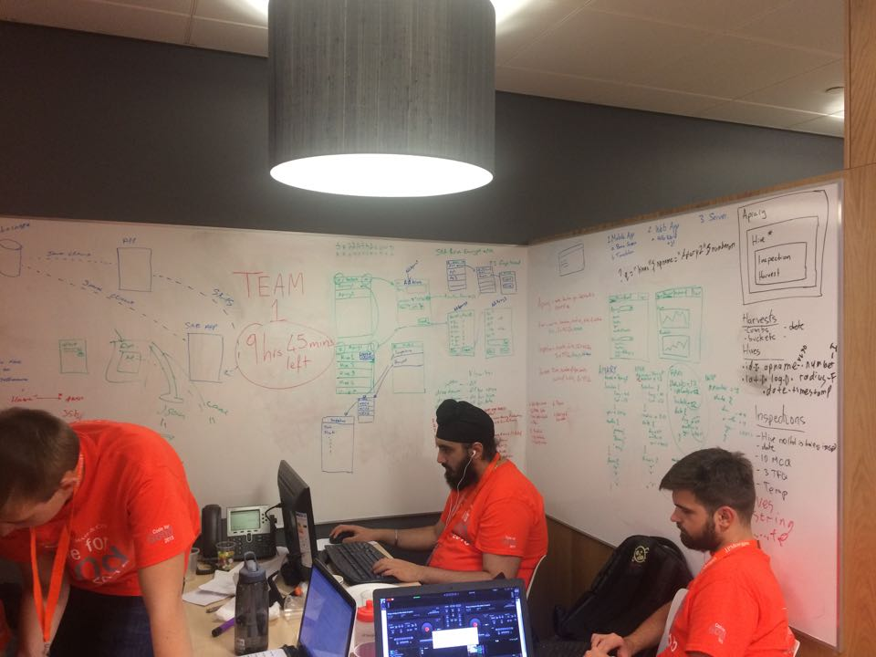
Questions?
9 hours 45 mins to go!

