Slide 1



Paper Piano
Team Number：Team 14
2023.1.25

Slide 2
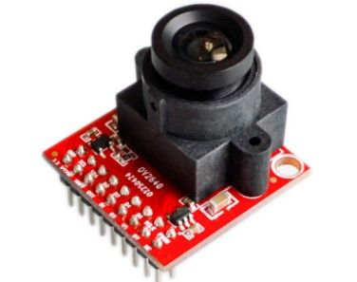
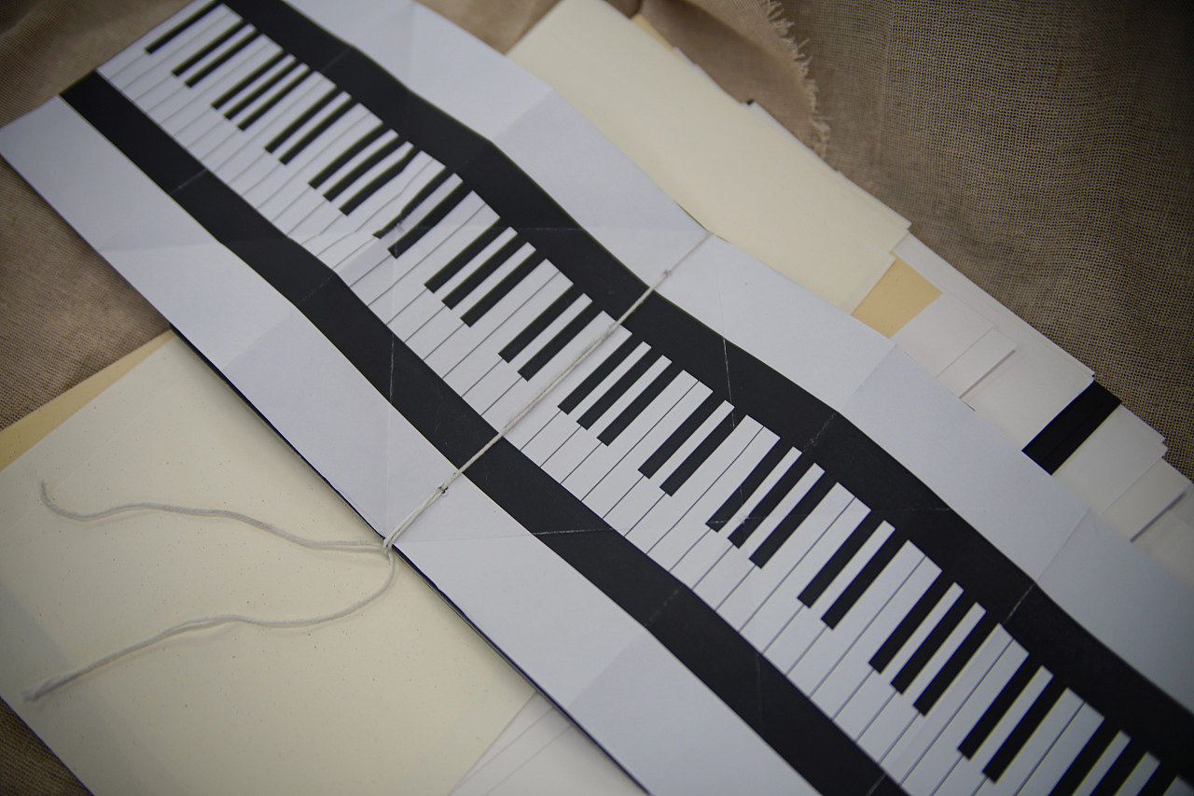
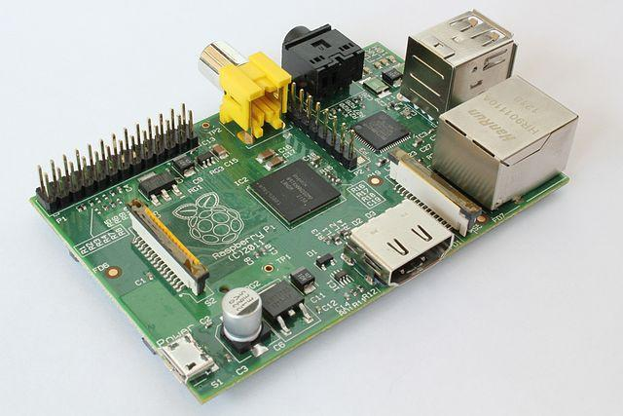
01
Hardware Component
A
B
C
Piano made of paper
Raspberry pie
Camera

Slide 3

02
Software Component
Black piano key recognition
Binarization
Set a threshold
recognize one row of keys
02
04
01
03
Edge extraction
Grayscale
Convert color image to black and white image.
Split different piano keys

Slide 4
THANKS
Team Number：Team 14
2023.1.25

