Slide 1

In my hometown, there was a huge mountain. No one could climb it. It was just too tall.

Slide 2


In my hometown, there was a huge mountain. No one could climb it. It was just too tall.
In my hometown, there was a huge mountain. No one could climb it. It was just too tall.
SPACE

Slide 3


In my hometown, there was a huge mountain. No one could climb it. It was just too tall.
In my hometown, there was a huge mountain. No one could climb it. It was just too tall.

Slide 4
+
In my hometown, there was a huge mountain. No one could climb it. It was just too tall.

Slide 5

In my hometown, there was a huge mouxhair. No one could climb it. It was just too tall.
X

Slide 6
Fake word
Grammar error
Nonsense
In my hometown, there was a huge mouxhair.
In my hometown, huge there was a mountain.
In my hometown, there was a huge supernova.
There was a huge mountain. It was very small.
In my mountain, there was a huge hometown.
Conflicts
Swapped words
X

Slide 7

There was a huge mountain. It was very small. One day, I called my friend to see

Slide 8
There was a huge mountain. It was very tall. One day, I called my friend to see
SPACE

Slide 9
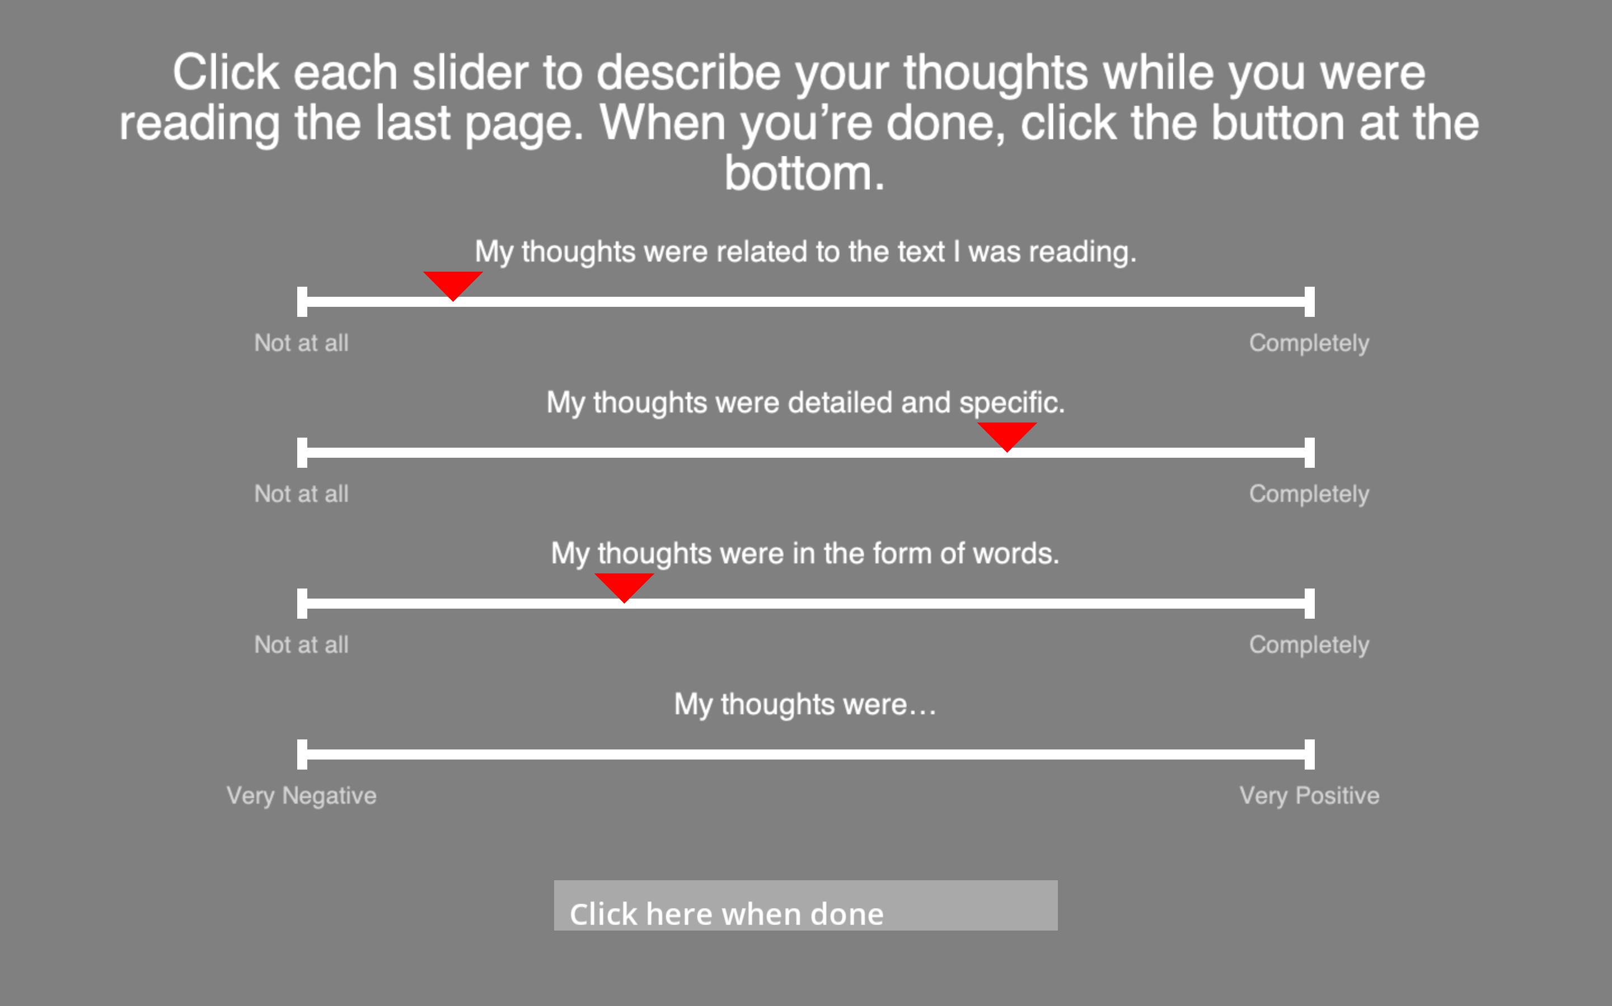


Slide 10
Where was the mountain in this story?
On an island
In a very dangerous jungle
In the narrator’s hometown
In between two cities
3

Slide 11
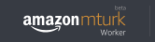
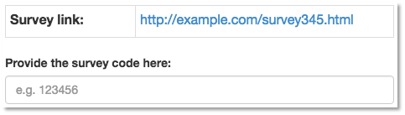
Thank you for participating!
Please enter the following code into your MTurk HIT:
90357-6800

Slide 12
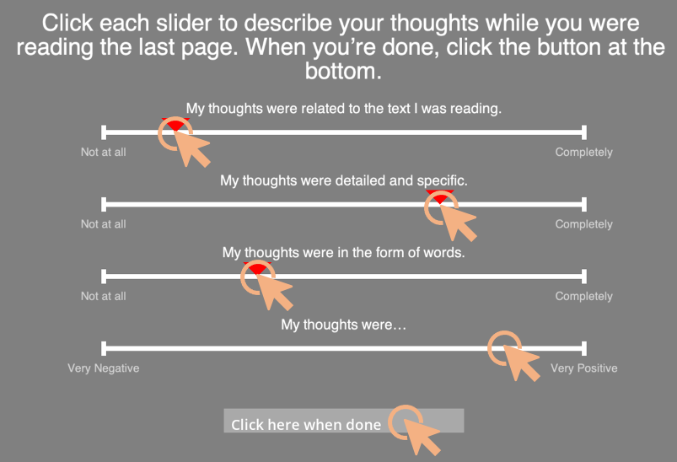
Read page once, then press SPACE
Press X when you see an error
Click to describe mental state
Keep your code
In my hometown, there was a huge mountain. No one could climb it. It was just too tall.
In my hometown, there was a huge mouxhair. No one could climb it. It was just too tall.
Thank you for participating!
Please enter the following code into your MTurk HIT:
90357-6800
SPACE
X

