Slide 1

In my hometown, there was a huge mountain. No one could climb it. It was just too tall.

Slide 2


In my hometown, there was a huge mountain. No one could climb it. It was just too tall.
In my hometown, there was a huge mountain. No one could climb it. It was just too tall.
SPACE

Slide 3
In my hometown, there was a huge mountain. No one could climb it. It was just too tall.
In my hometown, there was a huge mountain. No one could climb it. It was just too tall.

Slide 4


In my hometown, there was a huge mountain. No one could climb it. It was just too tall.
In my hometown, there was a huge mountain. No one could climb it. It was just too tall.

Slide 5
+
In my hometown, there was a huge mountain. No one could climb it. It was just too tall.

Slide 6

In my hometown, there was a huge mouxhair. No one could climb it. It was just too tall.
X

Slide 7
Fake word
Swapped words
In my hometown, there was a huge mouxhair.
In my mountain, there was a huge hometown.
X

Slide 8

In my mountain, there was a huge hometown.

Slide 9
There was a huge mountain. It was very tall. One day, I called my friend to see
SPACE

Slide 10
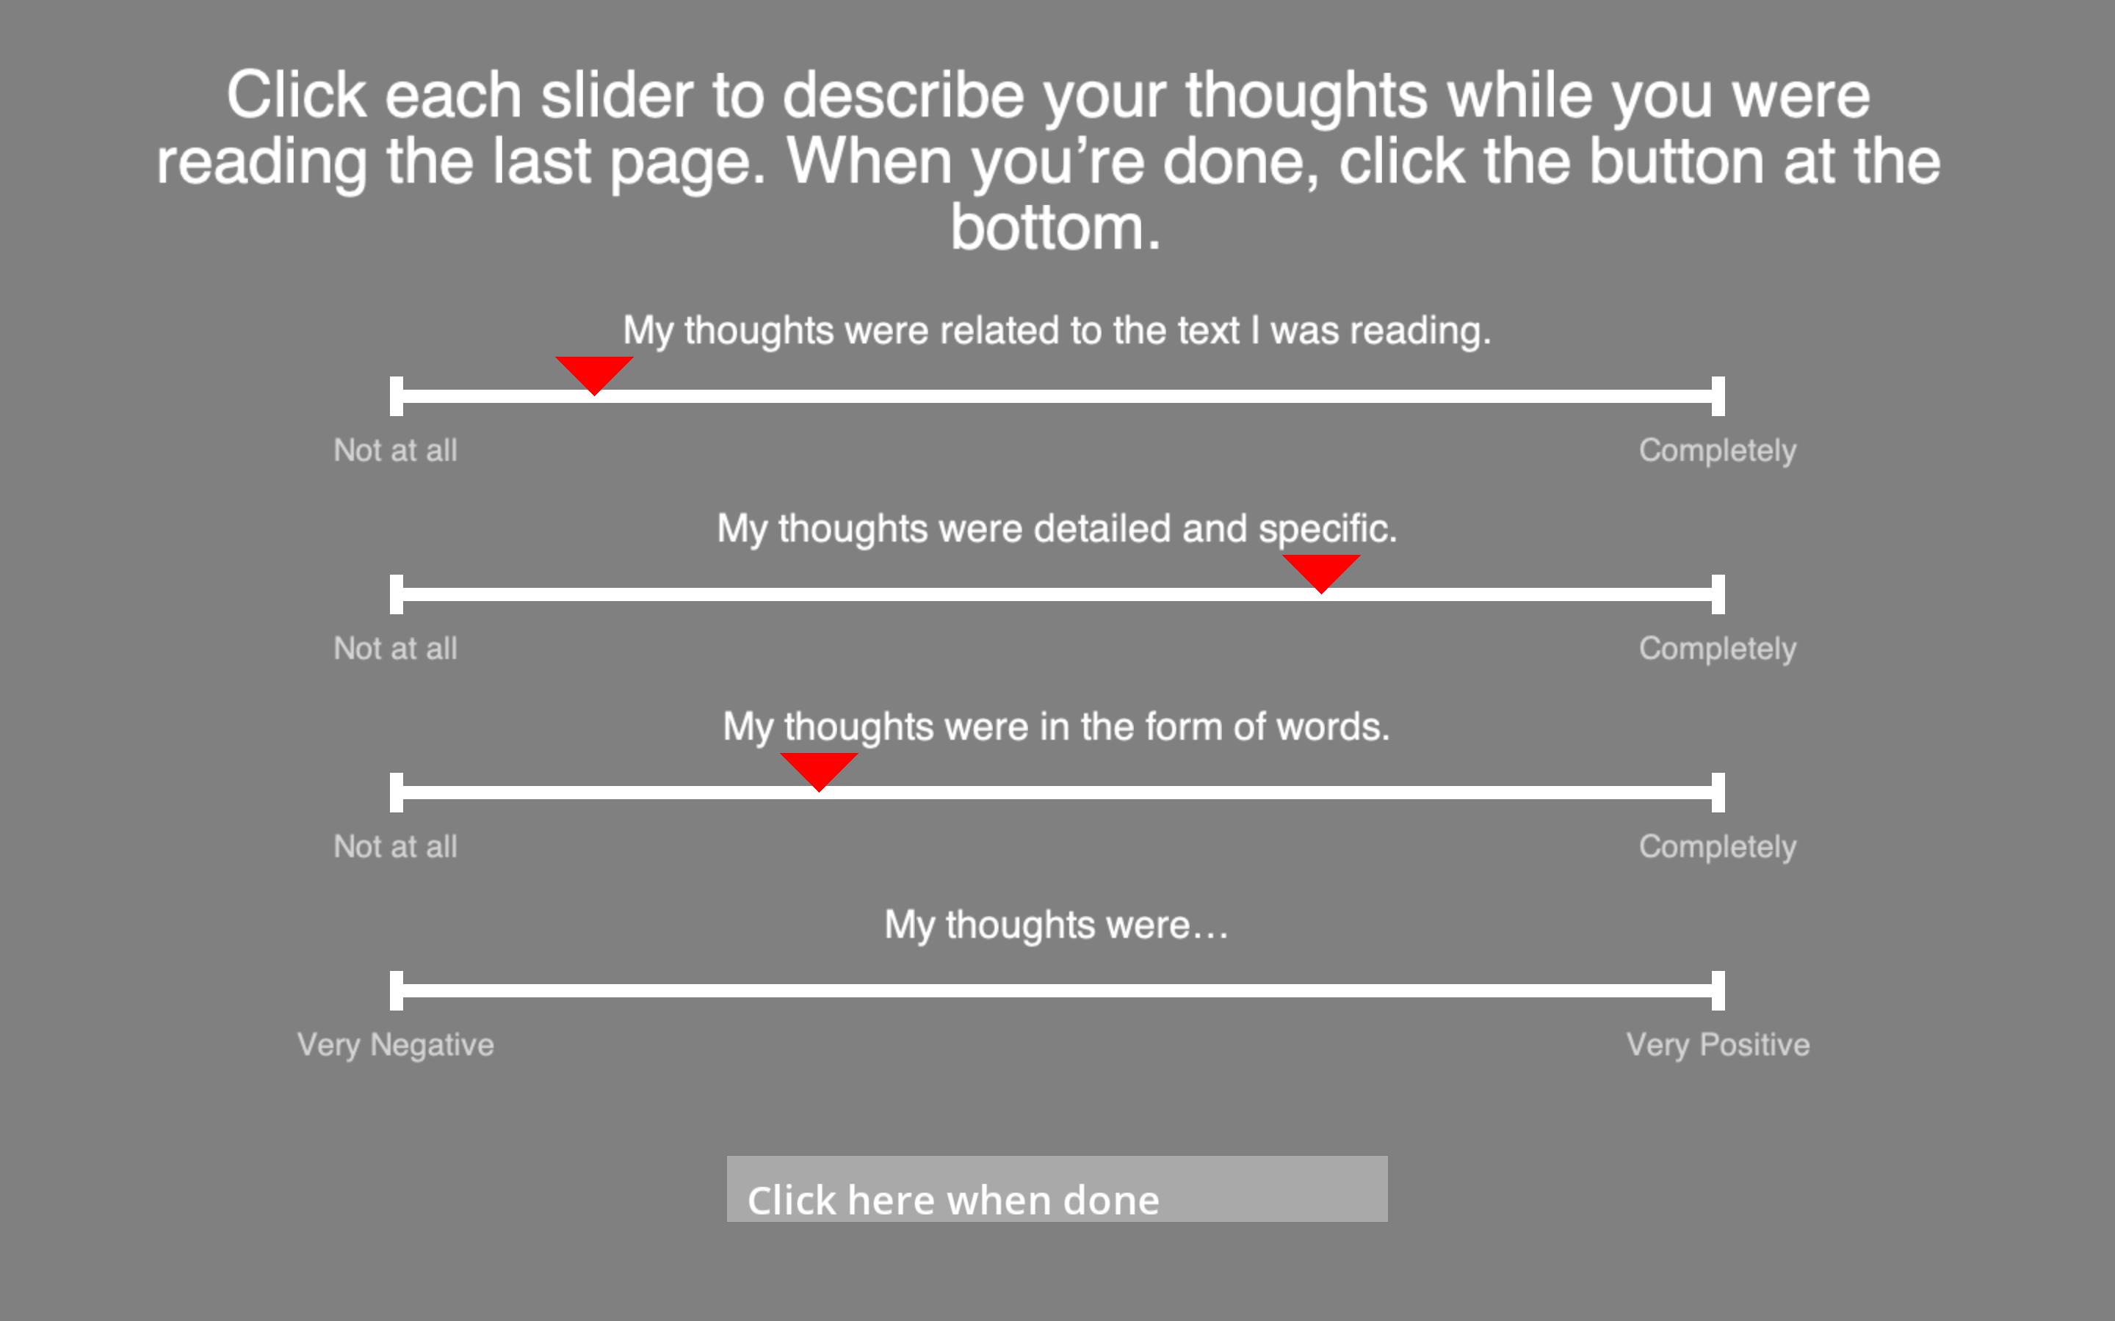


Slide 11
Where was the mountain in this story?
On an island
In a very dangerous jungle
In the narrator’s hometown
In between two cities
I am not sure
3

Slide 12
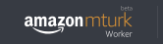
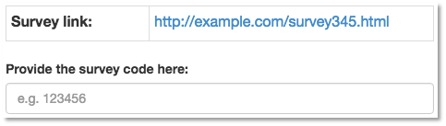
Thank you for participating!
Please enter the following code into your MTurk HIT:
90357-6800

Slide 13
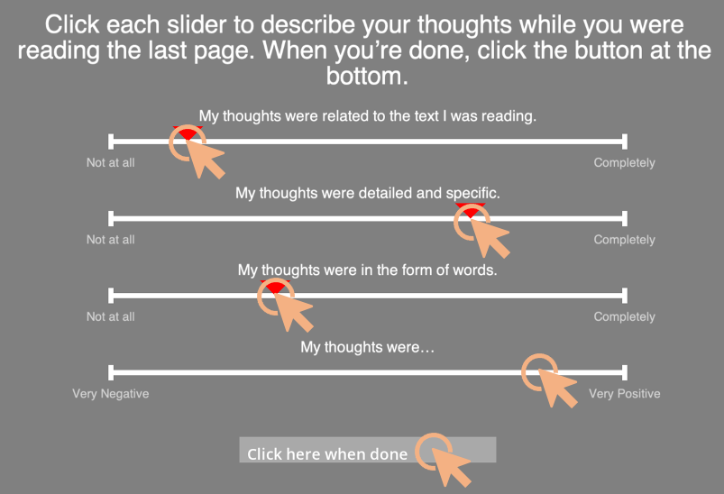
Read page once, then press SPACE
Press X when you see an error
Click to describe mental state
In my hometown, there was a huge mountain. No one could climb it. It was just too tall.
In my hometown, there was a huge mouxhair. No one could climb it. It was just too tall.
SPACE
X

Slide 14
Read page once, then press SPACE
Answer Questions After the Scan
In my hometown, there was a huge mountain. No one could climb it. It was just too tall.
Where was the mountain in this story?
On an island
In a very dangerous jungle
In the narrator’s hometown
In between two cities
I am not sure
SPACE

Slide 15
Read page once, then press any button
Answer Questions After the Scan
In my hometown, there was a huge mountain. No one could climb it. It was just too tall.
Where was the mountain in this story?
On an island
In a very dangerous jungle
In the narrator’s hometown
In between two cities
I am not sure

