Slide 1
2017 Patent Grant Analytics
Looking for patterns to predict delays in patent prosecution based on bibliographic patent data.
Jay Clare
Springboard, April 2018

Slide 2
Topics covered
Introduction: what is the problem?
Working with the Data
Geographic and Time Series Analysis
Exploratory Data Analysis: looking for correlations
Linear Regression Analysis
Conclusion: what have we learned?

Slide 3
Introduction: what is the problem?
THE BIG PICTURE:
The United States Patent and Trademark Office (USPTO) receives > 500k patent applications annually
Tremendous backlog with reviewing and approving the patents
Limited resources for making sure “good” patents are issued (granted) and “bad” patents fail
Result: the quality of patents being issued suffers and innovation incentives are out of alignment

Slide 4
Introduction: what is the problem?
Questions arise about what influences patent prosecution (i.e., review) time
Are there any basic surface-level characteristics that cause a delay in the review process?
If things are running smoothly, patent review time should not be influenced by administrative differences in the way patents are drafted (e.g., number of claims, number of figures, etc.)

Slide 5
Working with the data
~350,000 patents granted in 2017
52 XML files published annually (1 filed per wee)
Source: https://bulkdata.uspto.gov/
> 6 million lines of data each year

Slide 6
Working with the data
Problems:
Files are enormous
Lacking proper “root” tags for analysis by traditional algorithms
Highly fragmented and inconsistent
Solutions:
Custom script for processing all 52 files at once using ‘globbing’ module
Adding root tags to all files to enable processing with standard libraries
Custom algorithm for retrieving bibliographic data points of interest

Slide 7
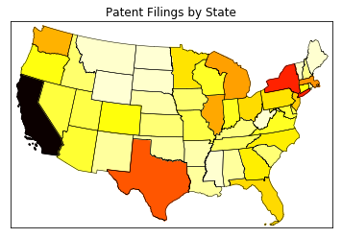
Geographic analysis
Where are patents being filed in the US?

Slide 8
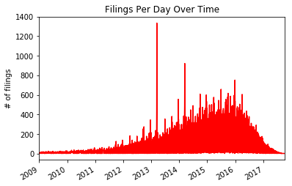
Time series analysis
When are patents being filed in the US?

Slide 9
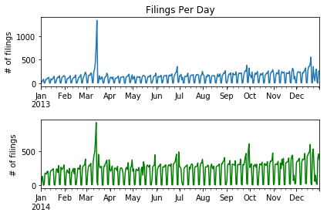
Time series analysis
Are there seasonal patterns in patent filing activity?

Slide 10
Exploratory Data Analysis: looking for correlations
Questions Investigated:
Is there a significant difference in prosecution period of utility patents versus non-utility patents (i.e., design and plant)?
Is there a significant difference in prosecution period between plant and design patents?
Is there a significant correlation between the number of claims and the prosecution period for utility patents?
Is there a significant correlation between the number of figures and the prosecution period for patents?

Slide 11
Utility vs. non-utility prosecution time
Mean prosecution time of utility patents: approx. 1,067 days
Mean prosecution time of non-utility (i.e., plant, design) patents: approx. 584 days
Probability of such a difference being random: less than 1.0e-9
Conclusion: utility patents take longer to prosecute

Slide 12
Plant vs. design prosecution time
Mean prosecution time of plant patents: approx. 648 days
Mean prosecution time of design patents: approx. 581 days
Probability of such a difference being random: less than 4.286e-44
Conclusion: plant patents take longer to prosecute vs. design patents

Slide 13
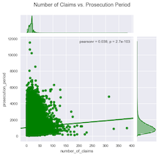
Number of claims vs. prosecution time

Slide 14
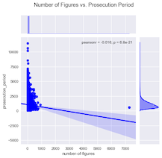
Number of Figures vs. prosecution time

Slide 15
Linear regression analysis
Ordinary least squares (OLS) multivariate linear regression model
Experimental variables: number of claims; number of figures
Target variable: prosecution period
Model is a poor fit (R² = 0.0003)
R-Squared | 0.0003
Adjusted R-Squared | 0.0003
Coefficients:
Number of Claims | -0.912
Number of Figures | 3.0519

Slide 16
Linear regression analysis
Visualizing Normalized Residuals: where does the model perform best?

Slide 17
Linear regression analysis
Visualizing Residual Distribution: Histogram

Slide 18
conclusions
Interesting geographic distribution state-by-state
Interesting temporal distribution of filing activity
More investigation needed to explain spike in week 2 of March
Correlations exist but are week
Negative correlation between number of figures and prosecution time
Linear regression models do not perform well on the data

