Slide 1

Design and Verification of ALU using uvm
Athematic Logic Unit
Made By: Ziad Ahmed Mamdouh
SI-Vision Academy

Slide 2
Contents
Design of an ALU using FSM.
Design Specs and Signals.
FSM diagram.
Macro for defining next state logic.
Operations and Parameters.
Output Waveform and Operation.
Design Challenge.
Verification of an ALU using UVM
UVM Testbench Architecture.
Sequences and Test Cases.
Key components and hierarchy.
Important configuration object.
Simulation Results
This is the main part.

Slide 3
Acknowledgement
Acknowledgement
I would like to express my sincere gratitude to this great chance to dive in a great knowledge related to Verification Filed by interacting with this project.
Thank You!

Slide 4
Abstract
This project focuses on the verification of an Arithmetic Logic Unit (ALU) using the Universal Verification Methodology (UVM).
The ALU performs various arithmetic and logical operations, and its correctness is critical for the overall functionality of the system.
The verification process ensured the ALU's reliability and correctness, demonstrating the effectiveness of UVM in complex digital design verification.

Slide 5
Design Specs and Signals
ALU Design
Operand1
Operand1_en
Operand2_en
Operand2
The ALU is a hardware module that performs various arithmetic and logical operations on two operands based on operation codes and control signals. The ALU can perform operations such as addition, subtraction, XOR, AND, OR, and more. The ALU supports a finite state machine (FSM) for controlling the different processing steps, allowing it to switch between different operation modes.
Operand1_op
clk
Rst_n
Inputs
clk: Clock signal for the module.
rst_n: Active low reset signal.
ALU_en: ALU enable signal. When low, the ALU operations are disabled.
Operand1_en: Enable signal for the first operand.
Operand2_en: Enable signal for the second operand.
Operand1: The first input operand (width defined by Data_Width).
Operand2: The second input operand (width defined by Data_Width).
Operand1_op: A 3-bit operation code that defines the operation to be performed on Operand1.
Operand2_op: A 2-bit operation code that defines the operation to be performed on Operand2.
Outputs
ALU_output: A signed 6-bit result of the ALU operation.
Operand1_op
ALU_en
ALU_out

Slide 6

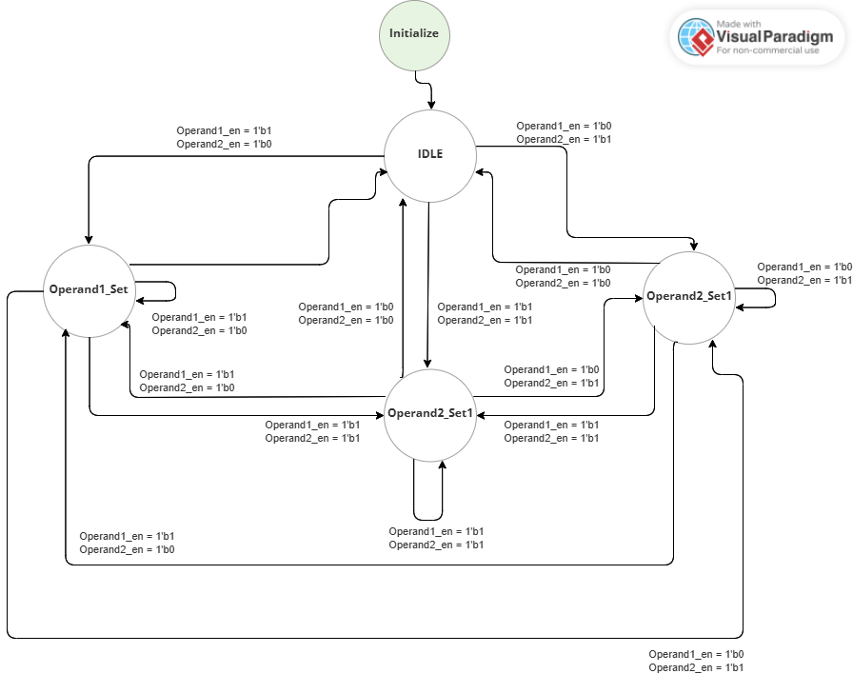
FSM Diagram
ALU Design
The ALU operates with an FSM that controls the transitions between different states, based on the enable signals and the operation modes. The FSM defines four primary states, as detailed below:
State | Description
IDLE | The ALU waits for operand enable signals to transition to other states.
Operand1_set | This state is used for processing operations related to the first operand (Operand1), including operations like addition, subtraction, XOR, etc. The operation to be performed is selected via the Operand1_op input.
Operand2_set1 | This state handles the first set of operations related to the second operand (Operand2). The operations are controlled via the Operand2_op input.
Operand2_set2 | This state handles the second set of operations for Operand2, which include XOR, XNOR, decrementing Operand1, and incrementing Operand2.

Slide 7
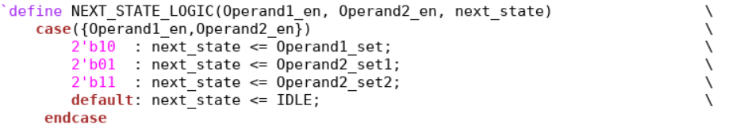
Macro for defining next logic or state
ALU Design
The macro NEXT_STATE_LOGIC defines how the state machine transitions based on the enable signals for Operand1 and Operand2:
If only Operand1_en is active (and Operand2_en is not), the next state will transition to Operand1_set.
If only Operand2_en is active (and Operand1_en is not), the next state will transition to Operand2_set1.
If both operands are enabled (Operand1_en && Operand2_en), the next state will transition to Operand2_set2.If neither operand is enabled, the state will return to IDLE.

Slide 8
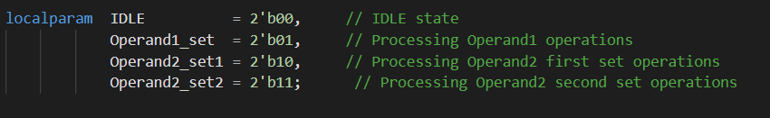
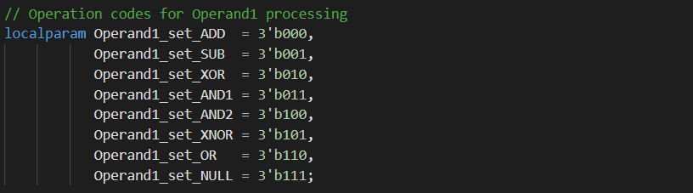
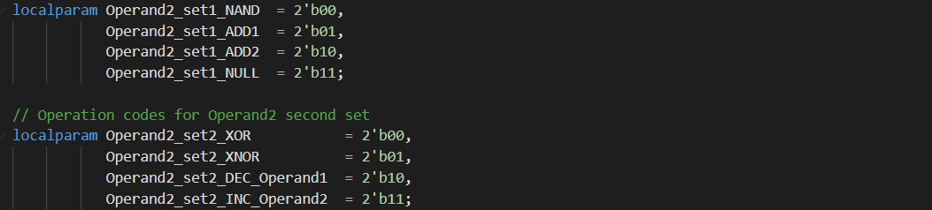
Operations and Parameters
ALU Design
The operations are performed based on the selected operation codes (Operand1_op and Operand2_op), and the corresponding operation for each case is implemented in the state machine logic.
FSM States (IDLE, Operand1_set, Operand2_set1, Operand2_set2): Used to control the ALU's operation sequence.
Operand1 Operations (ADD, SUB, XOR, AND1, AND2, XNOR, OR, NULL): Define operations to be performed on Operand1.Operand2 First Set Operations (NAND, ADD1, ADD2, NULL): Define operations to be performed on Operand2 (first set).
Operand2 Second Set Operations (XOR, XNOR, DEC_Operand1, INC_Operand2): Define operations to be performed on Operand2 (second set).

Slide 9
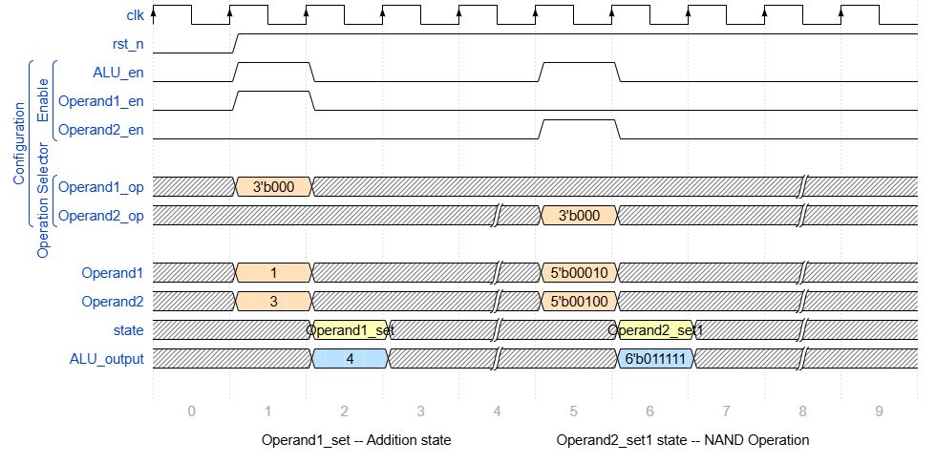
Output Waveform and Operation.
ALU Design
- Sequential Logic
The ALU module operates in a synchronous manner: The ALU output is updated based on the current state.
The FSM state transitions and ALU output are driven by the clock signal (clk) and reset (rst_n).
The ALU uses a sequential state machine, which is updated on every clock cycle.
- Output Logic
The ALU output is driven based on the current state and operation mode. The result is computed using the values of Operand1, Operand2, and the respective operation codes.

Slide 10

Design Challenge
ALU Design
Same State Output Issue: If we are doing an operation and the next operation is in the same state, we can find that the output remains the same that happens because the state didn’t change so that the always block which is responsible for calculating and registering the output isn’t executed. Solve: I am always checking for the state at the always block which is responsible for the clock and registering the new state(This maybe not a good way to solve the problem but I wanted to observe the FSM coverage in Coverage report so I Tried my best to implement a working FSM).
MSB in Bitwise Operations: as XNOR function that will see always the MSB of the 5bits input operands as they are six bits and the last bit is always zero because the ALU output is 6bits width so that the XNOR and NAND function will place 1 ( 0 NAND 0 )(0 XNOR 0) in the sixth bit in the ALU output which isn’t correct.
Switch Case vs. If-Else: using switch cases instead of If else if conditions which will affect the condition coverage report in the verification environment.

Slide 11
UVM Testbench Architecture
ALU Verification
This is the structure of one of the 4 tests used in this project.
TOP
CNFG
Operand1_set_test
TEST_VIRTUAL
SEQUENCE
Repeat_Operation_sequence
MSB_sequence
Edge_Cases_
sequence
Operand1_basic
_sequence
ALU_ENV
AGENT
CNFG
ALU_SCOREBOARD
ALU_SEQUENCER
ALU_MONITOR
ALU_DRIVER
ALU_SUBSCRIBER
VIRTUAL INTERFACE
VIRTUAL INTERFACE
ALU_INTF
DUT

Slide 12
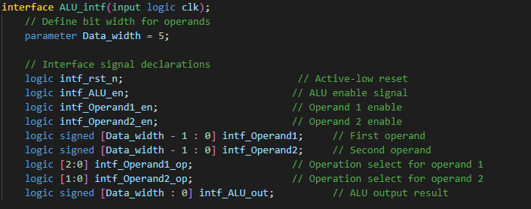
Build the Interface
ALU Verification
The ALU_intf interface encapsulates all the signals required to communicate with the ALU module.It serves as a central point for connecting the ALU to the UVM testbench.

Slide 13
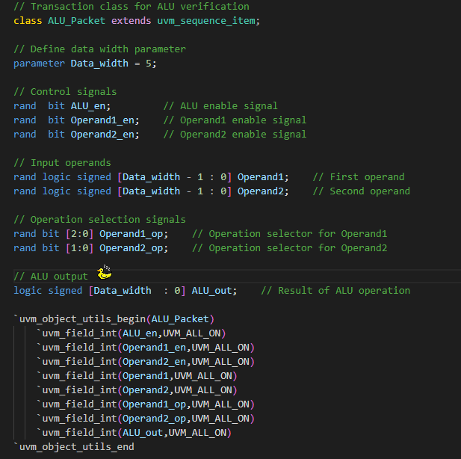
ALU_Packet
ALU Verification
It contains various signals, constraints, and a constructor for different test cases, which can help verify the behavior of the ALU in different scenarios.

Slide 14
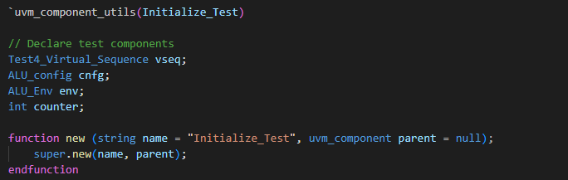
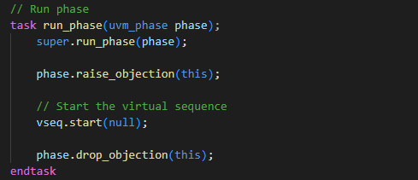
Sequences and Tests
ALU Verification
I have created 8 different sequences which can cover all the cases and op_codes for ALU and generated 4 tests.
Every single test is responsible to run some of these sequences and make sure that the behavior of ALU is correct. 1- Initialize_Test: The test sets the configuration for the ALU, controls specific operand behavior, runs a virtual sequence that contains: - ALU_en_sequence. - State_Transation_sequence.

Slide 15

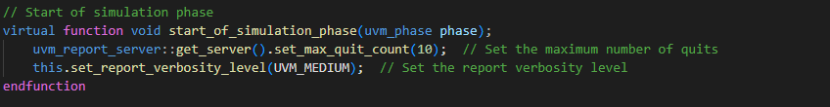
Sequences and Tests
End of elaboration Phase: In this phase, the test hierarchy (the UVM components) is printed out, which is useful for debugging and ensuring that all components are correctly initialized and connected.
Start of simulation phase: In this phase, the maximum number of times the simulation should quit is set via the uvm_report_server. The verbosity level for the test is also configured (UVM_MEDIUM), which determines how detailed the logs and reports will be.

Slide 16
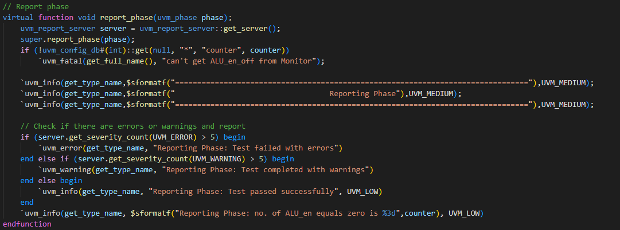
Sequences and Tests
Report phase: In this phase, If the number of errors exceeds a threshold (in this case, greater than 5), the test is flagged as failed. Similarly, if there are too many warnings, the test is flagged with a warning. If no critical issues are found, the test is considered to have passed. The phase also reports the value of the counter (which tracks the number of times Operand1 is set to 0), as this is an important check for the configuration.

Slide 17
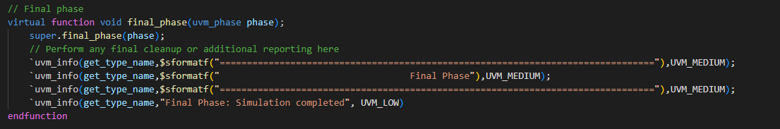
Sequences and Tests
final phase: The test logs the final status of the simulation to indicate completion.

Slide 18
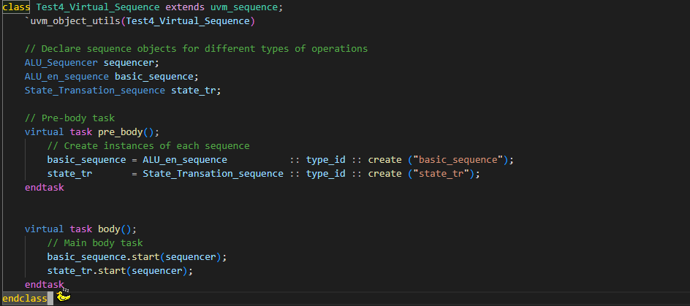
Sequences and Tests
ALU Verification
Virtual Sequence used: Test4_Virtual_Sequence Purpose: Orchestrates the execution of multiple sequences to test the ALU (Arithmetic Logic Unit). Objective: Validates the ALU's functionality by enabling operands and testing state transitions.

Slide 19
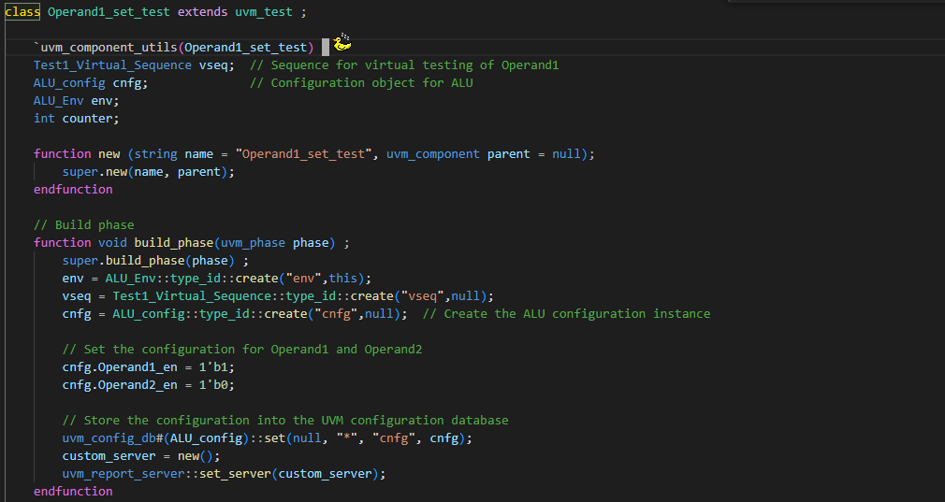
Sequences and Tests
ALU Verification
2- Operand1_set_test : It is a UVM-based test that configures the ALU to enable Operand1 and disable Operand2, then validates the behavior of the ALU under this configuration.

Slide 20
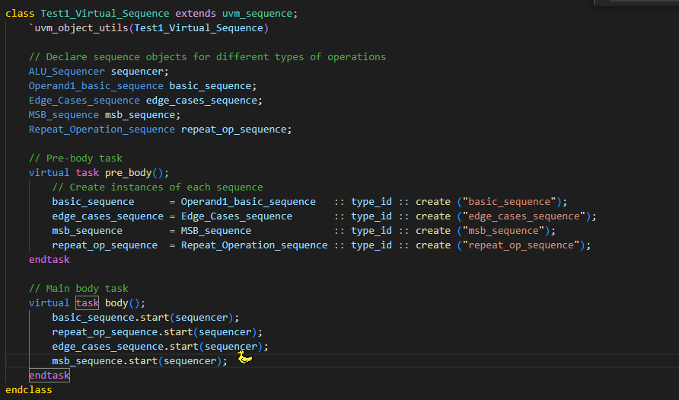
Sequences and Tests
ALU Verification
Virtual Sequence used: Test1_Virtual_Sequence Purpose: Orchestrates multiple sub-sequences to test different ALU operations for Operand1. Objective: Ensures correct functionality of the ALU across a range of common and edge-case operations for Operand1.

Slide 21
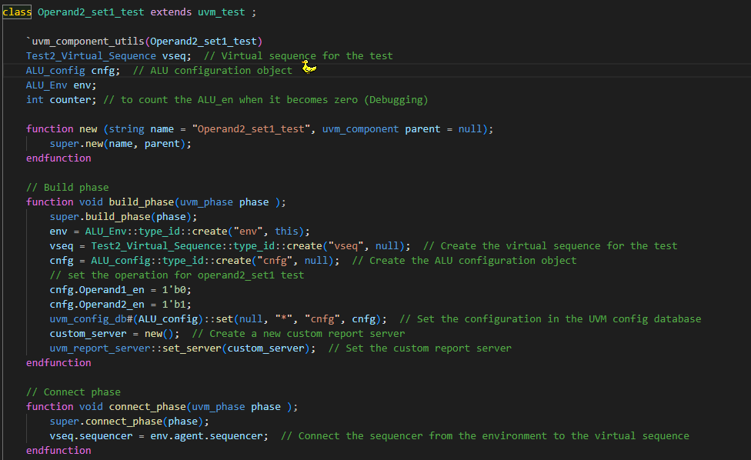
Sequences and Tests
ALU Verification
2- Operand2_set1_test : This UVM test configures the ALU to enable Operand2 and disable Operand1 to verify the behavior of the ALU when Operand2 is active while Operand1 is inactive.

Slide 22
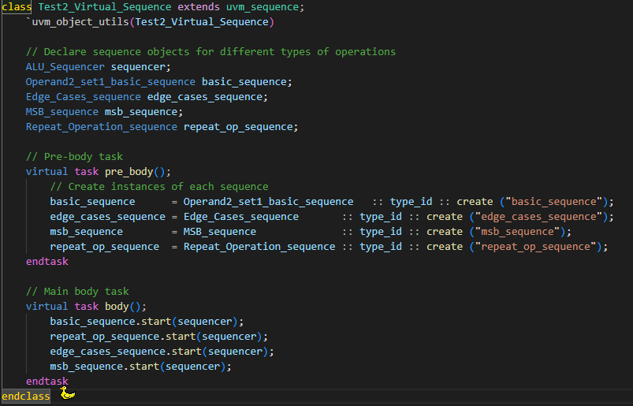
Sequences and Tests
ALU Verification
Virtual Sequence used: Test2_Virtual_Sequence Purpose: Validates ALU behavior when Operand2 is enabled and Operand1 is disabled. Objective: Ensures the ALU functions correctly with Operand2 enabled by running a series of tests (basic operations, edge cases, MSB handling, and repeated operations).

Slide 23
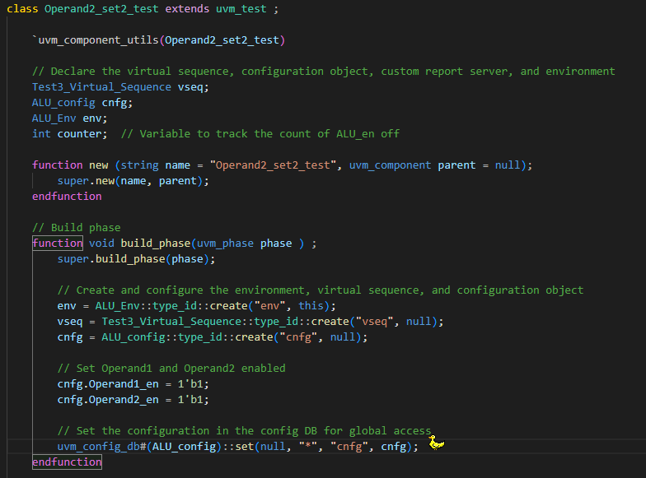
Sequences and Tests
ALU Verification
2- Operand2_set2_test : Validates ALU functionality when both Operand1 and Operand2 are enabled.

Slide 24
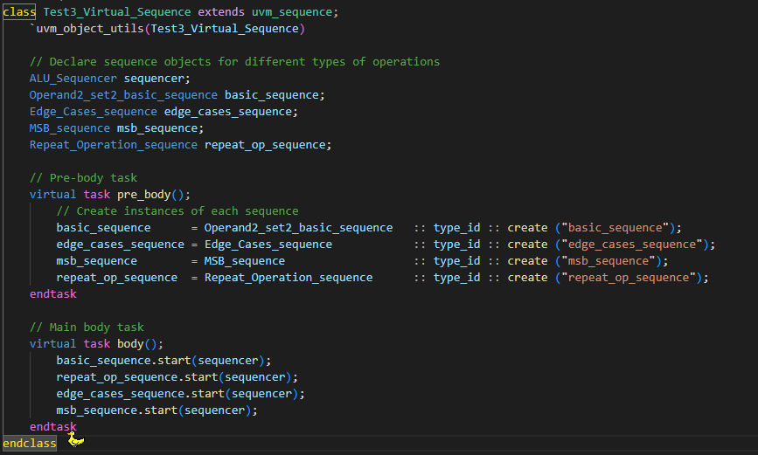
Sequences and Tests
ALU Verification
Virtual Sequence used: Test3_Virtual_Sequence Purpose: Verifies ALU behavior when both Operand1 and Operand2 are enabled. Objective: Ensures the ALU functions correctly when both Operand1 and Operand2 are enabled, covering normal operations, edge cases, MSB handling, and repeated operations.

Slide 25

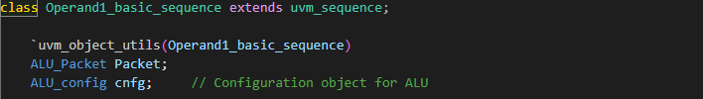
Sequences and Tests
ALU Verification
ALU_en_off: This sequence specifies that when ALU_en is 0, the ALU should be disabled and not perform any operations.
Operand1_basic_sequence: This sequence specifies that only Operand1 is enabled (Operand1_en == 1) while Operand2 is disabled (Operand2_en == 0).

Slide 26


Sequences and Tests
ALU Verification
Operand2_set1_basic_sequence: This sequence ensures that only Operand2 is enabled (Operand2_en == 1) while Operand1 is disabled (Operand1_en == 0).
Operand2_set2_basic_sequence: This sequence specifies that both Operand1 and Operand2 are enabled (Operand1_en == 1 and Operand2_en == 1).

Slide 27
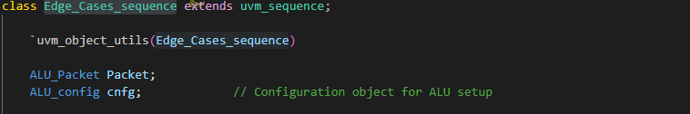
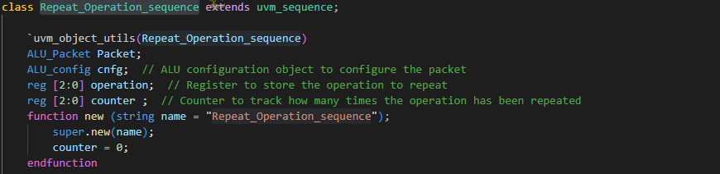
Sequences and Tests
ALU Verification
Edge_Cases_sequence: This sequence handles edge cases for operand values. It checks if Operand1 and Operand2 are within a specific range (15 and -16) and defines a distribution where both values are more likely to be 15 or -16. Additionally, it restricts certain Operand2_op values when both operands are enabled.
Repeat_Operation_sequence: This sequence ensures that the operation remains the same when Operand1_en == 1 and Operand2_en == 0 (meaning only Operand1 is involved in the operation).

Slide 28

Sequences and Tests
ALU Verification
MSB_sequence: This sequence applies when bitwise operations are being tested on Operand1. It limits the operation types for Operand1 to valid bitwise operations (using the range [2:6] for Operand1_op). It also defines rules for Operand2 operation (Operand2_op == 0 when only Operand2 is enabled).

Slide 29
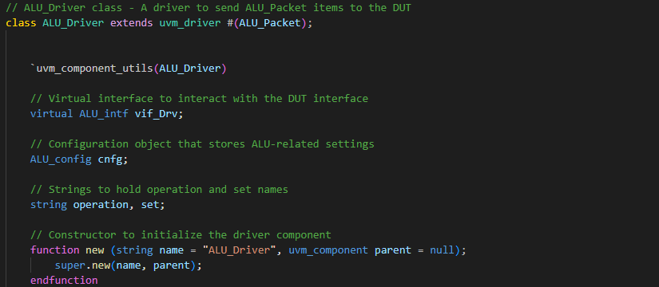
ALU_Driver
ALU Verification
The driver interacts with the DUT through a virtual interface (vif_Drv).

Slide 30
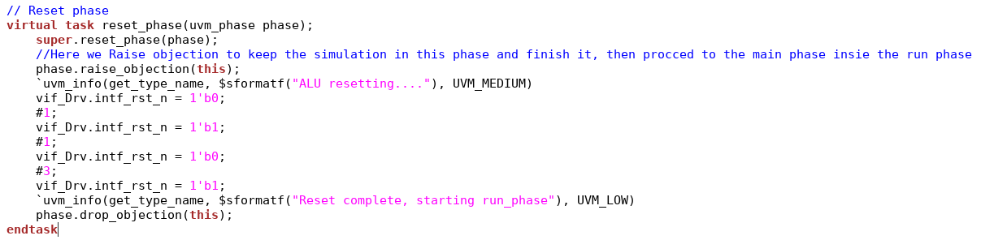
ALU_Driver
ALU Verification
Resets the DUT by asserting and de-asserting the reset signal (intf_rst_n).

Slide 31

ALU_Driver
ALU Verification
It also contains a custom macro to extract operation details from the packet so we can print the operation correctly as a string.

Slide 32
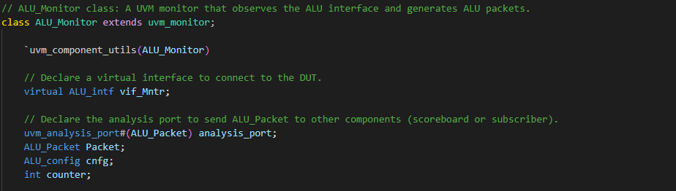
ALU_Monitor
The Monitor class listens to the signals from the DUT (Device Under Test) and samples both input and output values at specific times. These values are then passed to the write function of the scoreboard and subscriber via analysis port.

Slide 33

ALU_Monitor
I am writing the counter value (number of times ALU_en is 0) to the UVM config database for later use in the top module reporting.

Slide 34
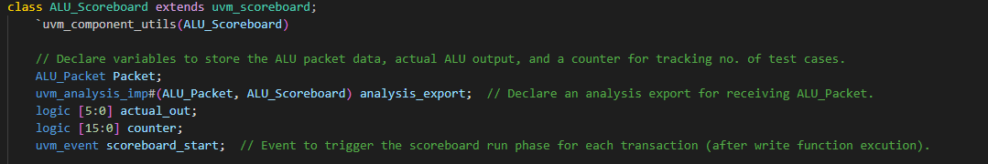
ALU_Scoreboard
ALU Verification
It checks if the ALU output matches the expected result for various operations, using a combination of inputs, operations, and control signals.

Slide 35
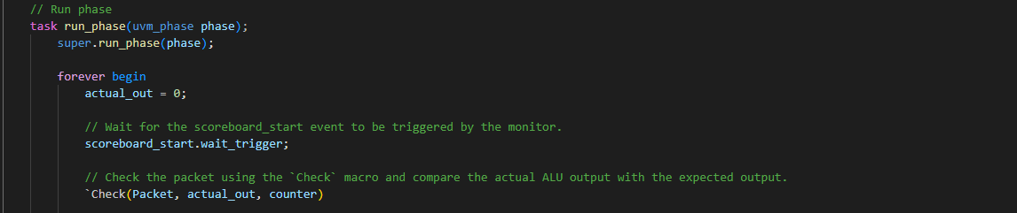
ALU_Scoreboard
ALU Verification
The Check macro is used to compare the received ALU packet with the expected output, verifying whether the ALU operation was correct.

Slide 36
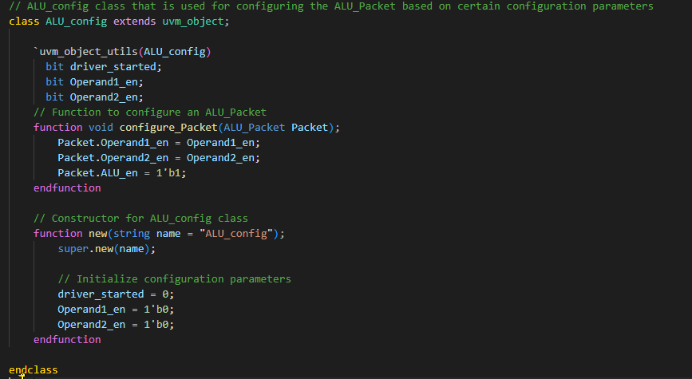
ALU_config
ALU Verification
The ALU_config class is designed to manage configuration parameters for the ALU, specifically for controlling the enabling of operands and managing synchronization between the ALU_Driver and ALU_Monitor. This class ensures that the driver and monitor are synchronized and that certain ALU operations can be configured before they start interacting with each other.

Slide 37
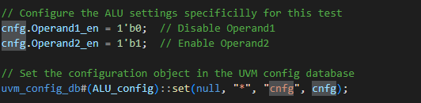


ALU_config
ALU Verification
ALU_Monitor
CNFG
TEST
In the test class, the ALU_config object is instantiated and then set with specific value and flag.
ALU_Driver
CNFG
Driver: The configuration object is used to get the driver_started flag, and set it to 1 after finishing send packet
Monitor: The configuration object is used to get the driver_started flag, indicating whether the driver has completed sending a packet.

Slide 38

ALU_macros
ALU Verification
It’s a user defined macros created by me to make the code inside the uvm_components easy and readable. It contains 3 main macros: 1- get_operation macro defines the ALU operation based on the enable signals (Operand1_en, Operand2_en) and operation codes (Operand1_op, Operand2_op). 2- Check macro compares the actual ALU output against the expected result based on operands and operations, and logs whether the test passes or fails. It also handles special cases, like when certain operands are disabled or operations do not apply. 3- wait_last_transaction macro simulates a delay, ensuring proper synchronization before proceeding with the next transaction in the simulation.

Slide 39
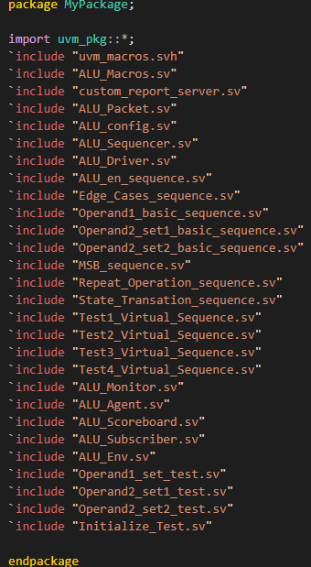
My_Package
ALU Verification
It’s a user defined that package contains a collection of SystemVerilog classes and UVM components related to the testing of an Arithmetic Logic Unit (ALU). The package includes sequences, tests, monitors, agents, scoreboards, subscribers, drivers, and various configuration and packet definitions necessary for verifying the functionality of the ALU design.

Slide 40
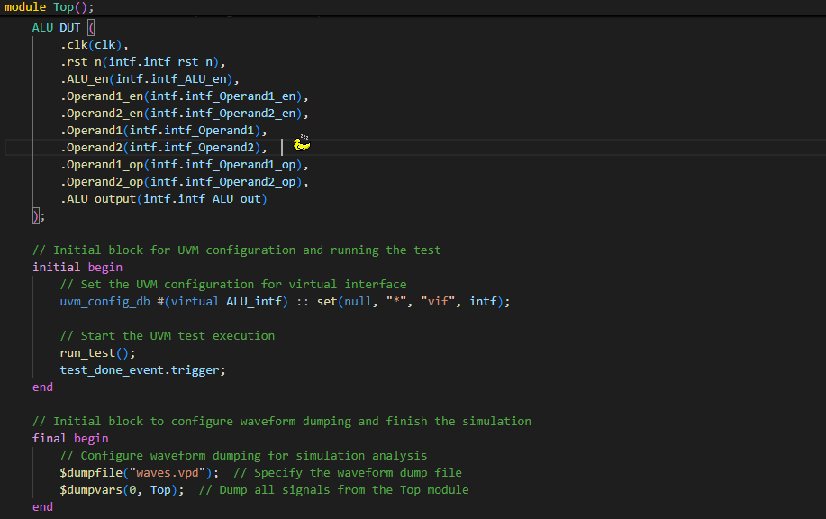
Top Module()
ALU Verification
The Top module sets up a UVM testbench for an ALU: - Clock Generation: A clock (clk) is toggled every 5 time units. - ALU Interface: The ALU_intf interface connects control signals between the DUT (ALU) and UVM components. - DUT Instantiation: The ALU is instantiated with inputs/outputs connected to the interface. - UVM Configuration: The virtual interface is registered in the UVM config database for interaction with UVM components. - Simulation: run_test() starts the test, and waveform dumping is enabled for analysis at the end.

Slide 41
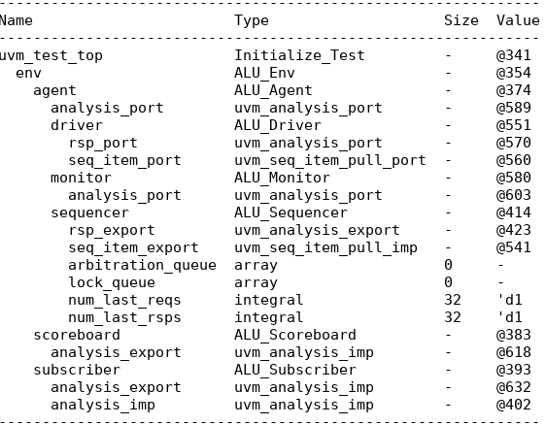
Simulation Results
ALU Verification
Test1: Initialized Test Hierarchy

Slide 42
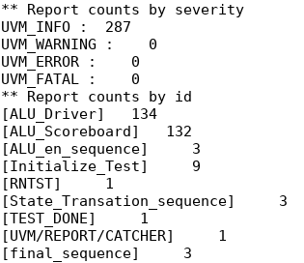
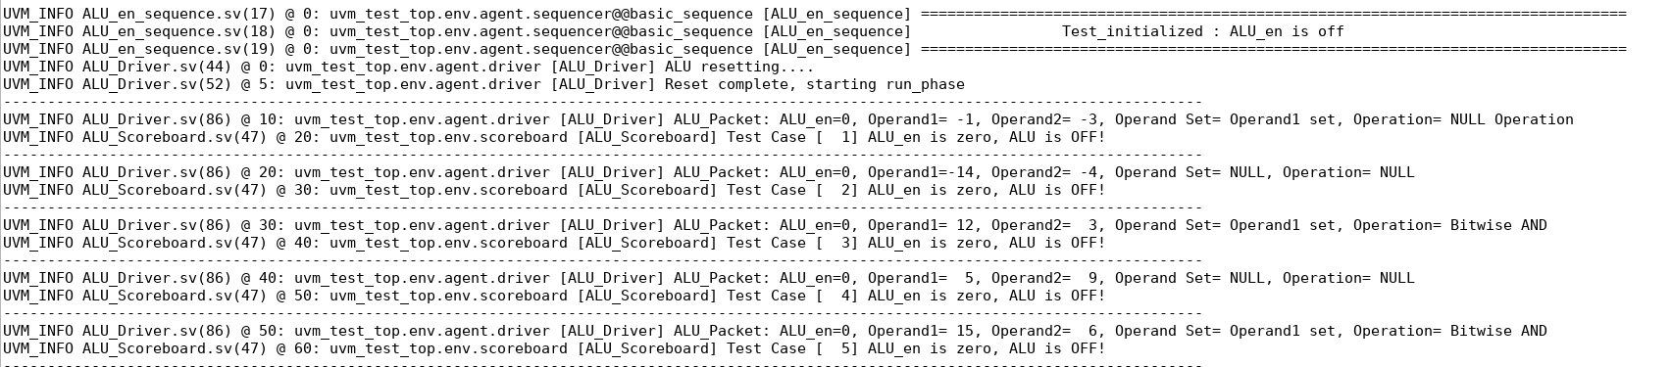
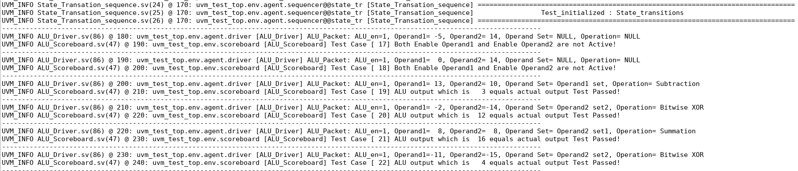
Simulation Results
ALU Verification
Test1: Initialized Test

Slide 43
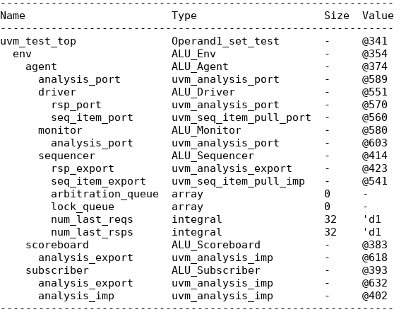
Simulation Results
ALU Verification
Test2: Operand1_set_Test Hierarchy

Slide 44
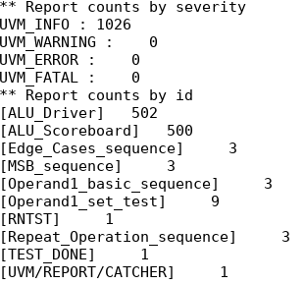
Simulation Results
ALU Verification
Test2: Operand1_set_Test

Slide 45
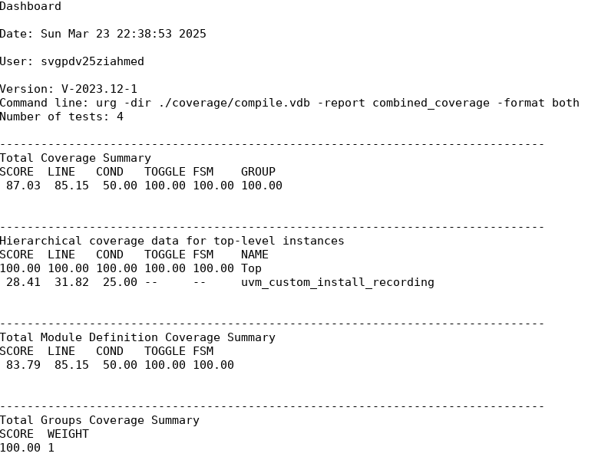
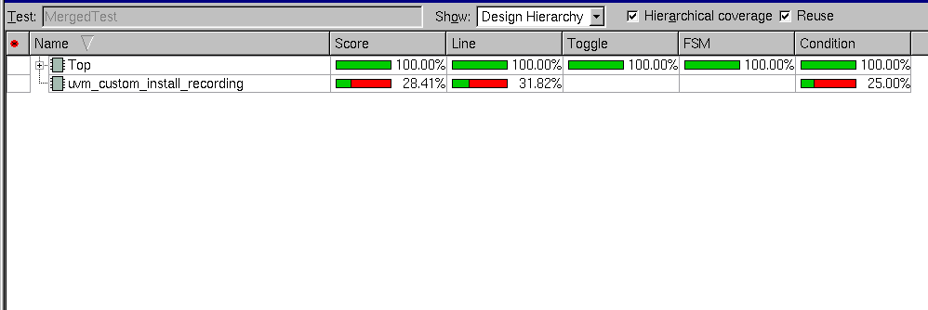
Coverage Closure
ALU Verification
This is the results before excluding the uvm_custom_install_recording.

Slide 46
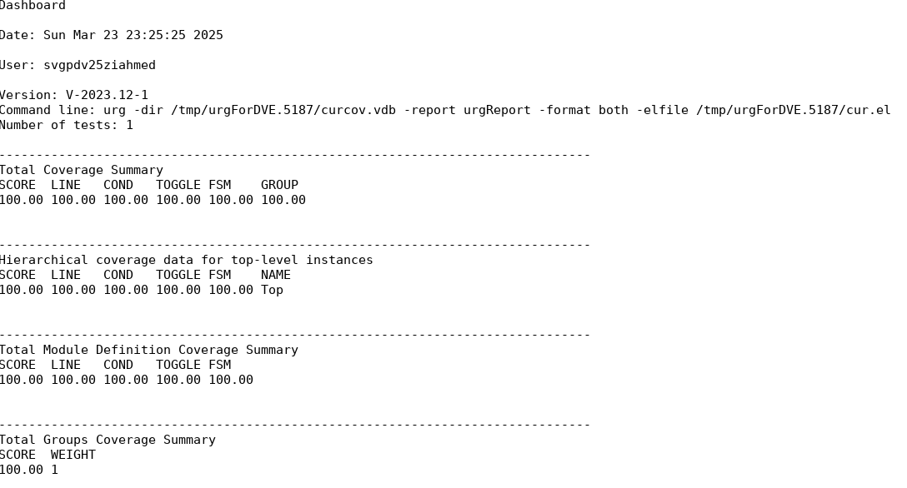
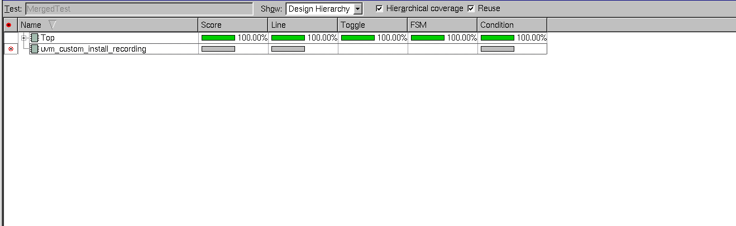
Coverage Closure
ALU Verification
This is the results after excluding the uvm_custom_install_recording.

Slide 47
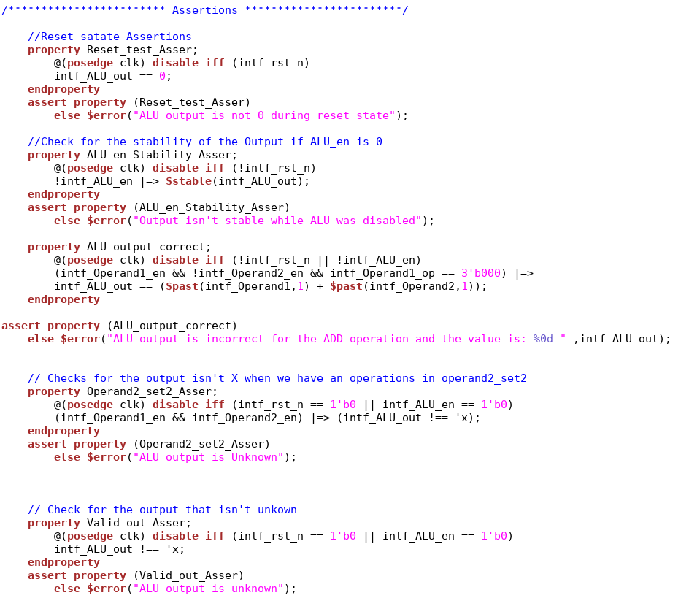
Assertions
ALU Verification
Reset State Assertion (Reset_test_Asser): This assertion checks that when the reset signal is active (intf_rst_n is low), the ALU output (intf_ALU_out) must be 0. If the output is not 0, it raises an error.
ALU Enable Stability Assertion (ALU_en_Stability_Asser): This checks that when the ALU enable signal (intf_ALU_en) is disabled (0), the ALU output (intf_ALU_out) should remain stable (no change). If the output changes, it raises an error.
ALU Output Correctness Assertion (ALU_output_correct): This ensures that when Operand1 is enabled and Operand2 is not, and the operation is addition (3'b000), the ALU output should match the sum of the operands from the previous cycle.
Operand2 Set 2 Assertion (Operand2_set2_Asser): This checks that if both operands are enabled and ALU operations are performed with Operand2_set2, the ALU output should not be 'x' (unknown value). If it is 'x', an error is triggered.
Valid Output Assertion (Valid_out_Asser): This verifies that the ALU output (intf_ALU_out) is not an unknown value ('x'). If it is, an error message is shown.

Slide 48

Summary
ALU Design:
Implemented using a Finite State Machine (FSM) to control operations.
Supports arithmetic (ADD, SUB) and logical (XOR, AND, OR, etc.) operations.
Handles two operands with enable signals and operation codes.
Sequential logic ensures output updates on every clock cycle.
UVM Verification Environment:
Components include Sequencer, Driver, Monitor, Scoreboard, and Subscriber.
SUBSCRIBER tracks input operands, operations, and output values.
Assertions ensure correct behavior during reset, disable, and state transitions.

Slide 49
Summary
Key Challenges:
Resolved same-state output issues by checking state transitions.
Addressed MSB handling in bitwise operations.
Improved condition coverage by using switch-case over if-else.
Verification Results:
Achieved high coverage scores for FSM, line, and toggle coverage.
Successfully validated ALU functionality across various test scenarios.

Slide 50

Conclusion
Successful Implementation:
The ALU design was successfully implemented using an FSM, ensuring efficient control over arithmetic and logical operations.
The design meets the specified requirements, handling various operations and edge cases effectively.
Comprehensive Verification using UVM

Slide 51
Project Path
/home/svgpdv25ziahmed/SI-VisionAcademy/ALU_project_UVM

Slide 52
Verification Challenge
Tried to override the uvm_report_server to create a custom format for uvm_info macro but it fails and wasn’t printing anything.
Interact with different phases.
I used a virtual sequence here just to practice.

Slide 53
Thank You

