Slide 1
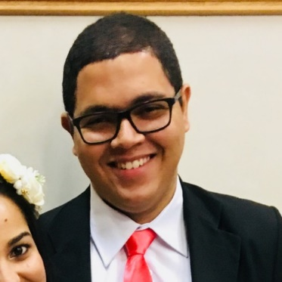
Glaucio’s User Manual
Glaucio Oliveira | Software Engineer

Slide 2
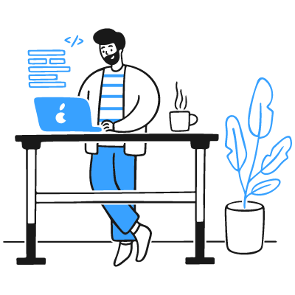
Conditions I like to work in
I like a quiet working environment without distractions. In the silence is when I’m most creative.
I like to have a nice chair with a standing desk
Don’t make me take my headphones off, if what you are going to say is not important.

Slide 3
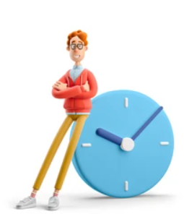
Times / hours I like to work
I like to start my work as early as possible when I’m working from home because that is a time when there is no noise or distraction. I work best in the morning
I don’t like to receive messages outside my working hours if it’s not something really important.
I’m open and willing to help anyone as long as we have some previously scheduled appointment on my calendar.

Slide 4

Best ways to communicate with me
Chat is the best way if you want to get a response from me. I’m usually quick at responding chat questions.
Make sure you give all the details needed when sending me a chat request. So I’ll be able to provide a concise response.
I usually check my emails at morning, after returning from lunch, and at the end of the day. I usually give response to emails within 24 hours at the latest.
[OPTIONAL IMAGE / GIF HERE]

Slide 5
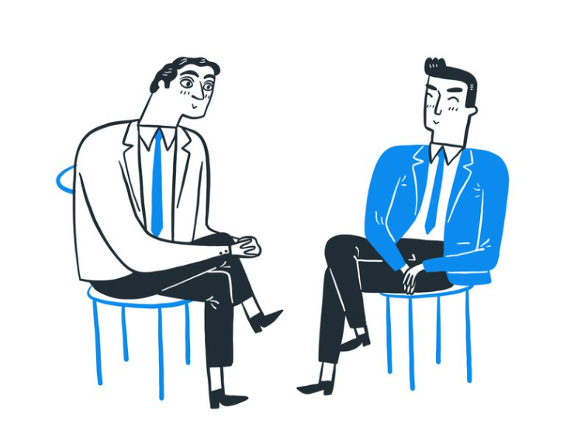
How I best receive feedback
I prefer to hear the truth when I’m doing something wrong, even if it my hurt my feelings / ego.
I like receiving feedback in person or through video conference sharing the video
I like to receive feedback on things I need to change / improve and also on things I’m doing good

Slide 6

Things I need
I need time alone usually in the morning to plan for my day and to ponder about how I’m conducting my life.
I need challenges to keep myself motivated in the programming field or life in general
I love to learn new things, this keeps my mind active and willing to learn more and more

Slide 7

How I learn best
I love to learn things by reading a reliable book and what others say about it usually on Reddit.
The best way for me to fix something on my mind is by doing it. Sometimes I prefer to experiment and if it entices me, I try to read more about it.
I need to be in a quiet environment to grasp what I need to learn, without any distractions.

Slide 8
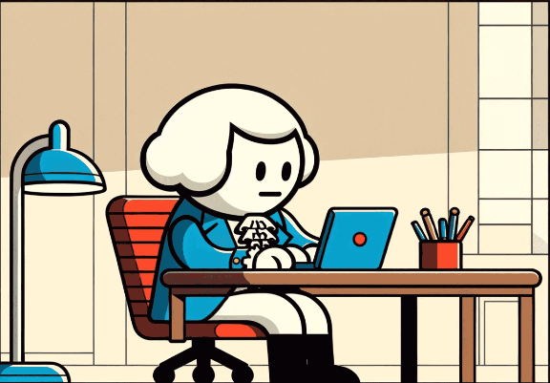
Things I struggle with
When there is a lot of dialogue without objectivity. That takes all my energy away.
Sometimes I can't explain my point of view clearly, and I have to draw or show an example.
I can't stay motivated in a job when I don't see any kind of growth in the activities I perform or when I'm working on something poorly done and outdated.

Slide 9

Things I love
I love passing on knowledge to new people on the team.
I love to play with new technologies and think about the new possibilities that they provide in my career and life in general.
I like to give everyone at a meeting or event a chance to participate.

Slide 10

Other things to know about me
I use more logic than my feelings to make a decision.
Honesty really matters to me
I like to keep things simple
I can’t hide when I’m not motived about something

Slide 11
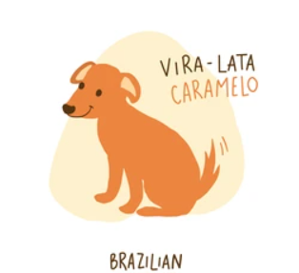
If I were an animated gif / meme / animal / song, I would be...
[ADD IMAGE / GIF HERE]

Slide 12
No other success can compensate for failure in the home.
David O. McKay

Slide 13
When You Become A Recognized Authority, Opportunities Chase You.
John Sonmez

Slide 14
Thank you!
Glaucio Oliveira | Software Engineer

