Slide 1
ASP.NET MVC 5
Stepping stone

Slide 2
Who
Glauco Godoi
Principal Consultant @ Findmore talents
Microsoft platform enthusiast
Web guy
glauco.godoi@findmore.pt
https://pt.linkedin.com/in/glaucorgodoi
http://ftp.netponto.org/membro/glauco-godoi/

Slide 3
What
Introduction
The task
The basics
The tricks

Slide 4
Introduction / MVC
MVC is an organization tool
MVP and MVVM are similar but different
Main components
Models
Views
Controllers
Notes:
Trygve Reenskaug introduced MVC into Smalltalk-76 while visiting Xerox Parc
First to introduce the concept of responsabilities

Slide 5
Introduction / MVC
What does MVC look like?
Request
Controller
Controller
Retrieves Model
“Does Stuff”

Model

Response
View
View
Visually represents
the model

Notes:
A controller can send commands to the model to update the model's state (e.g., editing a document). It can also send commands to its associated view to change the view's presentation of the model (e.g., by scrolling through a document).
A model stores data that is retrieved according to commands from the controller and displayed in the view.
A view generates an output presentation to the user based on changes in model.

Slide 6
Introduction / ASP.NET MVC
Open source (Apache License 2.0 )
Based on ASP.NET
First version – ASP.NET MVC CTP : 2007/12/10
Current version – ASP.NET MVC 5.2.3 : 2015/01/09
Fully integrated in Visual Studio with a great tooling mechanism
Notes:
Every web application needs some structure
MVC helps you stay organized, start to finish
Often end up with less code, not more
Smoother learning curve as your project grows
CONVENTION over CONFIGURATION approach

Slide 7

Introduction / ASP.NET MVC

Slide 8
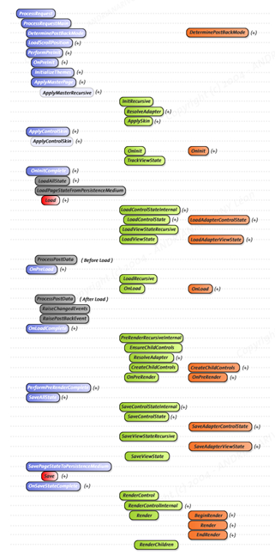
Introduction / ASP.NET MVC
Site.master
Products.aspx
Cart.ascx

Slide 9
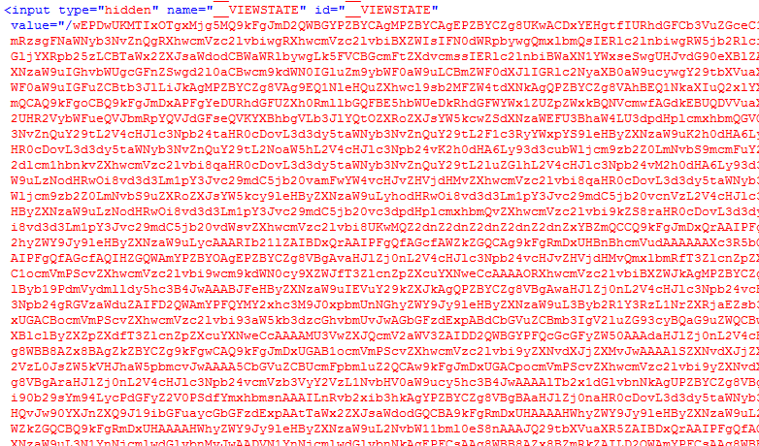

Slide 10
Introduction / ASP.NET MVC
<select name="ctl00$uxLanguageSelector$uxLanguageSelector" onchange="javascript:setTimeout('__doPostBack(\'ctl00$uxLanguageSelector$uxLanguageSelector\',\'\')', 0)" id="ctl00_uxLanguageSelector_uxLanguageSelector" class="countrySelect">

Slide 11
THE TASK
Notes:
Create a form that allows users to register contact messages.
If the user is Admin than he can view and answer the messages.

Slide 12
Code

Slide 13
Questions ???

Slide 14
ASP.NET MVC – Stepping stone
Thanks !
Important links:
https://github.com/GlaucoGodoi/AspNet-MVC-5-Stepping-stone
https://github.com/CodeSeven/toastr
https://github.com/eternicode/bootstrap-datepicker

